Slide 1


Energy Efficiency In Smart Buildings

Slide 2
Content
Abstract
Problem Statement
Objective
Data Collection and Preparation
Proposed Solution (Methodology)
Model Performance Evaluation
Screenshots / Demonstration (video)
Future Scope
Conclusion
Notes:
Abstract
Problem Statement (Clearly define the challenge)
Objective (State your project's goal)
Background and Research (Discuss existing solutions, trends, and gaps)
Data Collection and Preparation (Focus on data sources, cleaning, and augmentation)
Proposed Solution (Methodology)
Model Architecture (e.g., CNN, U-Net, YOLOv5)
Key Techniques (e.g., Transfer Learning, Image Augmentation)
Model Performance Evaluation
Metrics (Accuracy, Precision, Recall, IoU, etc.)
Graphs (Confusion Matrix, ROC Curve, etc.)
Screenshots / Demonstration (Visual proof of system functionality)
Future Scope (Improvements, scalability, and integration ideas)
Conclusion (Summarize results and impact)
Q&A Session

Slide 3
Abstract
This project aims to predict inverter failures in solar panel systems using machine learning techniques.
By analyzing real-time sensor data such as temperature, voltage, and current, we can detect early warning signs of failure.
The project employs a Random Forest classifier to achieve high accuracy, and addresses class imbalance through oversampling techniques.

Slide 4
Problem Statement
Inverter failure in solar panels often goes undetected until significant energy loss occurs. Manual monitoring is inefficient and reactive.
This project proposes an automated, predictive solution using sensor data to forecast inverter failure before it happens.

Slide 5
Objective
• To develop a machine learning model that accurately predicts inverter failure using sensor data, enabling proactive maintenance and reducing system downtime.

Slide 6
Data Collection and Preparation
• - Dataset: solarpanelsensor_dataprocessed.csv
• - Features: Temperature (°C), Voltage (V), Current (A)
• - Target: Failure (0 = No, 1 = Yes)
• - Preprocessing: Removed timestamp, handled class imbalance using oversampling, standardized features using StandardScaler

Slide 7
Proposed Solution (Methodology)
• 1. Load and preprocess the dataset
• 2. Split data into training and test sets
• 3. Standardize features
• 4. Train a Random Forest classifier on both original and balanced data
• 5. Evaluate feature importance and model performance

Slide 8
Model Performance Evaluation
• - Metrics used: Accuracy, Precision, Recall, F1score
• - Feature Importance: Voltage > Current > Temperature
• - Balanced model performance (Example):
•- Accuracy: 0.95• •
•- Precision: 0.94 - Recall: 0.96- F1-score: 0.95

Slide 9
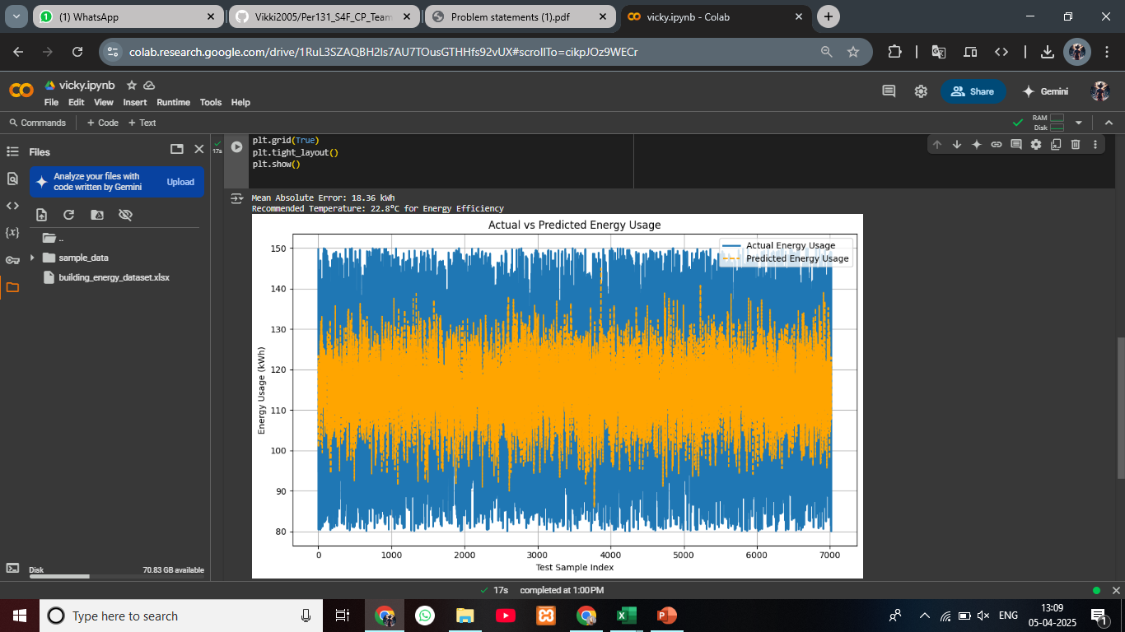
Screenshots / Demonstration (video)
Collab link;: https://colab.research.google.com/drive/1RuL3SZAQBH2ls7AU7TOusGTHHfs92vUX?usp=sharing
Github link: https://github.com/Vikki2005/Per131_S4F_CP_Team_11955_case_study_3_Energy_efficiency_in_smart_buildings

Slide 10
Future Scope
• - Integrate with real-time data collection from IoT devices
• - Deploy the model in a cloud environment for live predictions
• - Experiment with deep learning models and other ML algorithms
• - Add anomaly detection for better fault analysis

Slide 11
Conclusion
The project successfully demonstrates the use of machine learning for predictive maintenance in solar energy systems.
The Random Forest model, supported by proper preprocessing and data balancing, achieved strong performance metrics.
This solution has the potential to reduce downtime and maintenance costs significantly.

