Slide 1
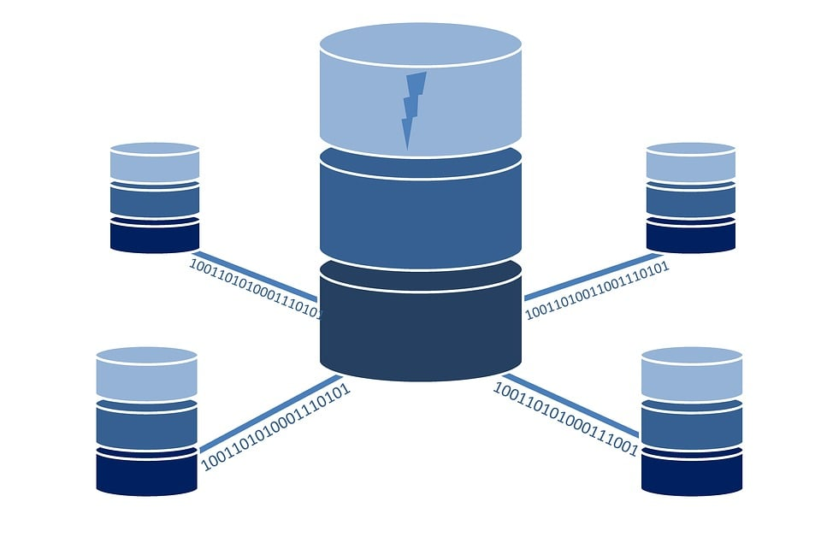

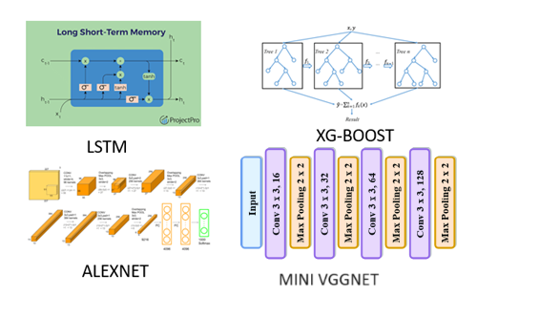
FEATURE EXTRACTION
MINIORITY,MAJORITY CLASS
(WEB ATTCK,DOS,DDOS)
DATA PREPROCESSING
CICIDS-2018
MODEL TRAINING
Concat()
EVALUATION
TESTING DATA
F1 SCORE, PRECISION,ACCURACY, RECALL
DEPLOYMENT

