Slide 1
MY SQL
PROJECT BY
VIGNESHWARAN D

Slide 2
CONTENTS
09 SQL operators
10 SQL order by & group by
11 SQL joins
12 SQL case expression
13 SQL indexes
14 SQL Procedures
15 SQL triggers
01 introduction to MYSQL
02 Introduction to DBMS
03 Introduction to RDBMS
04 Difference between dbms & rdms
05 Datatypes in sql
06 SQL commands & databases
07 SQL clause
08 SQL constraints

Slide 3
01 introduction to MYSQL

Slide 4
MY SQL
SQL stands for structured query language (SQL) which is fundamentally a programming language designed for accessing, modifying and extracting information from relational databases .
MySQL is the world’s most popular open source database. According to DB engines.
MySQL powers many of the most accessed applications, including facebook, twitter, netflix, uber, airbnb, shopify, and booking.com .

Slide 5
02 introduction to DBMS

Slide 6
DBMS
DBMS stands for database management system is a software that manage or organize the data in a database.
We can arrange the data in a tabular form ( i.e. in row or column ). it helps the user to retrieve the data from the database.
Best examples of DBMS are – MYSQL, ORACLE, DBase etc.

Slide 7
03 Introduction to RDBMS

Slide 8
RDBMS
RDBMS stands for Relational Database Management System. It is a program used to maintain a relational database.
RCBMS is the basis for all modern database systems such as MYSQL, Microsoft SQL server, oracle and Microsoft access.
SQL stands for Structured Query Language. it is a domain specific language used for storing, retrieving, and manipulating data.

Slide 9
04 Difference between Dbms & rdbms
DBMS stores data as file
Normalization is not present
Security is less
It supports single user.
Examples: XML, Window Registry, etc.
RDBMS stores data in tabular form
Normalization is present.
More security measures provided.
It supports multiple users.
Examples : MySQL, PostgreSQL, SQL Server, Oracle, etc.

Slide 10
05 DatatypeS in SQL
In mysql, a data type is a guideline for sql to understand what type of data is expected inside of each column and it also identifies how sql will interact with the stored data.
In MySQL there are three main data types: numeric, string and date and time.

Slide 11
DatatypeS in SQL - NUMERIC
Numeric data type | Description
INT | -2147483648 to 2147483647 0 to 42949677295 (11 DIGITS)
TINYINT | -128 to 127 0 to 255 (4 digits)
SMALLINT | -327688 to 32767 0 to 65535 (5 digits)
MEDIUMINT | -8388608 to 8388607 0 to 16777215 (9 digits)

Slide 12
.
Numeric data type | Description
BIGINT | -9223372036854775808 to 9223372036854775808 0 to 18446744073709551615 (20 digits)
FLOAT(m,d) | Default to 12,2 24 places for a float.
DOUBLE(m,d) | Default to 16,4 53 places for double.

Slide 13
DatatypeS in SQL - STRING
In sql , string data types are used to store any kind of data in the table , the differrent types of string data types are :
CHAR (num): a fixed length string which can contain letters, numbers and special characters.
VARCHAR (num): A variable length string which can contain letters, number and special characters.
BINARY (num): Equal to char, but stores binary bytes
VARBINARY (num): equal to varchar , but stores binary bytes
TEXT: contains non-binary strings. The length is fixed, you specify it when
Declaring.

Slide 14
DatatypeS in SQL - STRING
VARCHAR (Size) | Maximum size of 255 characters.
TINYTEXT(Size) | Maximum size of 255 characters.
TEXT(Size) | Maximum size of 65,535 characters. 5 digits
MEDIUMTEXT (Size) | Maximum size of 16,777,215 characters. 9 digits
LONGTEXT (Size) | Maximum size of 4GB or 4,294,967,295 characters.
BINARY (Size) | Maximum size of 255 Characters
VARBINARY (Size) | Maximum size of 255 Characters

Slide 15
DatatypeS in SQL - Date & Time Data type
Datatype | Range | Example
Date | ‘1000-01-01’ to ‘9999-12-31’. | Displayed as ‘yyyy-mm-dd’.
Date Time | ‘1000-01-01 00:00:00’ to ‘9999-12-31 23:59:59’. | Displayed as ‘yyyy-mm-dd hh:MM:SS’.
Timestamp | ‘1970-01-01 00:00:01’ UTC to ‘2038-01-19 03:14:07’ TC. | Displayed as ‘yyyy-mm-dd hh:MM:SS’.
Time | ‘-838:59:59’ to ‘838:59:59’. | Displayed as ‘HH:MM:SS’
Year | 2 digits or 4 digits. | Default is 4 digits.

Slide 16
06 MY SQL commands & DATABASES
.

Slide 17
MY SQL COMMANDS
Create database (Create a New Database)
Show database (View Databases)
Drop database
Alter database (Modify Database)
Create tables
Show tables
Insert values
Drop table
Alter table ( for new column creation)
Alter table modify
Alter table drop ( drop the column)
Alter table rename (rename the table)
Update table ( to change the values)

Slide 18
MY SQL DATABASES
A SQL database is a collection of tables that stores a specific set of structured data
EXAMPLE OF SQL DATABASES – Maria DB and MySQL are binary compatible open source SQL Database servers that originally started as just MySQL.
SQL database server stores and organizes data in tables. In RDBMS, tables are fundamental database objects logically designed to collect data in rows and columns format

Slide 19
MY SQL COMMANDS and its uses
Create database - used to create a new database or a new table.
Show database - used to view the database.
Drop database - used to delete a view, table or index from a database.
Alter database - used to alter or change the structure of the database.
Create tables - used to create a new table in a database.
Show tables - used to view the table in a database.
Insert values - used to add new data to a table in a database.

Slide 20
‘
Drop table - used to delete the entire table from a database.
Alter table - used to modifying the table to add new rows and columns.
Alter table modify - used to change the data type of a column in a table.
Alter table drop - used to drop the column of the table.
Alter table rename - used to rename the table.
Update table - used to change the values in a table.

Slide 21
MY SQL DATABASES AND EXAMPLES
SQL CREATE DATABASE - this statement is used to create a new sql database.
- Syntax - create database databasename ;
- Example - create database vikkywoofyz;
SQL DROP DATABASE - this statement is used to drop a existing database.
- Syntax - drop database databasename ;
- Example - drop database vikkywoofyz ;
SQL CREATE TABLE - used to create a new table in a database.
- Example - CREATE TABLE Suppliers ( SupplierID int, firstname varchar(25),
lastname varchar(25), city varchar(25), country varchar(25) );

Slide 22

SQL DESCRIBE STATEMENT - describe is used to describe something. we can use DESCRIBE or DESC (both are the same) commands to describe the structure of a table. syntax - describe tablename; or desc tablename; example - describe Student_info;

Slide 23
.
SQL DROP TABLE - statement is used to delete an existing table in a database;
syntax - drop tablename;
example - drop table suppliers;

Slide 24

SQL ALTER TABLE ( drop column ) - used to add , delete or modify columns in a table. Syntax - alter table tablename drop gender ; Example - alter table emp_det drop income;

Slide 25

SQL ALTER TABLE ( add COLUMN ) - used to add a column Syntax - alter table tablename add column name after columnname; Example - alter table emp_det add income after city_state;

Slide 26
SQL INSERT INTO STATEMENT
The insert into statement is used to insert new records in a table
Syntax – it is possible to write the insert into statement in two ways :
1. Specify both the column names and the values to be inserted:
insert into table_name (column1, column2, column3, … )
values (value1, value2, value3, …);
2. If you are adding values for all the columns of the table, you do not need to specify the column names in the sql query. However, make sure the order of the values is in the same order as the columns in the table. Here, the insert into syntax would be as follows:
insert into table_name
values (value1, value2, value3, …);

Slide 27
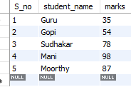
EXAMPLE of SQL INSERT INTO STATEMENT
insert into student_info values
insert into Student_info (S_no, Student_name, Marks)values
(1, 'Guru', 35),
(2, 'Gopi', 54 ),
(3, 'Sudhakar', 78),
(4, 'Mani', 98),
(5, 'Moorthy', 87);

Slide 28

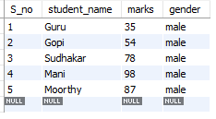
SQL SELECT STATEMENT
The select statement is used to select data from a database
syntax - select * from tablename; example - select * from Student_info;

Slide 29

SQL SELECT DISTINCT
distinct statement is used to return only distinct values , distinct values mean different values syntax - select distinct columnname FROM table_name;
example - select distinct marks from student_info;

Slide 30
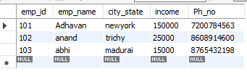
.
SQL UPDATE
the update statement is used to modify the existing records in a table.
SYNTAX - UPDATE table_name SET column1 = value1, column2 = value2,…
WHERE condition;
EXAMPLE - update emp_det set city_state = 'newyork', income =150000 where emp_id = 101;

Slide 31
07 SQL CLAUSE where clause | having clause
.

Slide 32

SQL WHERE CLAUSE
The where clause is used to filter records .
It is used to extract only those records that fulfill a specified condition
Syntax - select columnname FROM table_name WHERE condition;
Example - select city_state, income from emp_det where emp_id = 101;

Slide 33
SQL HAVING CLAUSE
The HAVING CLAUSE was added to SQL because the WHERE keyword cannot be used with aggregate functions
SYNTAX - SELECT column_name(s) FROM table_name WHERE condition GROUP BY column_name(s) HAVING condition ORDER BY column_name(s);
EXAMPLE - SELECT COUNT(CustomerID), Country FROM Customers GROUP BY Country HAVING COUNT(CustomerID) > 5;

Slide 34
08 SQL constraints

Slide 35
SQL constraints
SQL constraints are used to specify rules for the data in a table.
Constraints are used to limit the type of data that can go into a table.
This ensures the accuracy and reliability of the data in the table.
syntax - create table table name (columnname1 datatype constraint, column name 2 datatype constraint , column name 3 datatype constraint );

Slide 36
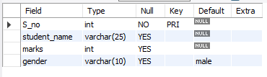
EXAMPLE of sql constraints
create table Student_info (S_no int primary key, student_name varchar(25),marks int, gender varchar(10) default 'male');

Slide 37
09 SQL OPERATORS | AND, OR, not, IN, BETWEEN
.

Slide 38

.
SQL AND OPERATOR – the AND operator is used to filter records based on more than one condition
syntax – SELECT columnname1, columnnname2 FROM table_name WHERE condition1 and condition2;
Example - select marks from student_info where S_no = 1 ;

Slide 39
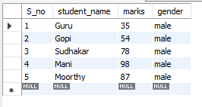

.
SQL OR OPERATOR – The OR operator is used to filter records based on more than one condition
Syntax - select columnname1, columnname2 FROM table_name WHERE condition1 or condition2;
Example - select student_name from student_info where marks = '98' or marks = '87';

Slide 40
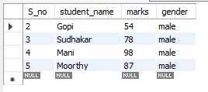
.
SQL NOT OPERATOR - The not operator is used in combination with other operator to give the opposite result, also called the negative result.
Syntax - select columnname1, columnname2 from table_name where not condition;
Example - select * from Student_info where not marks = '35';

Slide 41
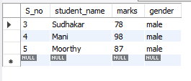
.
SQL IN OPERATOR - the in operator allows you to specify multiple values in a where clause.
Syntax - select columnname1, columnname2 from table_name where condition in columnname;
Example - select * from Student_infowhere marks In ('98','87','78');

Slide 42
.
SQL BETWEEN OPERATOR – the between operator selects values within a given range. the values can be numbers, text and dates .the between operator is inclusive: begin and end values are included.
SYNTAX - select column_name
from table_name
where column_name BETWEEN value1 AND value2;
EXAMPLE - select * from Student_info where marks between 50 and 100;

Slide 43
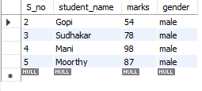

Slide 44
10 SQL ORDER BY & GROUP BY

Slide 45
SQL order by
The ORDER BY command is used to sort the result set in ascending or descending order.
The order by command sorts the results set in ascending order by default. To sort the records in descending order, use the DESC keyword.
SYNTAX - SELECT * FROM tablename ORDER BY Columnname;
EXAMPLE - select * from Student_info order by student_name;

Slide 46
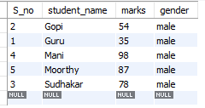

Slide 47
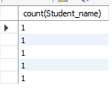
SQL GROUP BY
The group by statement groups rows that have the same values into summary rows, like “find the number of customers in each country”.
SYNTAX - SELECT COUNT(Columnname1), columnname2 FROM table_name GROUP BY Columnname3;
EXAMPLE - SELECT count(Student_name) FROM student_info GROUP BY student_name;

Slide 48
11 SQL JOINS
.

Slide 49
TYPES OF JOINS INNER | righT |left | FULL OUTER

Slide 50
.
SQL JOINS - the sql join clause is used to combine rows from two or more tables, based on a relatws column between them.
SQL join statements allow us to access information from two or more tables at once. They also keep our database normalized. Normalization allows us to keep data redundancy low so that we can decrease the amount of data anomalies in our application when we delete or update a record.

Slide 51
SQL INNER JOINS
The INNER JOIN keyword selects all rows from the tables as long as a join condition satisfies. This keyword will create a result-set made up of combined rows from both tables where a common field exists.
SYNTAX - select column_name()
FROM table1
INNER JOIN table2
on table1.column_name = table2.column_name;
EXAMPLE - SELECT ProductID, ProductName, CategoryName
FROM Products
INNER JOIN Categories ON Products.CategoryID = Categories.CategoryID;

Slide 52
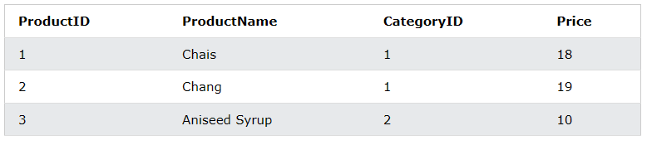
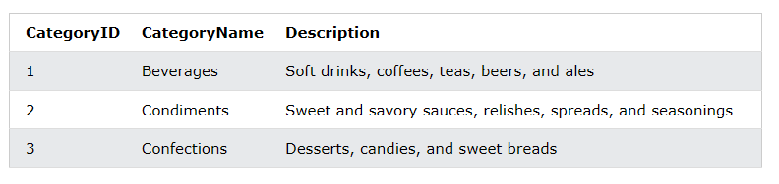
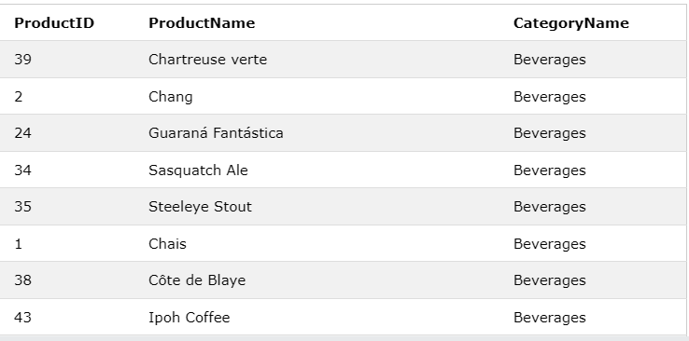

Slide 53
SQL right joins
This join statement takes all the records from Table B whether or not they have NULL values and the matching columns from Table A.
SYNTAX - SELECT column_name(s) FROM table1 RIGHT JOIN table2 ON table1.column_name = table2.column_name;
EXAMPLE - SELECT Orders.OrderID, Employees.LastName, Employees.FirstName FROM Orders RIGHT JOIN Employees ON Orders.EmployeeID = Employees.EmployeeID ORDER BY Orders.OrderID;

Slide 54
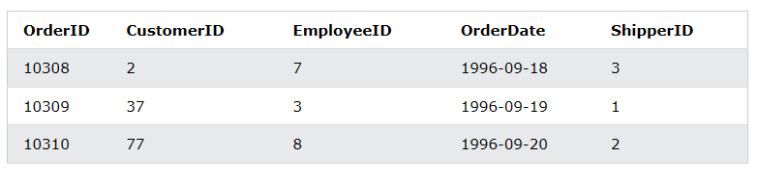
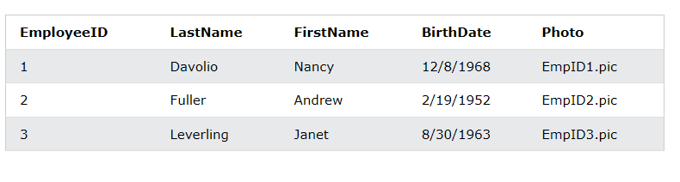
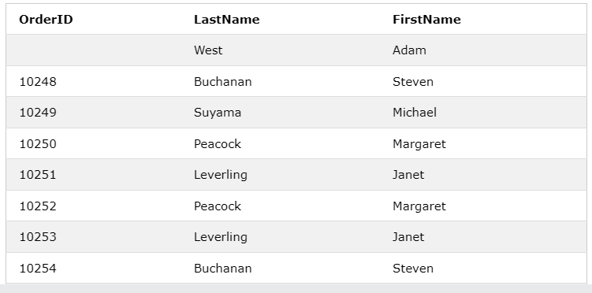

Slide 55
SQL LEFT JOINS
Left join is similar to right join. Left join returns all the rows of the leftmost table and the matching rows for the rightmost table.
SYNTAX - SELECT column_name(s) FROM table1 LEFT JOIN table2 ON table1.column_name = table2.column_name;
EXAMPLE - SELECT Customers.CustomerName, Orders.OrderID FROM Customers LEFT JOIN Orders ON Customers.CustomerID = Orders.CustomerID ORDER BY Customers.CustomerName;

Slide 56
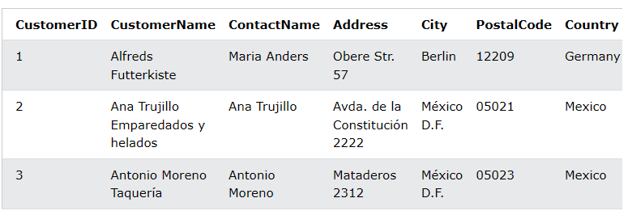
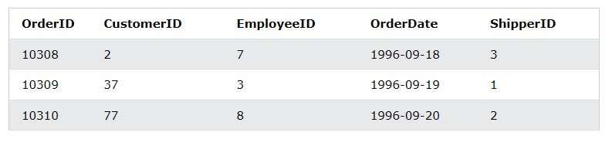
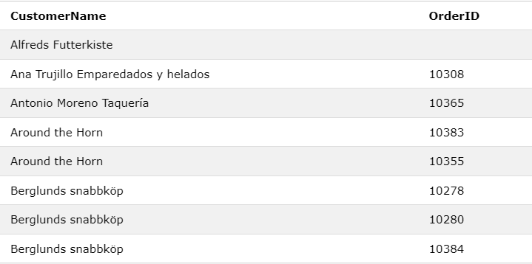

Slide 57
SQL FULL OUTER JOINS
The full outer jon keyword returns all records when there is a match in left (table1) or right (table2) table records
SYNTAX -SELECT column_name(s) FROM table1 FULL OUTER JOIN table2 ON table1.column_name = table2.column_name WHERE condition;
EXAMPLE - SELECT Customers.CustomerName, Orders.OrderID FROM Customers FULL OUTER JOIN Orders ON Customers.CustomerID=Orders.CustomerID ORDER BY Customers.CustomerName;

Slide 58
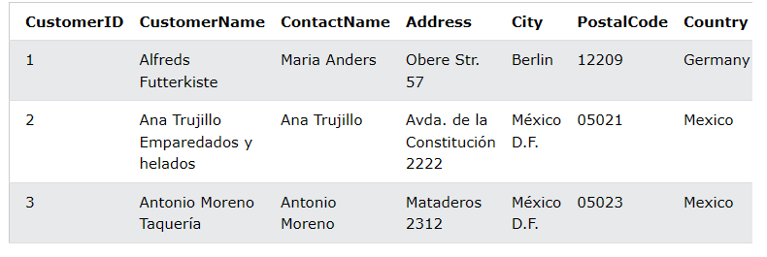
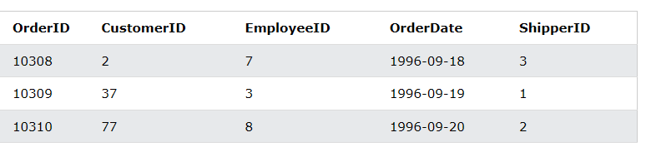
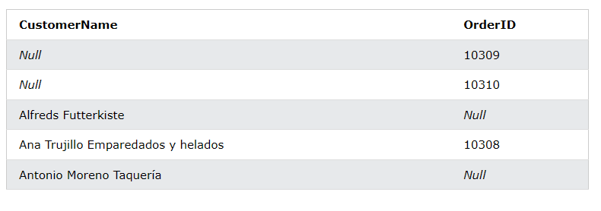

Slide 59
12 SQL CASE EXPRESSION

Slide 60
.
The case expression goes through conditions and returns a value when the first condition is met (like an if-then-else statement). So, once a condition is true, it will stop reading and return the result. If no conditions are true, it returns the value in the else clause.
You can use the CASE expression in a clause or statement that allows a valid expression. For example, you can use the CASE expression in statements such as select, delete, and update or in clauses such as select, order by and having.
SYNTAX
EXAMPLE

Slide 61
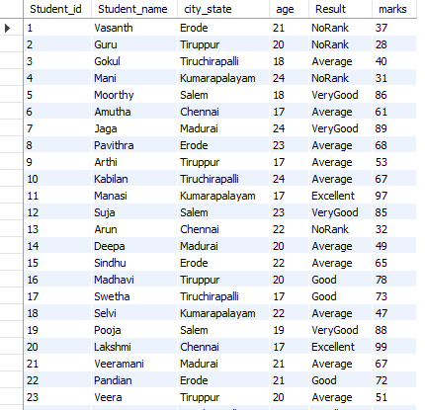
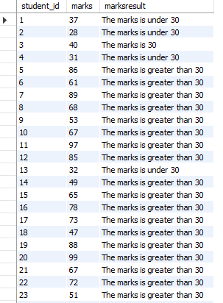

Slide 62
13 SQL INDEXES

Slide 63
.
A SQL index is used to retrieve data from a database very fast. Indexing a table or view is, without a doubt, one of the best ways to improve the performance of queries and applications.
SQL Indexes are special lookup tables that are used to speed up the process of data retrieval. They hold pointers that refer to the data stored in a database, which makes it easier to locate the required data records in a database table.

Slide 64
SQL create INDEX
command is used to create indexes in tables (allows duplicate values).
Indexes are used to retrieve data from the database very fast. The users cannot see the indexes, they are just used to speed up searches/queries.
SYNTAX – CREATE INDEX index_name ON table_name (column1, column2, ...);
EXAMPLE - CREATE INDEX student_details ON student_info (student_name, city_state);

Slide 65

SQL DROP INDEX
The drop index command is used to delete an index in a table.
Syntax - ALTER TABLE table_nameDROP INDEX index_name;
Example - ALTER TABLE student_info DROP INDEX student_details;

Slide 66
14 SQL PROCEDURES

Slide 67
.
A PROCEDURES also called as stored procedures is a prepared SQL code that you can save, so the code can be reused over and over again.
So if you have an SQL query that you write over and over again, save it as a stored procedure, and then just call it to execute it.
You can also pass parameters to a stored procedure, so that the stored procedure can act based on the parameter value(s) that is passed.

Slide 68
STORED procedure syntax
SYNTAX - CREATE PROCEDURE procedure_name AS sql_statement GO;
EXAMPLE - CREATE PROCEDURE SelectAllCustomers AS SELECT * FROM Customers GO;

Slide 69
Stored procedure example
To Execute the stored procedure above as follows: EXEC SelectAllCustomers;

Slide 70
15 SQL TRIGGERS

Slide 71
.
Trigger is a statement that a system executes automatically when there is any modification to the database. In a trigger, we first specify when the trigger is to be executed and then the action to be performed when the trigger executes. Triggers are used to specify certain integrity constraints and referential constraints that cannot be specified using the constraint mechanism of SQL.
Example – Suppose, we are adding a tuple to the ‘Donors’ table that is some person has donated blood. So, we can design a trigger that will automatically add the value of donated blood to the ‘Blood_record’ table.

Slide 72
Types of Triggers
AFTER INSERT | AFTER UPDATE | AFTER DELETE |
BEFORE INSERT | BEFORE UPDATE | BEFORE DELETE

Slide 73
We can define 6 types of triggers for each table:
AFTER INSERT activated after data is inserted into the table.
AFTER UPDATE: activated after data in the table is modified.
AFTER DELETE: activated after data is deleted/removed from the table.
BEFORE INSERT: activated before data is inserted into the table.
BEFORE UPDATE: activated before data in the table is modified.
BEFORE DELETE: activated before data is deleted/removed from the table.

Slide 74
AFTER INSERT TRIGGER - MySQL after insert triggers are automatically invoked after an insert event occurs on the table. The basic syntax of after insert trigger : create trigger trigger_name after insert on table_name for each row trigger body

Slide 75
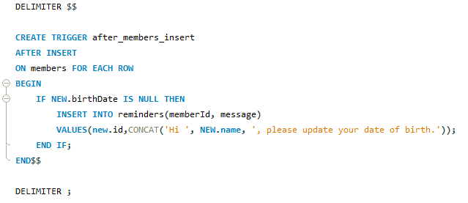
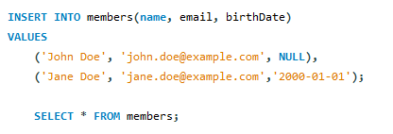
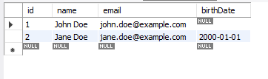
EXAMPLE OF AFTER INSERT TRIGGER :

Slide 76
AFTER UPDATE triggers : my sql After update triggers are invoked automatically event occurs on the table associated with the triggers syntax for after update : create trigger trigger_name after update on table_name for each row trigger_body

Slide 77
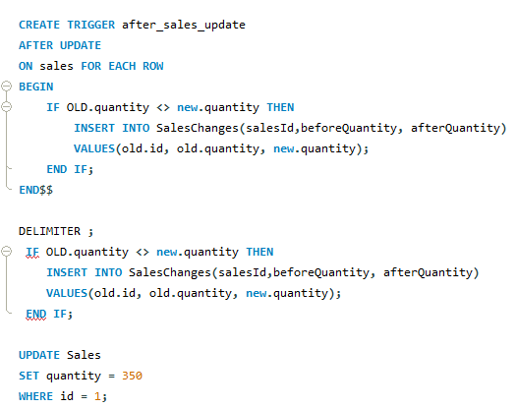
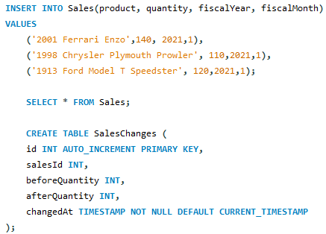

EXAMPLE OF after update trigger :

Slide 78
After delete trigger: mysql after delete triggers are automatically invoked after a delete event occurs on the table. Syntax for after update trigger : create trigger trigger_name after delete on table_name for each row trigger-body;

Slide 79
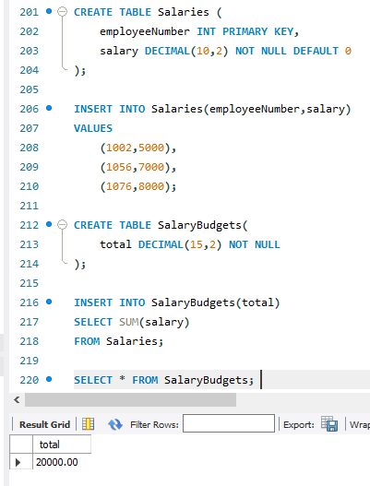
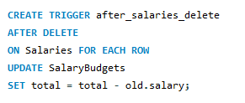

Example of after delete trigger :

Slide 80
MYSQL BEFoRE insert triggers : Mysql before insert triggers are automatically fired before an insert event occurs on the table. Syntax of before insert trigger : create trigger trigger_name on table_name for each row trigger_body;

Slide 81
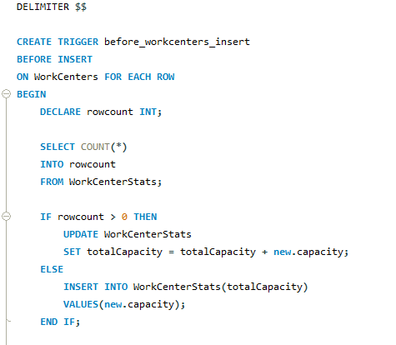
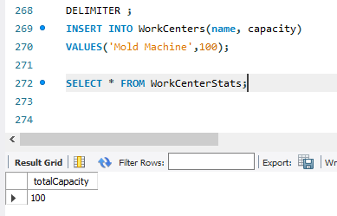
EXAmPLE of before insert trigger :

Slide 82
Mysql Before update trigger : mysql before insert triggers are invoked automatically before an update event occurs on the table associated with the triggers. Syntax for before update trigger: create trigger trigger_name: before update on table_name for each row trigger_body

Slide 83
Mysql before delete trigger: mysql before delete triggers are fired automatically before a delete event occurs in a table syntax for before delete trigger: create trigger trigger_name before delete on table_name for each row trigger_body

Slide 84
Thank you

