Slide 1
Hybrid app for tourism
Proposed by:
Node larvel

Slide 2
Problem statement:
Native and foreign tourists don't have access to government website and portal through offline mobile app.
It have been a tedious task to visit government websites for every purpose.

Slide 3
Proposed Solution
A dynamic mobile app which integrates every government websites and portals into a mobile app.
It have enhanced rich user design and customized UI with reliable performance.
It can solve the problems with network connectivity as offline mode is used for static data.
Internet will be needed only for booking travel,food & accomodation as they are separate websites provided by rajasthan government.

Slide 4
Technology stack
Framework used:
Ionic framework 3.x
Plugins used:
Cordova,InAppBrowser

Slide 5
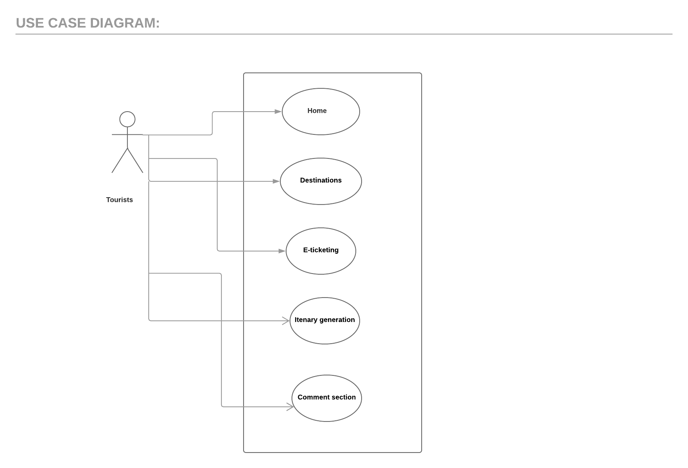
UML DIAGRAM:

