Slide 1

DEPARTMENT OF ARTIFICIAL INTELLIGENCE
20AM6203 - DESIGN PROJECT - 2
Batch - 14
Presented by :
Guided by :
SRIVISHWA A - 811722001049
UDHAYA SANKAR N - 811722001053
VIKNESHWARAN M - 811722001055
Mrs. G. NALINA KEERTHANA,
Assistant Professor / AI

Slide 2
PROJECT TITLE
AI-POWERED EVENT MANAGER

Slide 3
OBJECTIVE
The AI-Powered Event Manager helps organizers quickly create and share attractive event posters using DALL·E, making event planning easier and more efficient.

Slide 4
EXISTING SYSTEM
Event posters are usually created manually using tools like Photoshop, Canva, or PowerPoint.
Requires graphic design skills and significant time to finalize a professional-looking poster.
Demerits:
Time-Consuming and Manual
Lack of Integration
Requires Design Skills
Limited Scalability
No Personalization or Intelligence

Slide 5
PROPOSED SYSTEM
Automatically generates event posters using DALL·E based on user inputs like event name, date, and description.
Integrates event scheduling with poster generation in one easy-to-use interface.
Merits:
Automated Poster Generation
Unified Platform
User-Friendly and Accessible
Customization and Thematic Relevance
Scalable and Efficient

Slide 6
LITERATURE SURVEY
S. No | TITLE | AUTHOR NAME | PUBLISHED YEAR | TECHNIQUES AND TOOLS USED | DEMERITS
1 | PosterBot: AI Poster Generator. | Lian C, Gao Y, & Talneas J. | 2021 | Neural networks, Text summarization. | Limited to academic papers. Not adaptable for general event posters.
2 | AI-Based Poster Content Extraction. | Liu Y, & Chen Z . | 2021 | NLP, Machine learning | Designed only for research posters. Not user-customizable.

Slide 7
LITERATURE SURVEY
S. No | TITLE | AUTHOR NAME | PUBLISHED YEAR | TECHNIQUES AND TOOLS USED | DEMERITS
3 | AI in Event Experience. | Wirtz J, & Zeithaml, V. A. | 2021 | AI personalization, Process automation. | Future predictions may not be accurate.
4 | AI-Based Event Management. | Gupta S. K, Singh P. K., & Gupta, D. | 2022 | AI content generation, Chatbots, Recommandations system. | Lack of details on AI model implementation
5 | AI in Event Industry. | Olayemi, O. | 2023 | Machine learning, NLP, Data analytics. | Lack of real-world testing and Mostly theoretical.

Slide 8
DATA FLOW DIAGRAM
User access
Event creation interface
If Updation Required
Automated schedule generation
Yes
No
Poster export to local storage
Poster Generated
Poster Rendering
Finalized event schedule
Edit
End

Slide 9
System & Software Specifications
Component | Specification
Processor (CPU) | Intel Core i5 or AMD Ryzen 5 (or higher)
RAM | Minimum 8 GB
Storage | At least 5 GB free space
Operating System | Windows 10/11, macOS, or Linux
Python Version | Python 3.8 or higher
Frontend Framework | Streamlit (v1.20 or higher)
Backend Framework | Flask (v2.0 or higher)
API Integration | OpenAI Python SDK (openai package)
Additional Packages | flask-cors, requests (optional), dotenv
Internet Access | Required (for OpenAI DALL·E API usage)

Slide 10
MODULES
Data Preparation Module
GAN Model Training Module
Event Scheduling Module
Poster Generation Module

Slide 11
DATA PREPARATION MODULE
PURPOSE
This module collects and prepares event-related data such as event type, title, date, and theme. It ensures the model receives clean, usable inputs.
Data Collection:
Collects user input or dataset entries for various events.
Packages Used:
pandas
streamlit.text_input
Data Formatting:
Converts raw input into structured data format for model training and image generation.
Packages Used:
Python string processing
basic validation

Slide 12
FUNCTIONS:
This module ensures all event-related details are gathered accurately, serving as the foundation for prompt and poster generation.
It standardizes and formats the input data, making it suitable for machine understanding and image generation APIs.
By preparing a clean, descriptive prompt, it directly influences the quality and relevance of the final event poster.

Slide 13
GAN Model Training Module
PURPOSE
This module trains a Generative Adversarial Network (GAN) to generate creative event posters based on text descriptions.
Dataset Feeding:
Feeds event-theme-based images and titles into the GAN model.
Packages Used:
torch
tensorflow
Generator & Discriminator Training:
Teaches the model how to create realistic poster images using training data.
Packages Used:
torch.nn
matplotlib

Slide 14
FUNCTIONS:
This module trains a GAN using a dataset of posters to learn how to generate realistic and creative visuals.
It uses adversarial learning, where two networks improve through competition, enhancing the quality of generated images.
The trained model serves as a base for generating posters that follow design aesthetics and category-specific features.

Slide 15
EVENT SCHEDULING MODULE
PURPOSE
This module schedules upcoming events and keeps event information organized and up to date.
Input Interface:
Allows users to input event name, date, time, and venue.
Packages Used:
streamlit.date_input
streamlit.time_input
Backend Storage:
Stores scheduled data in a structured format.
Packages Used:
json
sqlite3

Slide 16
FUNCTIONS:
GAN Algorithm:
GAN uses two parts a Generator that creates fake data (like images), and a Discriminator that checks if the data is real or fake. They compete with each other to improve.
GANs learn from real data and then generate new, similar-looking data, like realistic photos, drawings, or even music, without needing
This module records upcoming event details and keeps them organized in a structured schedule or database.
It ensures time-sensitive events are prioritized and linked with the correct poster generation cycle.
It enables easy updates, edits, or deletions to scheduled events, maintaining an always-accurate list.

Slide 17
POSTER GENERATION MODULE
PURPOSE
Generates event posters using the DALL·E API based on text prompts from the user.
Text Prompt Creation:
Converts user input into a format suitable for DALL·E.
Packages Used:
Python string operations
Image Generation via DALL·E API:
Sends the text to DALL·E and receives an image in return.
Packages Used:
openai
requests

Slide 18
FUNCTIONS:
This module connects with the DALL·E API to convert the prepared event prompt into a visually appealing poster.
It ensures that the AI-generated image reflects the event’s theme, tone, and details accurately.
Posters are displayed instantly and saved for future use, reducing the time required for manual design work.

Slide 19
ADVANTAGES
Auto poster creation saves time
Just enter event details
Posters match event theme
High-quality, unique images
Combines schedule + poster
No need for designer/tools
Cost-effective and easy

Slide 20
APPLICATIONS
Educational Institutions
Corporate Sector
Event Management Firms
NGOs and Community Groups
Freelancers and Content Creators

Slide 21
CONCLUSION
The AI-Powered Event Manager simplifies and streamlines event planning by automating key processes such as event creation, scheduling, and organization.
With an AI-powered poster generator, it ensures visually appealing and informative event promotions.
Overall, this system enhances efficiency, reduces manual effort, and improves the overall event experience, making it a valuable tool for college event management.

Slide 22
REFERENCES
Kumar, R., & Sinha, M. (2022). Enhancing Event Experiences Using Artificial Intelligence and Big Data. Proceedings of the 2022 IEEE International Conference on Smart Technologies, 112–118.
Morris, T., & Zhao, L. (2021). The Role of Artificial Intelligence in Event Personalization and Audience Engagement. Journal of Event Technology and Innovation, 9(1), 23–34.
Praveen, A., & Sharma, N. (2023). AI-Based Event Management System: Automating Planning and Real-Time Monitoring. International Journal of Emerging Technology and Advanced Engineering, 13(2), 45–52.

Slide 23
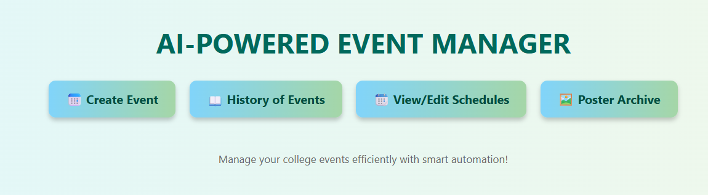
SCREENSHOTS

Slide 24
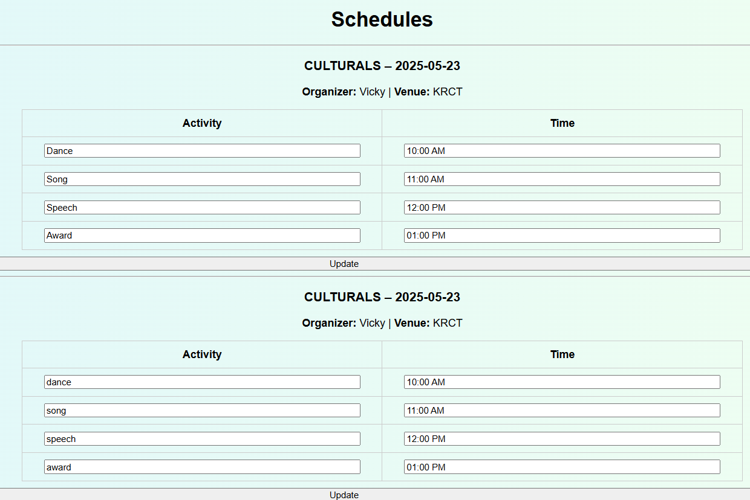

Slide 25
