Slide 1

From Silence to Symphony: Crafting Your Communication Symphony

Slide 2
Communication
Communication (from Latin communicare, meaning "to share”) is the act of conveying meanings from one entity or group to another through the use of mutually understood signs, symbols, and semiotic rules.
Communication is simply the act of transferring information from one place, person or group to another. Every communication involves (at least) one sender, a message and a recipient.
The imparting or exchanging of information by speaking, writing, or using some other medium.

Slide 3
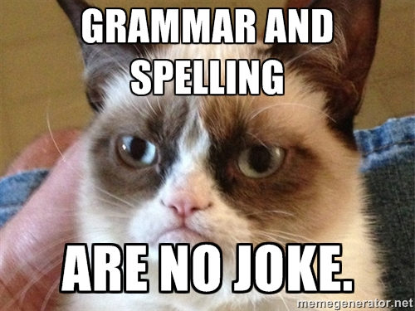

Slide 4
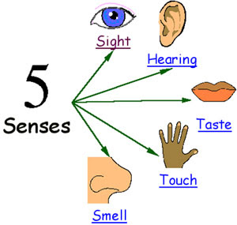
Communication is a series of experience of...
Seeing
Hearing
Tasting
Touching
Smelling

Slide 5
Communication skills
Communication skills is the ability to use language (receptive) and express (expressive) information.
Effective communication skills are a critical element in your career and personal lives.

Slide 6
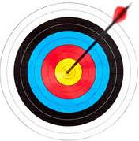
Communication goals
Change of behaviour
To get action
To ensure understanding
To persuade
To get and give information

Slide 7
Most Common Ways to Communicate
Speaking
Writing
Visual aids
Body language

Slide 8
Types of Communication
On the basis of organization relationship:-
Formal
Informal
On the basis of flow :-
Vertical
Crosswise/diagonal
Horizontal
On the basis of expression :-
Oral
Written
Gesture

Slide 9
Barriers to Communication
Semantic Barriers
Emotional Or Psychological Barriers
Organizational Barriers
Barriers in Superiors

Slide 10
Semantic Barriers
Symbols with different meaning
Badly expressed message
Faulty translation
Un-clarified assumption
Specialist’s language

Slide 11
2. Emotional Or Psychological Barriers
Premature evolution
Inattention
Loss of transmission & poor retention
Undue reliance on the written word
Distrust of communication
Failure to communicate

Slide 12
3. Organization Barriers
Organizational policy
Organization rules & regulation
Status relation
Complexity in organization

Slide 13
4. Personal Barriers
Barriers in superior:-
Attitude of superior
Fear of challenge
Lack of time
Lack of awareness

Slide 14
4. Personal Barriers cont...
Barriers in subordinates:-
Unwillingness to communicate
Lack of proper initiative

Slide 15
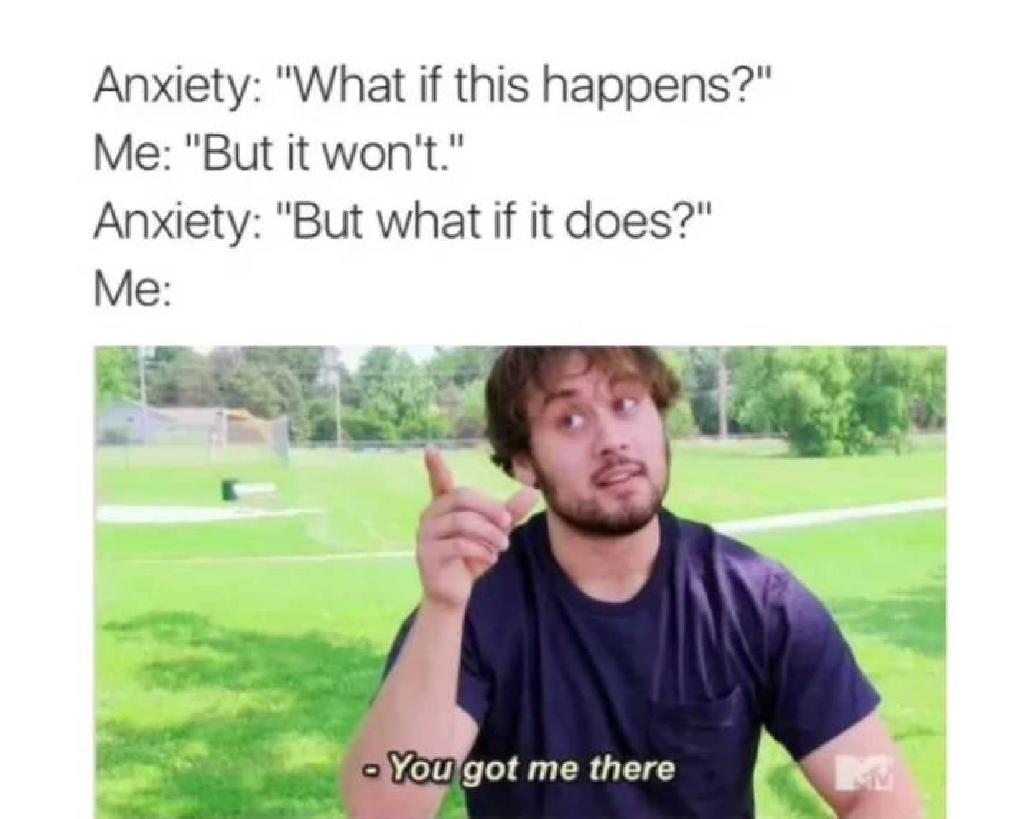

Slide 16
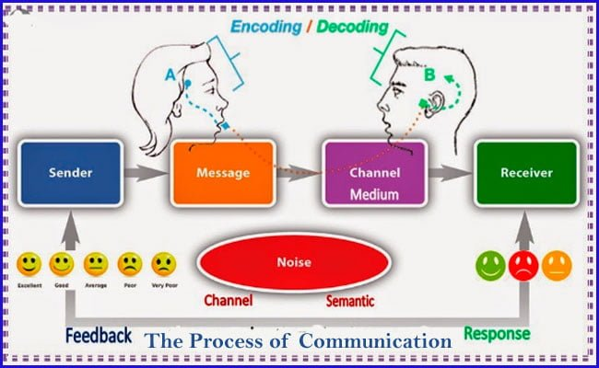
Communication process
Communication is the process of sending and receiving information among people.

Slide 17
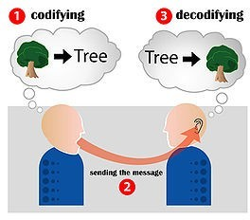
Communication code scheme

Slide 18
Communication involves three components
Verbal messages :- the words we choose
Para-verbal messages :- how we say the words
Non-verbal messages :- our body language
These three components are used to:-
Send clear, concise messages
Receive and correctly understand messages sent to us.

Slide 19
Sending message
Effective verbal message:-
Are brief, succinct, and organized
Are free of jargon
Do not create resistance in the listener

Slide 20
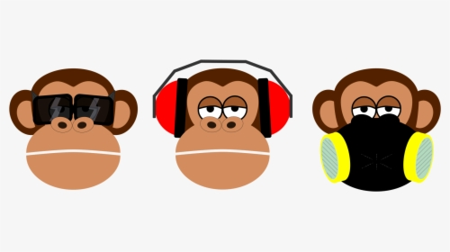
Non-verbal message
Nonverbal messages are the primary way that we communicate emotions

Slide 21
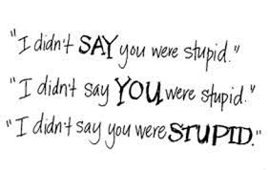
Para-verbal message
Para-verbal communication refers to the messages that we transmit through the tone, pitch, and pacing of our voices.

Slide 22
Receiving message
Listening:-
Requires concentration and energy.
Involves a psychological connection with the speaker.
Includes a desire and willingness to try and see things from another's perspective
Requires that we suspend judgment and evaluation.

Slide 23
Key learning skills
Nonverbal:-
Giving full physical attention to the speaker;
Being aware of the speaker's nonverbal messages
Verbal:-
Paying attention to the words and feelings that are being expressed.

Slide 24
What makes a good communicator?
Qualities
Clarity
Timing
Integrity
Adequacy

Slide 25
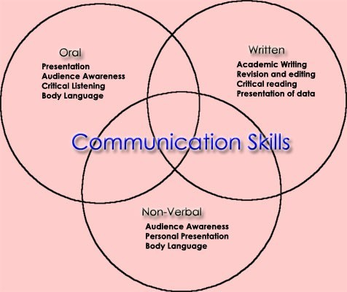
How to develop communication skills? Explore related skills.

Slide 26
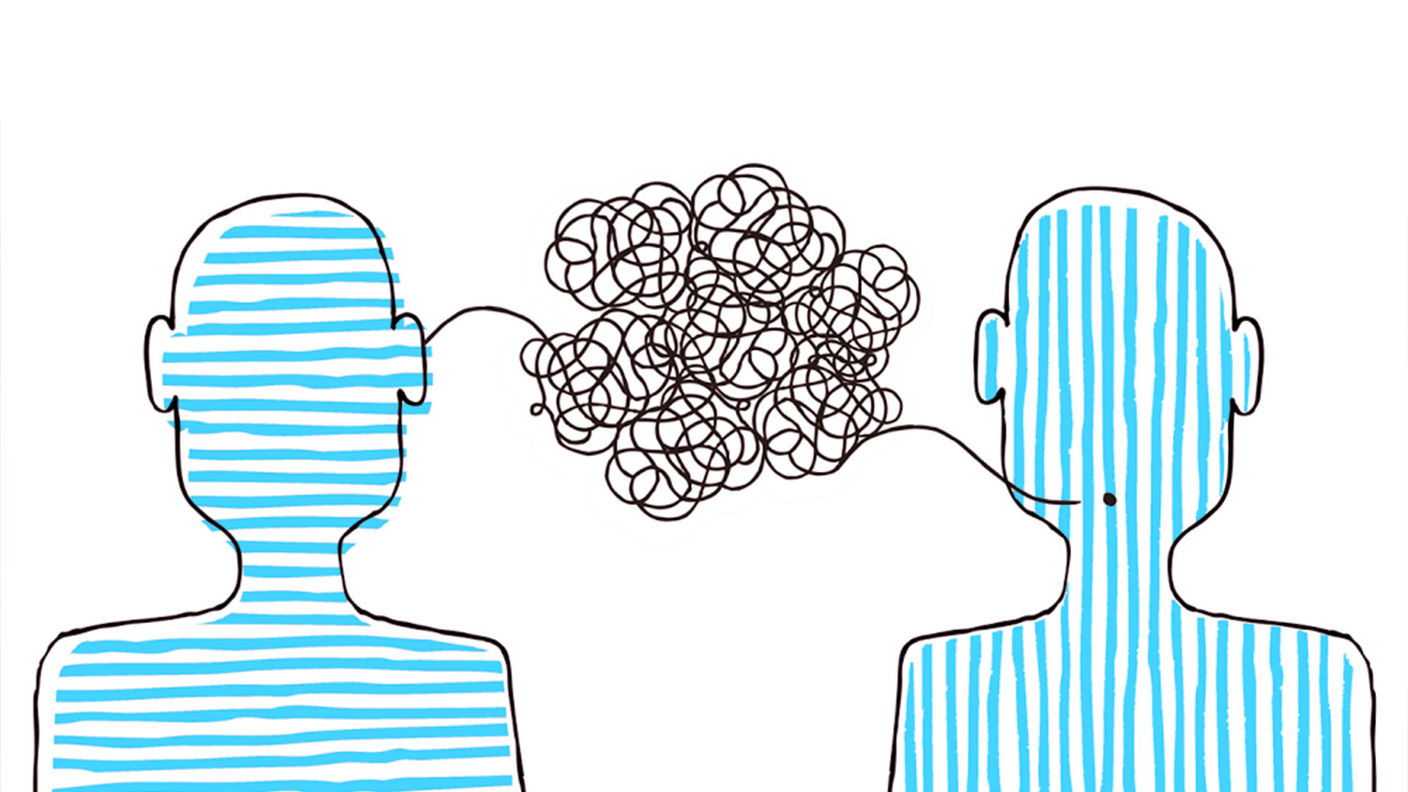
Tips to good communication skills
Maintain eye contact with the audience
Body awareness
Gestures and expressions
Convey one's thoughts
Practice effective communication skills.

Slide 27
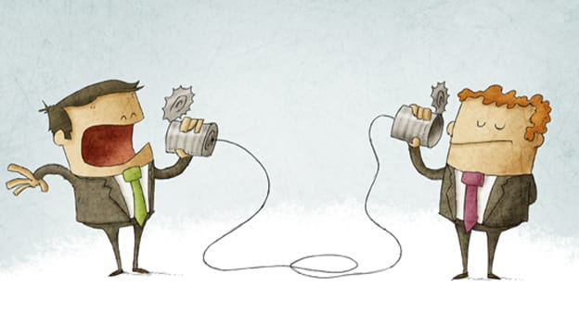
Effective communication
It is two way.
It involves active listening.
It reflects the accountability of speaker and listener.
It utilizes feedback. It is free of stress.
It is clear.

Slide 28


