Slide 1
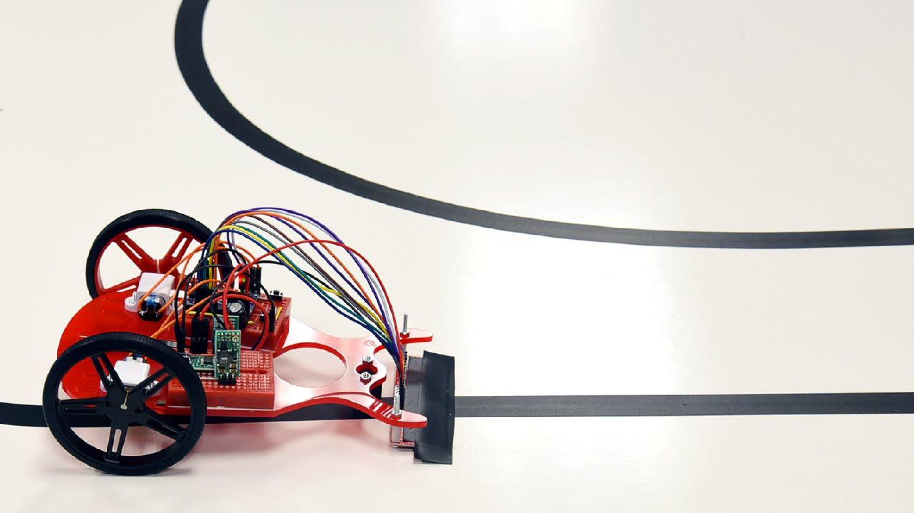
L I N E F O L L O W I N G R O B O T
Report by :-
Vikram Jha(08010102817) Jai Sachdeva(50310102817) Arshwin Kumar(20110102817)

Slide 2
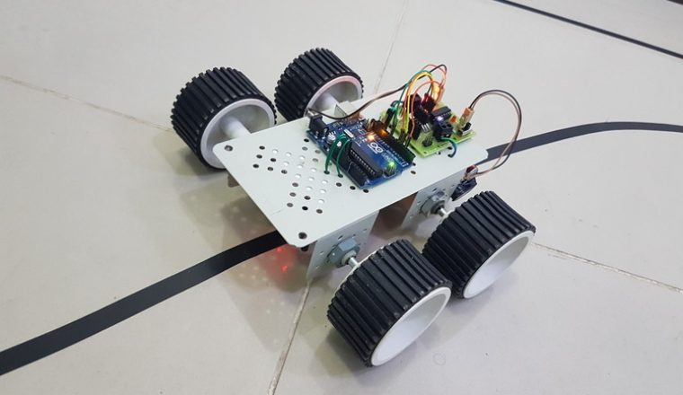
Introduction
A line follower robot, as the name suggests, is an automated guided vehicle, which follow a visual line embedded on the floor or ceiling.
Usually, the visual line is the path in which the line follower robot goes and it will be a black line on a white surface but the other way (white line on a black surface) is also possible.
Certain advanced line follower robots use invisible magnetic field as their paths.

Slide 3
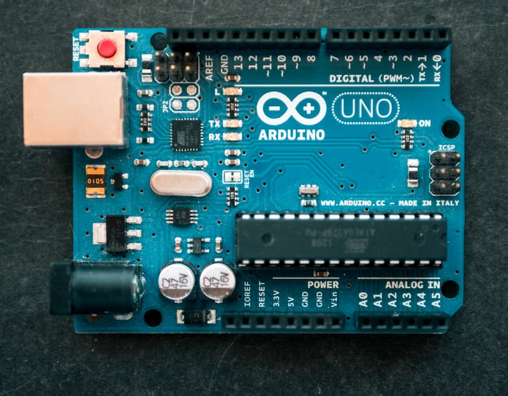
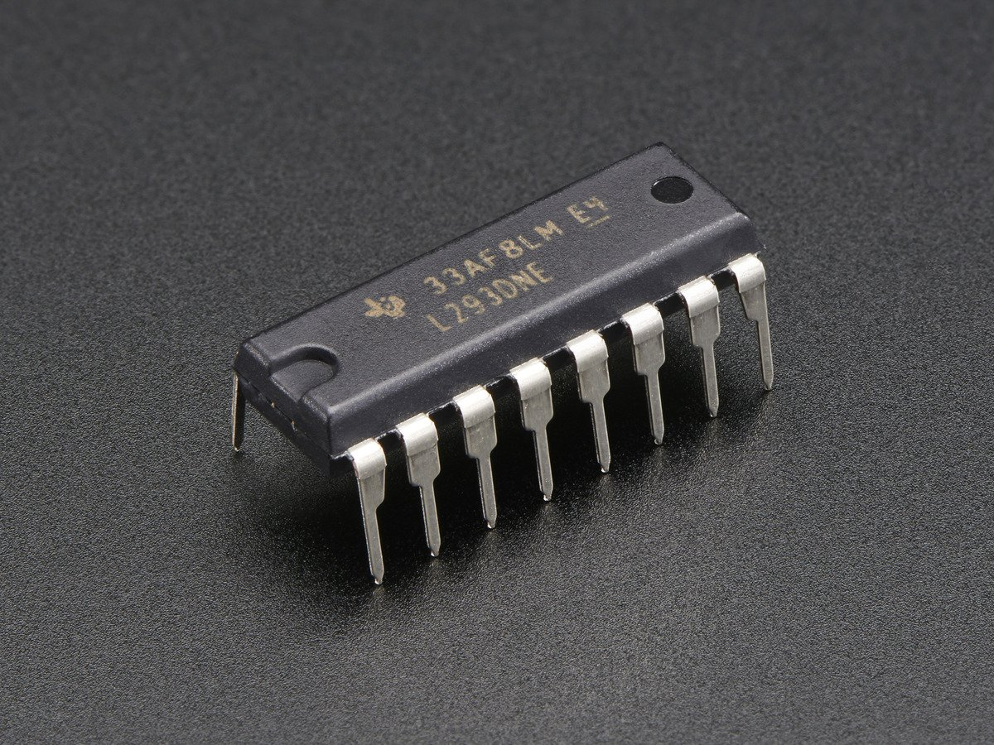
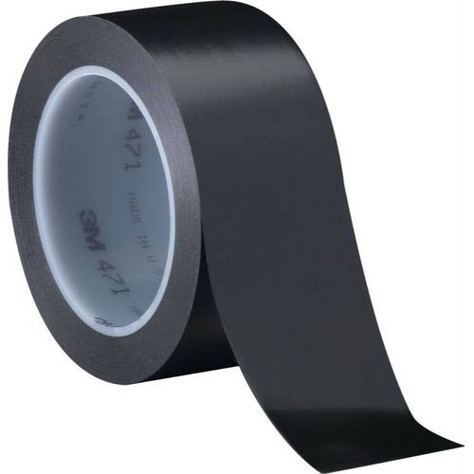
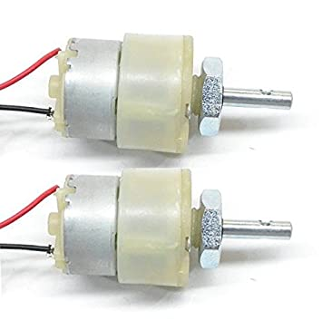
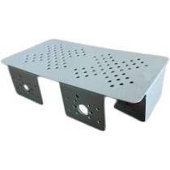
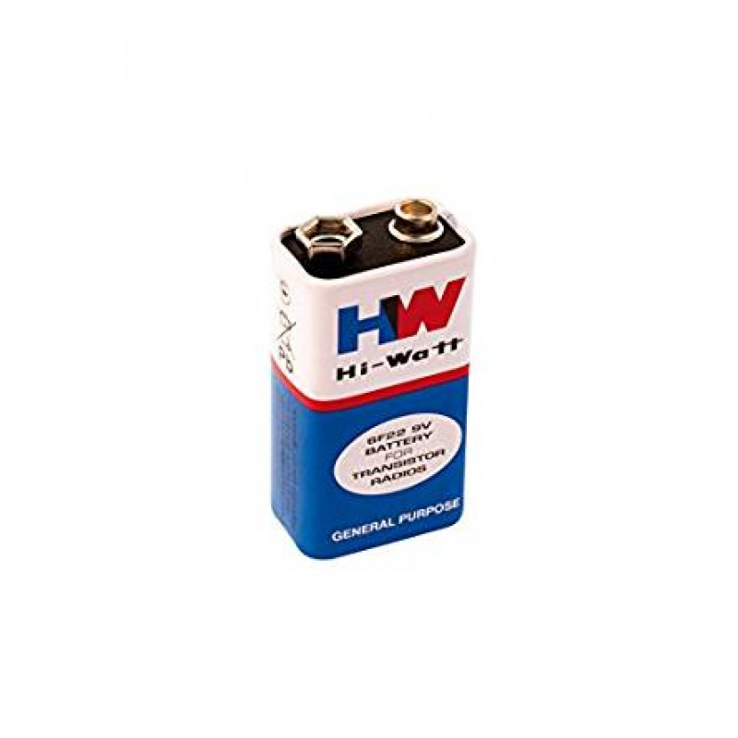
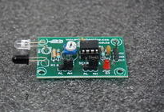
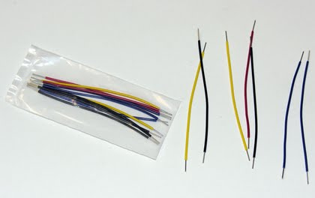
components
Arduino UNO
L293D Motor Driver IC
Geared Motors x 2
IR Sensor Module x 2
Robot Chassis
Black Tape
Connecting Wires
Power supply
Battery Connector

Slide 4
cOMPONENTS
Sensors (IR Sensor): We have used IR Sensor Module as the line detecting sensor for the project. It consists of an IR LED and a Photo diode and some other components like comparator, LED etc.
Controller (Arduino UNO): Arduino UNO is the main controller in the project. The data from the sensors (IR Sensors) will be given to Arduino and it gives corresponding signals to the Motor Driver IC.
Motor Driver (L293D): L293D Motor Driver IC is used in this project to drive the motors of the robot. It receives signals from Arduino based on the information from the IR Sensors.
Note: The power supply to the motors must be given from the motor driver IC. Hence, choose the appropriate power supply which is sufficient for all the components including the motors.
Motors (Geared Motors): We have used two geared motors at the rear of the line follower robot. These motors provide more torque than normal motors and can be used for carrying some load as well.

Slide 5
Arduino UNO
The Arduino Uno is a microcontroller board based on the ATmega32(8 Bit).
It contains 14 digital input/output pins (of which 6 can be used as PWM outputs).
It contains has 6 analog inputs.
It contains has a 16 MHz ceramic resonator.
It contains a USB connection.
It contains a power jack.
It contains an ICSP header.
A reset button. It contains everything needed to support the microcontroller; simply connect it to a computer with a USB cable or power it with a AC-to-DC adapter or battery to get started.
The Uno differs from all preceding boards in that it does not use the FTDI USB-to-serial driver chip. Instead, it features the Atmega16U2 (Atmega8U2 up to version R2) programmed as a USB-to-serial converter.

Slide 6
L293D Motor Driver IC
The IC works on the principle of Half H-Bridge.
this IC is capable of running two motors at the any direction at the same time.
Can be used to run Two DC motors with the same IC.
Speed and Direction control is possible.
Motor voltage Vcc2 (Vs): 4.5V to 36V.
Maximum Peak motor current: 1.2A.
Maximum Continuous Motor Current: 600mA.
Supply Voltage to Vcc1(vss): 4.5V to 7V.
Transition time: 300ns (at 5Vand 24V).

Slide 7
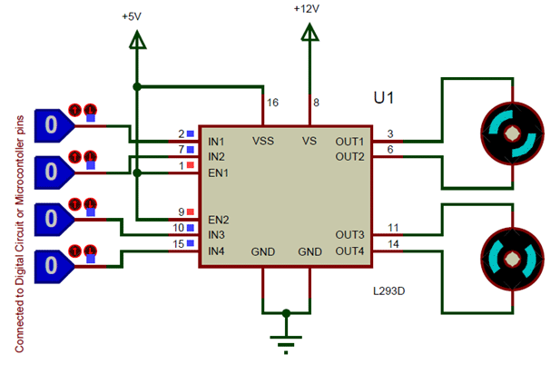
Schematic diagram

Slide 8
L293D Motor Driver IC
All the Ground pins should be grounded.
There are two power pins for this IC, one is the Vss(Vcc1) which provides the voltage for the IC to work, this must be connected to +5V.
The other is Vs(Vcc2) which provides voltage for the motors to run, based on the specification of your motor you can connect this pin to anywhere between 4.5V to 36V, here I have connected to +12V.
The Enable pins (Enable 1,2 and Enable 3,4) are used to Enable Input pins for Motor 1 and Motor 2 respectively.
Since in most cases we will be using both the motors both the pins are held high by default by connecting to +5V supply.
The input pins Input 1,2 are used to control the motor 1 and Input pins 3,4 are used to control the Motor 2.
The input pins are connected to the any Digital circuit or microcontroller to control the speed and direction of the motor. You can toggle the input pins based on the following table to control your motor.

Slide 9
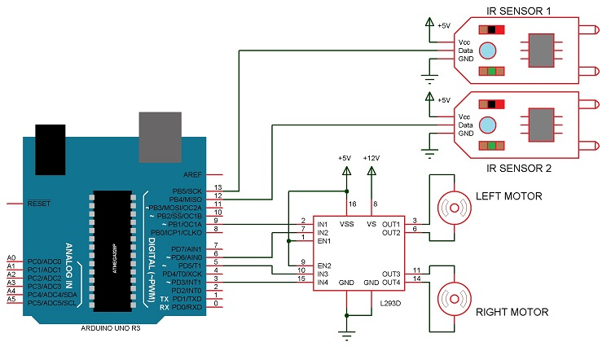
Circuit Diagram

Slide 10
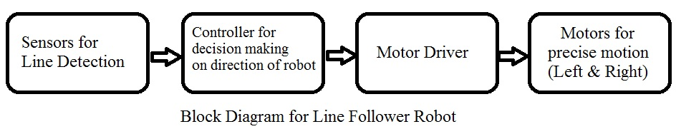
WORKING
The line follower robot built in this project is divided in to 4 blocks. The following image shows the block diagram for line follower robot.

Slide 11
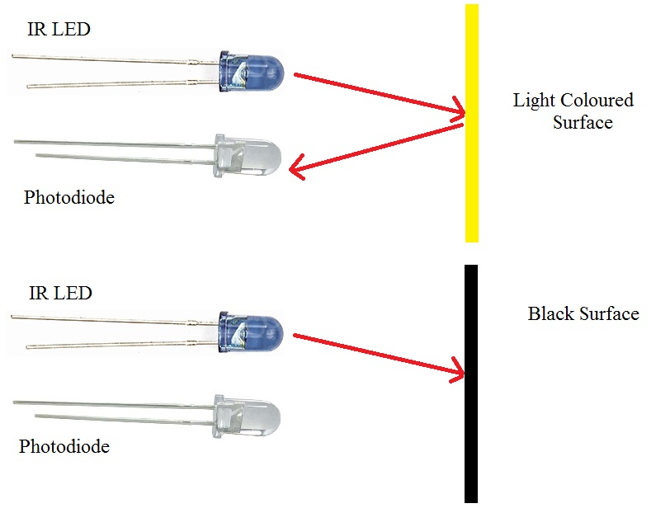
WORKING
The IR sensor detects the light emitted by the transmitter, if the receiver receives light, the wheel of that side will keep on moving, as soon as the receiver stops receiving the light (black colour absorbs the light and thus no light is reflected so receiver cannot receive any light) the wheel of that side will stop.
For turning ,the robot stops 1 motor and runs the second to make the turn possible.
For eg: If the robot has to turn right then the motor on right side will stop and left motor will keep on running and thus allowing the robot to turn.

Slide 12
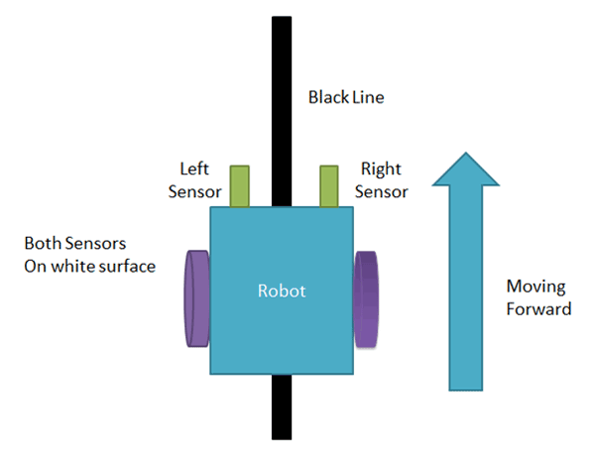
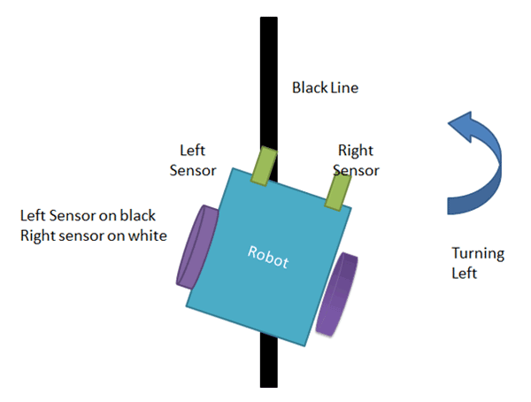
WORKING
we are using two IR sensor modules namely the left sensor and the right sensor. When both left and right sensor senses white then the robot moves forward.
If the left sensor comes on a black line then the robot turn the left side.

Slide 13
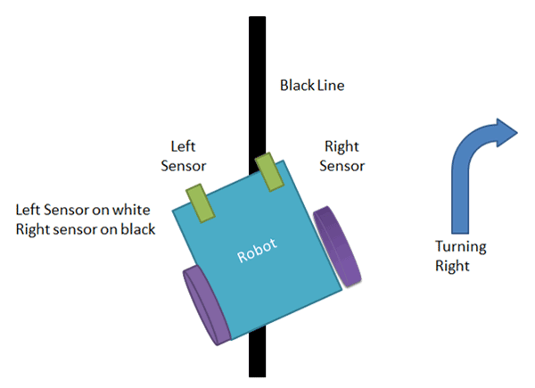
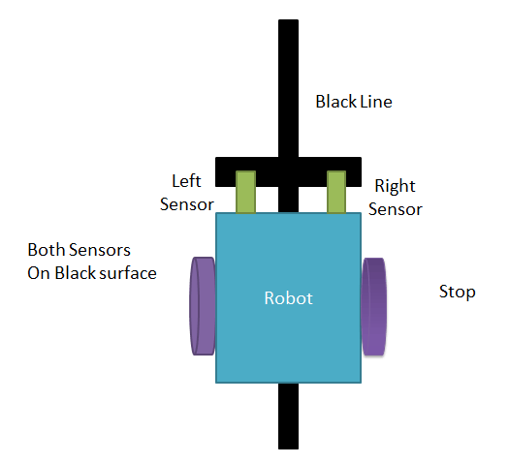
WORKING
If the right sensor sense black line then robot turn right side until both sensors comes at the white surface. When the white surface comes robot starts moving on forward again.
If both sensors come on the black line, the robot stops.

Slide 14
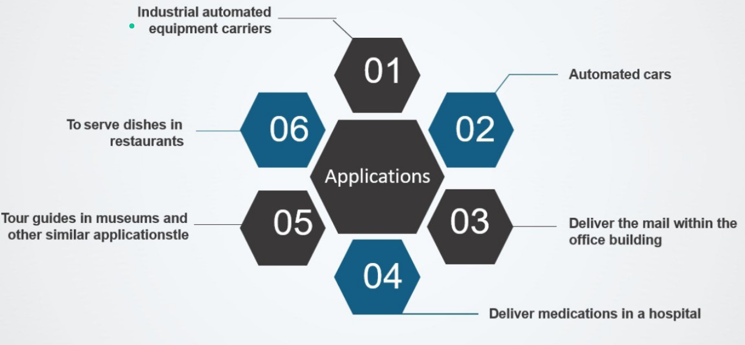
APPLICATIONS

Slide 15
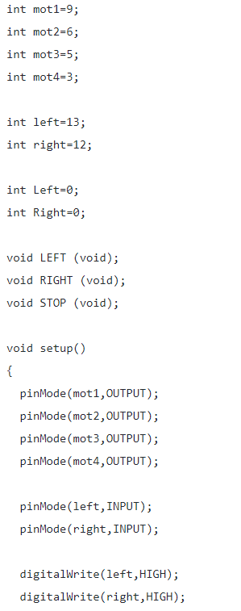
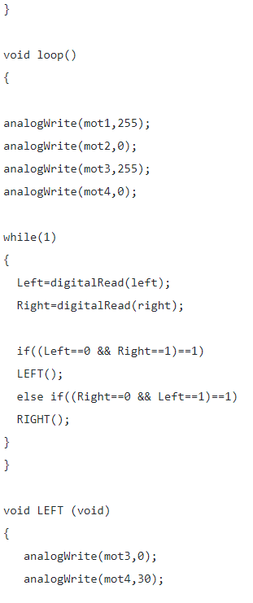
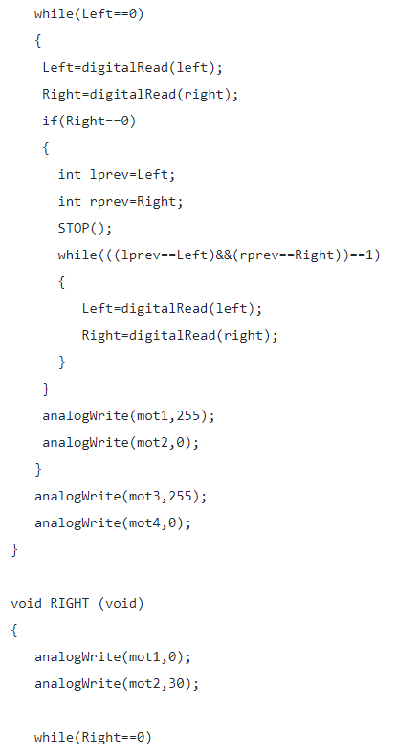
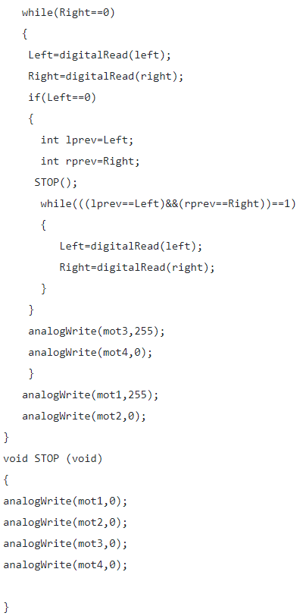
CODE

Slide 16


