Slide 1
CS542: Topics in
Distributed Systems
Diganta Goswami

Slide 2
Some examples of
Distributed Systems

Slide 3
Some examples of
Distributed Systems
Client-Server (NFS)
The Web
The Internet
A wireless network
DNS
Gnutella or BitTorrent (peer to peer overlays)
A “cloud”, e.g., Amazon EC2/S3, Microsoft Azure
A datacenter, e.g., a Google datacenter, The Planet

Slide 4
What is a Distributed System?

Slide 5
FOLDOC definition
A collection of (probably heterogeneous) automata whose distribution is transparent to the user so that the system appears as one local machine. This is in contrast to a network, where the user is aware that there are several machines, and their location, storage replication, load balancing and functionality is not transparent. Distributed systems usually use some kind of client-server organization.

Slide 6
Textbook definitions
A distributed system is a collection of independent computers that appear to the users of the system as a single computer.
[Andrew Tanenbaum]
A distributed system is several computers doing something together. Thus, a distributed system has three primary characteristics: multiple computers, interconnections, and shared state.
[Michael Schroeder]
Notes:
Contradictions:
uh, doesn’t each computer need to know about a few other computers in the system (somewhere deep down there in the RAM)?
If computers don’t exchange any information and make no progress, would this count as a distributed system?

Slide 7
Textbook definitions
System of networked computers that
  communicate and coordinate their actions only by passing messages
[Coulouris et at]
Notes:
Contradictions:
uh, doesn’t each computer need to know about a few other computers in the system (somewhere deep down there in the RAM)?
If computers don’t exchange any information and make no progress, would this count as a distributed system?

Slide 8
Unsatisfactory
Why do these definitions look inadequate to us?
Because we are interested in the insides of a distributed system
  design and implementation
  Maintenance
  Algorithmics (“protocols”)

Slide 9
A working definition for us
A distributed system is a collection of entities, each of which is autonomous, programmable, asynchronous and failure-prone, and which communicate through an unreliable communication medium using message passing.
Entity=a process on a device (PC, PDA)
Communication Medium=Wired or wireless network
Our interest in distributed systems involves
  design and implementation, maintenance, algorithmics
Notes:
Designers and progammers interested in : algorithmics, maintenance.
(informal definition, for us programmers of distributed systems)
Ok: peer to peer systems
Contradiction: a computer without ROM or disk drives that needs to boot over the network. Is a collection of these computers a distributed system?

Slide 10
The Internet – Quick Refresher
Underlies many distributed systems.
A vast interconnected collection of computer networks of many types.
Intranets – subnetworks operated by companies and organizations.
Intranets contain subnets and LANs.
WAN – wide area networks, consists of LANs
ISPs – companies that provide modem links and other types of connections to users.
Intranets (actually the ISPs’ core routers) are linked by backbones – network links of large bandwidth, such as satellite connections, fiber optic cables, and other high-bandwidth circuits.

Slide 11
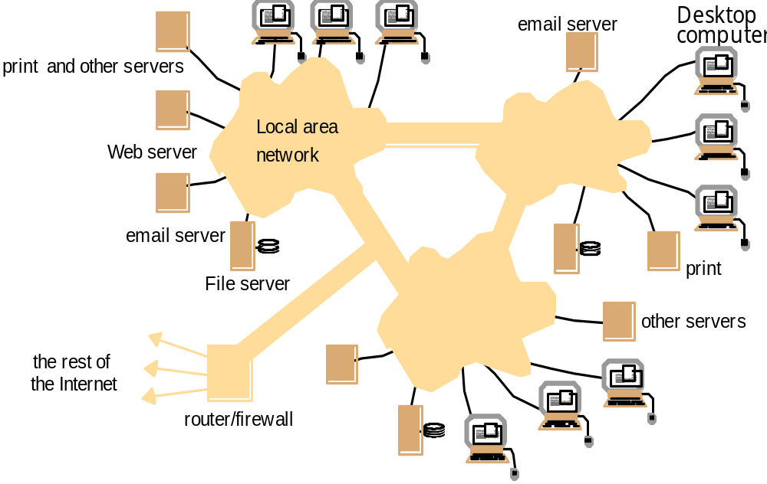
An Intranet and a distributed system over it
Running over this Intranet is a distributed file system -
What are the “entities”
(nodes) in it?
What is the
communication medium?
prevents unauthorized messages from leaving/entering;
implemented by filtering incoming and outgoing messages

Slide 12
Distributed Systems are layered over networks
Application
layer protocol
smtp [RFC 821]
telnet [RFC 854]
http [RFC 2068]
ftp [RFC 959]
proprietary
(e.g. RealNetworks)
NFS
proprietary
(e.g., Skype)
Underlying
transport protocol
TCP
TCP
TCP
TCP
TCP or UDP
TCP or UDP
typically UDP
Application
e-mail
remote terminal access
Web
file transfer
streaming multimedia
remote file server
Internet telephony
TCP=Transmission Control Protocol
UDP=User Datagram Protocol
Implemented via network
“sockets”. Basic primitive that
allows machines to send
messages to each other
Distributed System Protocols!
Networking Protocols

Slide 13

The Secret of the World Wide Web: the HTTP Standard
HTTP: hypertext transfer protocol
WWW’s application layer protocol
client/server model
  client: browser that requests, receives, and “displays” WWW objects
  server: WWW server, which is storing the website, sends objects in response to requests
http1.0: RFC 1945
http1.1: RFC 2068
  Leverages same connection to download images, scripts, etc.
http request
PC running
Explorer
http response
http request
Server
Running
Apache
Web
server
http response
Mac running
Safari

Slide 14
The HTTP Protocol: More
http: TCP transport service:
client initiates a TCP connection (creates socket) to server, port 80
server accepts the TCP connection from client
http messages (application-layer protocol messages) exchanged between browser (http client) and WWW server (http server)
TCP connection closed
http is “stateless”
server maintains no information about past client requests
Why?
Protocols that maintain session “state” are complex!
past history (state) must be maintained and updated.
if server/client crashes, their views of “state” may be inconsistent, and hence must be reconciled.

Slide 15
HTTP Example
Suppose user enters URL www.iitg.ernet.in/
1a. http client initiates a TCP connection to http server (process) at www.cs.uiuc.edu. Port 80 is default for http server.
1b. http server at host www.iitg.ernet.in waiting for a TCP connection at port 80. “accepts” connection, notifying client
2. http client sends a http request message (containing URL) into TCP connection socket
3. http server receives request messages, forms a response message containing requested object (index.html), sends message into socket
time

Slide 16
HTTP Example (cont.)
4. http server closes the TCP connection (if necessary).
5. http client receives a response message containing html file, displays html, Parses html file, finds 10 referenced jpeg objects (say)
6. Steps 1-5 are then repeated for each of 10 jpeg objects
time
For fetching referenced objects, have 2 options:
non-persistent connection: only one object fetched per TCP connection
  some browsers create multiple TCP connections simultaneously - one per object
persistent connection: multiple objects transferred within one TCP connection

Slide 17
A human as a browser (Client Side)
1. Telnet to your favorite WWW server:
telnet www.google.com 80
Opens TCP connection to port 80
(default http server port) at www.google.com
Anything typed in sent
to port 80 at www.google.com
2. Type in a GET http request:
GET /index.html
Or
GET /index.html HTTP/1.0
By typing this in (may need to hit
return twice), you send
this minimal (but complete)
GET request to http server
3. Look at response message sent by http server!
What do you think the response is?

Slide 18
Does our Working Definition work for the http
Web?
A distributed system is a collection of entities, each of which is autonomous, programmable, asynchronous and failure-prone, and that communicate through an unreliable communication medium.
Entity=a process on a device (PC, PDA)
Communication Medium=Wired or wireless network
Our interest in distributed systems involves
  design and implementation, maintenance, study, algorithmics
Notes:
Designers and progammers interested in : algorithmics, maintenance.
(informal definition, for us programmers of distributed systems)
Ok: peer to peer systems
Contradiction: a computer without ROM or disk drives that needs to boot over the network. Is a collection of these computers a distributed system?

Slide 19
Motivation
Two Advances in the mid 80s
  Powerful micro-processor:
    8-bit, 16-bit, 32-bit, 64-bit
    x86 family, 68k family, Alpha chip
    Clock rate: 8Mhz up to 600+Mhz
  Computer network
    Local Area Network (LAN), Wide Area Network (WAN), MAN, Wireless Network
    Network type: Ethernet, Token-bus, Token-ring, ATM, Fast-Ethernet, Gigabit Ethernet, Fibre Channel
    Transfer rate: 64 kbps up to 1Gbps

Slide 20
Motivation for distribution
People & information are distributed
Functional distribution: computers have different functional capabilities.
  Client / server
  Host / terminal
  Data gathering / data processing
Inherent distribution stemming from the application domain, e.g.
  cash register and inventory systems for supermarket chains
  computer supported collaborative work

Slide 21
Motivation for distribution
Share resources
sharing of resources with specific functionalities
  Data sharing: Allow many users access to a common database
  Device sharing: Allow many users to share expensive peripherals
Performance & cost
  Load distribution / balancing: assign tasks to processors such that the overall system performance is optimized.
  Replication of processing power: independent processors working on the same task
  Economics: collections of microprocessors offer a better price/performance ratio than large mainframes

Slide 22
“Important” Distributed Systems Issues
No global clock: no single global notion of the correct time (asynchrony)
Unpredictable failures of components: lack of response may be due to either failure of a network component, network path being down, or a computer crash (failure-prone, unreliable)
Highly variable bandwidth: from 16Kbps (slow modems or Google Balloon) to Gbps (Internet2) to Tbps (in between DCs of same big company)
Possibly large and variable latency: few ms to several seconds
Large numbers of hosts: 2 to several million

Slide 23
There are a range of interesting problems for Distributed System designers
Real distributed systems
  Cloud Computing, Peer to peer systems, Hadoop, distributed file systems, sensor networks, graph processing, …
Classical Problems
  Failure detection, Asynchrony, Snapshots, Multicast, Consensus, Mutual Exclusion, Election, …
Concurrency
  RPCs, Concurrency Control, Replication Control, …
Security
  Byzantine Faults, …
Others…

Slide 24
Typical Distributed Systems Design Goals
Common Goals:
  Heterogeneity – can the system handle a large variety of types of PCs and devices?
  Robustness – is the system resilient to host crashes and failures, and to the network dropping messages?
  Availability – are data+services always there for clients?
  Transparency – can the system hide its internal workings from the users?
  Concurrency – can the server handle multiple clients simultaneously?
  Efficiency – is the service fast enough? Does it utilize 100% of all resources?
  Scalability – can it handle 100 million nodes without degrading service? (nodes=clients and/or servers)
  Security – can the system withstand hacker attacks?
  Openness – is the system extensible?

Slide 25
“Important” Issues
The Goal for the Rest of the Course: see examples and learn enough concepts so these topics and issues will make sense

Slide 26
Course description (tentative)
  Motivation & examples
  System models:
    synchronous/asynchronous, shared memory/message passing
  Interprocess Communication
  Time & event order, global state, clock synchronization
  Group communication, managing group views

Slide 27
Course description (tentative)
Fundamental Algorithms
- Vector clocks
- Global state snapshots
- Coordination & agreement
- Leader Election
- Termination detection
- Mutual exclusion
- Consensus
- Deadlock

Slide 28
Course description (tentative)
Distributed transactions and Concurrency control
Replication
Distributed shared memory – coherence models
Distributed File Systems
Checkpointing, rollback recovery
Security
Other topics: P2P, Self-stabilization, Cloud computing

Slide 29
Reference Texts
George Coulouris, Jean Dollimore and Tim Kindberg:
  “Distributed Systems: Concepts and Design”
    Pearson Education
Andrew S. Tanenbaum and Marten van Steen:
  “Distributed Systems: Principles and Paradigms”
    Pearson Education
Mukesh Singhal & N. G. Shivaratri:
  “Advanced Concepts in Operating Systems”
    Tata McGraw-Hill

Slide 30
Grading Policy (Tentative)
Exams
  Midterm : 30 - 40%
  Final: 40 - 50%
Term papers / Projects: 20%

Slide 31
Project / Term Paper
Purposes:
Introduction to the technical literature in the area
Application of ideas and techniques presented in class
Practice in writing technical documents
Practice in making oral presentations

Slide 32
Project / Term Paper
Topic should concern distributed systems
Read several related papers from the literature
Summarize and critically review the work
Either extend the work in some way and/or simplify the results by making some simplifying assumptions and/or solve an open problem related to the papers and/or come up with a new problem based on some application area known to you and try to solve it – Your original research content.

Slide 33
Schedule
Mon – 5 to 6 pm
Tue – 4 to 5 pm
Wed – 3 to 4 pm

