Slide 1
CS162
Operating Systems and
Systems Programming
Lecture 20
Reliability and Access Control
November 10, 2010
Prof. John Kubiatowicz
http://inst.eecs.berkeley.edu/~cs162

Slide 2

Review: Example of Multilevel Indexed Files
Multilevel Indexed Files:
(from UNIX 4.1 BSD)
  Key idea: efficient for small
  files, but still allow big files
  File Header format:
    First 10 ptrs to data blocks
    Block 11 points to “indirect
    block” containing 256 blocks
    Block 12 points to “doubly-
    indirect block” containing
    256 indirect blocks for total
    of 64K blocks
    Block 13 points to a triply indirect block (16M blocks)
UNIX 4.1 Pros and cons
  Pros: Simple (more or less)
  Files can easily expand (up to a point)
  Small files particularly cheap and easy
  Cons: Lots of seeks
  Very large files must read many indirect block (four I/Os per block!)

Slide 3
Review: UNIX BSD 4.2
Inode Structure Same as BSD 4.1 (same file header and triply indirect blocks), except incorporated ideas from DEMOS:
  Uses bitmap allocation in place of freelist
  Attempt to allocate files contiguously
  10% reserved disk space
  Skip-sector positioning
BSD 4.2 Fast File System (FFS)
  File Allocation and placement policies
    Put each new file at front of different range of blocks
    To expand a file, you first try successive blocks in bitmap, then choose new range of blocks
  Inode for file stored in same “cylinder group” as parent directory of the file
  Store files from same directory near each other
  Note: I put up the original FFS paper as reading for last lecture (and on Handouts page).
Later file systems
  Clustering of files used together, automatic defrag of files, a number of additional optimizations

Slide 4
Goals for Today
File Caching
Durability
Authorization
Distributed Systems
Note: Some slides and/or pictures in the following are
adapted from slides ©2005 Silberschatz, Galvin, and Gagne
Note: Some slides and/or pictures in the following are
adapted from slides ©2005 Silberschatz, Galvin, and Gagne. Many slides generated from my lecture notes by Kubiatowicz.

Slide 5
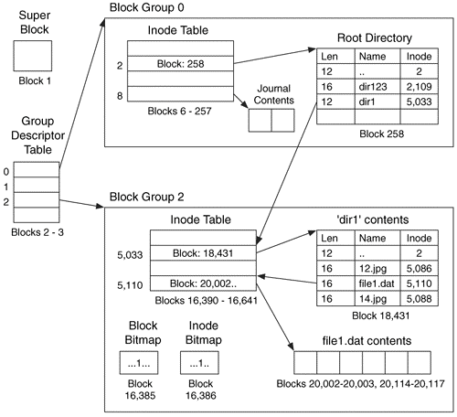
Linux Example: Ext2/3 Disk Layout
Disk divided into block groups
  Provides locality
  Each group has two block-sized bitmaps (free blocks/inodes)
  Block sizes settable
  at format time:
  1K, 2K, 4K, 8K…
Actual Inode structure similar to 4.2BSD
  with 12 direct pointers
Ext3: Ext2 w/Journaling
  Several degrees of protection with more or less cost
Example: create a file1.dat
under /dir1/ in Ext3

Slide 6

In-Memory File System Structures
Open system call:
  Resolves file name, finds file control block (inode)
  Makes entries in per-process and system-wide tables
  Returns index (called “file handle”) in open-file table
Read/write system calls:
  Use file handle to locate inode
  Perform appropriate reads or writes

Slide 7
File System Caching
Key Idea: Exploit locality by caching data in memory
  Name translations: Mapping from paths→inodes
  Disk blocks: Mapping from block address→disk content
Buffer Cache: Memory used to cache kernel resources, including disk blocks and name translations
  Can contain “dirty” blocks (blocks not yet on disk)
Replacement policy? LRU
  Can afford overhead of timestamps for each disk block
  Advantages:
    Works very well for name translation
    Works well in general as long as memory is big enough to accommodate a host’s working set of files.
  Disadvantages:
    Fails when some application scans through file system, thereby flushing the cache with data used only once
    Example: find . –exec grep foo {} \;
Other Replacement Policies?
  Some systems allow applications to request other policies
  Example, ‘Use Once’:
    File system can discard blocks as soon as they are used

Slide 8
File System Caching (con’t)
Cache Size: How much memory should the OS allocate to the buffer cache vs virtual memory?
  Too much memory to the file system cache ⇒ won’t be able to run many applications at once
  Too little memory to file system cache ⇒ many applications may run slowly (disk caching not effective)
  Solution: adjust boundary dynamically so that the disk access rates for paging and file access are balanced
Read Ahead Prefetching: fetch sequential blocks early
  Key Idea: exploit fact that most common file access is sequential by prefetching subsequent disk blocks ahead of current read request (if they are not already in memory)
  Elevator algorithm can efficiently interleave groups of prefetches from concurrent applications
  How much to prefetch?
    Too many imposes delays on requests by other applications
    Too few causes many seeks (and rotational delays) among concurrent file requests

Slide 9
File System Caching (con’t)
Delayed Writes: Writes to files not immediately sent out to disk
  Instead, write() copies data from user space buffer to kernel buffer (in cache)
    Enabled by presence of buffer cache: can leave written file blocks in cache for a while
    If some other application tries to read data before written to disk, file system will read from cache
  Flushed to disk periodically (e.g. in UNIX, every 30 sec)
  Advantages:
    Disk scheduler can efficiently order lots of requests
    Disk allocation algorithm can be run with correct size value for a file
    Some files need never get written to disk! (e..g temporary scratch files written /tmp often don’t exist for 30 sec)
  Disadvantages
    What if system crashes before file has been written out?
    Worse yet, what if system crashes before a directory file has been written out? (lose pointer to inode!)

Slide 10
Administrivia
Final Exam
  Thursday, December 16th, 8:00-11:00 am
  All material from the course
    With slightly more focus on second half, but you are still responsible for all the material
  Two sheets of notes, both sides
Optional Final Lecture: Monday 12/6
  Send me topics you might want to hear about
  Won’t be responsible for topics on Final
  Examples:
    Realtime OS, Secure Hardware, Quantum Computing
    Dragons… Etc.
Coding now for project 3?
  Would be a very good idea!
  Target first version of code earlier, rather than later!

Slide 11
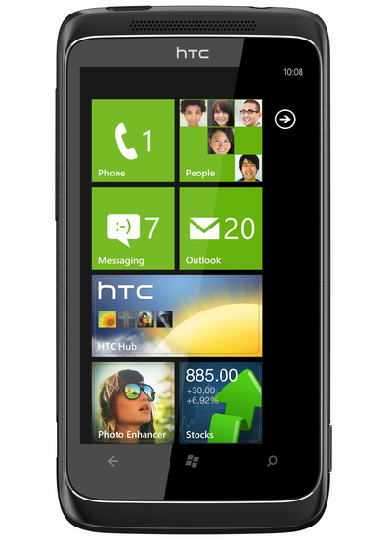
Windows 7 Phone
New Mobile OS: Windows Phone 7
  Clever ads (people looking at phones while life passes)
    Bi-Line: “Really!???”
  Apparently very zippy interface
  Targetting iPhone/Android market (touch screen, apps…)
Features:
  Xbox Live (games), Zune (music), Facebook, email, Mobile Office, (oh, and phone!)

Slide 12
Aside: Command Queueing
Mentioned that some disks do queueing
  Ability for disk to take multiple requests
  Do elevator algorithm automatically on disk
First showed up in SCSI-2 timeframe
  Released in 1990, but later retracted
  Final release in 1994
    Note that “MSDOS” still under Windows-3.1
Now prevalent in many drives
  SATA-II: “NCQ” (Native Command Queueing)
Modern Disk (Seagate):
  2 TB
  7200 RPM
  3Gbits/second SATA-II interface (serial)
  32 MB on-disk cache

Slide 13
Important “ilities”
Availability: the probability that the system can accept and process requests
  Often measured in “nines” of probability. So, a 99.9% probability is considered “3-nines of availability”
  Key idea here is independence of failures
Durability: the ability of a system to recover data despite faults
  This idea is fault tolerance applied to data
  Doesn’t necessarily imply availability: information on pyramids was very durable, but could not be accessed until discovery of Rosetta Stone
Reliability: the ability of a system or component to perform its required functions under stated conditions for a specified period of time (IEEE definition)
  Usually stronger than simply availability: means that the system is not only “up”, but also working correctly
  Includes availability, security, fault tolerance/durability
  Must make sure data survives system crashes, disk crashes, other problems

Slide 14
What about crashes?
Log Structured and Journaled File Systems
Better reliability through use of log
  All changes are treated as transactions.
    A transaction either happens completely or not at all
  A transaction is committed once it is written to the log
    Data forced to disk for reliability
    Process can be accelerated with NVRAM
  Although File system may not be updated immediately, data preserved in the log
Difference between “Log Structured” and “Journaled”
  Log Structured Filesystem (LFS): data stays in log form
  Journaled Filesystem: Log used for recovery
For Journaled system:
  Log used to asynchronously update filesystem
    Log entries removed after used
  After crash:
    Remaining transactions in the log performed (“Redo”)
Examples of Journaled File Systems:
  Ext3 (Linux), XFS (Unix), etc.

Slide 15
Other ways to make file system durable?
Disk blocks contain Reed-Solomon error correcting codes (ECC) to deal with small defects in disk drive
  Can allow recovery of data from small media defects
Make sure writes survive in short term
  Either abandon delayed writes or
  use special, battery-backed RAM (called non-volatile RAM or NVRAM) for dirty blocks in buffer cache.
Make sure that data survives in long term
  Need to replicate! More than one copy of data!
  Important element: independence of failure
    Could put copies on one disk, but if disk head fails…
    Could put copies on different disks, but if server fails…
    Could put copies on different servers, but if building is struck by lightning….
    Could put copies on servers in different continents…
RAID: Redundant Arrays of Inexpensive Disks
  Data stored on multiple disks (redundancy)
  Either in software or hardware
    In hardware case, done by disk controller; file system may not even know that there is more than one disk in use

Slide 16
RAID 1: Disk Mirroring/Shadowing
recovery
group
Each disk is fully duplicated onto its "shadow“
  For high I/O rate, high availability environments
  Most expensive solution: 100% capacity overhead
Bandwidth sacrificed on write:
  Logical write = two physical writes
  Highest bandwidth when disk heads and rotation fully synchronized (hard to do exactly)
Reads may be optimized
  Can have two independent reads to same data
Recovery:
  Disk failure ⇒ replace disk and copy data to new disk
  Hot Spare: idle disk already attached to system to be used for immediate replacement

Slide 17
RAID 5+: High I/O Rate Parity
Stripe
Unit
Data stripped across
multiple disks
  Successive blocks
  stored on successive
  (non-parity) disks
  Increased bandwidth
  over single disk
Parity block (in green)
constructed by XORing
data bocks in stripe
  P0=D0⊕D1⊕D2⊕D3
  Can destroy any one
  disk and still
  reconstruct data
  Suppose D3 fails,
  then can reconstruct:
  D3=D0⊕D1⊕D2⊕P0
Later in term: talk about spreading information widely across internet for durability.
D0
D1
D2
D3
P0
D4
D5
D6
P1
Increasing
Logical
Disk
Addresses
D7
D8
D9
P2
D10
D11
D12
P3
D13
D14
D15
P4
D16
D17
D18
D19
D20
D21
D22
D23
P5
Disk 1
Disk 2
Disk 3
Disk 4
Disk 5

Slide 18
Hardware RAID: Subsystem Organization
CPU
host
adapter
array
controller
single board
disk
controller
manages interface
to host, DMA
single board
disk
controller
control, buffering,
parity logic
single board
disk
controller
physical device
control
single board
disk
controller
Some systems duplicate all hardware, namely controllers, busses, etc.
often piggy-backed
in small format devices

Slide 19
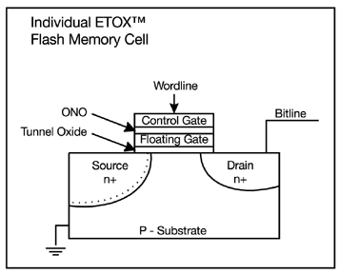
Solid State Disk (SSD)
Becoming Possible to store
(relatively) large amounts of data
  E.g. Intel SSD: 80GB – 160GB
  NAND FLASH most common
    Written in blocks – similarity to
    DISK, without seek time
  Non-volatile – just like disk,
  so can be disk replacement
Advantages over Disk
  Lower power, greater reliability, lower noise (no moving parts)
  100X Faster reads than disk (no seek)
Disadvantages
  Cost (20-100X) per byte over disk
  Relatively slow writes (but still faster than disk)
  Write endurance: cells wear out if used too many times
    10⁵ to 10⁶ writes
    Multi-Level Cells ⇒ Single-Level Cells ⇒ Failed Cells
    Use of “wear-leveling” to distribute writes over less-used blocks
Trapped Charge/No charge
on floating gate
MLC: MultiLevel Cell

Slide 20

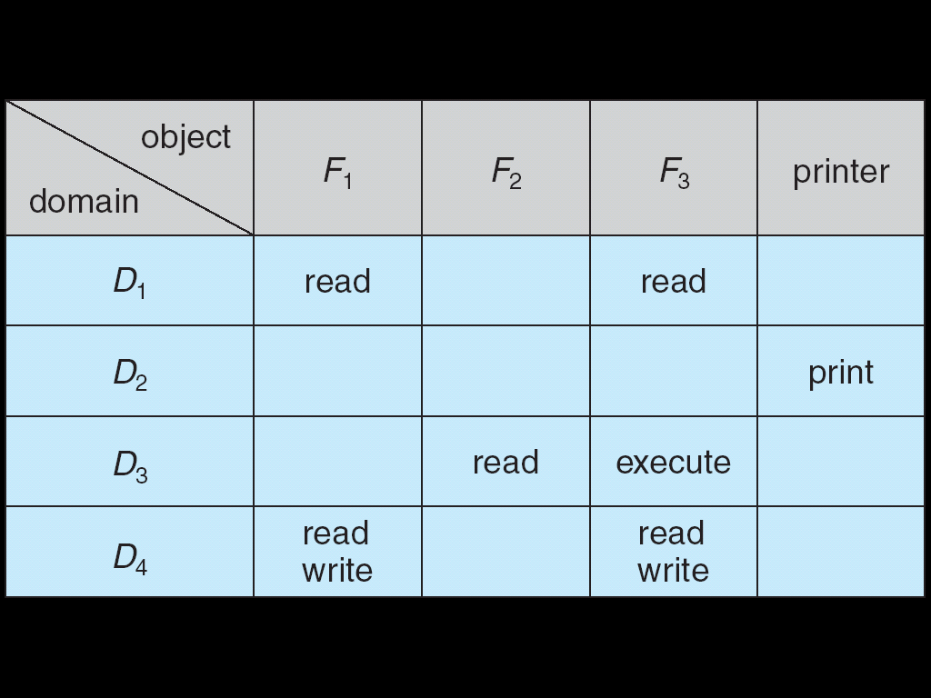
Authorization: Who Can Do What?
How do we decide who is
authorized to do actions in the
system?
Access Control Matrix: contains
all permissions in the system
  Resources across top
    Files, Devices, etc…
  Domains in columns
    A domain might be a user or a
    group of users
    E.g. above: User D3 can read F2 or execute F3
  In practice, table would be huge and sparse!

Slide 21
Authorization: Two Implementation Choices
Access Control Lists: store permissions with object
  Still might be lots of users!
  UNIX limits each file to: r,w,x for owner, group, world
  More recent systems allow definition of groups of users and permissions for each group
  ACLs allow easy changing of an object’s permissions
    Example: add Users C, D, and F with rw permissions
Capability List: each process tracks which objects has permission to touch
  Popular in the past, idea out of favor today
  Consider page table: Each process has list of pages it has access to, not each page has list of processes …
  Capability lists allow easy changing of a domain’s permissions
    Example: you are promoted to system administrator and should be given access to all system files

Slide 22

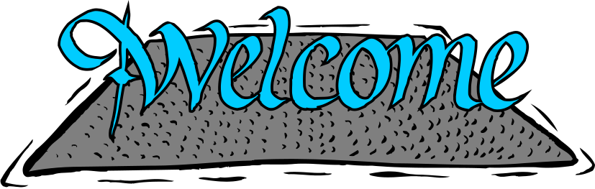
Authorization: Combination Approach
Users have capabilities,
called “groups” or “roles”
  Everyone with particular group access is “equivalent” when accessing group resource
  Like passport (which gives access to country of origin)
Objects have ACLs
  ACLs can refer to users or groups
  Change object permissions object by modifying ACL
  Change broad user permissions via changes in group membership
  Possessors of proper credentials get access

Slide 23
Authorization: How to Revoke?
How does one revoke someone’s access rights to a particular object?
  Easy with ACLs: just remove entry from the list
  Takes effect immediately since the ACL is checked on each object access
Harder to do with capabilities since they aren’t stored with the object being controlled:
  Not so bad in a single machine: could keep all capability lists in a well-known place (e.g., the OS capability table).
  Very hard in distributed system, where remote hosts may have crashed or may not cooperate (more in a future lecture)

Slide 24
Revoking Capabilities
Various approaches to revoking capabilities:
  Put expiration dates on capabilities and force reacquisition
  Put epoch numbers on capabilities and revoke all capabilities by bumping the epoch number (which gets checked on each access attempt)
  Maintain back pointers to all capabilities that have been handed out (Tough if capabilities can be copied)
  Maintain a revocation list that gets checked on every access attempt

Slide 25

Centralized vs Distributed Systems
Server
Client/Server Model
Peer-to-Peer Model
Centralized System: System in which major functions are performed by a single physical computer
  Originally, everything on single computer
  Later: client/server model
Distributed System: physically separate computers working together on some task
  Early model: multiple servers working together
    Probably in the same room or building
    Often called a “cluster”
  Later models: peer-to-peer/wide-spread collaboration

Slide 26
Distributed Systems: Motivation/Issues
Why do we want distributed systems?
  Cheaper and easier to build lots of simple computers
  Easier to add power incrementally
  Users can have complete control over some components
  Collaboration: Much easier for users to collaborate through network resources (such as network file systems)
The promise of distributed systems:
  Higher availability: one machine goes down, use another
  Better durability: store data in multiple locations
  More security: each piece easier to make secure
Reality has been disappointing
  Worse availability: depend on every machine being up
    Lamport: “a distributed system is one where I can’t do work because some machine I’ve never heard of isn’t working!”
  Worse reliability: can lose data if any machine crashes
  Worse security: anyone in world can break into system
Coordination is more difficult
  Must coordinate multiple copies of shared state information (using only a network)
  What would be easy in a centralized system becomes a lot more difficult

Slide 27

Distributed Systems: Goals/Requirements
Transparency: the ability of the system to mask its complexity behind a simple interface
Possible transparencies:
  Location: Can’t tell where resources are located
  Migration: Resources may move without the user knowing
  Replication: Can’t tell how many copies of resource exist
  Concurrency: Can’t tell how many users there are
  Parallelism: System may speed up large jobs by spliting them into smaller pieces
  Fault Tolerance: System may hide varoius things that go wrong in the system
Transparency and collaboration require some way for different processors to communicate with one another

Slide 28

Networking Definitions
Network: physical connection that allows two computers to communicate
Packet: unit of transfer, sequence of bits carried over the network
  Network carries packets from one CPU to another
  Destination gets interrupt when packet arrives
Protocol: agreement between two parties as to how information is to be transmitted

Slide 29
Conclusion
Important system properties
  Availability: how often is the resource available?
  Durability: how well is data preserved against faults?
  Reliability: how often is resource performing correctly?
Use of Log to improve Reliability
  Journaled file systems such as ext3
RAID: Redundant Arrays of Inexpensive Disks
  RAID1: mirroring, RAID5: Parity block
Authorization
  Controlling access to resources using
    Access Control Lists
    Capabilities
Network: physical connection that allows two computers to communicate
  Packet: unit of transfer, sequence of bits carried over the network

