Slide 1


AskMyPDF
Extractive Question Answering over PDF Documents using Transformers
Natural Language Processing — Mini Project
Hugging Face Transformers · RoBERTa & XLM-RoBERTa · Streamlit · EasyOCR
Team Members
G. Vikram — 70572300022
B. Dhanush — 70022300509
Mentor
Niladri Sath
HYDERABAD
Notes:
Introduce the project in one sentence: ask a question about any PDF and get the exact answer back, with the page it came from. Stress 'extractive' — the model copies text from the document, it does not generate it.

Slide 2
Agenda / Contents
1
Problem Statement
2
Objectives
why searching a PDF by hand fails
what the system must do
3
System Architecture
4
NLP Concepts Applied
PDF → text → chunks → model → answer
tokenization, chunking, span prediction
5
Models & Hugging Face
6
Implementation
RoBERTa and XLM-RoBERTa on SQuAD 2.0
modules, interface, technology stack
7
Multilingual Support & OCR
8
Results, Limitations, Conclusion
~100 languages, scanned books
what works and what does not
Notes:
Keep this short — read the eight headings and move on.

Slide 3
Problem Statement & Objectives
The problem
WORKED EXAMPLE
Finding one fact in a long document means reading all of it
Ctrl+F only works if you guess the author's exact words
Scanned books hold no searchable text at all
Indian-language and other non-English PDFs are served worst
“Which computer defeated Garry Kasparov in 1997?”
Document: 3 pages, 1,354 words
Deep Blue
Objectives
Confidence: 76.7%
Source: chunk 3 of 4, pages 2–3
Answer a plain-language question from any PDF
Show confidence and the exact source passage
Handle long documents, many languages and scanned pages
Say “no answer” instead of guessing
The answer is copied from the document — the model cannot invent a fact, and it returns nothing when the document does not contain one.
Notes:
The 'no answer' behaviour is deliberate: the models are trained on SQuAD 2.0, which contains unanswerable questions on purpose.

Slide 4
System Architecture
1
2
3
4
5
6
PDF input
Text extraction
Scanned check
Chunking
QA model
Best answer
Uploaded in the browser
➤
pdfplumber, PyPDF2 fallback
➤
If image → OCR
➤
Overlapping, token-sized
➤
Each chunk read with the question
➤
Ranked, with its source
Why chunking is necessary
How the best chunk is chosen
A transformer reads at most 512 tokens at once — about 400 English words. A 10,000-word document is cut into overlapping chunks, and every chunk is asked the same question.
Each chunk also scores “no answer here”. Ranking by (answer score − no-answer score) makes chunks comparable — a raw score only means something inside its own chunk.
Modules: pdf_extractor.py → ocr.py → chunker.py → qa_engine.py → app.py
Notes:
This is the main technical slide — walk left to right, then explain the two notes.

Slide 5
NLP Concepts Applied
Extractive question answering
Sub-word tokenization
The model predicts where the answer starts and ends, and returns that span — it never generates text.
BPE and SentencePiece split words into pieces. Measured: ~1.2 tokens per word in English, ~2.7 in Telugu.
Context window & chunking
Overlap between chunks
512 tokens maximum, so documents are split into overlapping windows sized from the measured token ratio.
Chunks share 50 words so an answer on a boundary stays whole in at least one of them.
Unanswerable questions
Cross-lingual transfer
Trained on SQuAD 2.0, the model can decline; that null score also makes chunks comparable.
Fine-tuned for QA in English only, yet answers in ~100 languages — zero-shot transfer.
Notes:
Examiners usually ask 'where exactly is the NLP?' — this slide is the answer.

Slide 6
Models & Hugging Face Integration
Default — English
Multilingual
deepset/roberta-base-squad2
deepset/xlm-roberta-large-squad2
Parameters
124 M
Parameters
560 M
Languages
English
Languages
~100
SQuAD 2.0 score
82.95 F1
Fine-tuned on
SQuAD 2.0 (English)
Speed
≈ 0.2 s per chunk
Size on disk
≈ 2.2 GB
How the library is used
from transformers import pipeline
qa = pipeline("question-answering",
model="deepset/roberta-base-squad2")
Model details fetched live from the Hugging Face Hub API and shown in the app
Runs locally, or on Hugging Face's hosted Inference API with a token
RoBERTa chosen over BERT: same size, pre-trained on ~10× more text
Notes:
If asked why not a large language model: this is extractive, runs offline, cites its source and cannot hallucinate.

Slide 7
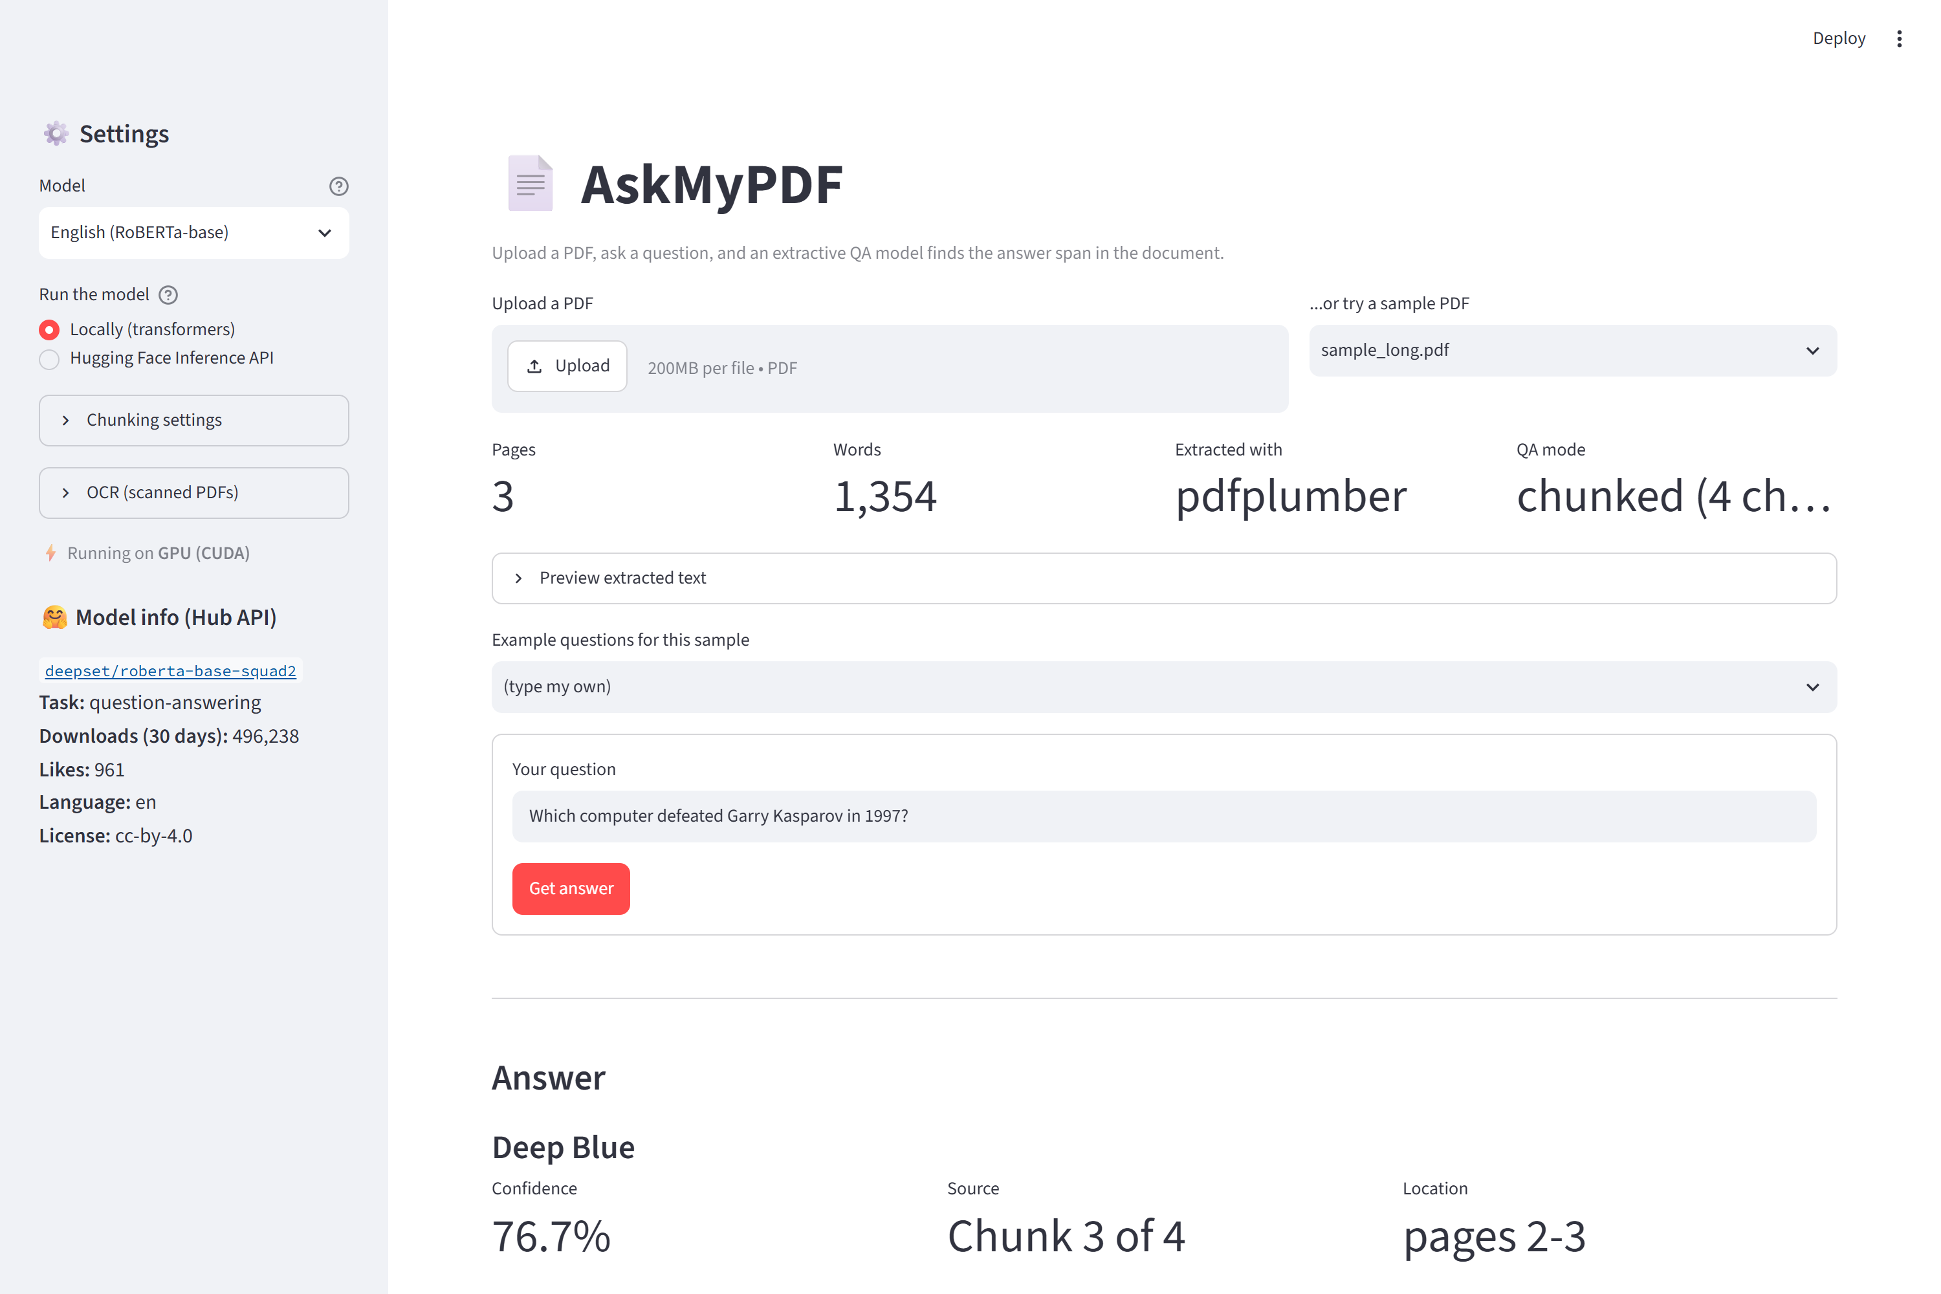
Implementation & Technology Stack
Modules
pdf_extractor.py
PDF → text, column handling, repairs
ocr.py
scanned pages → text with EasyOCR
chunker.py
overlapping, token-sized chunks
qa_engine.py
the model, scoring, selection
app.py
interface only, no NLP logic
Technology stack
Python 3.10 · Hugging Face transformers · PyTorch (CUDA) · Streamlit · pdfplumber · PyPDF2 · EasyOCR · pypdfium2
Streamlit web interface
Notes:
Demo here if the laptop allows: pick the sample PDF, ask the Kasparov question, show the highlighted source passage.

Slide 8
Multilingual Support & OCR
26
45/55
25/25
15/22
languages tested
questions correct
Indian-language questions
scheduled Indian languages
100% correct: English, French, Spanish, German, Portuguese, Russian, Turkish, Chinese, Japanese, Korean, Arabic, Urdu, Sindhi, Hindi, Tamil, Punjabi
Where it struggles — and why
OCR reads what the text layer cannot
In Telugu, Kannada and Bengali one question failed each — the one whose answer holds a conjunct letter. The PDF stores it as a single glyph with no mapping back to Unicode, so ఆగ్రా arrives as ఆ. It is a PDF limitation, not a model limitation.
A 39-page scanned Telugu book held 10 words of text — a watermark. Rendering the pages as images and running EasyOCR recovered 2,681 words, and the questions were answered in Telugu and in English. Telugu, Kannada and Bengali go 1/2 → 2/2.
Notes:
Best story in the project: a failure that looks like the model's fault but is really the file format's, diagnosed and worked around.

Slide 9
Results, Testing & Limitations
Testing and results
Known limitations
What was tested | Result
Automated tests (unit + end-to-end + UI) | 48 pass
English sample questions | 7 / 7
Indian-language questions (clean text) | 25 / 25
26-language PDF test set | 45 / 55
Dense research papers | ≈ 4 / 10
Extractive only — no summarising, counting or arithmetic
Reads one chunk at a time, so facts spread across distant pages cannot be joined
Tables and complex layouts arrive as flat rows of digits
Answers stay in the document's language (no translation step)
No OCR model for Gujarati, Malayalam, Odia or Punjabi
Multilingual model needs ~2.5 GB free memory; OCR ~20 s per page on CPU
Tests cover chunk overlap, the extractor fallback, scanned-PDF detection, every error path, and questions that must return “no answer”.
Notes:
Do not skip the limitations — stating precisely where the system fails, with numbers, is what separates a tested project from a demo.

Slide 10
Conclusion & Future Work
Conclusion
A working question-answering system over PDF documents: it locates the answer inside the document, reports how confident it is, and shows the page it came from — across ~100 languages and on scanned books.
Chunking shapes everything
Extraction is half the battle
Confidence must be earned
The 512-token limit drives every design decision in the pipeline
Most wrong answers came from bad text, not from a bad model
Comparing chunks needs the margin over saying nothing
Future work
Translate the extracted answer into the question's language
Batch chunks on the GPU for faster answering on long documents
Add Tesseract OCR for Gujarati, Malayalam, Odia, Punjabi and Tamil
Table-aware extraction so numeric questions work on research papers
Project repository
github.com/Vikram5002/AskMyPDF
Notes:
Close on the three takeaways, give the repository link, and invite questions.

