Slide 1
SkillBridge Analytics
Skill-gap analysis and placement prediction from job-posting text
Vikram · Jahnavy · Jansi
Notes:
Introduce the team and the one-line goal: use real job postings to tell each student what to learn and who needs help first.

Slide 2
Placement cells decide with old information
1
2
3
Who is at risk?
What should they learn?
What does the market want?
Spotted by intuition, student by student, late in the season
Advice comes from last year's recruiters, not today's postings
Thousands of postings a week, all unstructured text
Goal: turn job-posting text into a per-student action plan.

Slide 3
Five stages from raw postings to a decision
1
2
3
4
5
Ingest
Extract
Feature store
Model
Dashboard
LinkedIn / CSV / Kafka stream + student records
spaCy matcher finds ~150 skills in text
Demand per skill, gaps, alignment score
LogReg vs XGBoost, best AUC wins
Student, cohort and market views
Orchestrated by Apache Airflow · Outputs archived in Amazon S3

Slide 4
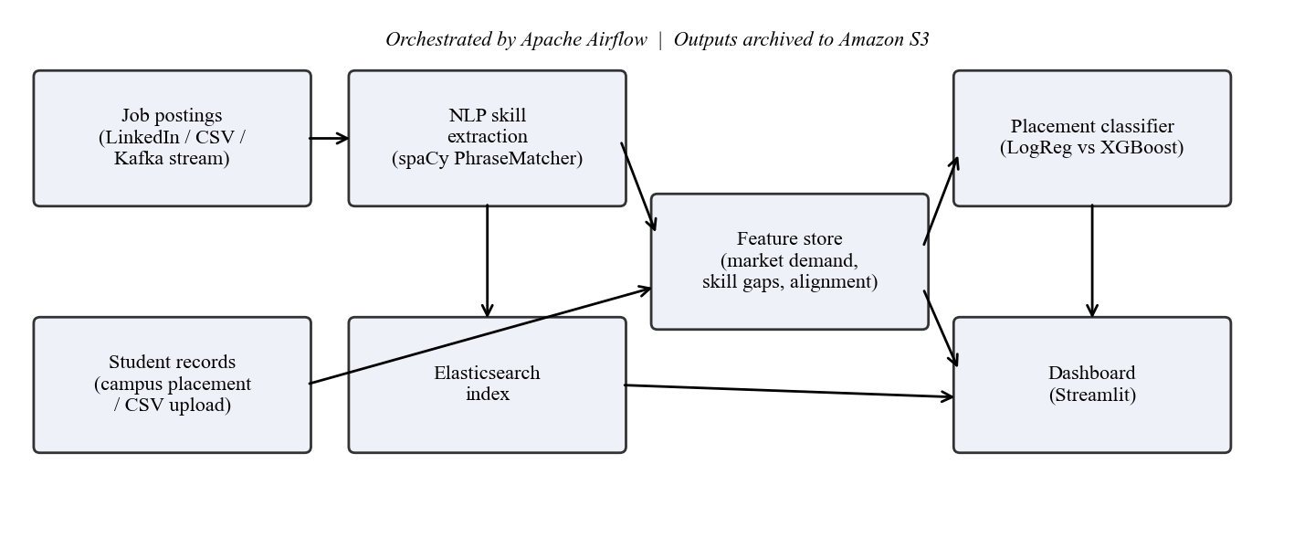
Architecture
Each stage reads the previous stage's output, so every stage can be tested on its own.

Slide 5
Big-data stack
Apache Kafka
Apache Airflow
Elasticsearch
Streams postings in; same extractor runs per message
4-task DAG, LocalExecutor, ~12 s per run
Find real postings that ask for a missing skill
Amazon S3
spaCy
XGBoost + scikit-learn
Archives every model and its training data
Fast phrase matching, no training data needed
Two models compared on held-out AUC

Slide 6
Skill extraction: 84% → 99% precision
Taxonomy of ~150 skills in 8 categories
Case-insensitive match, except Go, C and R (stops "go above and beyond")
Overlaps keep the longest span: "AWS Certified Solutions Architect" ≠ extra "AWS"
Fixed missing soft skill in the synthetic answer key
99.2%
mean precision (was 84.5%)
99.7%
mean recall on synthetic postings

Slide 7
Market alignment: share of demand covered
d(s) = postings with s ÷ all postings
A(u) = Σ d(s) for the student's skills ÷ Σ d(s) for all skills
0 = covers nothing employers ask for; 1 = covers everything. Skills never seen in postings earn no credit.

Slide 8
Placement model
0.947
ROC AUC on real campus-placement + LinkedIn data
6 features: CGPA, projects, certifications, internships, skill count, alignment
75/25 stratified split; higher held-out AUC wins
CGPA proxy dominates on real data

Slide 9
Dashboard: five pages
Student 360
Probability gauge, risk tier, skill radar, ranked gaps
What-if simulator
Change CGPA or add skills, see the new probability
Cohort analytics
Risk distribution and downloadable intervention list
Market pulse
Top skills, category treemap, full skill table
Data Studio
Upload CSVs, validate, re-run the pipeline

Slide 10
Results at a glance
0.947
99.2%
1,485
27
ROC AUC on real data
Skill-extraction precision
Real postings indexed in Elasticsearch
Automated tests, all passing
Kafka: 10/10 streamed postings processed live · Airflow: all 4 tasks green

Slide 11
Limitations and next steps
Limitations
Next steps
Real student skills were imputed from specialisation
Taxonomy misses new or unusual skill names
Demand not split by region or seniority
Collect real student skills via upload
Learned skill-NER on annotated postings
Spark + Delta Lake at larger scale
Track a full placement season

Slide 12
Thank you
Questions?
github.com/Vikram5002/Equilearn

