Slide 1


SkillBridge Analytics
A Big-Data Pipeline for Skill-Gap Analysis and Campus Placement Prediction
Big Data Analytics — Project Evaluation
Team Members:
G. Vikram - D022
L. Jahnavy - D023
K. Janshi - D064
Mentor Name:
Prof. Anshi Bajaj

Slide 2
Problem Statement & Objectives
The problem
Objectives
Placement cells spot at-risk students late, one by one, by intuition
Skill advice is based on last year's recruiters, not today's market
Job postings list required skills — but as unstructured text
1
Extract skills from free-text job postings (NLP)
2
Measure each student's alignment with market demand
3
Predict each student's placement probability
4
Act dashboard with gaps, risk tiers, what-if
Can job-posting text tell each student what to learn, and tell staff who needs help first?
5
Scale Kafka, Airflow, Elasticsearch, S3
SkillBridge Analytics · NMIMS STME, Hyderabad
2

Slide 3
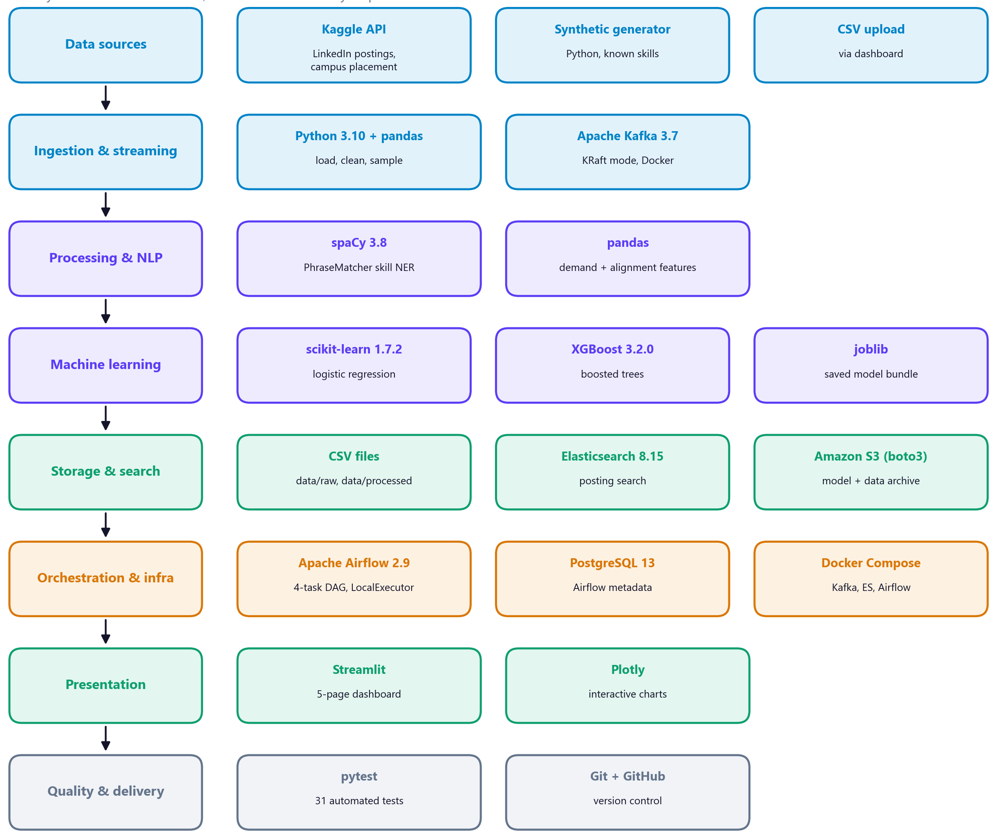
Data & Tech Stack
Real data (Kaggle)
215
1,500
students with real placement outcomes
LinkedIn job postings sampled
Synthetic data (validation)
300 postings + 200 students with known skills
Gives exact precision/recall for the NLP extractor
Real data has no skill list → imputed from specialisation (a stated limitation)
SkillBridge Analytics · NMIMS STME, Hyderabad
3

Slide 4
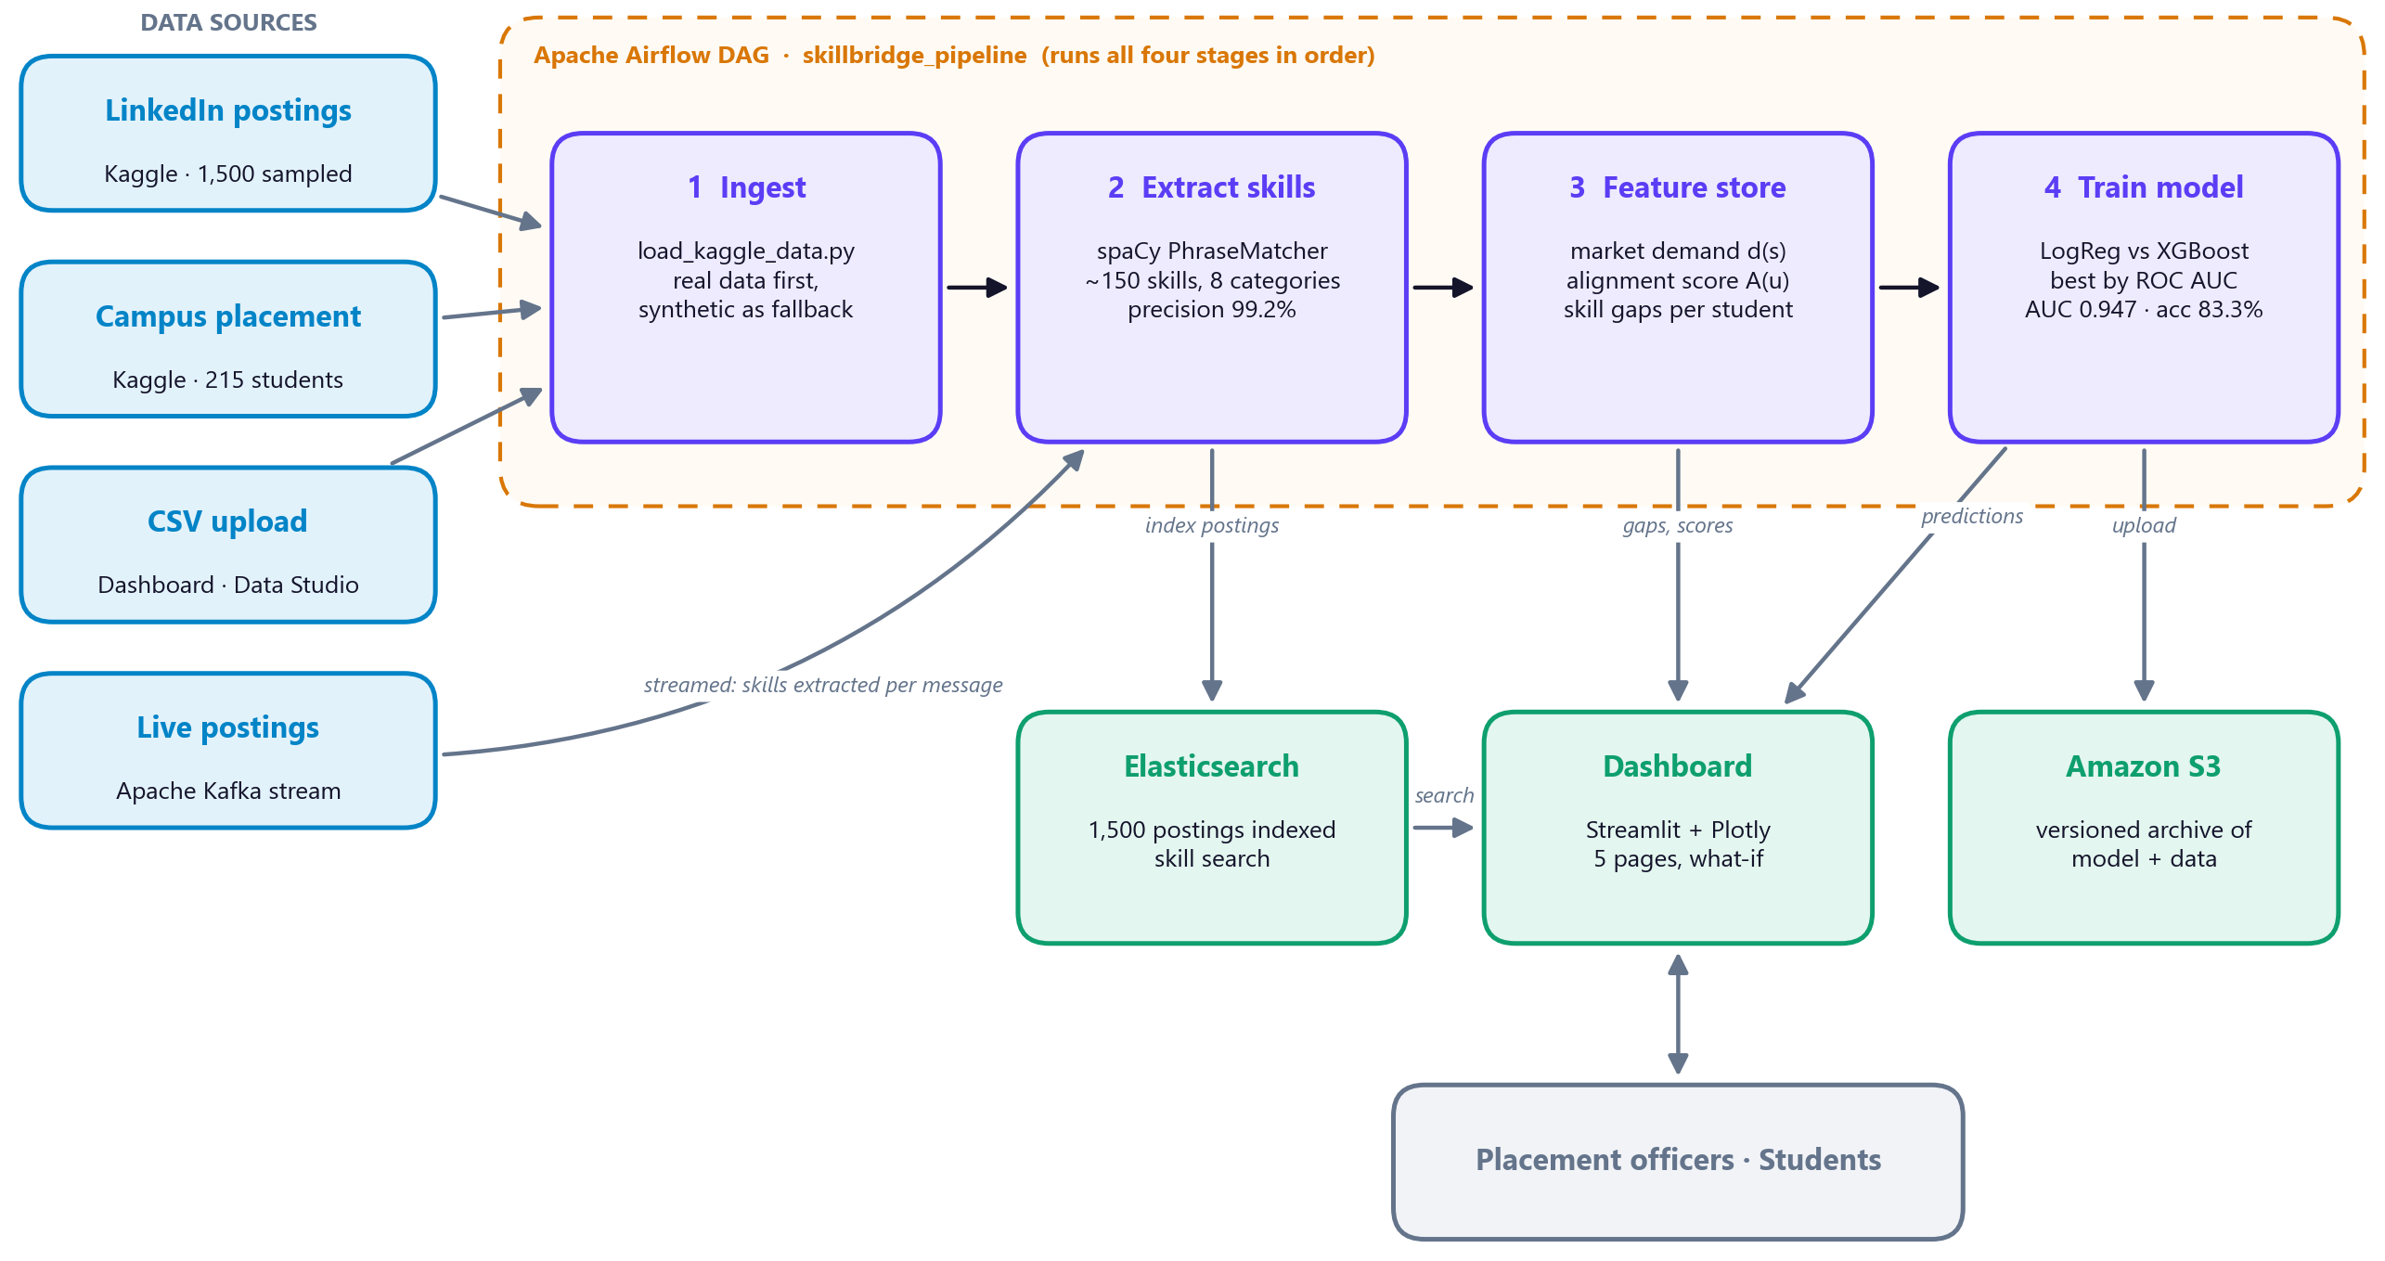
Project Flow (Architecture)
Four stages
Ingest real data (synthetic fallback)
Extract skills with spaCy
Build features: demand, alignment, gaps
Train & pick best model by AUC
Airflow runs all four in order
SkillBridge Analytics · NMIMS STME, Hyderabad
4

Slide 5
Methodology & Results
0.947
83.3%
0.896
How it works
Skill NER: spaCy PhraseMatcher, ~150 skills in 8 categories; precision 99.2%, recall 99.7%
Demand d(s) = share of postings asking for skill s
Alignment = demand covered by the student's skills ÷ total demand
6 features → logistic regression vs XGBoost, 75/25 stratified split, best ROC AUC kept
ROC AUC (real data)
accuracy (real data)
XGBoost AUC (not selected)
SkillBridge Analytics · NMIMS STME, Hyderabad
5
Notes:
CGPA is the strongest predictor (coefficient 2.24), then internships (0.69). Skill features are weak because skills were imputed, so the high AUC is not evidence that skills predict placement.

Slide 6
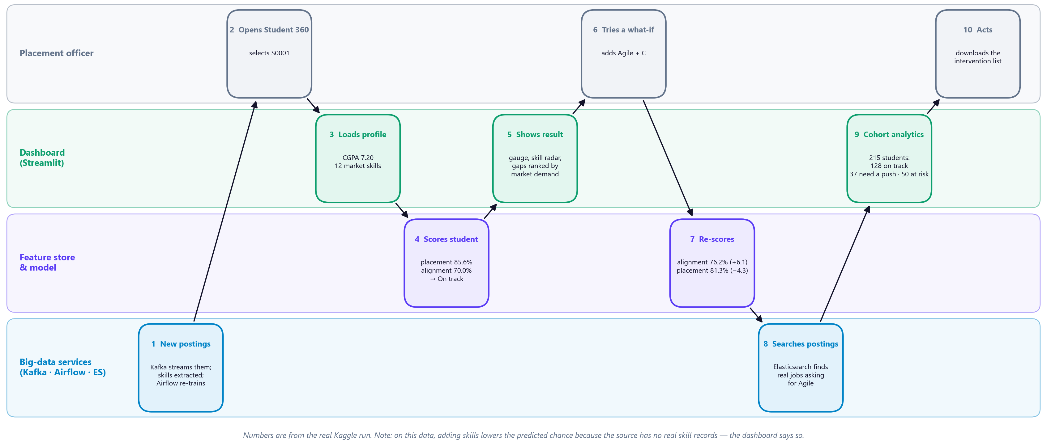
Scenario: Helping Student S0001
Officer opens the student → model scores 85.6% (On track) → what-if adds Agile + C → Elasticsearch finds matching jobs → cohort list shows 50 at-risk students to help first.
SkillBridge Analytics · NMIMS STME, Hyderabad
6

Slide 7
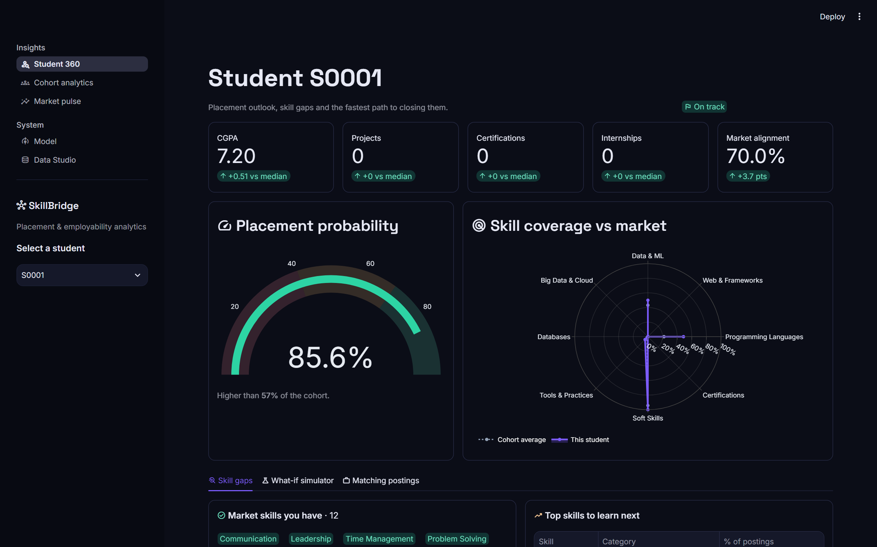
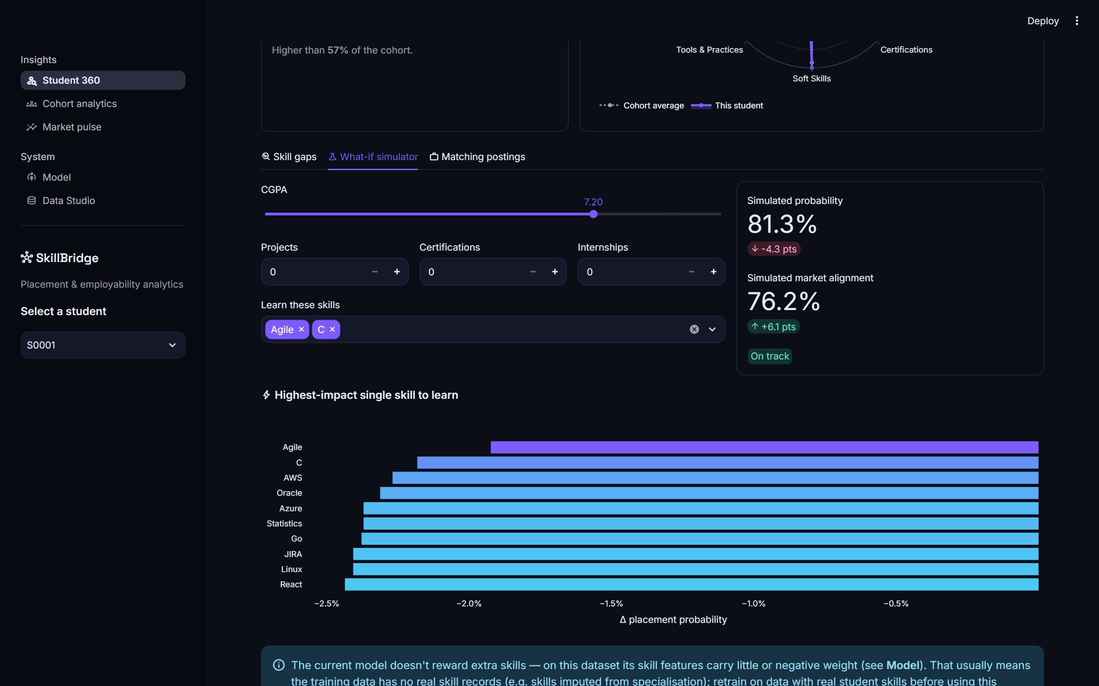
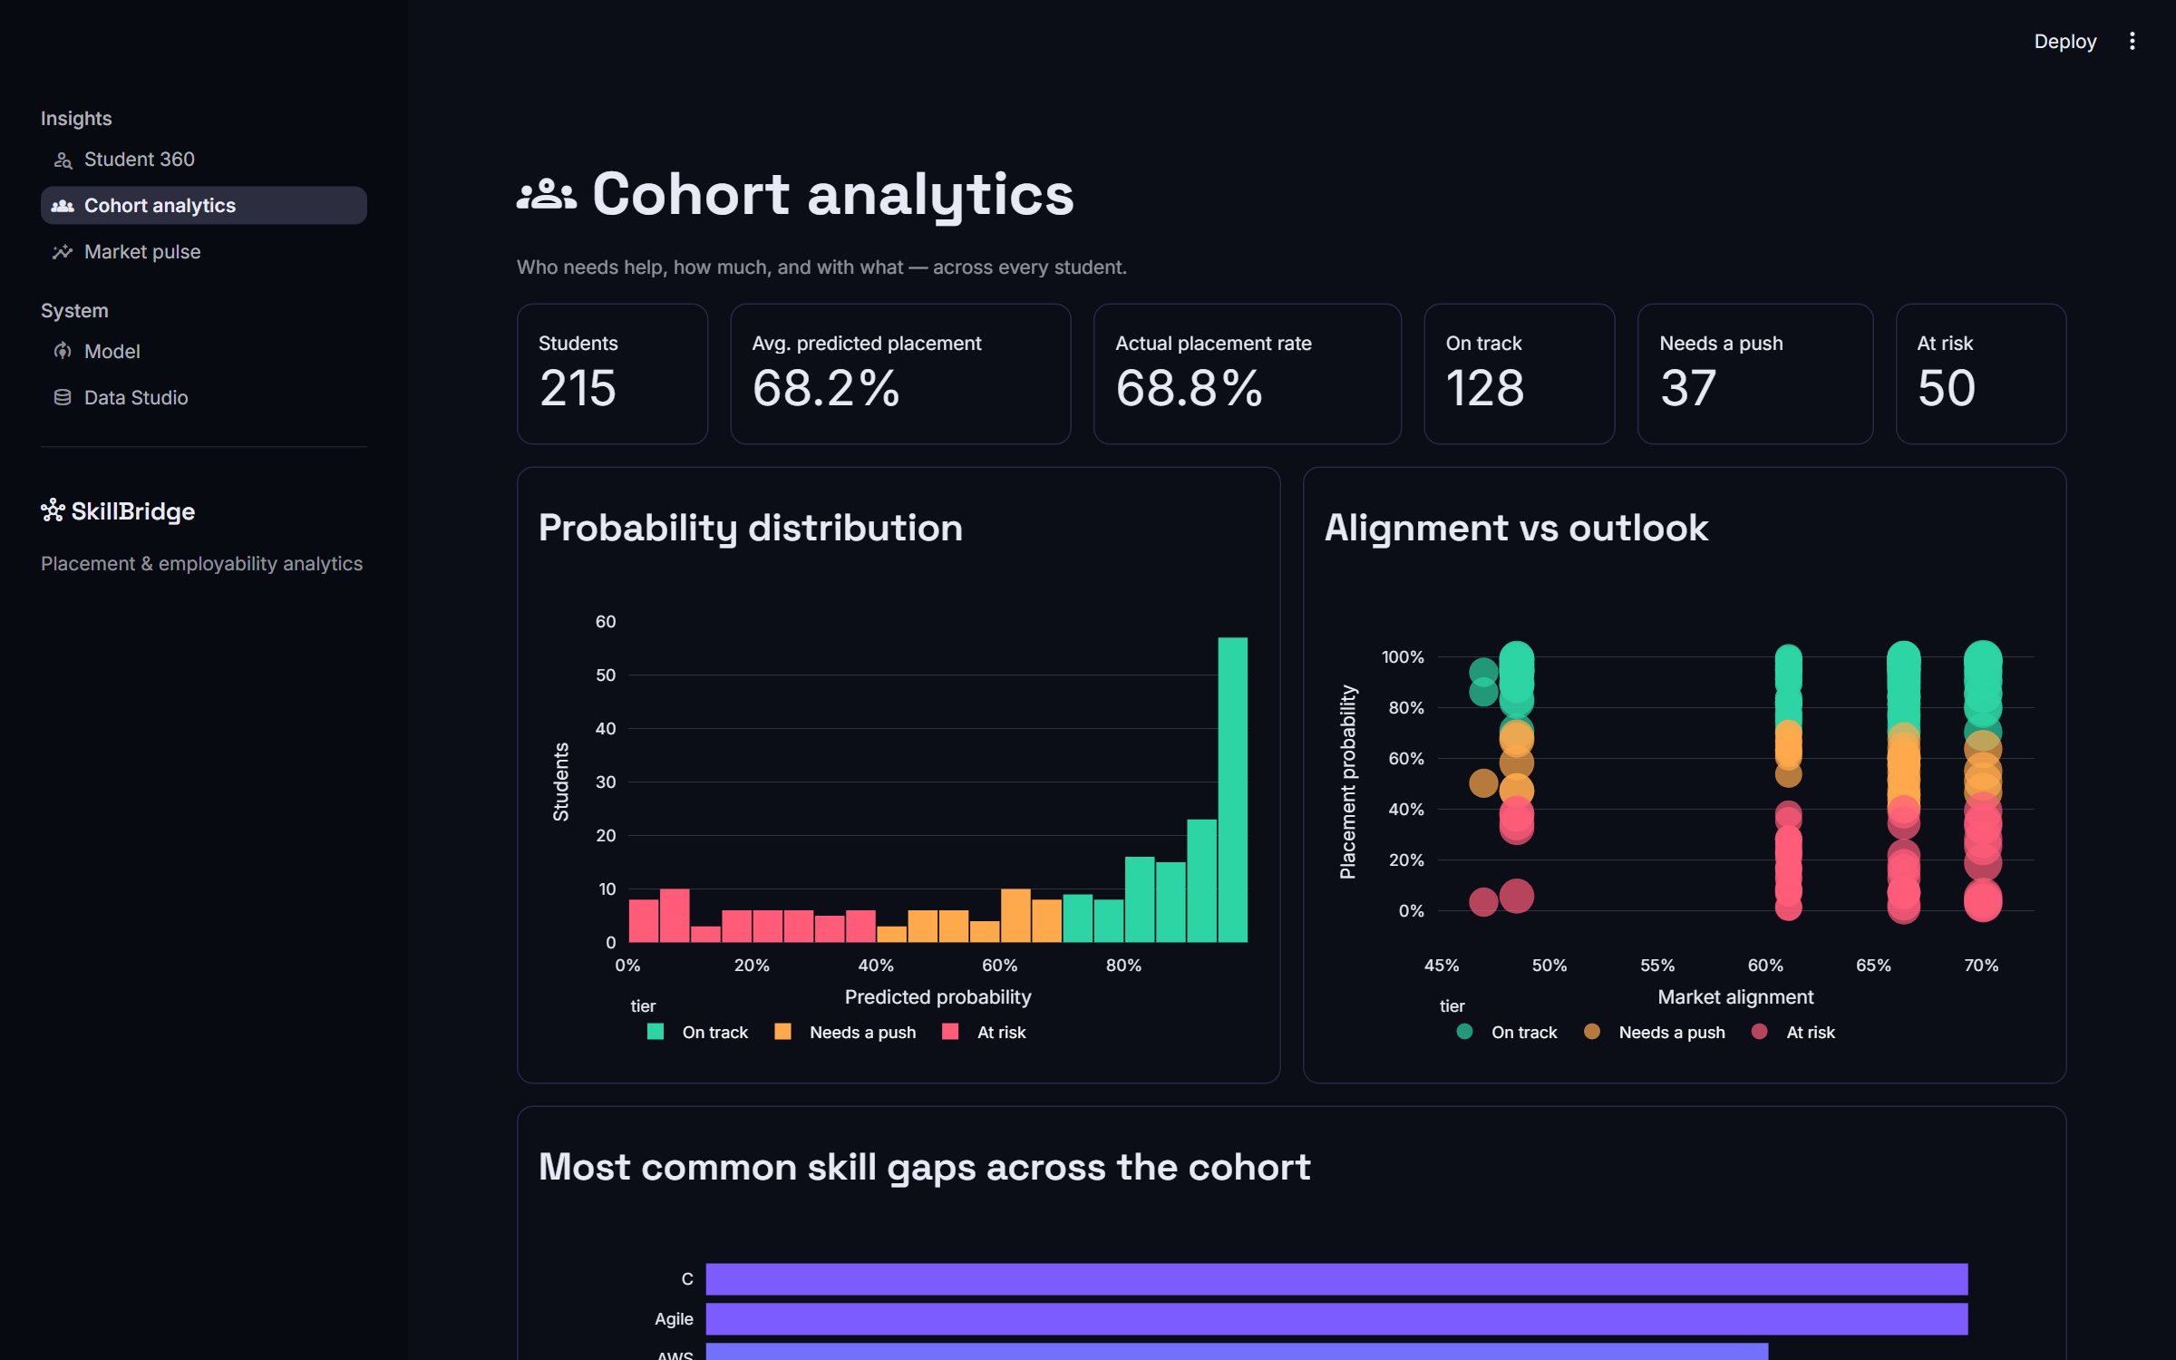
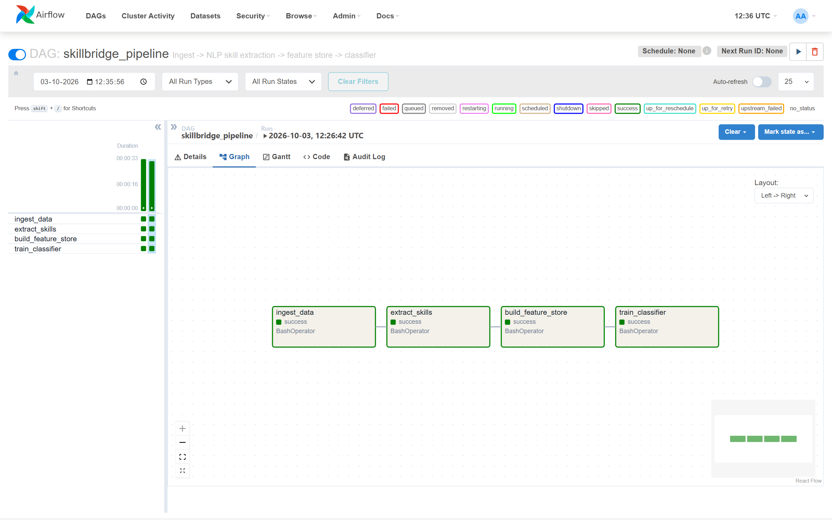
Live System: Dashboard & Airflow
What it does
Probability gauge, risk tier and skill radar per student
What-if: change CGPA or skills, see the effect
Cohort view: who to help first, downloadable list
Market pulse from 1,500 real postings
Airflow pipeline: 4 tasks, ~33 s per run
Student 360
What-if simulator
Cohort analytics
Airflow DAG — all tasks green
SkillBridge Analytics · NMIMS STME, Hyderabad
7

Slide 8
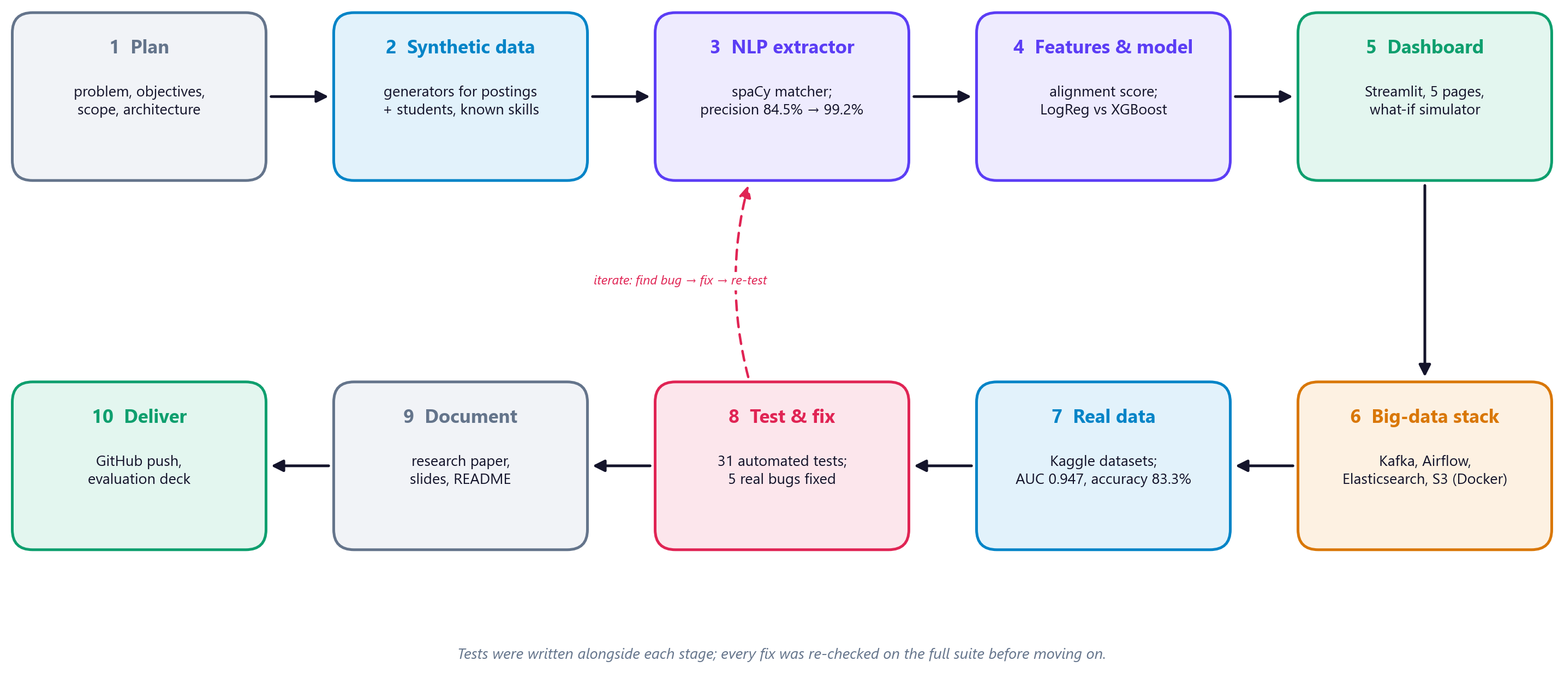
Development Flow & Testing
31
5
84.5→99.2%
1,500/1,500
automated tests, all passing on real data
real bugs found and fixed
extractor precision after fixes
postings indexed in Elasticsearch
SkillBridge Analytics · NMIMS STME, Hyderabad
8
Notes:
Bugs fixed: answer key missed soft skills and overlaps double-counted; Airflow overwrote real data; 15 postings rejected by Elasticsearch because a missing company was sent as NaN; dashboard crashed on models trained in Airflow (scikit-learn version mismatch); unpinned Elasticsearch client v9 couldn't talk to the v8 server.

Slide 9
Limitations, Future Work & Conclusion
Limitations
Future work
Conclusion
Real student skills were imputed, not recorded
Taxonomy misses new or unusual skill names
Demand not split by region or seniority
Collect real student skills via upload
Learned skill-NER on annotated postings
Spark + Delta Lake for larger volumes
Track a full placement season
Works end to end on real data: AUC 0.947, accuracy 83.3%
Real big-data stack: Kafka, Airflow, Elasticsearch, S3
Honest about limits; 31 tests guard it
Source code: github.com/Vikram5002/Equilearn
SkillBridge Analytics · NMIMS STME, Hyderabad
9

Slide 10
Thank You
Questions?
Team Members:
G. Vikram - D022
L. Jahnavy - D023
K. Janshi - D064
Mentor Name:
Prof. Anshi Bajaj

