Slide 1
SkillBridge Analytics
A big-data pipeline for skill-gap analysis and campus placement prediction
Vikram · Jahnavy · Jansi
Big Data Analytics — Project Evaluation

Slide 2
Agenda
1
Problem & objectives
2
Data
3
Architecture & tech stack
4
Methodology
5
Results
6
Live system
7
Testing & quality
8
Limitations & future work

Slide 3
Problem statement
1
2
3
Late, manual risk spotting
Outdated skill advice
Data locked in text
Placement cells find at-risk students by intuition, one by one, late in the season
Recommendations come from last year's recruiters, not today's job market
Thousands of postings a week list required skills — but as unstructured text
Question: can job-posting text tell each student what to learn, and tell staff who needs help first?

Slide 4
Objectives
1
Extract
Recognise skills in free-text job postings automatically
2
Measure
Score how well each student's skills match current market demand
3
Predict
Estimate each student's placement probability
4
Act
Give staff and students a dashboard with gaps, risk tiers and what-if analysis
5
Scale
Run it on a real big-data stack: Kafka, Airflow, Elasticsearch, S3

Slide 5
Data
Real data (Kaggle)
Synthetic data (validation)
215
1,500
300
200
students with real placement outcomes
LinkedIn postings sampled from ~500 MB
generated postings with known skills
generated students
Placement rate 68.8%
No skills in source data → imputed from specialisation (stated limitation)
Ground-truth skills allow exact precision/recall
Used to test the extractor, not to report model accuracy
Notes:
We deliberately avoided scraping LinkedIn/Naukri because of their terms of service; both datasets are public on Kaggle.

Slide 6
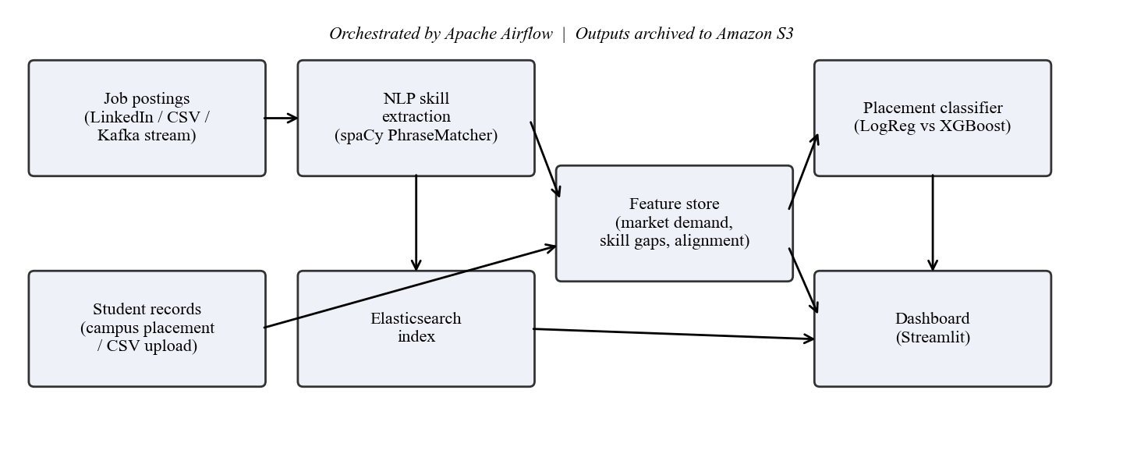
System architecture
Each stage reads the previous stage's output — every stage runs and is tested on its own.

Slide 7
Technology choices
Tool | Role | Why we chose it
spaCy PhraseMatcher | Skill NER | Transparent, no training data, canonical names
scikit-learn + XGBoost | Prediction | Linear baseline vs boosted trees, pick by AUC
Apache Kafka (KRaft) | Streaming | Postings processed as they arrive; no ZooKeeper
Apache Airflow | Orchestration | 4-task DAG; LocalExecutor for Windows stability
Elasticsearch 8 | Search | Find real postings asking for a missing skill
Amazon S3 | Storage | Versioned archive of models and training data
Streamlit + Plotly | Dashboard | Interactive UI built directly on the pipeline

Slide 8
Skill extraction (NLP)
Taxonomy of ~150 skills in 8 categories
Case-insensitive matching, except Go, C, R — stops "go above and beyond" being read as the Go language
Overlapping matches keep the longest span: "AWS Certified Solutions Architect" is not also counted as "AWS"
Same function runs in batch and on each Kafka message
99.2%
precision (up from 84.5% after our fixes)
99.7%
recall, on synthetic postings with ground truth

Slide 9
Market demand & alignment score
Demand of a skill
d(s) = postings mentioning s ÷ all postings
Student alignment
A(u) = Σ d(s) over the student's skills ÷ Σ d(s) over all skills
0 = covers nothing employers ask for, 1 = covers everything. Gaps are ranked by d(s).

Slide 10
Placement prediction model
6 features: CGPA, projects, certifications, internships, skill count, alignment score
Standardised; 75/25 stratified split, fixed seed
Logistic regression vs XGBoost — higher held-out ROC AUC is kept
AUC chosen because staff need a ranking of who to help first

Slide 11
Results at a glance
0.947
83.3%
99.2%
1,500
ROC AUC on real data
accuracy on real data
skill-extraction precision
real postings indexed and searchable
Logistic regression selected; CGPA is the strongest predictor (coefficient 2.24), then internships (0.69)
Airflow DAG: all 4 tasks succeed in ~33 s · Kafka: 10/10 streamed postings processed live

Slide 12
What drives placement in this data
Honest reading
Academics dominate — expected for this dataset
Projects and certifications are 0: not recorded in the source
Skill features are weak because skills were imputed, so the high AUC is not evidence that skills predict placement

Slide 13
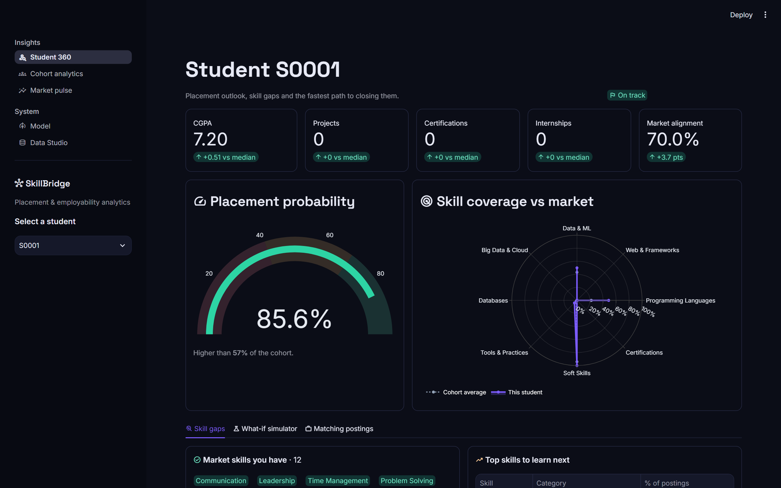
Dashboard — Student 360
One student, one page
Placement probability gauge with risk tier
KPIs compared with the cohort median
Skill-coverage radar vs cohort average
Gaps ranked by market demand

Slide 14
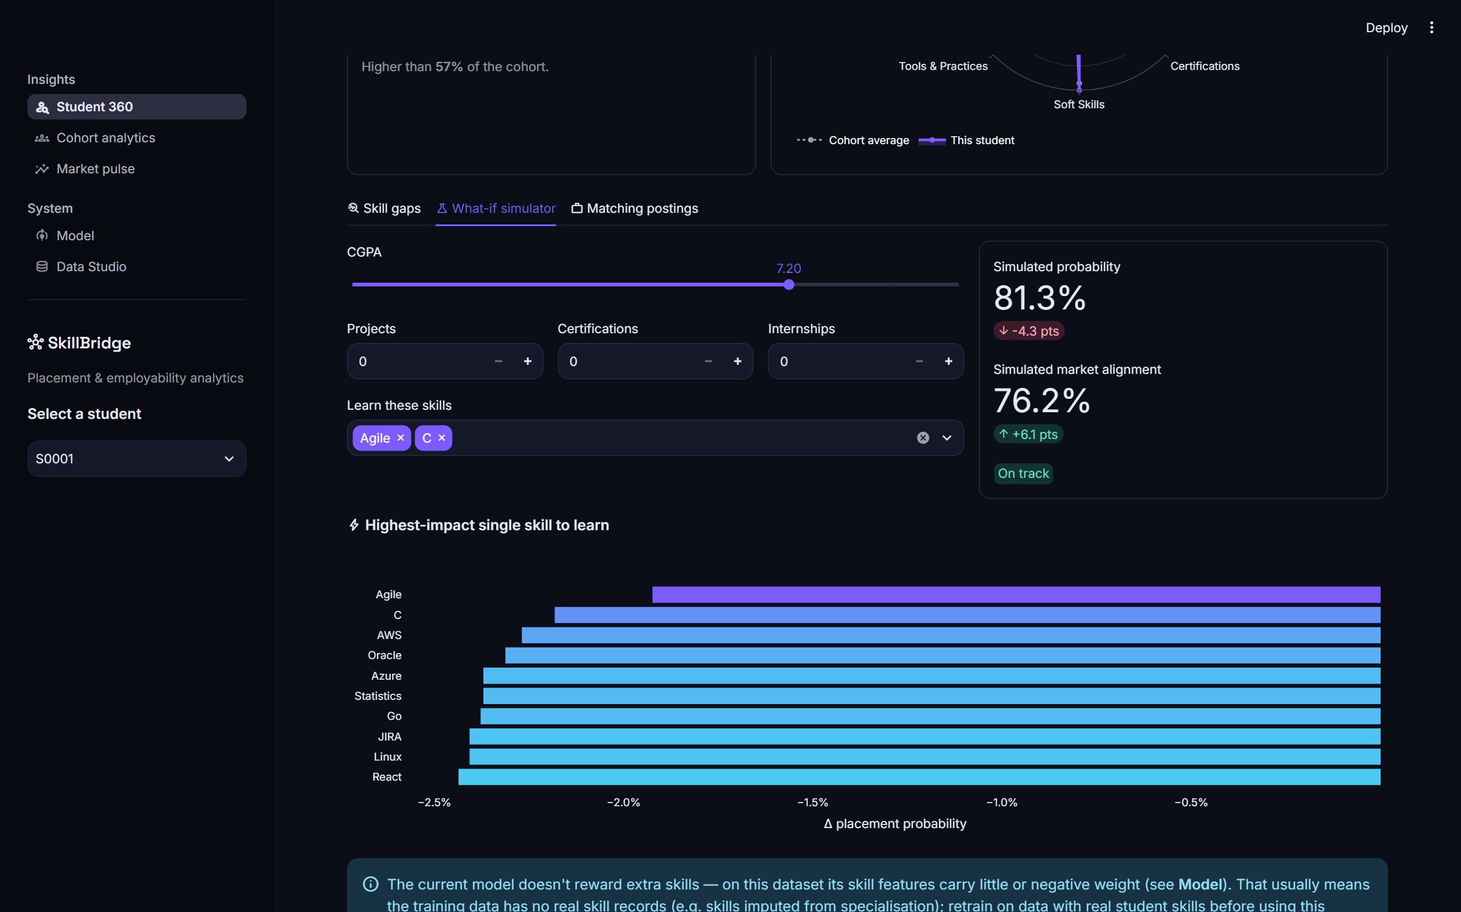
Dashboard — What-if simulator
Try a change, see the effect
Edit CGPA, projects, internships or add skills
Probability and alignment recompute instantly
Ranks the single most useful skill to learn
On the real data, adding skills lowers the estimate — the dashboard says so and explains why, rather than hiding it.
Notes:
On the real data, adding skills lowers the estimate — the dashboard says so and explains why, rather than hiding it.

Slide 15
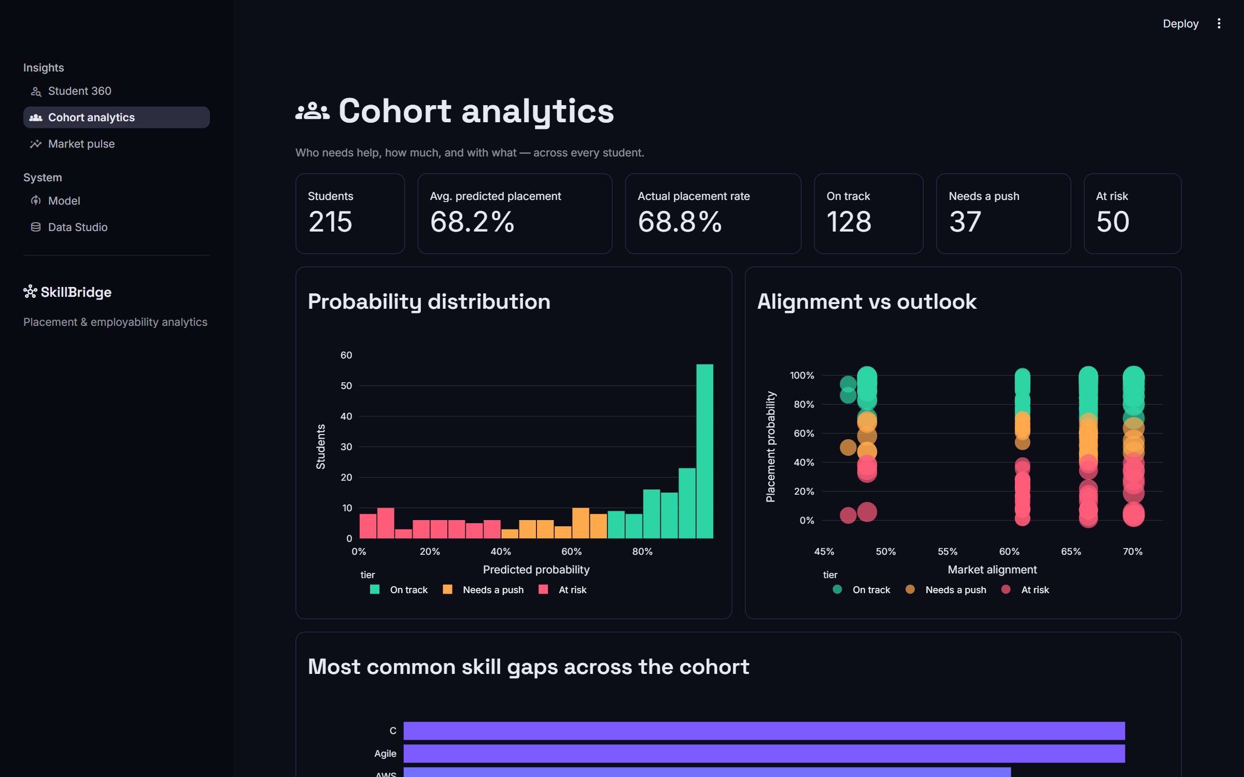
Dashboard — Cohort analytics
Who needs help first
Distribution of predicted probabilities
Alignment vs outlook for every student
Most common gaps across the cohort
Downloadable intervention list

Slide 16
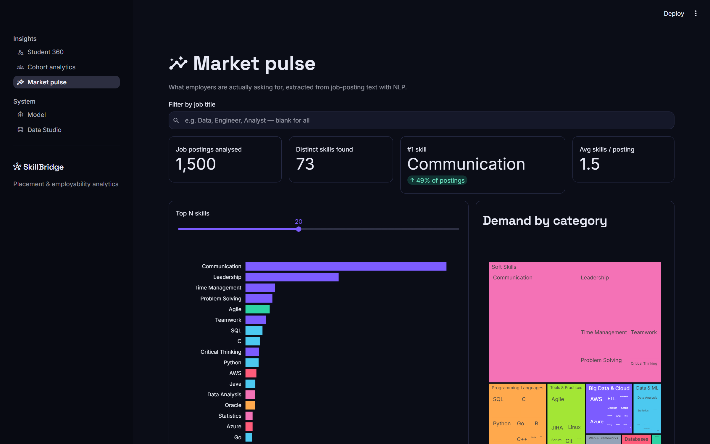
Dashboard — Market pulse
What employers ask for
Top-N skills from 1,500 real postings
Demand grouped by skill category
Filter by job title (e.g. "Data", "Engineer")

Slide 17
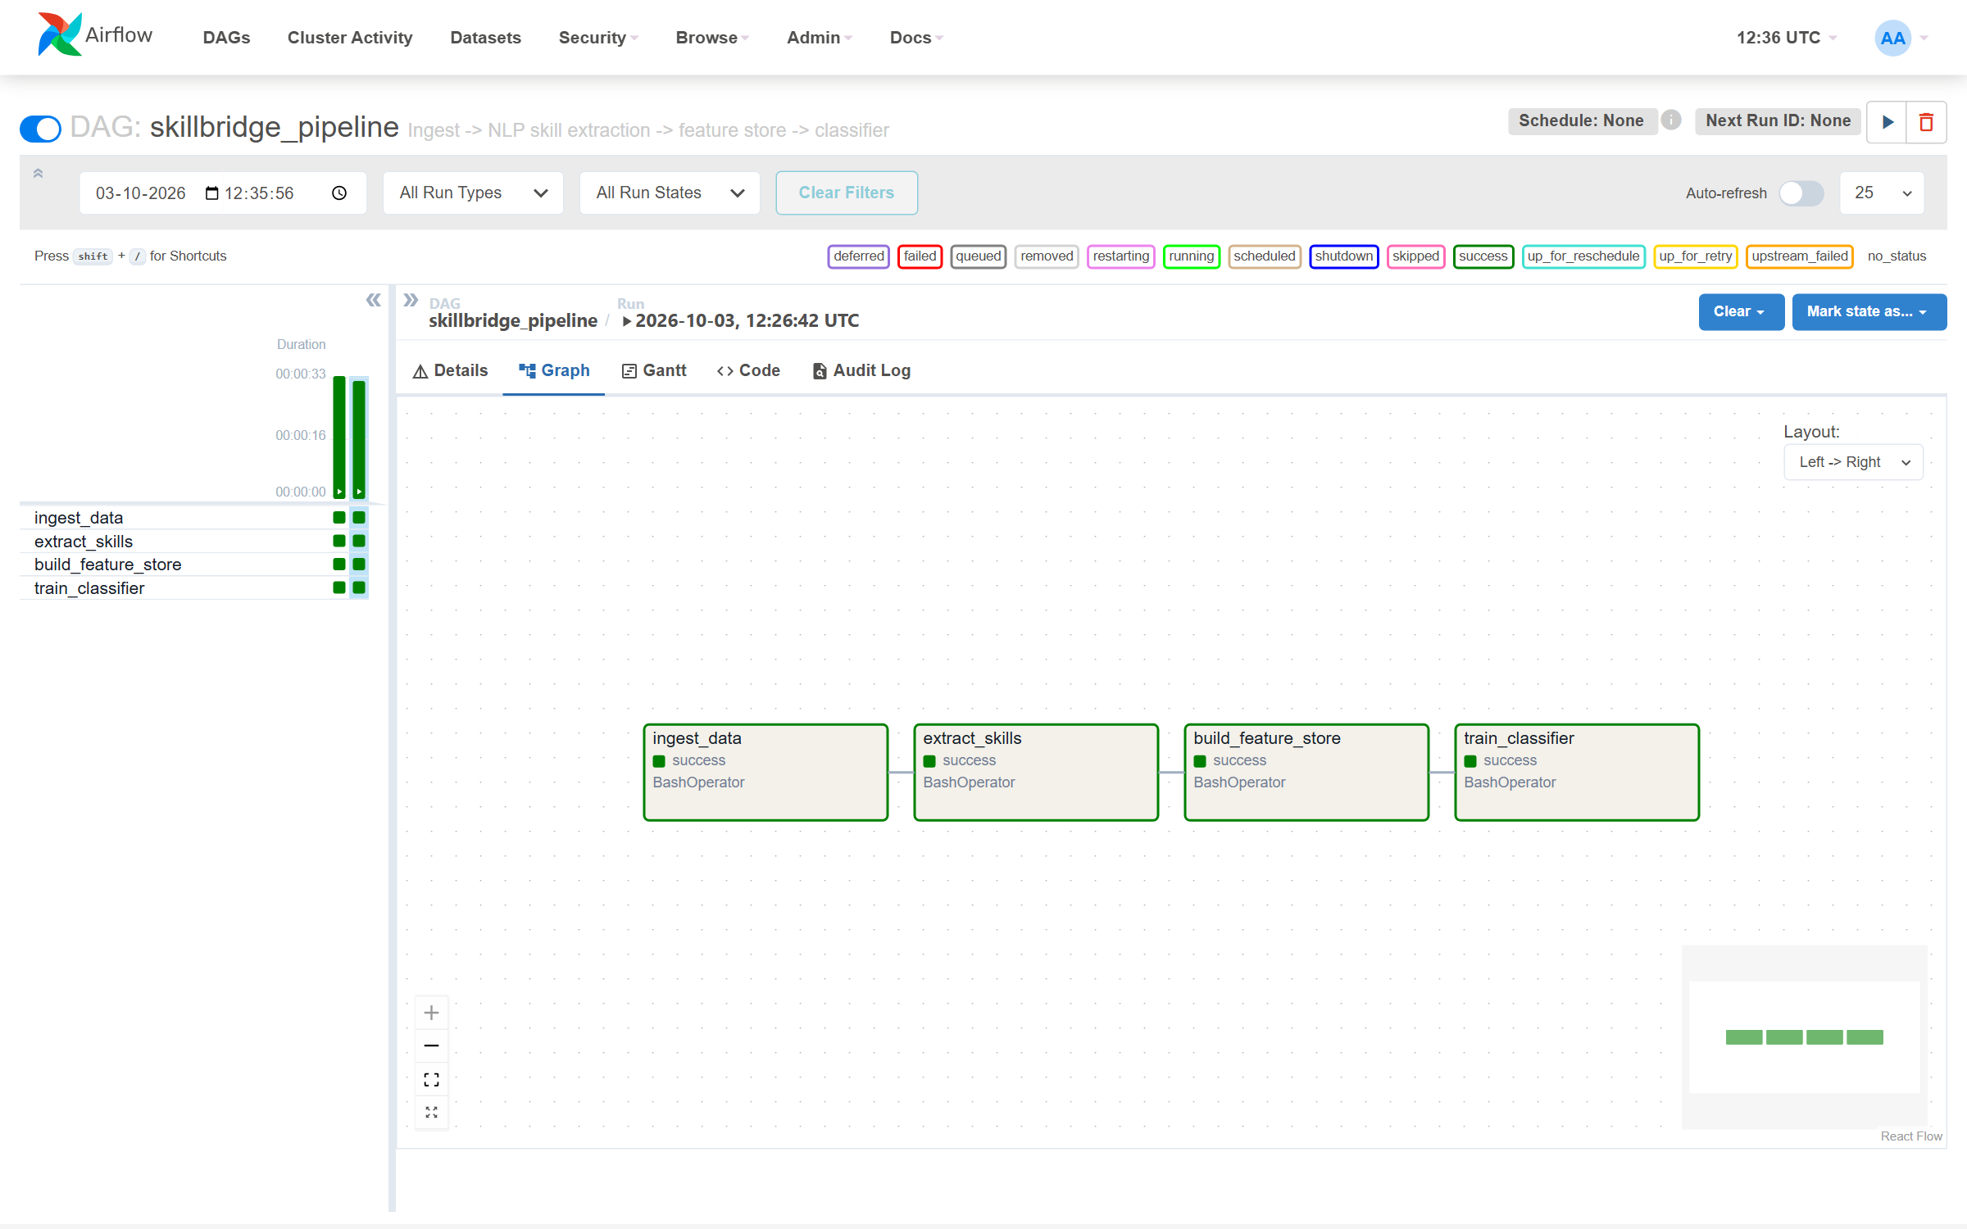
Orchestration — Apache Airflow
One DAG, four tasks
ingest → extract → features → train
Uses real data when present, synthetic otherwise
Verified green on real data, ~33 s per run

Slide 18
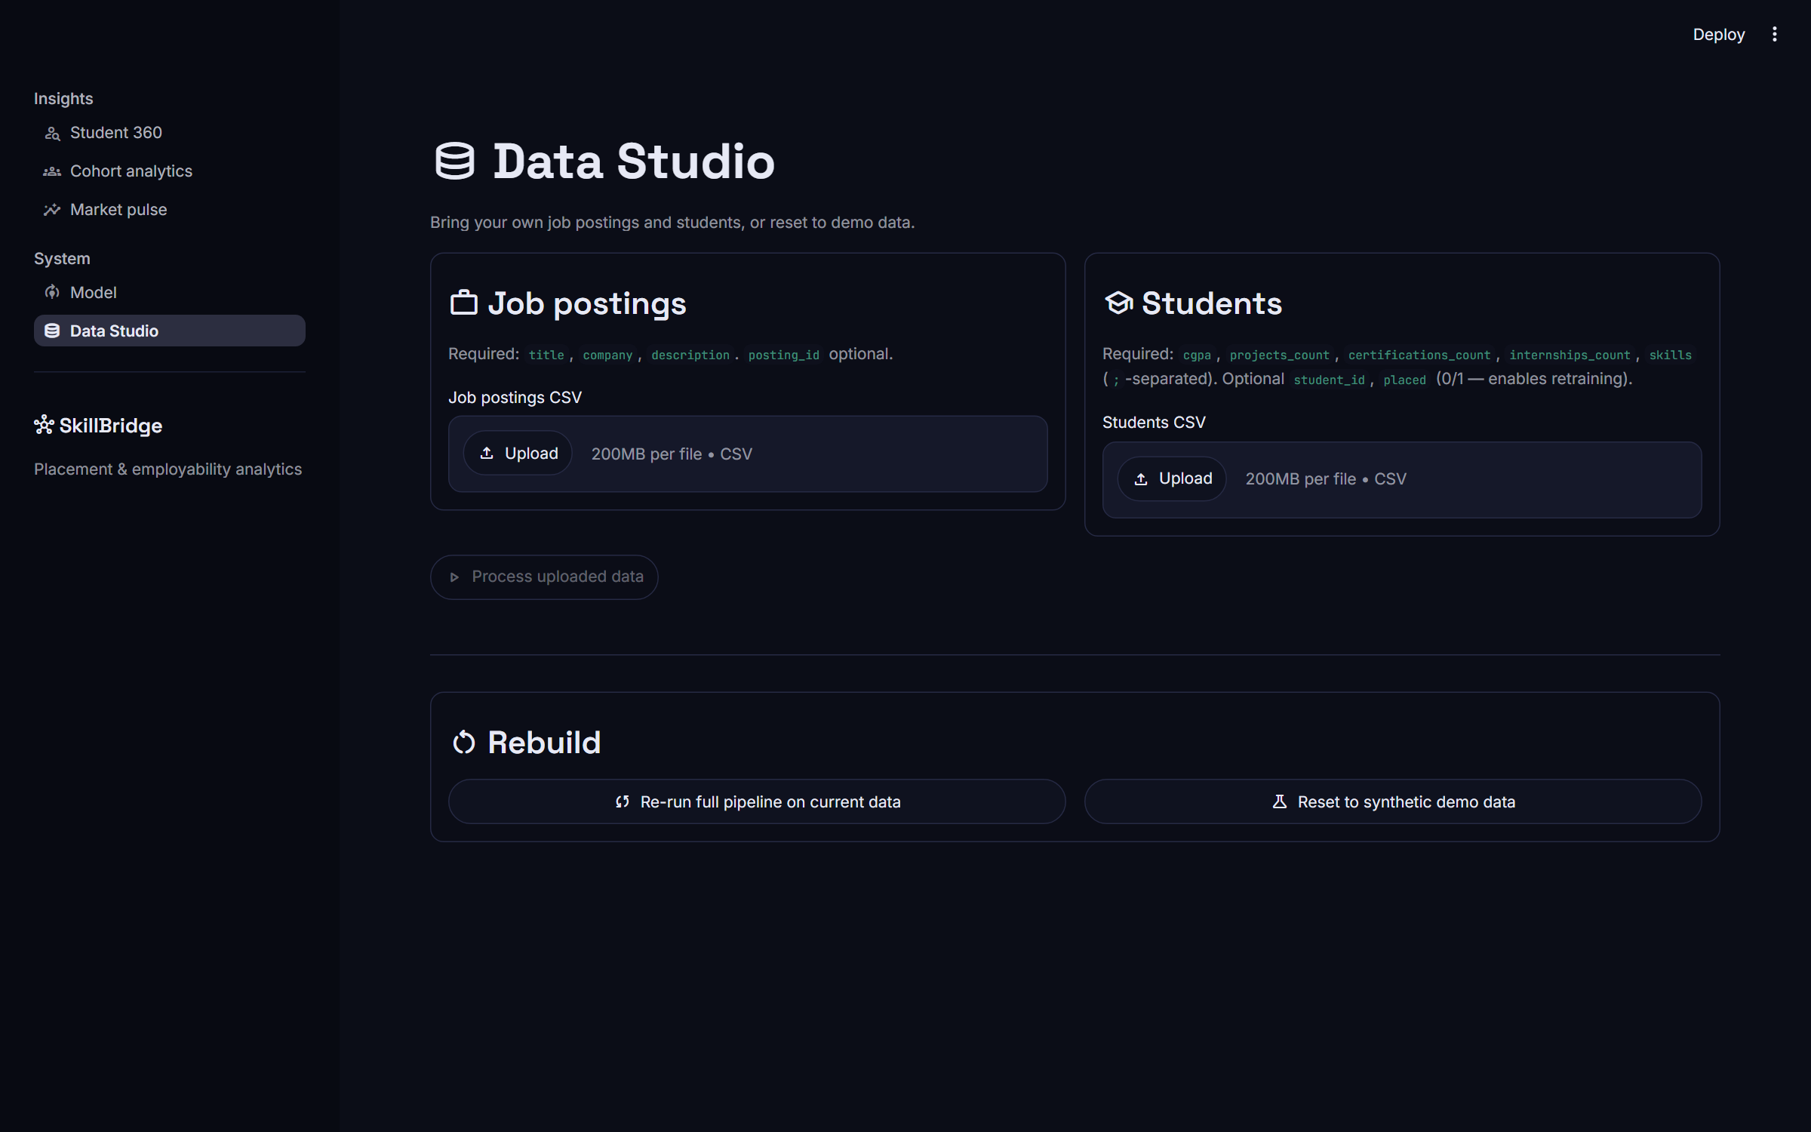
Dashboard — Data Studio
Bring your own data
Upload postings and student CSVs
Validated: columns, numbers, duplicate IDs
Re-runs the pipeline with live progress

Slide 19
Testing
31
NLP extractor: casing, overlaps, empty text, ambiguous short names
Feature store: empty input, students without skills
Upload validation and training guards
Kafka message handling and S3 upload (no live services needed)
Every dashboard page rendered automatically
automated tests, all passing on real data

Slide 20
Bugs we found and fixed
Symptom | Root cause | Result
Extractor precision only 84.5% | Answer key missed soft skills; overlaps double-counted | 99.2%
Airflow overwrote real data | Ingest always generated synthetic data | Prefers real data
15 postings not searchable | Missing company sent as NaN (invalid JSON) | 1,500 / 1,500
Dashboard crash after Airflow run | Different scikit-learn in Airflow vs local | Versions pinned
Fresh install couldn't search | Unpinned client v9 vs Elasticsearch 8 server | Client pinned to v8

Slide 21
Limitations and future work
Limitations
Future work
Real student skills were imputed, not recorded
Taxonomy misses new or unusual skill names
Demand not split by region or seniority
Collect real student skills via upload
Learned skill-NER on annotated postings
Spark + Delta Lake for larger volumes
Track a full placement season

Slide 22
Conclusion
✓
✓
✓
Works end to end
Strong, honest results
Real big-data stack
Postings → skills → gaps → prediction → dashboard, on real data
AUC 0.947, accuracy 83.3%, with clearly stated limits
Kafka, Airflow and Elasticsearch verified live; S3 upload covered by tests
Source code: github.com/Vikram5002/Equilearn

Slide 23
Thank you
Questions?
Vikram · Jahnavy · Jansi
github.com/Vikram5002/Equilearn

