Slide 1









Why this product needs to exist
VALUE PROPOSITION
Faster, more reliable group quotations, without accidentally accepting infeasible or unprofitable bookings
Target segment
Independent budget hotels and small properties; beachhead of about 10–50 rooms
From manual quoting to safe, fast quotes
Primary user
Hotel owner or sales manager handling group bookings
Current process
Pain points
Proposed outcome
Core problem
Enquiry by phone, WhatsApp or email
Rooms checked by hand against sheets
Rates, costs and discounts worked out manually
Quote sent; follow-up by phone
Overbooking from inventory mismatch
Discounts that erode contribution
Calculation errors, slow turnaround
Expired quotes, conflicting holds
Room-night availability checked
Contribution calculated per quote
Below-floor discounts need approval
Quotes expire and holds are released
Preparing group quotes while checking availability, dates, rates, costs and discounts
Existing alternatives
TO VALIDATE
Manual calculations, spreadsheets, phone calls, generic booking tools

Slide 2


BUSINESS MODEL, PRICING AND UNIT ECONOMICS
Payer
Offer
Why it works
Small hotel owner (10–30 rooms)
Group quotation and profitability workflow
Saves time, lifts group conversion, easy to use
Starter
Growth
Unit economics (per hotel, per month, ₹)
Plans (monthly subscription)
Up to 15 rooms
16 to 30 rooms
Particulars | Starter | Growth | Blended 70/30
Subscription revenue | 499 | 899 | 619
Variable costs | 120 | 120 | 120
Cloud hosting & infra | 30 | 30 | 30
Messaging & PDF generation | 20 | 20 | 20
Payment processing | 15 | 15 | 15
Support & maintenance | 55 | 55 | 55
Contribution (per hotel) | 379 | 779 | 499
Contribution margin | 76.6% | 86.7% | 80.6%
₹499 /month
₹899 /month
or ₹4,999 billed annually
or ₹8,999 billed annually
Unlimited quotes · Branded PDF quotations · WhatsApp share link
Starter + multi-user desk, banquet pricing, expiry reminders, receipts
Setup fee: ₹999 one-time (waived for annual subscribers)
Customer journey: payment to support
1
Sign up & pay: owner picks a plan, pays monthly or annually
2
Account setup: hotel account and logins within 24 hours
3
Onboarding: online demo or on-site training (30–60 min)
4
Start using C32: share quotes, track enquiries, confirm bookings
5
Ongoing support: WhatsApp / phone support and feature updates
Notes:
Payer is the small hotel owner. We chose a monthly per-property subscription over a per-quote fee for predictable revenue. Starter is 499 a month up to 15 rooms, Growth 899 for 16 to 30 rooms; setup 999, waived for annual plans. Blended at 70/30 the hotel brings 619 a month against 120 variable cost: 499 contribution, about 81% margin. CAC 1,500 pays back in 3 months; LTV 9,980 at 5% churn gives 6.7x LTV to CAC. At 100 hotels: about 6 lakh annual contribution; even the low-demand case (50 hotels) yields about 3 lakh.

Slide 3
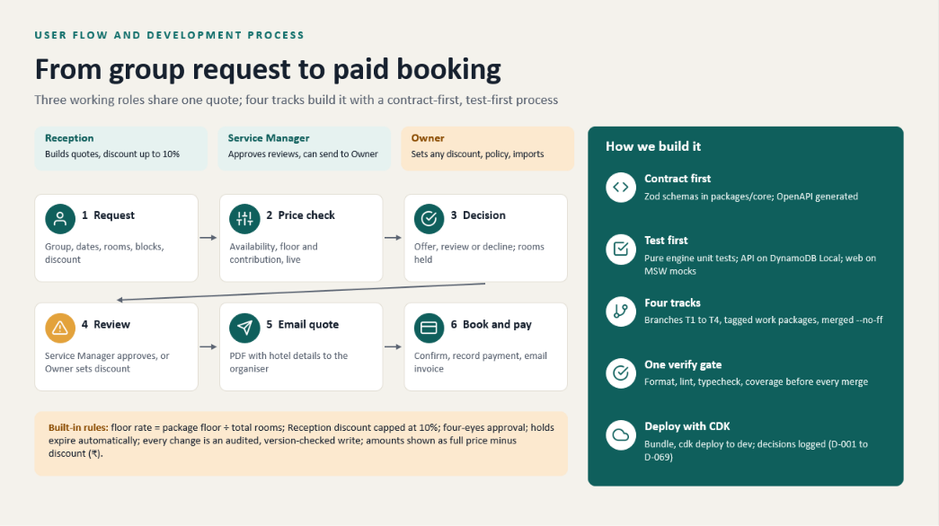

Slide 4
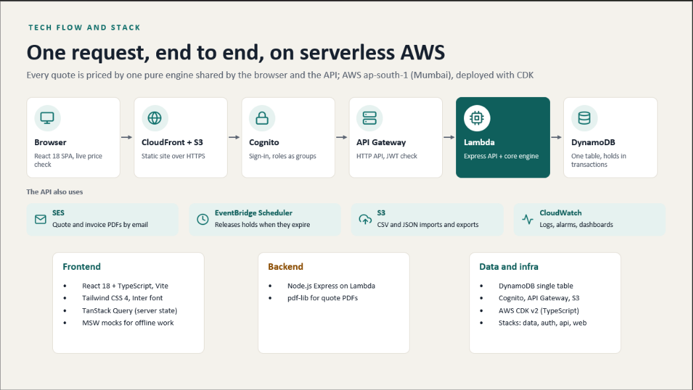

Slide 5




03 · MARKET ENTRY, SALES AND 30-DAY GROWTH PLAN
How we win our first paying hotels
Initial geography
Hotel profile
Lead sources
TIER-1 CITIES ACROSS ALL STATES.
Independent budget hotels, 10–50 rooms, with regular group enquiries
Hotel directories · Google Maps · local hotel associations · referrals · direct outreach
30-day action plan
DAYS 1–7
DAYS 8–14
DAYS 15–21
DAYS 22–30
Prepare
Reach out and demo
Pilot and onboard
Convert and retain
Sales lead
Sales lead
Product lead
Support lead
BUILD LEAD LIST; explore HOTEL BOOKING WEBSITES AND GATHER DATA OF THE HOTELS TO BE TARGETED.
Calls, WhatsApp, EMAIL and visits; association and referral intros
Free 14-day pilot; setup in 24 h; 30–60 min training
Review pilot usage, convert to paid, weekly check-ins, ask for referrals
Day-30 decision thresholds
Contact to demo ≥ 30%: keep channel, else change pitch.
Notes:
Start in Mumbai and nearby leisure towns with independent 10 to 50 room hotels that get group enquiries. Leads come from directories, Google Maps, hotel associations, referrals and direct outreach. Every demo uses a realistic 40-guest wedding block. Week by week: list 60 hotels, run 20 demos, put 8 on a 14-day pilot, convert 3. These are targets until they happen. Decision at day 30: at least 30% contact-to-demo keeps the channel; 3 or more paid hotels means we add the next city. Budget is team time only, no paid ads.

Slide 6












Why hotels choose Stayquote?
Built for small hotels. Designed for growth.
A simpler, smarter and more profitable way to manage group bookings
01
Built different
02
What hotels gain
03
The advantage
Focused on small hotels
Save time & effort
More group bookings
Tailored for 10–50 room hotels
Quotes in minutes, not hours
Higher occupancy
Easy & intuitive
Drive more bookings
Quick start, no complex setup
Reach more groups, fill rooms
Greater revenue potential
Group-centric features
Reduce revenue risk
Long-term growth
Purpose-built for group quotes
Track quotes, cut lost deals
Data-driven insights
Operate efficiently
Track results, decide faster
Manage groups in one place
Dedicated support
Grow your business
Your partner in growth
Unlock corporate & events
Notes:
Click through the build: 1) Built different, what sets C32 apart for 10–25 room hotels. 2) What hotels gain day to day. 3) The C32 advantage, four business outcomes. 4) The dashboard snapshot: 12 open quotes, 8 confirmed groups, 240 rooms booked, +35% booking trend.

