Slide 1

Entrepreneurship
As A Career Option

Slide 2
Seven months into 2022 and India has already seen 20 new unicorns including the likes of Fractal, LEAD, Xpressbees, Uniphore, Hasura, CredAvenue, Amagi, Oxyzo, Open, PhysicsWallah
The total count of Indian tech startups that have entered the unicorn club to date stands at 106
These unicorns have raised a total of $94 Bn in funding to date and are valued at around $343 Bn combined
https://www.youtube.com/watch?v=cEjomETxB7s

Slide 3

Entrepreneur: Definition
One who organizes, manages, and assumes the risks of a business or enterprise.

Slide 4

Entrepreneurship: The Verb
The undertaking of such an activity or activities.

Slide 5
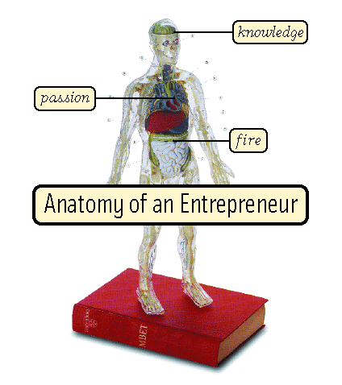
10 Common Characteristics
  Vision
  Ability to create/increase value
  Mastery Knowledge
  Focus
  Communication Skills
  Networking Skills/Allies
  Passion
  10 Thousand Hours
  Confidence
  Fortitude

Slide 6

?

Slide 7

Entrepreneur Facts
It’s not for everybody!
60% of all businesses ventures fail.
Business owners have a higher rate of marriage failure and stress, and stress related illnesses than employees.
75% of start-ups and new businesses secure financing through the “informal investing grapevine.

Slide 8
Entrepreneur Influences
Circumstances (recently laid off or fired?
Can’t find a job to match interests/skill set)
Lack of opportunities (employment, greater pay, utilization of talent, respect, flexibility, etc.)
Desire for greater control?
More responsibility?
Lifestyle?

Slide 9

Entrepreneur Facts
No Pension
No Medical/Dental Benefits
No days off
No paid vacation

Slide 10
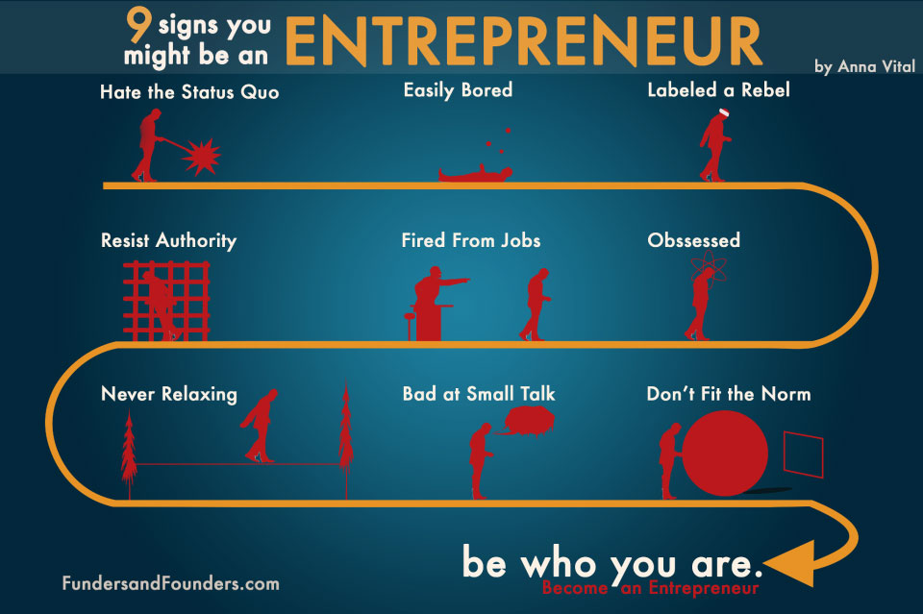

Slide 11

The Alternative?

Slide 12

Free Yourself!
Your skills, talents, and education provide you with many of the tools you need to establish your own business. All you need is courage.

Slide 13

Divergent & Convergent Thinking

Slide 14

College Degree? Or Degreed thinker?

Slide 15
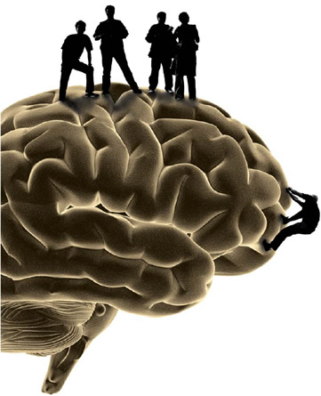
Intelligence Matters
Evaluate your passion, question your motives, use your intelligence…and the intelligence of others.

Slide 16
Do Work That Matters!
Purposeful Engagement

Slide 17

Do Work That Matters!
The Scientific Purpose of Passion

Slide 18

Choose Your Poison
Product or Service?

Slide 19

Know This…
Business ideas are not
bu$ine$$ opportunities…
unless they solve problems.

Slide 20

Achieve This…

Slide 21

Entrepreneur Success Formula
Solve Problems
Fulfill Needs
Cater To Desires

Slide 22
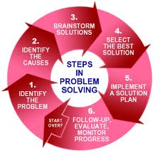
Learn
The 6 Steps to Solving Problems

Slide 23
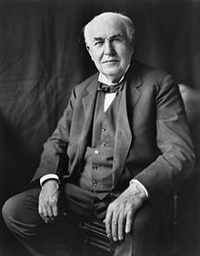
Thomas Edison
What problem did he solve?

Slide 24
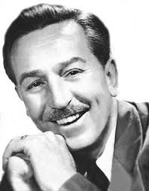
Walt Disney
What problem did he solve?

Slide 25

Larry Page & Sergey Brin
What problem did they solve?

Slide 26
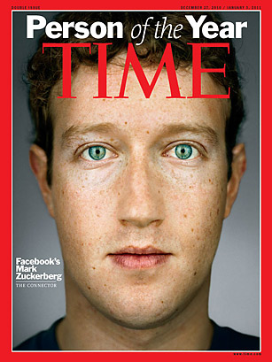
Mark Zuckerberg
What problem did he solve?

Slide 27

Piyush Bansal
What problem did he solve?

Slide 28
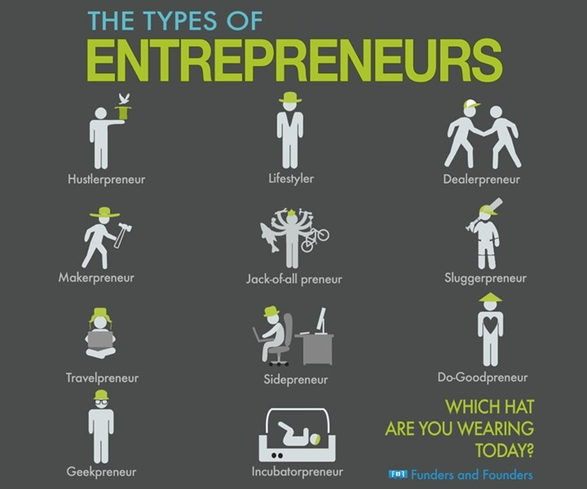
Ryan Blair?

Slide 29

Entrepreneurs Fail Because…
Lack of funding
Mismanagement
Ineffective Marketing

Slide 30

The Truth
Either you become an entrepreneur…
or you work for one.

Slide 31
Conclusion
Entrepreneurship
As A Career Option

