Slide 1

Knowledge Enhancement & Career Advancement With MOOC

Slide 2

Project Description
OVERVIEW :
Large scale online courses designed to deliver knowledge through a digital platform to advance skills and career of people. MOOC(Massive Open Online Courses) has the potential to transform education and provide access to knowledge and skills for learners around the world.
Problem Statement :
One of the MOOC affiliated industries is trying to be in trend with the current market and in order to achieve it, SMART questions are devised to improve their business strategy.
SYNOPSIS :
This project aims to use data mining tools to analyze large datasets ,identify patterns, insights and provide solutions to the business problems.

Slide 3
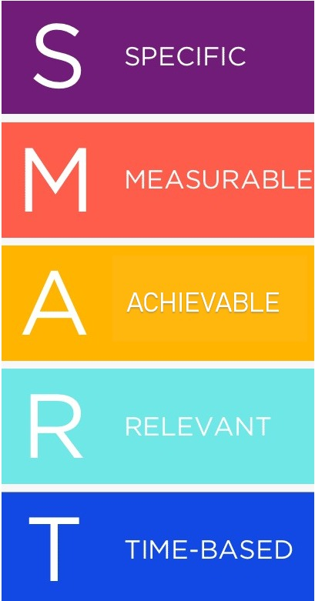
Specific : How activity of student effects the completion of course ?
Measurable : How number of videos watched describes the participation of the learner ?
Achievable : How many chapters completed by the learner ?
Relevant :How frequently user has posted relevant to the course ?
Timely : How long user is learning logging in to the account ?

Slide 4

Workflow
Data Discovery
Dataset for this is collected from Kaggle
Data Description
Data Structuring and Cleansing
Data Validation
Analysis and Predictions

Slide 5


Data Description
This dataset is at the level of one row per-person, per-course. So, for example, if one individual enrolled in three MITx or HarvardX courses during the period covered by the dataset (for this release, Fall 2012, Spring 2013, and Summer 2013), that person would have three rows associated with their userID.
The raw data set has 4,16,921 records divided into 21 columns. Columns are classified into three categories as Informative, Categorical & Numerical columns.
Data consists of some inconsistent records(outliers).

Slide 6
Categorical Variables :
Semester
Semester of course
Viewed
0/1; Anyone who accessed the ‘Courseware’ tab
Explored
Certified
0/1; Anyone who accessed at least half of the chapters in the courseware
LOE_DI
0/1; Anyone who earned a certificate. Certificates are based on course grades and depending on the course.
Level of education completed.

Slide 7
Numerical Variables :
Grades
Final grade in the course, ranges from 0 to 1
nevents
Number of interactions with the course
ndays_act
Number of unique days student interacted with course
nplay_video
n_chapters
Number of play video events of the course that student interacted.
nforum_posts
Number of chapters (within the Courseware) with which the student interacted.
Number of posts to the Discussion Forum.

Slide 8
Informative Variables :
Institute
Course Provider institute eg: MIT, HarvardX
Course_id
ID of the Course
Userid_DI
ID of each User
Final_cc_country
Gender
User IP address/Address
Start_time_DI
Last_event_DI
Age
Gender of the User
Date of Course registration
Date of last interaction with course
Age of the User
Year
Year of the Course

Slide 9

ASSUMPTIONS :
At least one of students accessed all chapters in coursework.
More the participation , more the learning , more the grade.
Gender is not being used as feature for analysis
Factoring Categorical Variables
course_id, institute, semester, LoE_Di, final_cc_cname_di are factored into numerical values by setting the levels.
Example of LoE_Di :
Less than Secondary
Secondary
Bachelor’s
Master’s
Doctorate
This Photo by Unknown Author is licensed under CC BY-NC

Slide 10

Outlier Identification & Treatment
Inserted a column Incomplete flag which takes value 1 for the records that have null values for nevents but have non-null values for ndays_act, nforum_posts, or nchapters. These values are considered as outliers
As per the data declaration, the users with explored field value as 1 cannot have viewed as 0. Hence, set of data with viewed=1 and explored=0 are outliers.
Set of data with explored as 1 and nchapters less than half of the maximum and explored as 0 and nchapters greater than half of maximum.
Set of data with last_event_di less than start_event _di are outliers.
Set of data with certified 1 and grade not meeting the threshold.
Age < 9 are considered as outliers based on level of degree values like Less than Secondary, Secondary , Bachelor’s, Master’s, Doctorate.
ndays_act greater than day difference between last_event_di and start_event _di are considered as outliers and difference is added as new column n_days.

Slide 11

Data Validation
Data being dealt is of both numerical and categorical.
Pearson Correlation is not the accurate method for calculation as it uses numerical comparisons. So, Kendall Correlation and Spearman Correlation are used.
The above stated methods make use of rank difference instead of numerical comparisons resulting in a better correlation values.
Correlation using Kendall method is highly computing for the complete data. So , random sets of 10 percent of data are taken for computation.

Slide 12
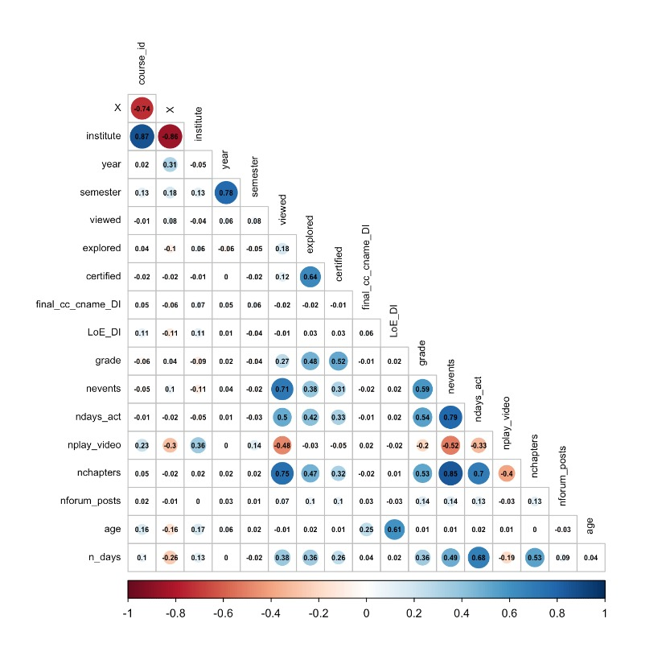
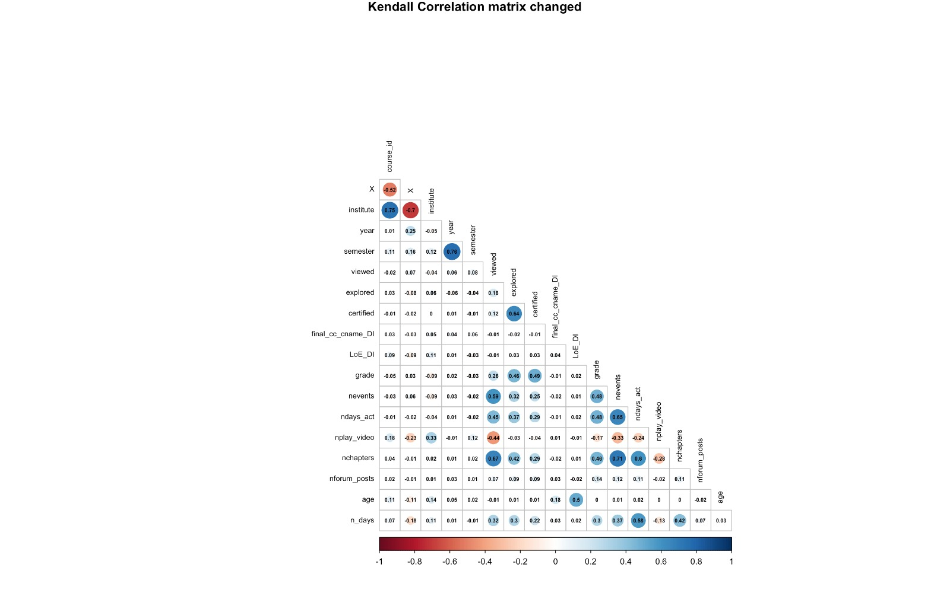
Spearman Correlation
Kendall Tau Correlation

Slide 13

How activity of student effects the completion of course ?
Outcomes –> “1”--- certified ,”0”--- not certified. So, basically classifying whether he was passed or failed.
Activity - function of some variables/ measures →?
From correlations.
From models.
Explaining the importance of each feature in defining the class(0/1).
Approach:
From correlations we identified some features which helps in defining the class.('explored','ndays_act','nchapters','nevents','n_days','viewed')
Used 4 models – trained and performed cross validation across various seed-(508,240,620).
The results are compared and found out the best model for predicting the class and interpretability.

Slide 14
Best model for predicting : Bagging- tree bag method
The Accuracy, Sensitivity, and Specificity values are very good here in both training and cross validation when compared to other models.
The model is very robust in classifying the both 0 and 1. However, probability of classifying the “Class 1” is a bit low.
Best model for interpretability: Logistic Regression
The Accuracy and Sensitivity are almost similar to other models, also the Sensitivity of this model bit low.
However, the interpretability of logistic is more than any other.
How will this analysis help the website?
Can implement an interactive model that will tell the user about his current status(can pass) and also suggest what are the further course of actions that will help him to succeed.
Measure | value
viewed | 14.9127
Explored | 3.14008
nchapters | 0.09904
ndays_act | 0.04142
n_days | 0.00208
nevents | 0.00014
Intercept | -21.682
Coefficients of logistic regression equation

Slide 15

How number of videos watched describes the participation of the learner ?
Participation of learner in a course is housed by metric nevents in the data which is measure of interactions with course.
From the correlation matrices above, it can be noticed that negative correlation is observed between nplay_video and nevents.
Increase in nplay_video might have an impact on features nchapters, ndays_act etc. that in turn amplifies participation. Hence, Impact of nplay_video feature can be better explained considering all these features.
Approach :
From matrices, features that are correlated to nevents and that have moderate correlation with nplay_video are considered such as ndays_act, nchapters etc.
Multiple Regression models are build using the above features.
Trained and performed cross validation and randomness with seeds-(508,240,620).
Compiled results are compared and best model that can interpret the impact will be considered.

Slide 16
Best model for Interpretation :.
Multiple Linear Regression with features (ndays_act, ndays, nchapters, nplay_video, nforum_posts).
Reasons for pick :
Models RMSE values for train and test data are closer explaining that overfitting is avoided.
Based on accuracies of models , it can be noticed that there is not much increase in accuracy with increase in complexity of model.
Considering the problem, interpretation of model is more important than predicting using the model.
So , increasing the complexity of model is not likely. From MLR , the coefficients of model can be seen.
 | Coefficients | Units
(Intercept) | -0.003
ndays_act | 0.828 | days
nplay_video | -0.05 | centiseconds
nchapters | 0.005 | increments of 1
nforum_posts | 0.003 | increments of 1
How will this analysis help the website ?
Based on impact of the metrics on participation, course design can be improvised such that both the parties can be benefitted.
Adding the number of videos in the same chapter frequently allows student to interact with website.
Quality and length of video can be crisp in this way which is an encouragement to student.
Model | RMSE Train | RMSE Test | R Squared Train | R Squared Test | Features
LR | 0.958 | 0.955 | 0.084 | 0.083 | nplay_video
MLR | 0.534 | 0.536 | 0.715 | 0.711 | ndays_act, nforum_posts, nchapters, nplay_video
Ridge | 0.533 | 0.539 | 0.708 | 0.716 | ndays_act, nplay_video, nchapters, nforum_posts
Lasso | 0.533 | 0.539 | 0.714 | 0.723 | ndays_act, nplay_video, Nchapters

Slide 17

How many chapters completed by the learner ?
Outcomes: Predicting the number of chapters a student is able to complete during the course duration.
Although we have ‘nchapters’ column already, we are trying to observe the impact on this column data based on the design of the course structure.
Approach:
From correlations we identified some features which helps in defining the metric.
Features : viewed, nevents, nplay_video, ndays_ac.
Tested 4 models – Linear Regression, Multi Linear Regression, Ridge Regression, LASSO Regression.
The results are compared and found out the best model for predicting the interpretability.

Slide 18
Best model for predicting and interpreting :
Multi Linear Regression
The Accuracy values are good for this model as they are same for the train and test data. Also, the RMSE values are very close to each other compared to the other models.
Model robustness:
Even after changing the randomness of data in test and train data, the model is not showing much change in the accuracy of the data.
How will this analysis help the website ?
This can be used to better the design of future course material, which helps in user retention and user growth.
Model | Train RMSE | Test RMSE
Multi Linear Regression | 2.85 | 2.81
Seeds | Train RMSE | Test RMSE | Train Accuracy | Test Accuracy
508 | 2.85 | 2.81 | 57% | 57%
200 | 2.84 | 2.86 | 57% | 57%
600 | 2.84 | 2.86 | 57% | 57%
80 | 2.85 | 2.82 | 57% | 57%
800 | 2.83 | 2.88 | 57% | 56%

Slide 19

How frequently user has posted relevant to the course ?
Objective:
Predict how frequently users have posted, based on their activity and engagement with the course.
Approach:
After analyzing correlations, we identified several features that could help define a regression model, including grade, nevents, ndays_act, and nchapters.
Tested Multiple Linear Regression and Ridge Regression models using above features.

Slide 20
Observations:
The RMSE values for both the MLR and Ridge models are relatively low, indicating that the models are able to make reasonably accurate predictions.
Unfortunately, none of the regression models yielded accuracy greater than 4%, indicating that the selected features alone are insufficient for predicting user posting frequency.
It was observed that only 1% of users have posted in the given dataset, which could be a potential reason for the low accuracy of the models.
How will this analysis help the website ?
To pursue this objective, we need to include additional relevant features beyond those currently considered.
Providing bonus points or recognition to users who summarize video topics or frequently respond to posted questions can motivate them to contribute more often, which can increase the likelihood of receiving answers for posted doubts in turn increasing engagement.
Including an option for anonymous users to post their questions can encourage hesitant users to participate. This approach can increase the volume of data available so that this approach can be chased down further.

Slide 21

How long user is learning logging in to the account ?
"Time Spent on Platform" is an important variable for understanding student engagement in MOOCs.
Variable which can greatly measure this is ndays_act which is our target variable. The three regression models that were performed on the data are:
1.Multiple Linear Regression
This model uses a linear equation to predict the target variable based on multiple independent variables.
Specifically, the columns grade, nevents, n_days, viewed, and explored were included, along with the target variable, to create the feature set used in the models based on correlation.
2.Ridge Regression-This model is similar to multiple linear regression, but it adds a penalty term to the equation to prevent overfitting.
3.Lasso Regression-This model is also similar to multiple linear regression, but it uses a different penalty term that encourages sparsity in the coefficients.

Slide 22
Key findings of each regression model
Best Model
R-squared values, indicating that they are good at predicting "ndaysact". However, rmse_train and rmse_test vary slightly between the models. Based on these results, we can could conclude that the multiple linear regression model is the best
How will this analysis help the website ?
This analysis is being done to understand the relationship between the amount of time a user spends on the MOOC platform and their level of engagement with the course content, as measured by the number of days they are active on the platform.
By examining this relationship, it can be noticed that time spent by student increases if the events/chapters/videos get released frequently rather than a bunch at a time which limits student interaction and learning curve.

Slide 23

Conclusion
In the whole process of assessing and answering SMART Questions. Data available from the industry has been good but some recommendations are made for the future so that some other perspectives of improvement can be pursued.
Among the five objectives, four have been successfully formulated and inferences of same are discussed.
All these models and analysis states the underlying patterns of user behavior and preferences which is highly needed to improve the current business model.

