Slide 1

Cleaning Services.
‘Making Every House A Home’
RUTUJA FIRKE
AMEYA JONDHALE
PRATIK JADHAV
SIDDIQUE SHAIKH
KARTIK GUND
VIKRAM PARDESHI

Slide 2
INTRODUCTION
HomeMate in a nutshell, is a web application that provides a vast range of cleaning services.
The main objective of this project is to provide various cleaning services under one platform. Basically, HomeMate will bridge and connect the customers to the vendors who will provide certain services.
The need of it is quite simply circled down to the ease of access through any device, seamless service browsing and booking and finally to digitalize a service that is usually done offline.
Our project contains basic and essential modules like authentication of the customer and vendor to avoid unwanted traffic.
Other modules include the daily database backup to avoid uncertain loss of data. We also have the provision of order ID for each order to keep track of all the order metadata. The user can also use our feedback portal to share their reviews.
Why?
What?

Slide 3

Integrants Of HomeMate
BACKEND
FRONTEND
SpringBoot
mySQL
Javascript
JSP
HTML
CSS
Javascript

Slide 4
Flow of Control
HomeMate has 3 flows of control
Login
Admin
User
Vendor
Session Start

Slide 5
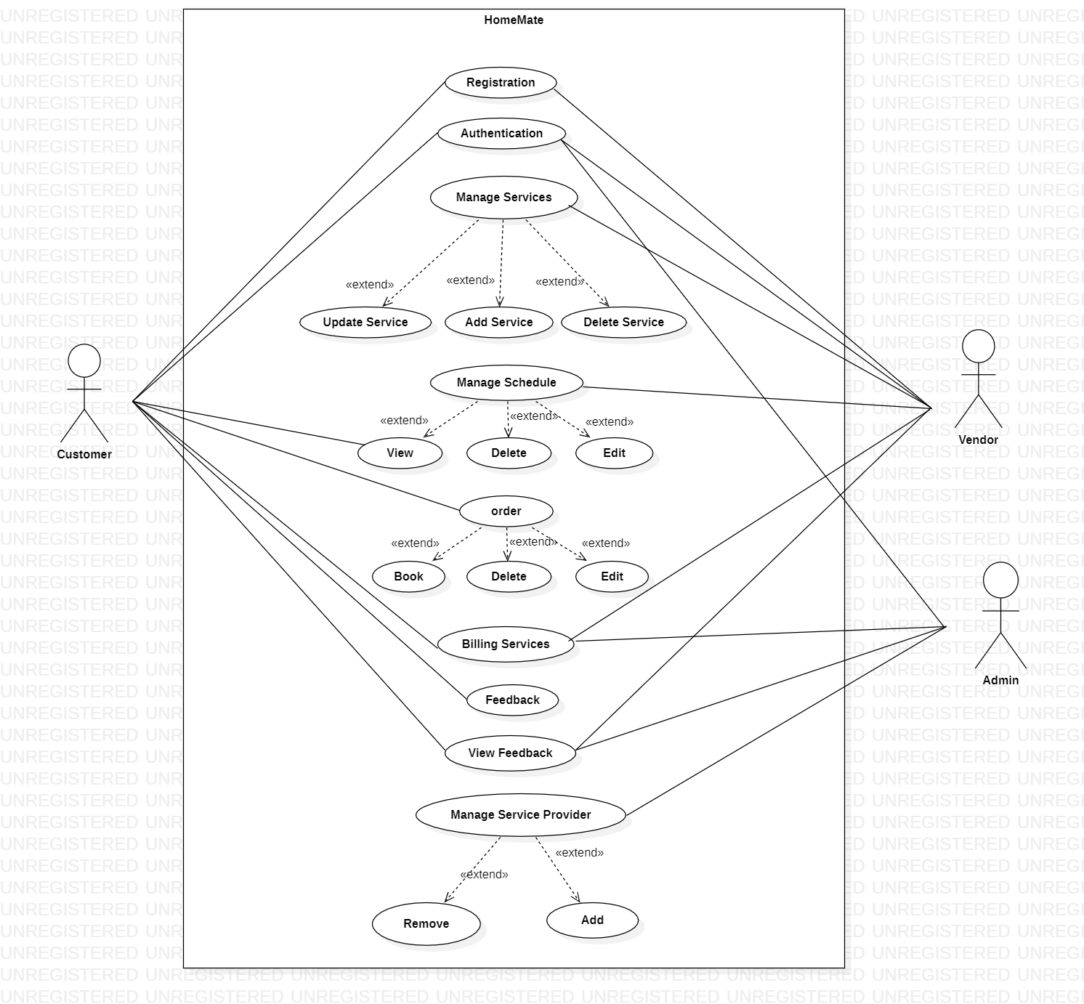
UML

Slide 6
THANK YOU!

