Slide 1

Cleaning Services.
‘Making Every House A Home’
RUTUJA FIRKE
AMEYA JONDHALE
PRATIK JADHAV
SIDDIQUE SHAIKH
KARTIK GUND
VIKRAM PARDESHI

Slide 2
INTRODUCTION
HomeMate in a nutshell, is a web application that provides a vast range of cleaning services. The main objective of this project is to provide various cleaning services under one platform. Basically, HomeMate will bridge and connect the customers to the vendors who will provide certain services.
Basic and essential modules:
Authentication
Daily Database Backup
Tracking Service Status
Admin Control Panel
Feedback Portal
Why?
What?

Slide 3

Integrants Of HomeMate
BACKEND
FRONTEND
SpringBoot
mySQL
Javascript
JSP
HTML
CSS
Java Server
Page

Slide 4
Flow of Control
HomeMate has 3 flows of control
Login
Admin
User
Vendor
Session Start

Slide 5
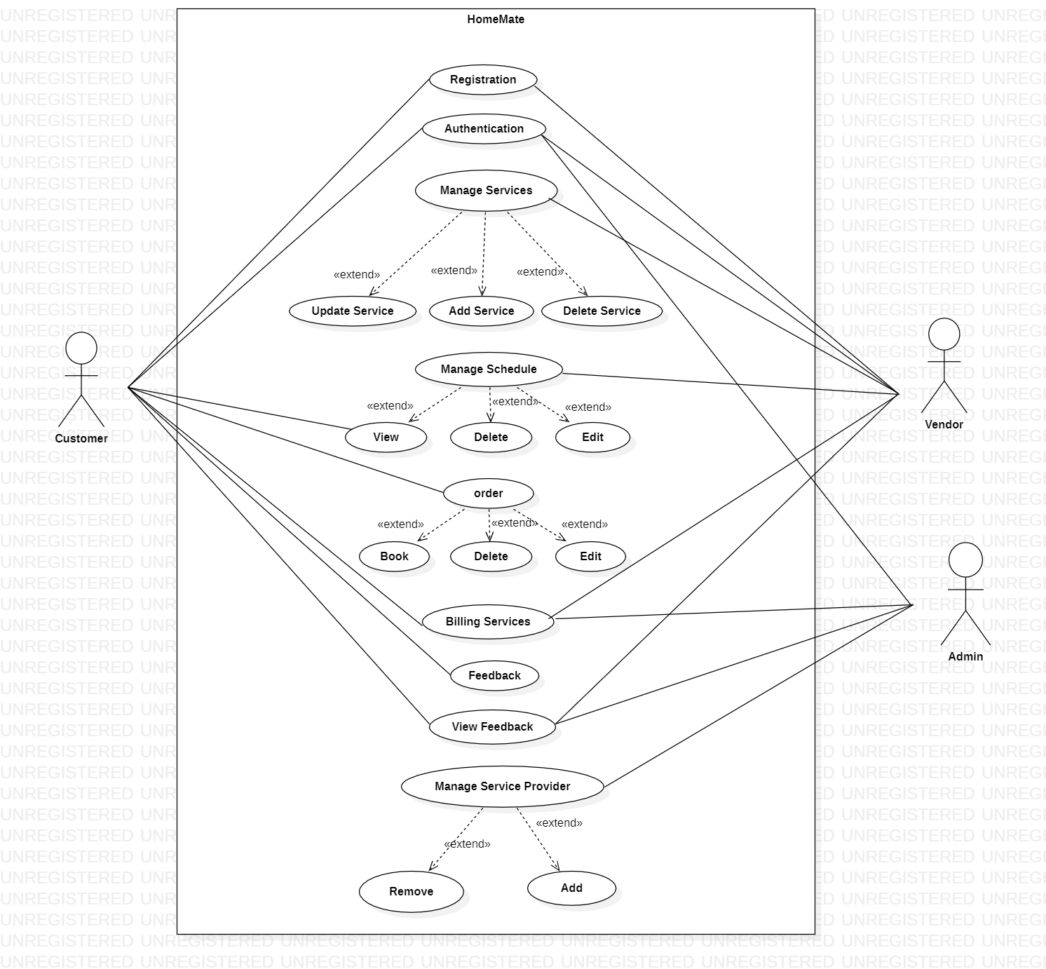
UML

Slide 6
THANK YOU!

