Slide 1




Monitoring your workload hosted on Microsoft Azure
Global Azure Bootcamp 2018
Vikram Pendse | Microsoft MVP – Azure

Slide 2






Agenda
Need of Monitoring
Various Monitoring Services ( + Some Security Offerings & Value Add Services)
DDoS Protection
Network Watcher
Log Analytics (OMS)
Azure Monitor
Application Insights
Getting GDPR Ready (DSR) – Azure Policy
References
Q & A

Slide 3

Need of Monitoring
Monitoring != Security
Keep Business Running
Monitoring
Objective – Ensuring no downtime
Security
Objective – Ensuring protection of data and assets

Slide 4












Monitoring Services in Azure
Azure Monitor
Log Analytics (OMS)
Application Insights
Network Watcher
Alerts
Metrics
Core Monitoring Services (Application + Infrastructure)
Shared Capabilities
Azure DDoS Protection
Azure Security Center
Azure Advisor
Marketplace
Logs
Dashboard
Advisory and 3rd Party Solutions (Application + Infrastructure)

Slide 5
Monitoring Services in Azure
Azure Monitor
Core Monitoring Services
Collection of Metrics, Activity and diagnostics Logs
Log Analytics
Part of OMS Suite – Pure Infrastructure Monitoring
Containers, AD, Threat Detection, Logs, Queries, Power BI Datasets
Application Level Monitoring
Value Add logs, Performance, Latency, Live Monitoring
Network Watcher
Designed for Azure Networks
Validates Connectivity and NSG
Application Insights

Slide 6
Demo
DDoS
Network Watcher
Azure Monitor
Log Analytics
Application Insight
Azure Security Center
Azure Advisor
* Disclaimer – Few Services / Configurations / Options are in Preview. Avoid applying it on Production Workloads unless its mandatory

Slide 7
Getting GDPR Ready (DSR) – Azure Policy
Policy != RBAC
Azure Policies
Define and Enforcement of Policy (Standards)
During the Deployment and the existing deployment
Subscription Level and Resource Group Level
Define → Apply → Compliance

Slide 8
Demo
{
"properties": {
"mode": "all",
"parameters": {},
"displayName": "Deny cool access tiering for storage accounts",
"description": "Ensures there's no usage of cool access tiering for storage.",
"policyRule": {
"if": {
"allOf": [
{
"field": "type",
"equals": "Microsoft.Storage/storageAccounts"
},
{
"field": "kind",
"equals": "BlobStorage"
},
{
"field": "Microsoft.Storage/storageAccounts/accessTier",
"equals": "cool"
}
]
},
"then": {
"effect": "deny"
}
}
}
}
Azure Policies

Slide 9
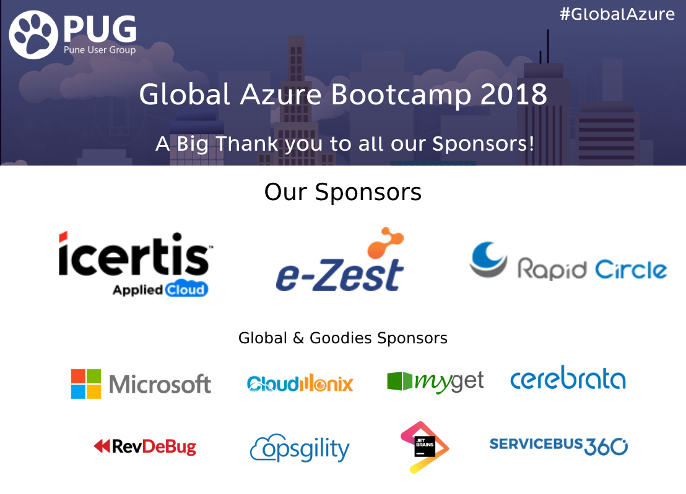

Slide 10





References
http://www.puneusergroup.org
http://www.facebook.com/puneusergroup
http://twitter.com/puneusergroup
http://www.linkedin.com/groups/Pune-User-Group-2023294

Slide 11
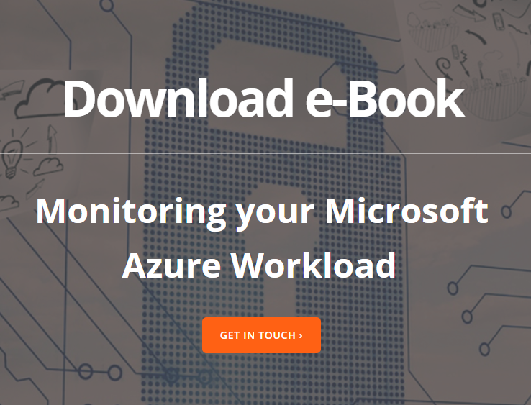

Get connected…
http://www.e-zest.com/monitoring-your-microsoft-azure-workload
http://www.dotnetcurry.com/author/vikram-pendse
https://developer.microsoft.com/en-us/advocates/index.html
https://azure.microsoft.com

Slide 12
See you in GAB 2019…
vikram.pendse@e-zest.in
@VikramPendse

Slide 13

Celebrating 14 glorious years of sharing passion
PUG Technology Foundation
* Disclaimer – All the icons and images used in the presentation are downloaded from Internet and used for presentation purpose only. Respective copyright is applicable. Name of the Microsoft products and logos have their respective trademarks. All rights reserved with the respective owner.

