Slide 1
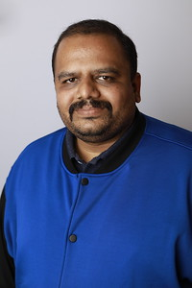

About Vikram Pendse
Vikram Pendse is currently working as Cloud Solution Architect in e-Zest Solutions Ltd. in (Pune) India. He is responsible for Building cloud strategy for e-Zest customers globally, moving Amazon AWS workloads to Azure, Providing Estimates, Architecture, Supporting RFPs and Sales. He is Microsoft MVP since year 2008 and currently he is Microsoft Azure MVP. He is a very active member in various Microsoft Communities and participates as a Speaker in many events in across the globe and talking on Microsoft Azure, Microsoft AI & ML, Azure Blockchain. You can follow him on Twitter @VikramPendse
VIKRAM PENDSE
Microsoft MVP – Azure, Cloud Solution Architect at e-Zest Solution

