Slide 1
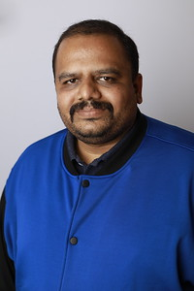

About Vikram Pendse
Vikram Pendse is currently working as a Cloud Solution Architect in Amdocs Global Cloud PSO from India. He is an active Microsoft MVP since year 2008 and have 15+ years of IT experience spanning a diverse mix of clients and geographies in the Microsoft Technologies Domain. Vikram enables Customers & Communities globally to design, build and deploy large scale complex apps using Microsoft Azure Cloud and Microsoft AI Solutions. He is a member of many Microsoft Communities online/offline and participates as a Speaker in many key Microsoft events like Microsoft Ignite, TechEd, etc. You can follow him on Twitter @VikramPendse and connect at LinkedIn.
VIKRAM PENDSE
Microsoft MVP – Azure, Cloud Solution Architect at Amdocs

Slide 2
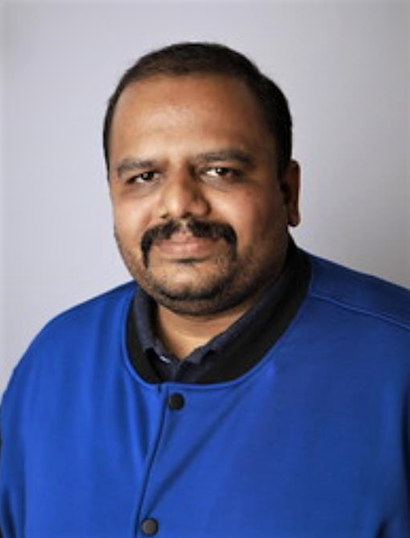
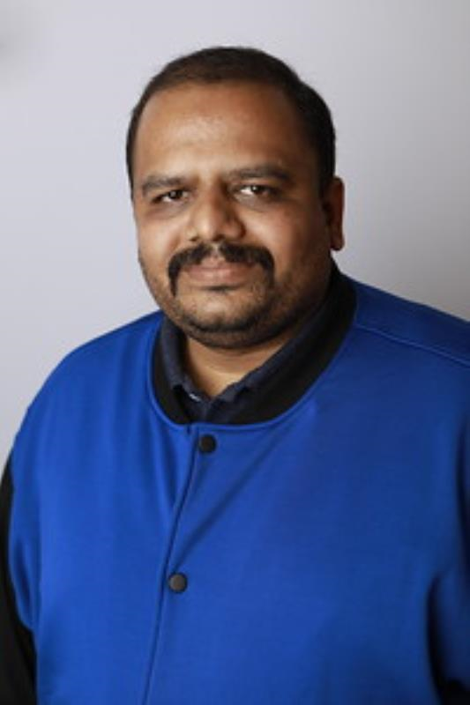
Speaker Photo

