Slide 1
Water Quality Prediction using Statistical,Ensemble and Hybrid models
Vyshali S Vikram V Shriya B
SSN College of Engineering, Chennai
March 31, 2022

Slide 2
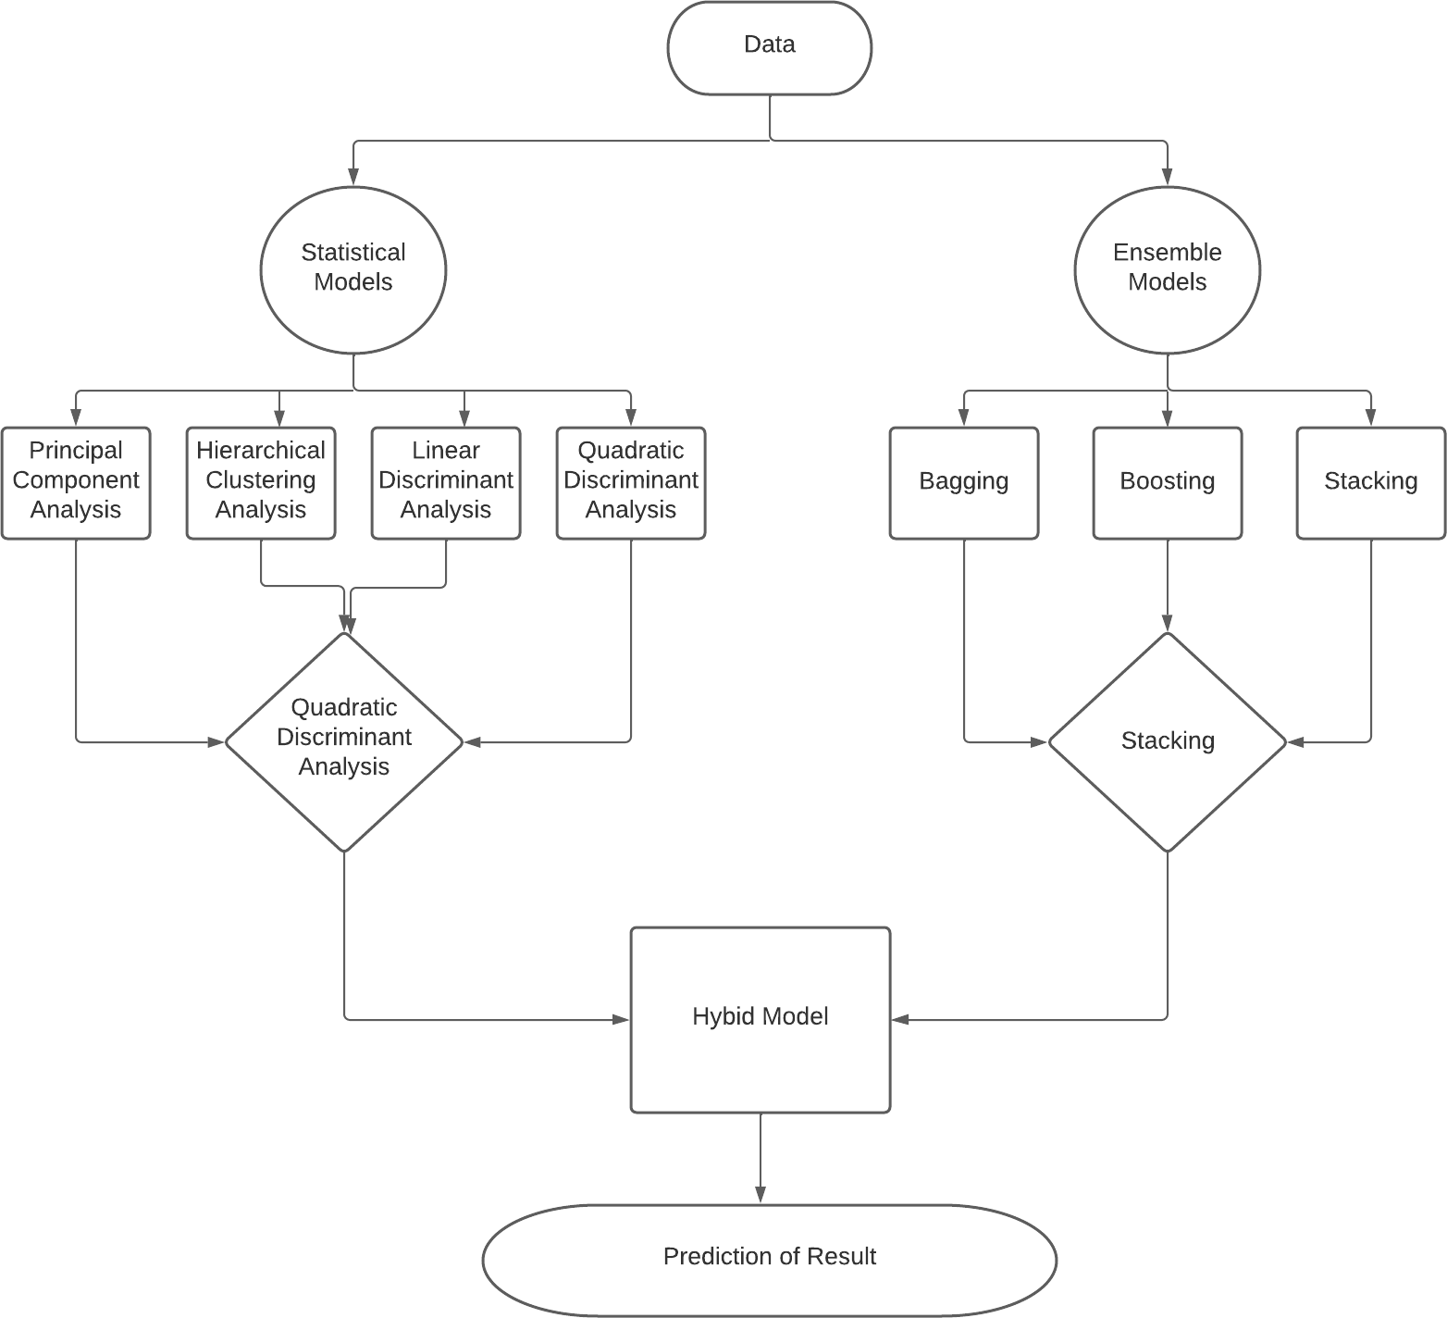
System Architecture

Slide 3
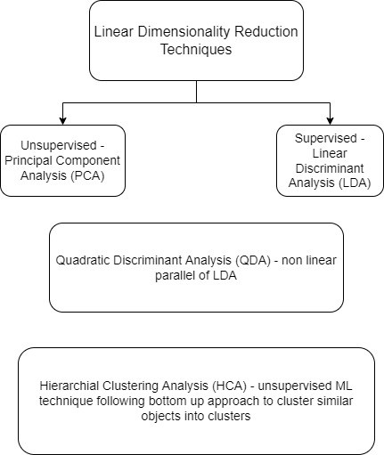
System Design - Statistical Models
Analyse the data set in order to resolve the shortcomings of real world data.

Slide 4
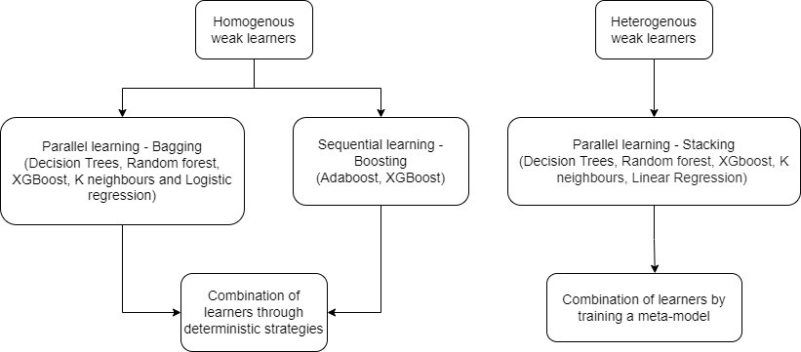
System Design - Ensemble Models
Combine several base models in order to produce one optimal predictive model.

Slide 5
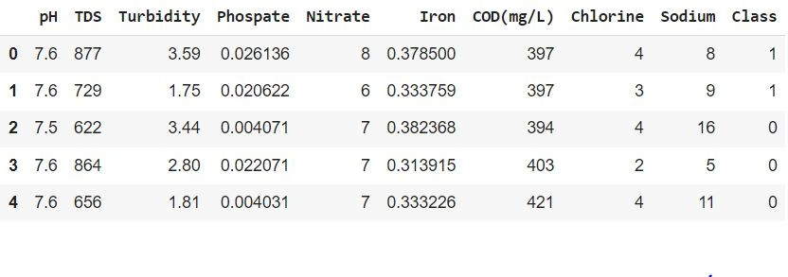
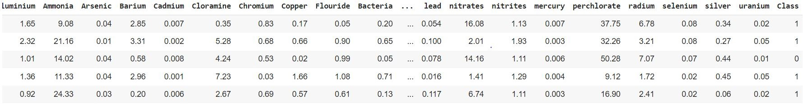
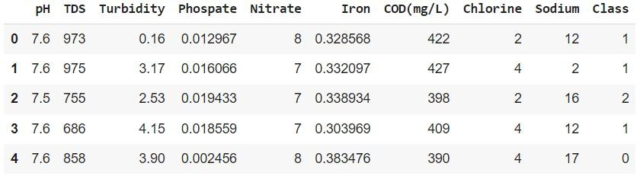
Datasets used
Binary Class Korattur Lake Dataset –> 5000 x 10
Binary Class Kaggle Dataset : –> 7999 x 21
Multi Class Korattur Lake Dataset : –> 10139 x 10

Slide 6
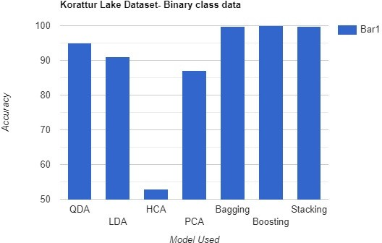
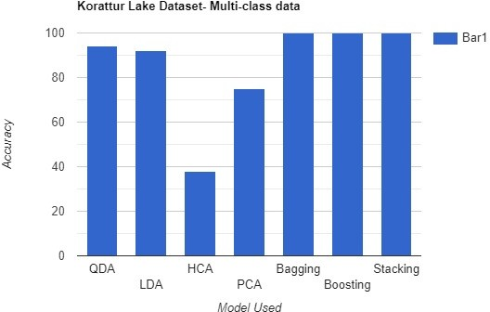
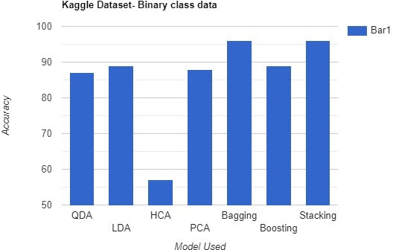
Results

Slide 7
Next Review
Building a hybrid model using the best statistical and ensemble models, that is Quadratic Discriminant Analysis(QDA) and Stacking.
Try Implementing time series forecasting models such as Moving-Average, Exponential Smoothing and Autoregressive Integrated Moving Average (ARIMA).

Slide 8
Thank You

