Slide 1


Quizmine.com
Product Plan & Road Map
Vikramaditya Jakkula
Director-Products
Quizmine.com

Slide 2

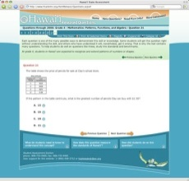




Agenda
Products Roadmap 2009 - 2010
Mastering Series
Mastering Everyday Maths
Mastering Advanced Maths
Exam Engine
Exam Portal for SAT,GRE,GMAT,CAT Online
Games for Elementary Kids – Flash
Games for High School Kids – Flash
iPhone Games - Educational
Games

Slide 3
Mastering Series
Mastering Everyday Maths
  Infinite question generation for everyday maths:
    Mastering money and time
    Mastering estimation
    Mastering Commission
    Mastering Discount
    Mastering Sales Tax
    Mastering Price with Sales Tax
    Mastering Shipping
    Mastering Simple Interest
    Mastering Estimating Tips
Mastering Advanced Maths
  Infinite question generation for advanced maths:
    Mastering fractions
    Mastering exponents
    Mastering percents
    Mastering rounding

Slide 4
Exam Engine
Exam Engine Portal
  Adaptive exam engine for standardized tests:
    SAT
    GRE
    GMAT
    CAT
  Informational Tools for various components of the tests:
    Vocabulary
    Writing
    Reading
    Maths

Slide 5
Quizmine Games
Quizmine Games Portal
  Games for Elementary Kids:
    Word Picker : Social
    Word Picker: Science
  Games for Middle and High School Kids:
    Math-o-Matics
    Math-Matches : Squares, Arithmetic Operations, Rounding, Finance
    Know your universe
    Jr. Doctor: Explore human body
  iPhone Games
    Maths Game
    QScience: Trainer for high school kids

Slide 6
Product Schedule
(2009-2010)
8-month schedule highlights
Mastering Basic Maths
Quizmine Games V1
Exam Engine
M 1
Quizmine Games V2
Beat the Machine
M 4
Challenge Your Opponent
M 2
Mastering Advanced Maths
Mastering Everyday Maths
M 3
May
Jun
July
Sep
Oct
Nov
Dec
Jan
Feb
Mar
Apr

Slide 7
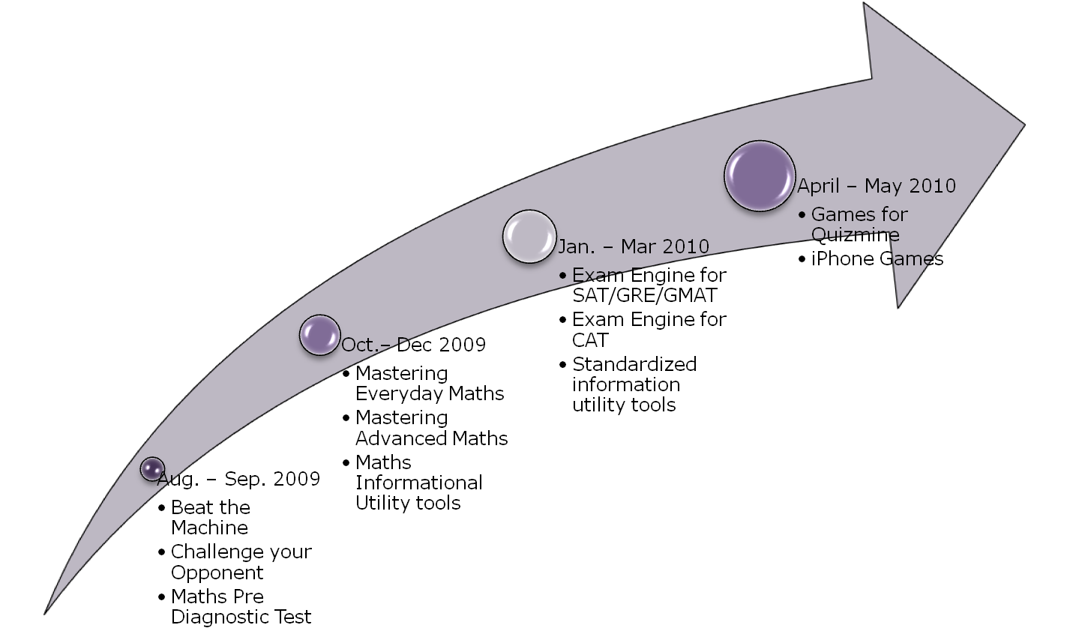
Product Road Map
(2009-2010)

Slide 8
Success Metrics
First year goals
  Increased User base with 5000 more registered users.
  Increased site traffic .
  Improved conversion of users to paid subscribers have 100 + paying customers.
  Less maintenance or patch releases.
Requirements for success
  Stable, scalable architecture with user friendly products design.
  Increased testing and feedback.
  Good hired staff.

Slide 9
Hiring Needs &
Updates
August – September 2009
  Skills needed: ASP.NET, C#, Sql Server
  Current Head Count:
    On-going part-time employee: 1
  Open Head Count:
    Intern – 2, Part-time employee: 1
October – December 2009
  Skills needed: ASP.NET, C#, Sql Server
  Current Head Count: Nil
  Open Head Count:
    Intern – 2, Part-time employee: 2
January – March 2010
  Skills needed: ASP.NET, C#, Sql Server
  Current Head Count: Nil
  Open Head Count:
    Intern – 2, Part-time employee: 2
April – May 2010
  Skills needed: Flash, iPhone Developer
  Current Head Count: Nil
  Open Head Count:
    Intern – 2, Part-time employee: 2

Slide 10
Learn Maths and Science via Animation and Video

