Slide 1
Blackjack
Vikramaditya Jakkula

Slide 2
Black Jack
Blackjack or twenty-one is a card game where the player attempts to beat the dealer, by obtaining a sum of card values that is equal to or less than 21 so that his total is higher than the dealer's. The probabilistic nature of the game makes it an interesting test bed problem for learning algorithms, though the problem of learning a good playing strategy is not obvious. Learning with a teacher system is not very useful since the target outputs for a given stage of the game are not known. Instead, the learning system has to explore different actions and develop a certain strategy by selectively retaining the actions that maximize the player's performance. We have explored the use of blackjack as a test bed for learning strategies in neural networks.

Slide 3
Goal
One of the goals of this project is to develop a better strategy for the dealer with ANN and reinforcement signaling (reward mechanism) that makes the Dealer’s learn its environment rather than simple standard rule, and, the new strategy will have a higher wining percentage. We also include two ways of dealer exploring its strategies and also compare them.

Slide 4
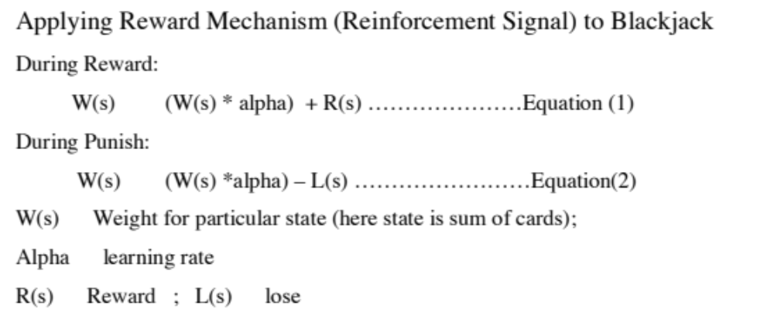
Reinforcement Signal

Slide 5
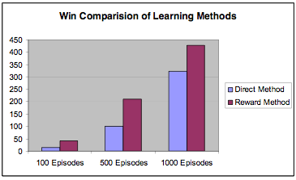
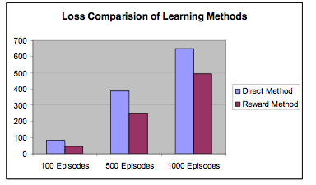
Result

