Slide 1
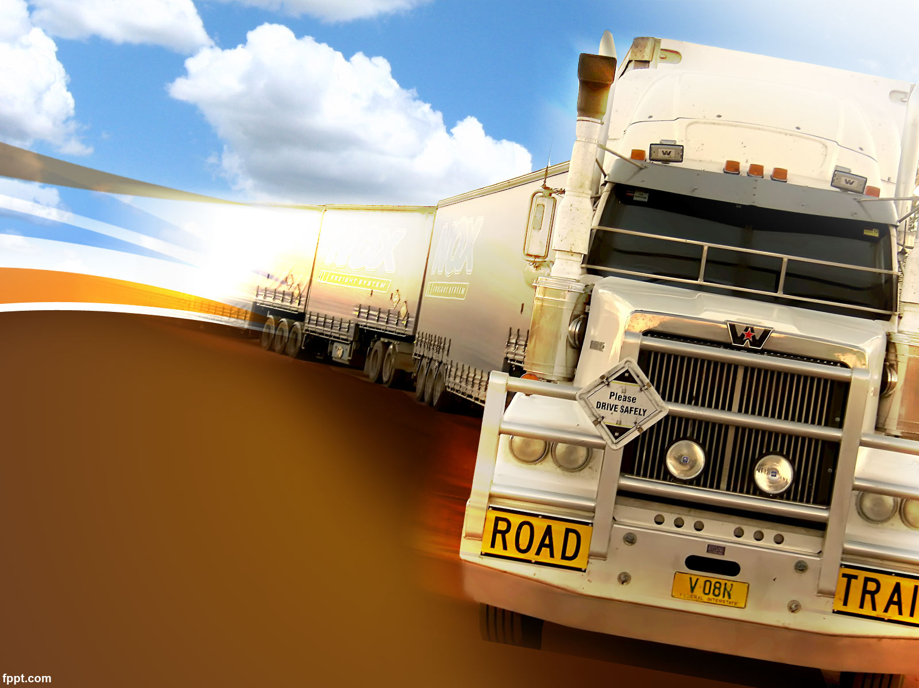
FREIGHT TRUCKS
R.VIKRAMAN
R.VISHNU RAJ
R.VINAYAK

Slide 2
Website for Frieght Trucks
Freight Companies are the companies that
Specialize in the moving of freight or cargo from one place to another place
The most common multi-modal way of
Shipping is reffered to as inter modal meaning
Truck delivery
Frieight trucks come in different types ranging from
Small pickups and semi trailers that haul small to large goods to heavy haulers that can handle oversized cargo

Slide 3
Problem statement
Problem Statement
Indian Logistics Supply market (trucking) is a very fragmented market and there is no generalization or standards in terms of processes, pricing or service level.
Shippers:
Normal practice: Shippers would use freight brokers as a middle man to match them with available truckers, taking a commission in the process.
Not Having Access to the Right Shipping Options and not getting the best price
Having Reliable and Accessible Shipment Tracking
Truck Companies:
Driver shortage due to lower pay

Slide 4
2.For trucking companies, the costs of running a business add up fast. From fuel, which can amount to 34% of trucking costs, to maintenance and tires, which together eat another 10%, these significant costs are an endless challenge. While some larger companies can offset these expenses by negotiating bulk discounts, most have to pay full price to keep their trucks on the road.
Design a mobile platform of an ideal marketplace for trucking services. Design the experience from the perspective of Shippers. Digitisation, Visibility and Analytics can be three pillars of the product.
Solution
Shippers:
Real-time tracking of goods transport and Geofence.
No need to wait for Freight for a long time.
Removes the need for a middle man.
Truck Drivers/Companies:
Drivers also get information on what they are hauling as well as how much they’ll be paid.
Can find their next job right from the app
Easy billing and payment

Slide 5
What is the need to use freight booking website?
Using a freight booking site simplifies the process of booking cargo transportation services. It eliminates the need to contact multiple carriers and makes it easy to compare prices, track shipments, and access customer support. The site also offers a range of payment options, making it easy to pay for services. Customers can also take advantage of real-time updates, allowing them to stay informed about their shipment's status.

Slide 6
Benefits of using a freight booking website
Using a freight booking site offers numerous advantages. It eliminates the need to contact multiple carriers and simplifies the process of booking cargo transportation services. Customers can easily compare prices, track shipments, and access customer support.
The site also offers a range of payment options, making it easy to pay for services. Customers can also take advantage of real-time updates, allowing them to stay informed about their shipment's status.

Slide 7
About our website
We have an administrater,admin is the role with
The highest level of access to your website.Admins can add content on all pages
And access all items in the admin toolbar
An admin provides office support to either
an individual or team and is vital for the smooth-running of a business
An office admin is a professional who oversees opertions across their organization’s
office
We can easily book the trucks on our website through online
We can made our customer to directly communicate to admins to book the trucks and make the payment easily between owner and the customer.

Slide 8
Database
Freight data is collected through different sources. These sources include online websites, the government, shipping companies, transport and logistics reight data is collected through different sources. These sources include online websites, the government, shipping companies, transport and logistics firms, and transportation agencies. These sources record and organize data in the forms of graphs, charts, figures, volumes, and statistical data. Before forming accurate datasets, freight data undergoes data cleansing and filtering to avoid duplication and to eliminate unnecessary information.
firms, and transportation agencies. These sources record and organize data in the forms of graphs, charts, figures, volumes, and statistical data. Before forming accurate datasets, freight data undergoes data cleansing and filtering to avoid duplication and to eliminate unnecessary information.

Slide 9
Security
A freight booking site offers a secure environment for customers to book cargo transportation services. The site uses encryption technology to protect customer data and ensures that all transactions are secure.
The site also has a range of safety features, such as fraud prevention and identity verification. These features help protect customers from fraud and ensure that their data is safe.

Slide 10
THANK YOU

