Slide 1
REACT PORTAL

Slide 2
React portals provide a first-class way to render and allow child components.
This React portal component exists outside the DOM hierarchy of the parent component.
What is React Portal?

Slide 3
Syntax of React Portal
Element, String, or Fragment
ReactDOM.createPortal(child, container)
DOM element

Slide 4
The Importance of Using Portals
React portals can use context to transfer data.
Event Bubbling
A portal behaves just like a standard component of React, and it can be anywhere in the DOM tree.
It has all the power that other components in React have.

Slide 5
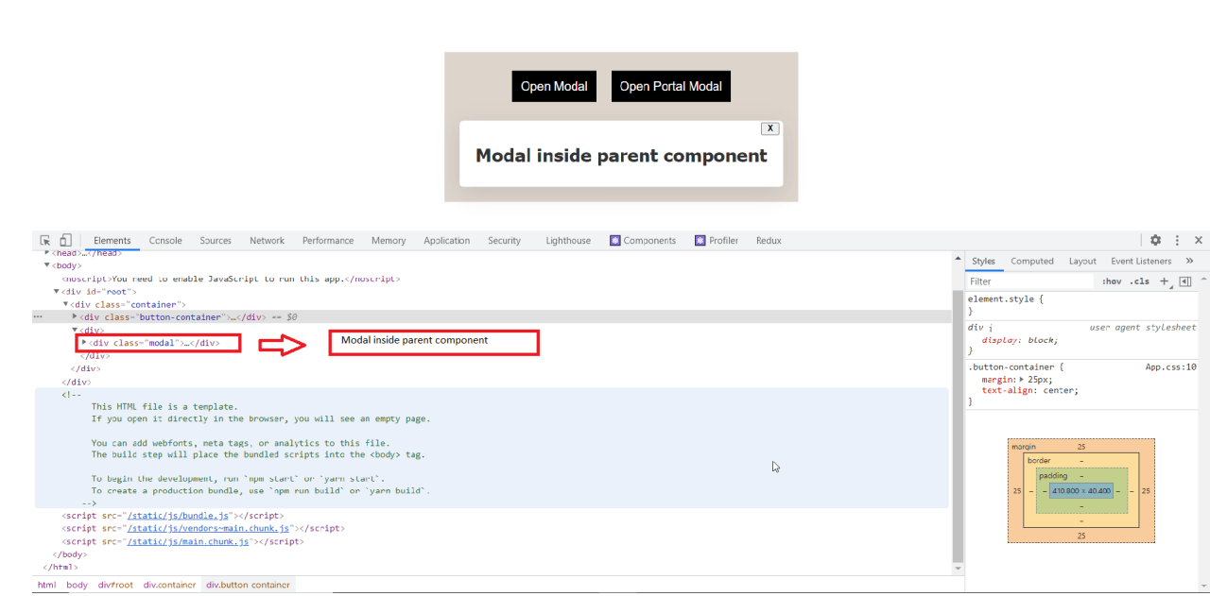
When You Should Use a Portal

Slide 6
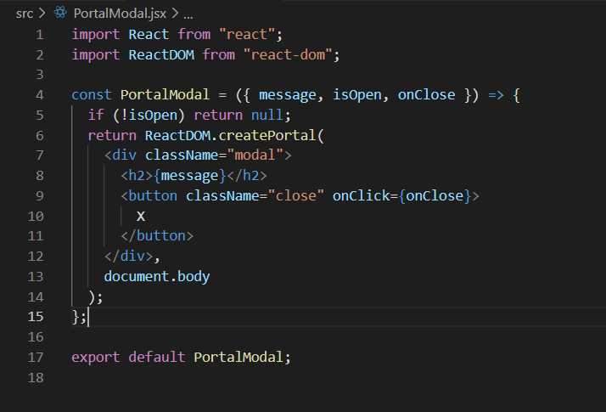
How to Use a Portal…
using the “createPortal()” to create a DOM node outside the root tree hierarchy.

Slide 7
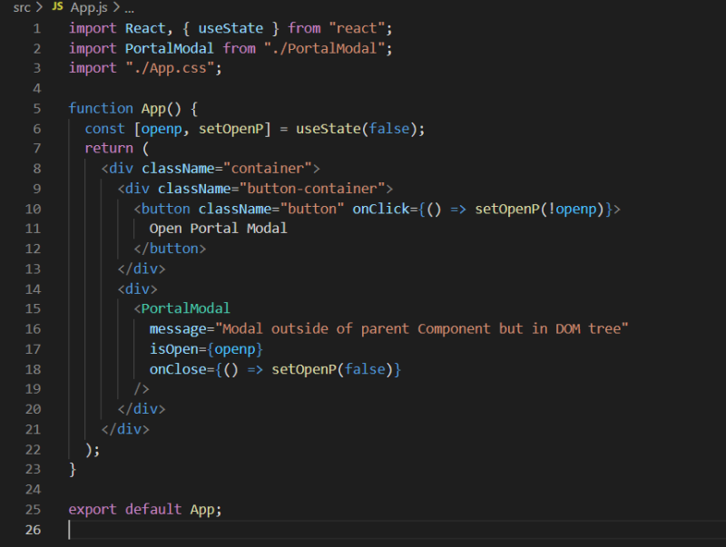
How to Use a Portal...

Slide 8
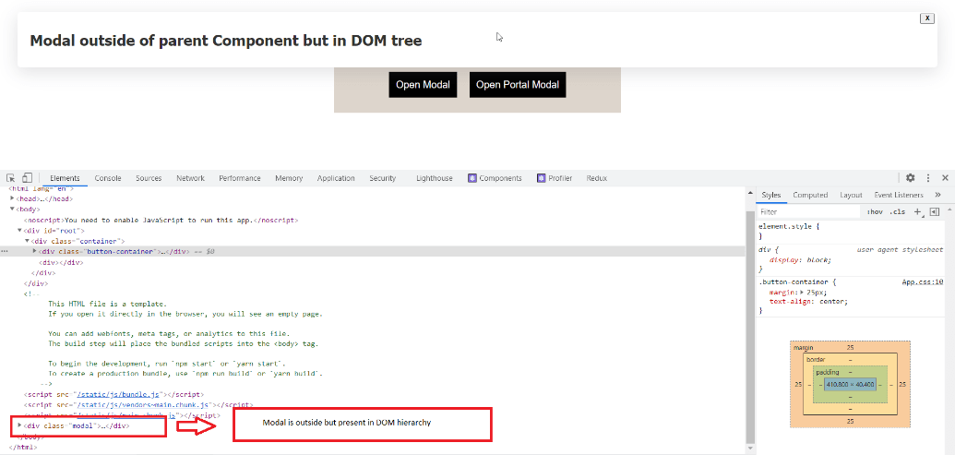
How to Use a Portal...

Slide 9
React Portals Are Easy to Understand
Even when the component resides outside the DOM hierarchy, we can use React portals to work as we usually would in the hierarchy.
Conclusion

Slide 10
Thank You!

