Slide 1
Connecting
React & Spring Boot

Slide 2
What is Spring Boot?
Spring Boot is an open-source, microservice-based Java web framework.
It allows you to create REST APIs with minimal configurations.
A few benefits of using Spring Boot for your REST APIs include: No requirement for complex XML configurations.

Slide 3
What is ReactJS?
React is a free and open-source front-end JavaScript library for building user interfaces based on UI components.
It is maintained by Meta(A.K.A, Facebook) and a community of individual developers and companies.
It lets you compose complex UIs from small and isolated pieces of code called “components”.

Slide 4
Project Architecture
Spring Boot
React
Axios
HTTP
Library
DAO Layer
MySQL or PostgreSQL
Router
Components
Service
controller
Service

Slide 5
Creating the Entity Class:
@Entity
@Table(name = "users")
public class UserEntity {
@Id
@GeneratedValue(strategy = GenerationType.IDENTITY)
private int id;
@Column(name = "user_name", nullable = false, length = 100)
private String name;
private String email;
private String password;
private String about;
public int getId() {
return id;
}
public void setId(int id) {
this.id = id;
}
public String getName() {
return name;
}

Slide 6
Creating the DAO interface:
@Repository
public interface UserRepository extends JpaRepository<UserEntity,Integer> {
}

Slide 7
Service interface and its implementation:
public interface UserService {
public List<UserDTO> getUsers();
}
@Service
public class UserServiceImpl implements UserService {
@Autowired
UserRepository userrepo;
@Override
public List<UserDTO> getUsers() {
return UserUtils.convertToUserDtoList(userrepo.findAll());
}

Slide 8
Controller Class:
@CrossOrigin(origins = "http://localhost:3000/")
@RestController
@RequestMapping("/user")
public class UserController {
@Autowired
UserService userservice;
@GetMapping("/get_users")
public List<UserDTO> viewUserList() {
List<UserDTO> user = userservice.getUsers();
return user;
}
}

Slide 9
Application.properties:
server.port= 8085
spring.datasource.url=jdbc:postgresql://localhost/Database_name
spring.datasource.username=username
spring.datasource.password=password
spring.datasource.driver-class-name=org.postgresql.Driver
spring.jpa.properties.hibernate.dialect=org.hibernate.dialect.PostgreSQL10Dialect
spring.jpa.hibernate.ddl-auto=update
spring.jpa.show-sql=true

Slide 10
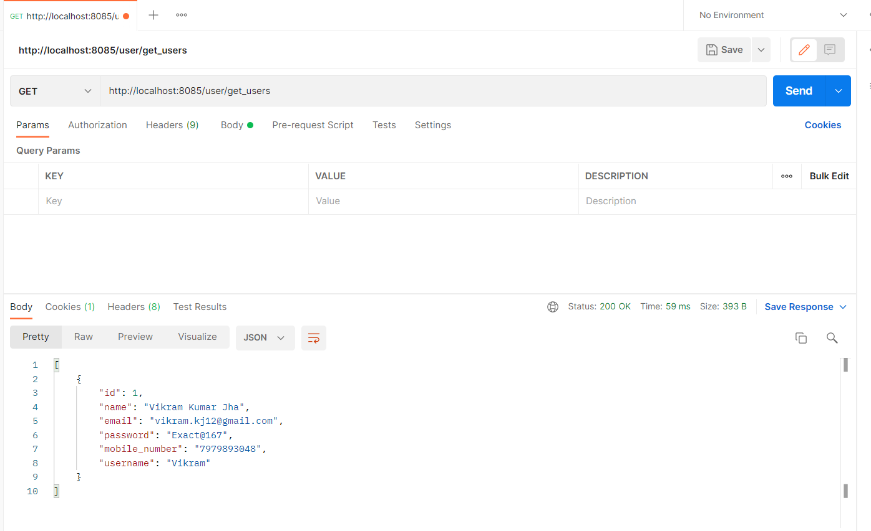
Hitting API using Postman :

Slide 11
Creating ListUser component:
import React, { useEffect, useState } from "react";
import UserService from "../Services/UserService";
function ListUser() {
const [users, setUsers] = useState([]);
useEffect(() => {
UserService.getUsers().then((res) => {
setUsers(res.data);
});
}, []);
<tbody>
{users.map((user) => (
<tr key={user.id}>
<td>{user.name}</td>
<td>{user.username}</td>
<td>{user.email}</td>
<td>{user.mobile_number}</td>
</tr>
))}
</tbody>
</table>
</div>
</div>
);
}
export default ListUser;
return (
<div className="container text-center">
<h2 className="text-center">User List</h2>
<div className="row">
<table className="table">
<thead>
<tr>
<th>Name</th>
<th>User Name</th>
<th>Email</th>
<th>Mobile Number</th>
<th>Action</th>
</tr>
</thead>

Slide 12
Creating UserService component:
import axios from "axios";
const User_API_BASE_URL = "http://localhost:8085/user/get_users";
class UserService {
getUsers() {
return axios.get(User_API_BASE_URL);
}
}
export default new UserService();

Slide 13
Adding ListUser in App.js:
import 'bootstrap/dist/css/bootstrap.min.css';
import ListUser from './components/ListUser';
function App() {
return (
<div className="App">
<ListUser/>
</div>
);
}
export default App;

Slide 14
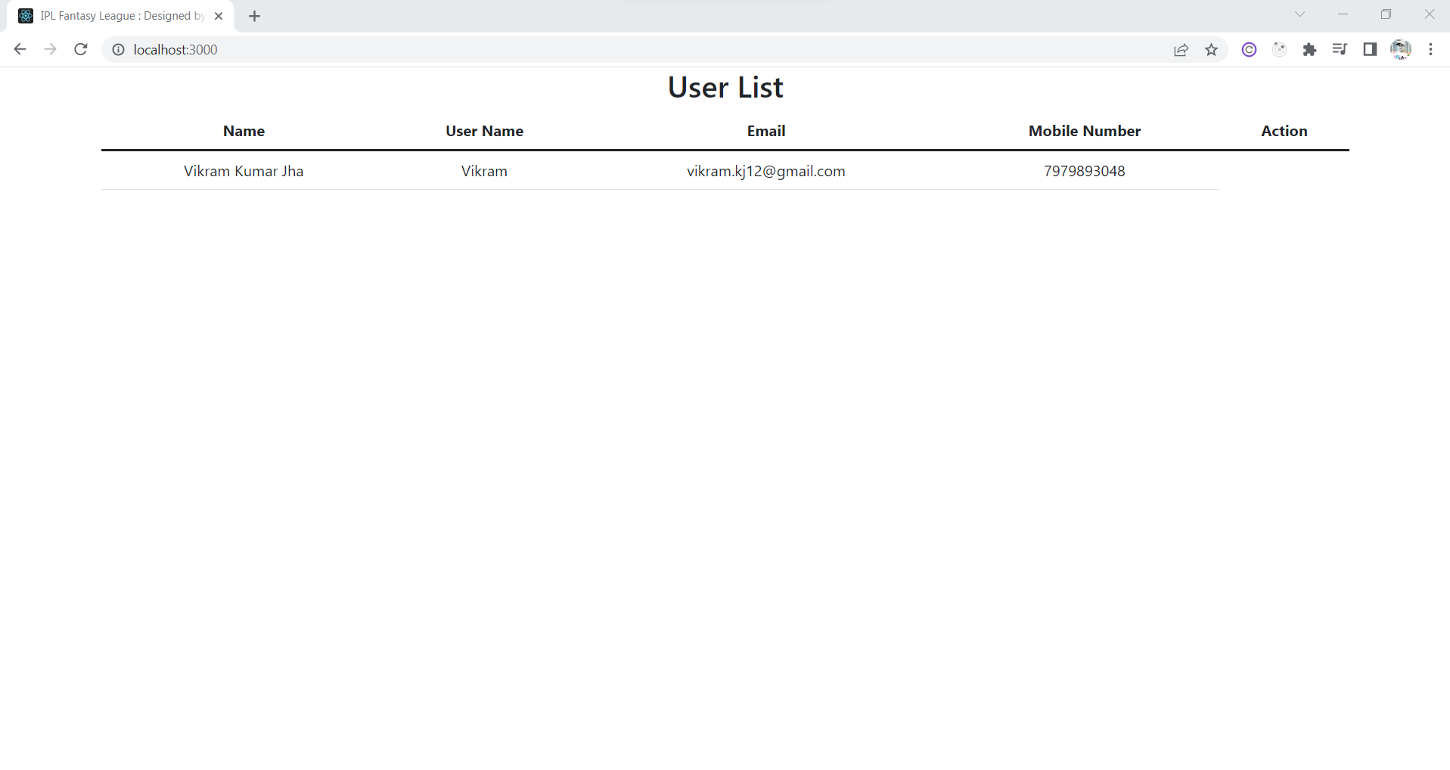
Getting the user List:

Slide 15
Summary:
Created the Entity class with all the required variables.
Created a DAO interface that implements the JPA Repository.
Created a Service interface and its implementation with the getUser() method.
Map the controller class with @GetMapping to create the URL.
Here, we were done with the API part.
We have checked the data by hitting API through Postman.
Created the ListUser functional component.
Created the UserService class.
Added the ListUser in the App.js file.
We have successfully achieved the data from the API we have created using Spring Boot.

Slide 16
Thank You

