Slide 1
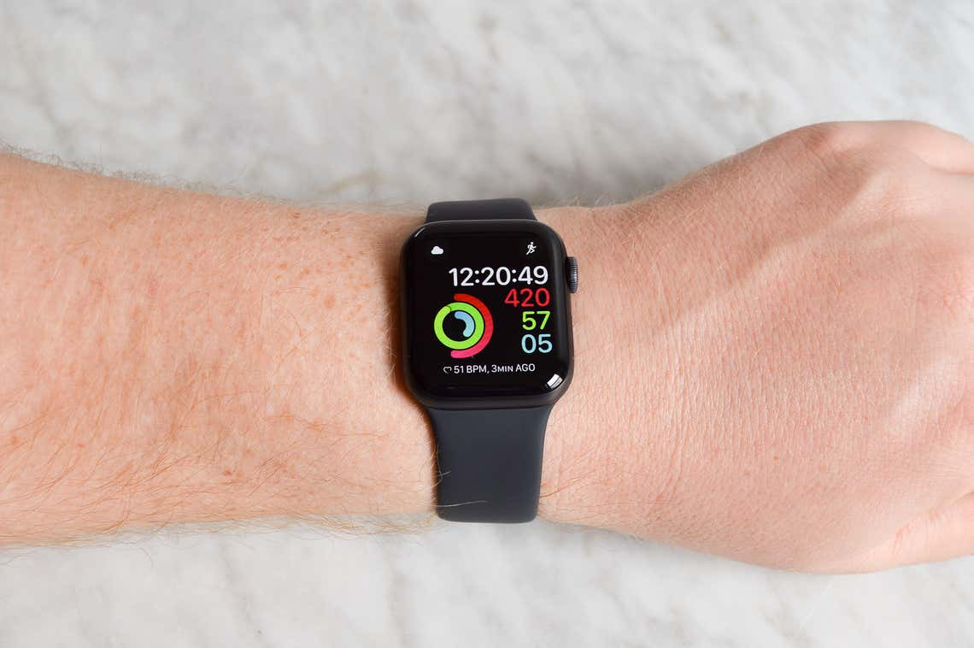
Smart watches for healthcare
Thrivikram , SE20UECE096
Kaundinya , SE20UECE034
Krishna swamy, SE20UECE037
Likhitha Sai, SE20UECE096
under the guidance of
Dr. Ankita Jain,
Assoc. Prof, MEC
Notes:
1

Slide 2
Introduction
Smart watch is a wearable computer that is designed to be worn on the wrist, similar to a traditional wristwatch. It offers features and functions that go beyond time keeping, such as activity tracking, health monitoring, phone notifications, and voice assistants, among other things. When it comes to healthcare mart watches can be helpful in various ways.
There are some main sensors that help that smart watches to predict human health those are Calorimeter, Pedometer, Sleep monitor, Bio-impedance sensor, GPS and tracking, Heart rate sensor, body composition, oxygen level sensing.
Smart watches use M.L algorithms to analyse the data collected from sensors and provide insights on body composition. These algorithms can learn and improve over time, allowing for more accurate and personal information.

Slide 3
Motivation
We had more interest to know the technology used in smart watches like how the sensors work in it, how it measures heartbeat, oxygen level, body composition, level of fat, water in body also lean mass.
We are very interested in knowing the working of different kinds of sensors and how they are useful to health care.
We are interested in doing coding using M.L Algorithms so that we can import the datasets of smart watch and work on it.
Finally, lot of improvements and working with sensors used in smart watches for healthcare is a good experience to learn.

Slide 4
Related Work
This systematic review examined the uses of smart watches for health and wellness.
The researchers, Blaine Reeder and Alexandria David from the University of Colorado, looked at various studies to gather information.
In simple words, the review found that smart watches can be helpful for monitoring and improving health. They can track things like heart rate, sleep patterns, and physical activity.
Smart watches can also provide reminders for medication and help manage stress through features like guided breathing exercises.
Overall, the review suggests that smart watches have the potential to support people in maintaining a healthy lifestyle and managing their well-being. However, it's important to note that more research is needed to fully understand their effectiveness and potential limitations.

Slide 5
Overview of Data Sets
We have collected the data sets from WISDM M.L UCI repository. We are taking only smart watch data. In that there are 2 sensors accelerometer and gyroscope.
In each sensor there are 50 patients. So, total 100 patients if we combined both of them. In each patient data there are six columns like patient id, activity, timestamp, x-axis, y-axis, z-axis. These are accelerometer sensor axis. Each of them has its own function.
The attributes are patient id, activity, timestamp, x-axis, y-axis, z-axis. And to know about the data sets ‘Readme’ files are for data set description. And finally, we do feature extraction using these data sets.
It refers to transferring raw data into required features while processing the original data sets.

Slide 6
Algorithm used
We have used decision trees algorithm, previously we used SVM, logistic regression, KNN etc. but we’ve got the correct accuracy for decision tree algorithm. It’s supervising learning technique for classification and regression problems.

Slide 7
Implementation Steps
The dataset was obtained from the WISDM UCI repository, specifically focusing on smartwatch data. The dataset comprises accelerometer and gyroscope sensor readings from 50 patients, resulting in a total of 100 patient datasets.
The first thing is importing all the libraries into the jupyter.
Reading all the raw data files and data cleaning is done like removing all the null values and duplicate values.
Now, plotting the data as per the activity like for the given activity is depicted towards x-axis and corresponding number of smaples (count) is depicted on y-axis.
Splitting the data into 2 parts one is the training data and other one is testing the data. The training data will be of 80% of whole data and the testing data is of 20% .
And from the original data we’re trying to import all the statistical features like Mean, std deviation, Median absolute deviation(mad) , Maximum value, Minimum value, signal magnitude(sma), energy , Interquartile range(iqt), Correlation between axis(Cxy).
So, here basically we are importing these feautures for both training and testing data also. So for each feauture there is training and testing implementation.
This process is called the feature extraction.
After all the feature extraction is completed, Now we are assigning these features into the training labels and testing labels.
We are using the logistic regression to perform the classification. We are passing all the training data and fitting into a model.

Slide 8
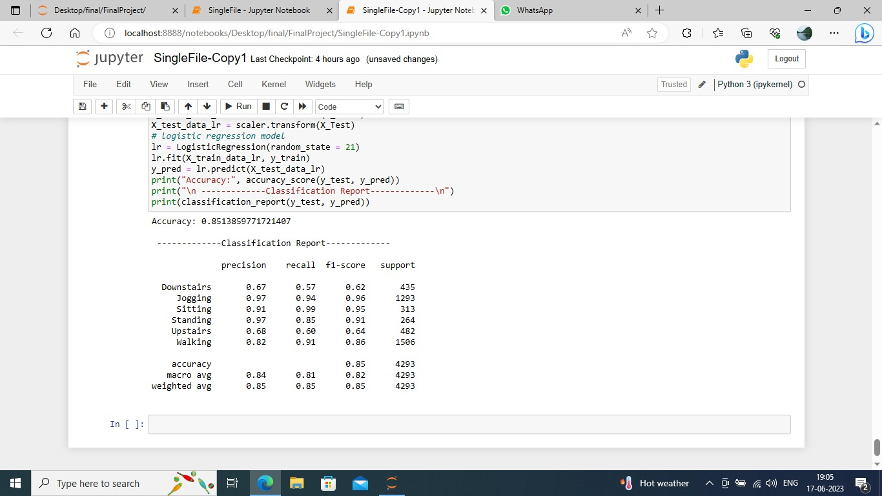
Results

Slide 9
Thanks !
Q&A
Notes:
9

