Slide 1
Analysing the impact of population,Environment and Health
(Team 5)
Team Members:
Jyothirmai Vallakati - 11697705
Manohar Varma Buddharaju - 11724300
Keerthi Yanala - 11629948
Pranay Rajana - 11667766

Slide 2
Introduction
Domain:
Analyzing of Population, Environment, and Health
This presentation focuses on the analysis of key factors impacting population dynamics, environmental sustainability, and public health.
Our goal is to explore the interplay between population trends, environmental factors such as CO2 emissions, and indicators of public health such as life expectancy.
By understanding these relationships, we aim to provide insights that can inform policy decisions, interventions, and strategies aimed at promoting sustainable development and improving public health outcomes.

Slide 3
Data Abstraction
Dataset:
Type: Three structured datasets CO2 emissions, population statistics, life expectancy data.
Attributes: Each dataset contains attributes such as year, country, CO2 emissions (metric tons per capita), population, life expectancy, GDP (in USD), etc.
Number of Records:
The number of records varies depending on the dataset.
The CO2 emissions dataset contain annual records for multiple countries spanning several decades, while the population dataset include population figures for each country over time.
Data Transformation:
Aggregation: Aggregating CO2 emissions data into 5-year intervals to smooth trends.
Binning: Binning urban population data to analyze its impact on life expectancy.

Slide 4
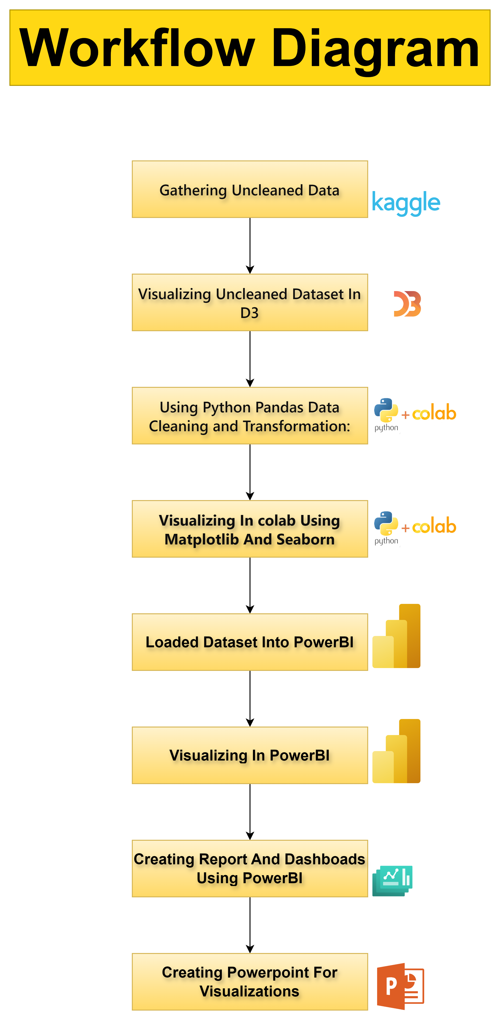

Slide 5
Above Workflow Explaination
Data Collection:
Getting relevant datasets from Kaggle, a popular platform for data science datasets.
Initial Visualization:
Utilizing D3.js to visualize the uncleaned dataset, providing an initial overview of the data's structure and potential insights.
Data Cleaning:
Using Python programming language and libraries like Pandas and NumPy to clean the dataset, handling missing values, outliers, and inconsistencies.
Refined Visualization:
Using Python's data visualization libraries such as Matplotlib or Seaborn to create more refined visualizations based on the cleaned dataset, focusing on specific variables of interest.
Dashboard Creation:
Utilizing Microsoft Power BI to design interactive dashboards and reports, incorporating the refined visualizations to provide a comprehensive view of the analyzed data.
Report Generation:
Creating detailed reports summarizing the analysis findings, insights, and conclusions drawn from the visualizations and data analysis process.

Slide 6
Task Abstraction
Task:
Target:
Analyzinf the impact of population, environment, and health factors.
Actions:
Select relevant datasets: Choose datasets containing CO2 emissions, population statistics, life expectancy data, GDP figures.
Design visualizations: Planning and creating visualizations such as line charts, histograms, scatter plots, and box plots to explore relationships between variables.
Implement visualizations: Developing visualizations using tools like D3.js, Python, and Microsoft Power BI.
Analyze insights: Interpreting visualizations to identify trends, correlations, and patterns in the data.
Draw conclusions: Using insights from visualizations to draw conclusions about the impact of population, environment, and health factors on global and regional trends.

Slide 7
Implementation using Tools
Tools Used:
D3.js:
Description: D3.js (Data-Driven Documents) is a JavaScript library commonly used for creating dynamic, interactive data visualizations in web browsers. It offers powerful capabilities for manipulating HTML, SVG, and CSS to generate custom visualizations.
Purpose: Initial visualization of uncleaned dataset, providing interactive charts to explore the data's structure.
Python:
Description: Python is a versatile programming language with a rich ecosystem of libraries for data manipulation, analysis, and visualization. Libraries such as Pandas, NumPy, Matplotlib, and Seaborn are commonly used for data processing and visualization tasks.
Purpose: Data cleaning, refining visualizations, and creating more sophisticated charts and plots based on the cleaned dataset.
Microsoft Power BI:
Description: Microsoft Power BI is a business analytics tool that enables users to visualize and analyze data, create interactive reports, and share insights across their organization. It offers a range of features for data visualization, data modeling, and dashboard creation.
Purpose: Designing interactive dashboards and reports, incorporating visualizations to provide a comprehensive view of the analyzed data

Slide 8
Results for Analysis

Slide 9
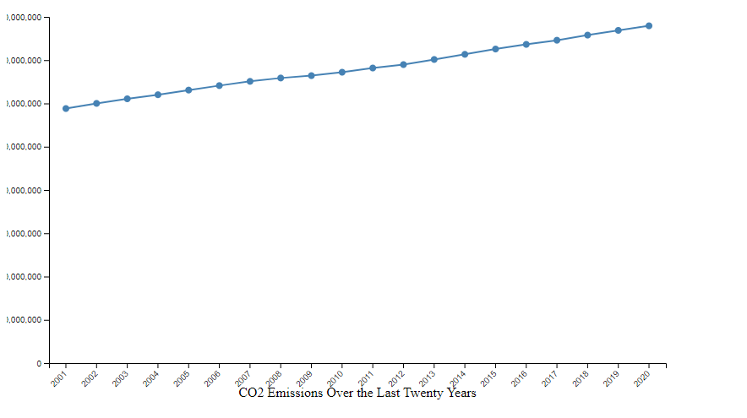
CO2 Emissions Using D3.js
Visualization: Line chart showing CO2 emissions over the years.
Explanation: This visualization presents an overview of global CO2 emissions trends over time. It helps viewers understand how CO2 emissions have changed globally over the years.
Storytelling: "Over the past few decades, global CO2 emissions have shown varying trends. From the early years, where emissions were relatively low, to the recent years where emissions have surged, this chart reveals the significant impact of human activities on carbon emissions."

Slide 10
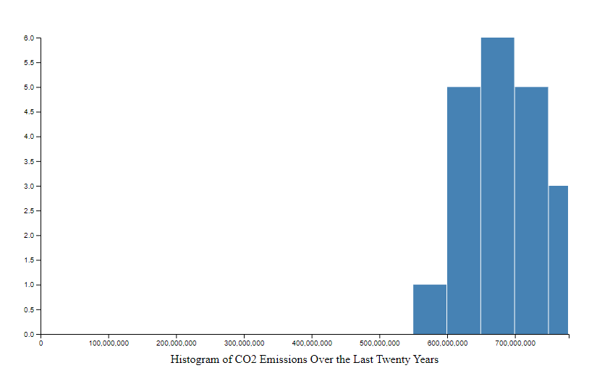
CO2 Emissions Distribution:
Visualization: Histogram showing the distribution of CO2 emissions across different emission levels.
Explanation: This histogram highlights the distribution pattern of CO2 emissions. It helps in understanding the frequency of emissions falling within different ranges.
Storytelling: "Understanding the distribution of CO2 emissions is crucial for addressing climate change. By examining this histogram, we can identify the most common emission levels and assess the need for targeted emission reduction strategies."

Slide 11
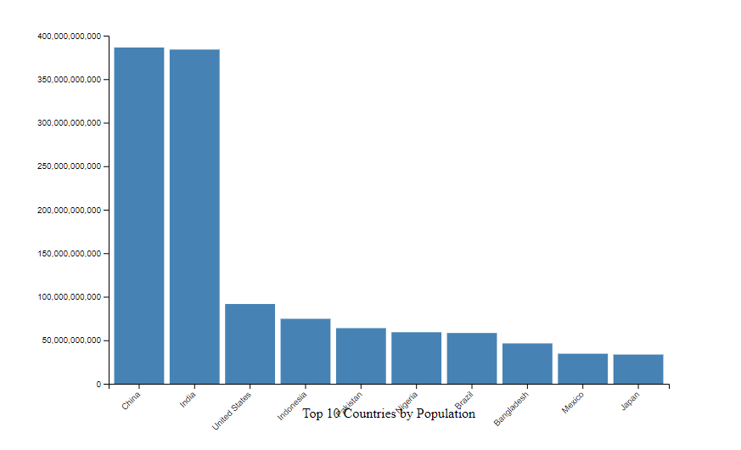
Top 10 Countries by Population:
Visualization: Bar chart showing the top 10 countries by population.
Explanation: This visualization ranks countries based on their population size, allowing viewers to compare the population of different countries visually.
Storytelling: "Population size varies significantly across countries. From populous nations like China and India to smaller countries like Japan and Russia, this bar chart illustrates the diversity in population distribution around the world."

Slide 12
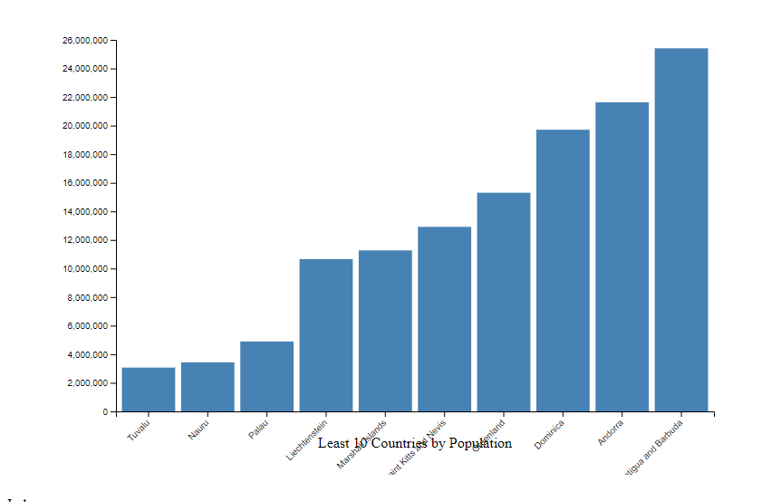
Least 10 Countries by Population:
Visualization: Bar chart showing the least 10 countries by population.
Explanation: This visualization highlights the countries with the smallest populations, providing insights into less populated regions.
Storytelling: "While some countries boast large populations, others have relatively small populations. Exploring the least 10 countries by population reveals insights into regions with lower population densities and their unique demographic challenges."

Slide 13
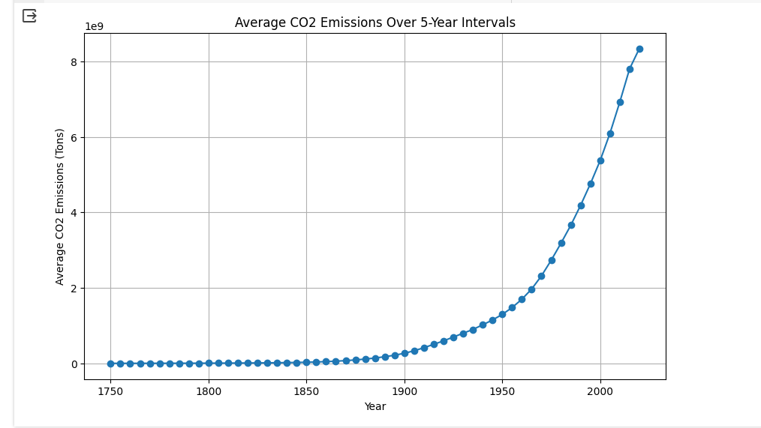
Visualisation Using Python While filtering Data:
Visualization :Line chart showing the average CO2 emissions over 5-year intervals.
Explanation :This visualization aggregates the CO2 emissions data into 5-year intervals and calculates the average emissions for each interval. It provides a smoothed overview of CO2 emission trends, reducing noise and fluctuations observed in annual data.
Storytelling : "Analyzing CO2 emissions on an annual basis can sometimes obscure long-term trends due to yearly fluctuations. To address this, we aggregate the data into 5-year intervals, providing a more stable view of CO2 emission trends over time. This line chart illustrates how average CO2 emissions have evolved over these intervals, offering insights into the broader patterns of carbon emissions and their impacts on climate change. From the early years with relatively low emissions to the recent decades where emissions have soared, this visualization helps us understand the trajectory of CO2 emissions and the urgency of addressing environmental challenges."

Slide 14
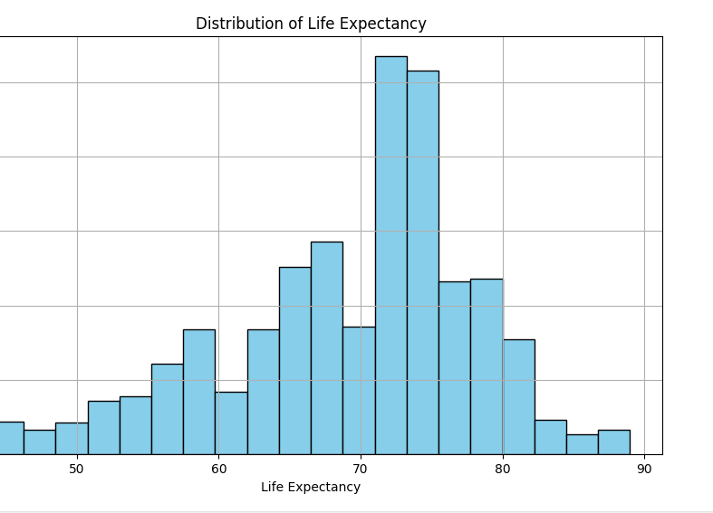
The distribution of life expectancy
Visualization: Histogram showing the distribution of life expectancy.
Explanation: This visualization provides insights into the distribution of life expectancy across a population. It segments life expectancy values into bins and counts the frequency of values falling within each bin. By visualizing the distribution, we can understand the typical range of life expectancies and any potential patterns or outliers.
Storytelling: "Life expectancy is a critical indicator of overall population health and well-being. By examining the distribution of life expectancy values through this histogram, we gain valuable insights into the demographic characteristics of a population. The shape of the histogram reveals the typical range of life expectancies within the population, with peaks indicating common life spans and tails representing outliers. Understanding the distribution of life expectancy is essential for policymakers, healthcare professionals, and researchers to address disparities in healthcare access, improve public health interventions, and enhance overall quality of life."

Slide 15
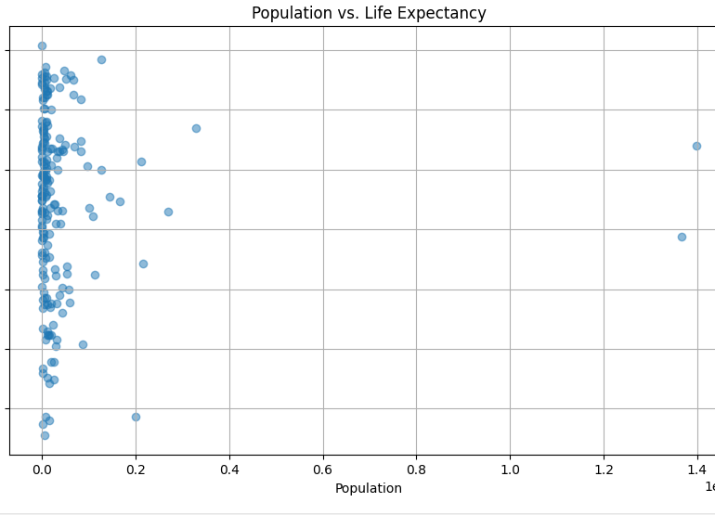
The scatter plot of population vs. life expectancy:
Visualization: Scatter plot showing the relationship between population and life expectancy.
Explanation: This visualization explores the relationship between population size and life expectancy across different regions or countries. Each point on the scatter plot represents a specific region or country, with its position determined by its population size on the x-axis and its life expectancy on the y-axis. By plotting these two variables together, we can identify any potential correlations or patterns between population size and life expectancy.
Storytelling: "Population size and life expectancy are two key indicators of a region's or country's overall well-being and development. This scatter plot allows us to explore the relationship between these two variables. As we observe the distribution of points, we may notice certain trends emerging. For instance, regions with larger populations may exhibit a wide range of life expectancies, indicating disparities in healthcare access and socio-economic factors. Conversely, regions with smaller populations may show more homogeneous life expectancy values. Understanding the relationship between population size and life expectancy is crucial for policymakers and healthcare professionals to implement targeted interventions aimed at improving public health outcomes and enhancing quality of life."

Slide 16
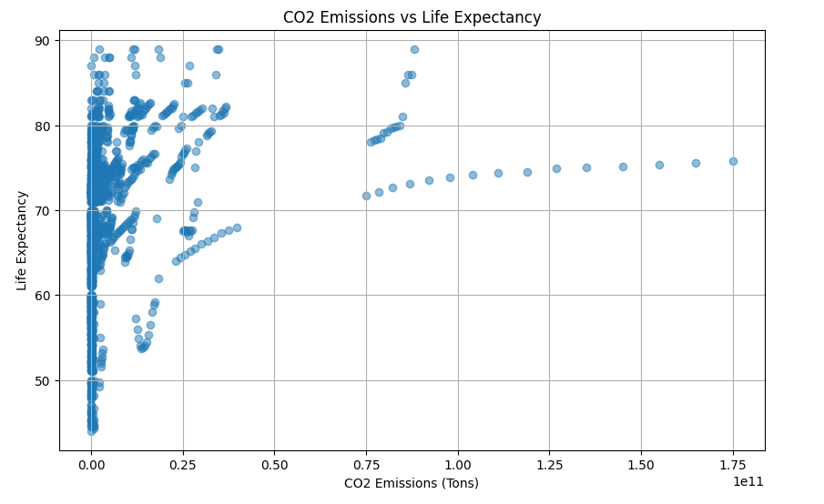
Co2 emissions vs. life expectancy:
Visualization: Scatter plot showing the relationship between CO2 emissions and life expectancy.
Explanation: This visualization examines the relationship between CO2 emissions and life expectancy across different countries or regions. Each point on the scatter plot represents a specific country and year, with its position determined by its CO2 emissions on the x-axis and its life expectancy on the y-axis. By plotting these two variables together, we can explore whether there is any association between carbon emissions and life expectancy.
Storytelling: "The correlation between CO2 emissions and life expectancy is a topic of significant interest in the context of environmental sustainability and public health. This scatter plot allows us to visualize the relationship between these two variables. As we examine the distribution of points, we may discern certain trends or patterns. Countries with higher CO2 emissions may exhibit varying levels of life expectancy, indicating potential impacts of environmental pollution on public health outcomes. Conversely, countries with lower CO2 emissions may demonstrate relatively higher life expectancies. Exploring this relationship can inform policymakers and stakeholders about the potential health implications of carbon emissions and the importance of implementing sustainable practices to safeguard public health and well-being."

Slide 17
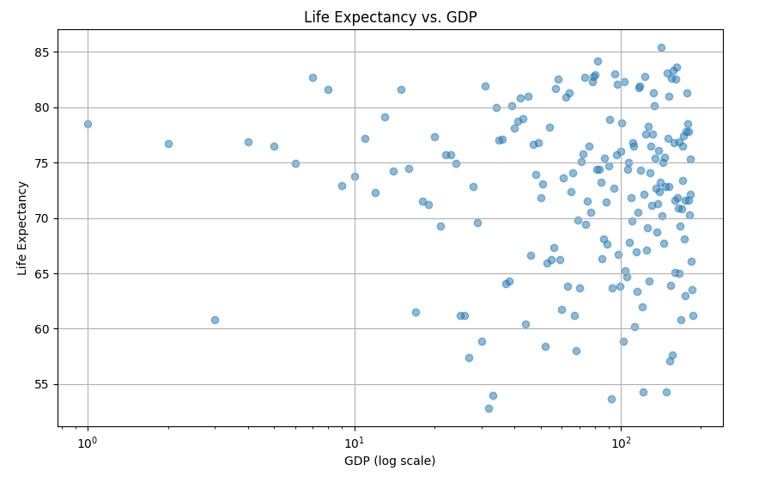
life expectancy vs. GDP:
Visualization: Scatter plot showing the relationship between GDP (Gross Domestic Product) and life expectancy.
Explanation: This visualization explores the relationship between a country's GDP and life expectancy. Each point on the scatter plot represents a specific country, with its position determined by its GDP on the x-axis (using a logarithmic scale) and its life expectancy on the y-axis. By plotting these two variables together, we can examine whether there is any correlation between a country's economic prosperity (as measured by GDP) and the life expectancy of its population.
Storytelling: "The relationship between a country's economic status and the health outcomes of its population is a topic of considerable interest. This scatter plot visualizes the association between GDP and life expectancy across different countries. As we observe the distribution of points, we may notice certain trends emerging. Countries with higher GDPs may exhibit longer life expectancies, reflecting the potential benefits of economic prosperity on healthcare access, infrastructure development, and overall quality of life. Conversely, countries with lower GDPs may demonstrate shorter life expectancies, highlighting the challenges faced by less economically developed regions in providing adequate healthcare and social services. Exploring this relationship can provide valuable insights into the complex interplay between economic factors and public health outcomes."

Slide 18
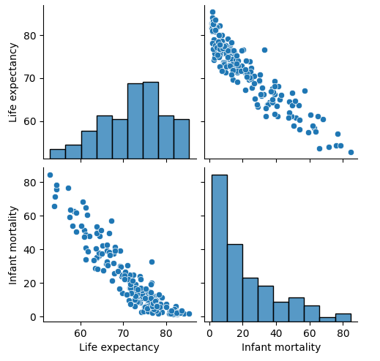
pairplot:
Explanation: The pairplot is a grid of scatterplots and histograms showing the relationships between pairs of variables in the dataset. Each cell in the grid represents the interaction between two variables. The diagonal cells display histograms of individual variables, while the off-diagonal cells display scatterplots showing the relationship between pairs of variables.
Storytelling: "The pairplot provides a comprehensive overview of the relationships between various factors and life expectancy. By examining the scatterplots and histograms in the pairplot, we can identify potential correlations, trends, and distributions among the variables. For example, we can explore how population size, GDP, agricultural land percentage, forested area percentage, infant mortality rate, urban population percentage, and out-of-pocket health expenditure relate to life expectancy. This visualization allows us to identify patterns and associations that may inform further analysis and policymaking efforts aimed at improving public health outcomes and overall well-being."

Slide 19
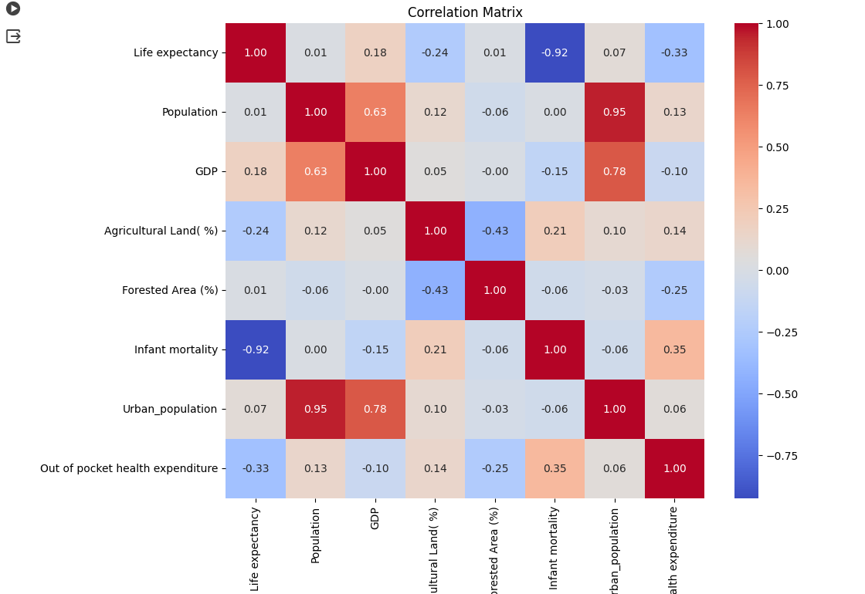
The heatmap of the correlation matrix:
Explanation: The heatmap of the correlation matrix visualizes the pairwise correlations between numeric variables in the dataset. Each cell in the heatmap represents the correlation coefficient between two variables. The color intensity of each cell indicates the strength and direction of the correlation: warmer colors (e.g., red) indicate positive correlations, while cooler colors (e.g., blue) indicate negative correlations.
Storytelling: "The heatmap of the correlation matrix offers valuable insights into the relationships between different factors in our dataset. By examining the color gradients in the heatmap, we can discern which variables are positively or negatively correlated with each other. Strong positive correlations are depicted by warmer colors, suggesting that changes in one variable are associated with corresponding changes in another variable. Conversely, strong negative correlations are depicted by cooler colors, indicating an inverse relationship between variables. This visualization aids in identifying potential multicollinearity among variables and can guide further analysis and modeling efforts to better understand the underlying patterns and drivers of life expectancy."

Slide 20
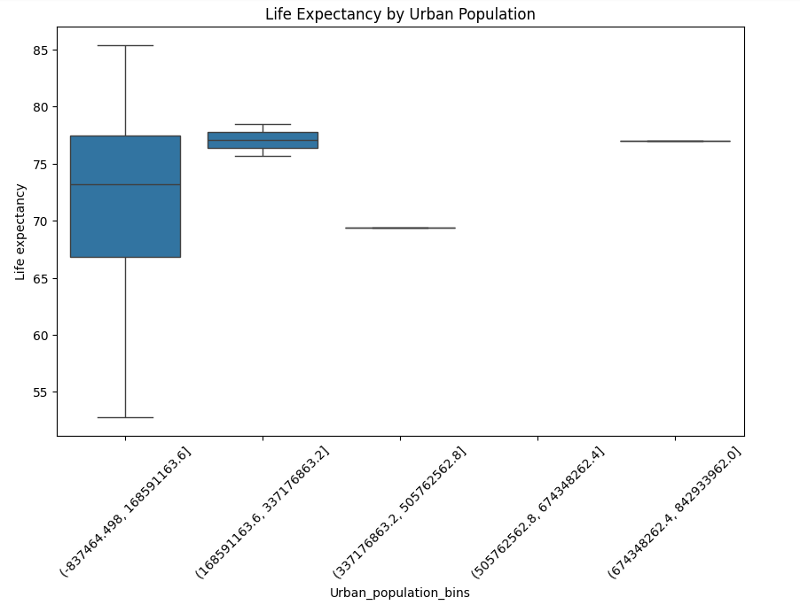
The boxplot of life expectancy by urban population bins:
Explanation: The boxplot visualizes the distribution of life expectancy across different categories of urban population. The 'Urban_population_bins' column is created by binning the 'Urban_population' column into categories, and the boxplot shows the distribution of life expectancy within each bin. The boxplot displays the median, quartiles, and potential outliers in the data.
Storytelling: "The boxplot provides insights into how life expectancy varies across different levels of urban population. By categorizing urban population into bins, we can observe the distribution of life expectancy within each category. The horizontal line within each box represents the median life expectancy, while the box itself spans the interquartile range (IQR), indicating the middle 50% of the data. The whiskers extend to 1.5 times the IQR from the quartiles, and any points beyond the whiskers are considered potential outliers. This visualization allows us to compare the central tendency and spread of life expectancy across different levels of urban population, helping us understand how urbanization may impact public health outcomes."

Slide 21
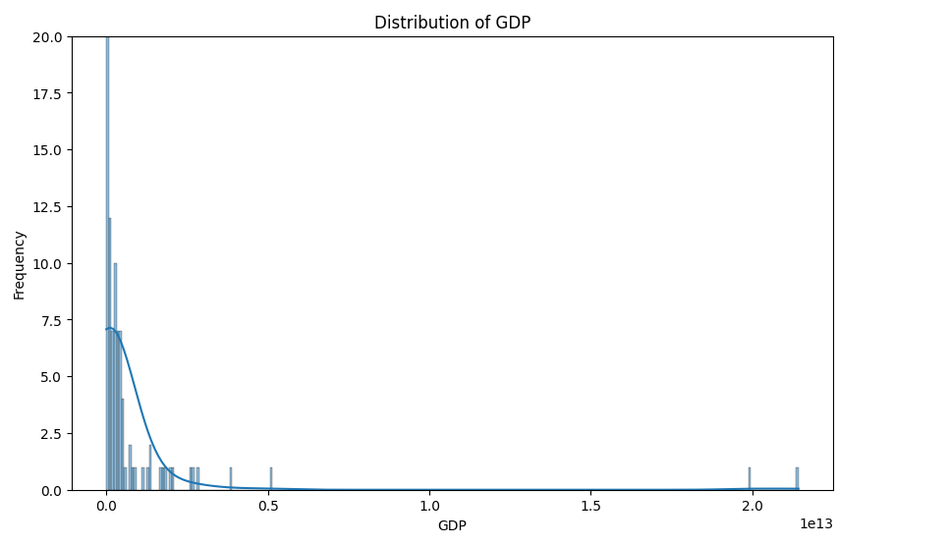
The histogram of GDP distribution:
Explanation: The histogram visualizes the distribution of GDP (Gross Domestic Product) values. Each bar in the histogram represents a range of GDP values, and the height of the bar indicates the frequency or count of observations falling within that range. The histogram provides insights into the distribution pattern and variability of GDP across the dataset.
Storytelling: "The histogram offers a detailed view of the distribution of GDP values across the dataset. By examining the shape and spread of the histogram, we can gain insights into the distribution pattern and variability of economic prosperity represented by GDP. In this visualization, the presence of a KDE (Kernel Density Estimation) curve provides additional information about the density of GDP values, allowing us to identify potential peaks, modes, and outliers in the data distribution. Understanding the distribution of GDP is essential for assessing economic inequality, identifying regions of prosperity or stagnation, and informing policy decisions aimed at promoting sustainable economic growth and development."

Slide 22
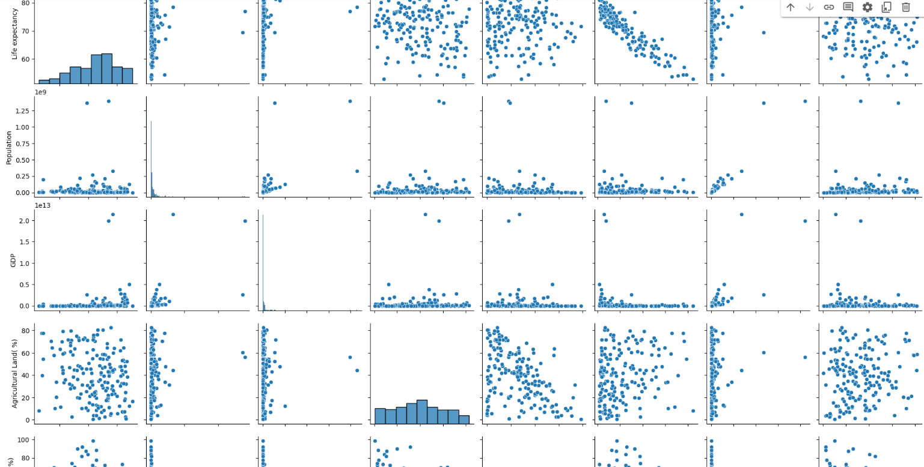
The scatterplot matrix:
Explanation: The scatterplot matrix, generated using the pairplot function, provides a visual overview of the relationships between multiple variables in the dataset. Each cell in the matrix contains a scatter plot showing the relationship between two variables. The diagonal cells display histograms of individual variables.
Storytelling: "The scatterplot matrix offers a comprehensive view of the relationships between various factors and life expectancy. By examining the scatter plots and histograms in the matrix, we can identify potential correlations, trends, and distributions among the variables. For instance, we can explore how population size, GDP, agricultural land percentage, forested area percentage, infant mortality rate, urban population percentage, and out-of-pocket health expenditure relate to life expectancy. This visualization allows us to identify patterns and associations that may inform further analysis and policymaking efforts aimed at improving public health outcomes and overall well-being."

Slide 23
Next we are going to create more visual insights using powerBI by embedding report here.

Slide 24
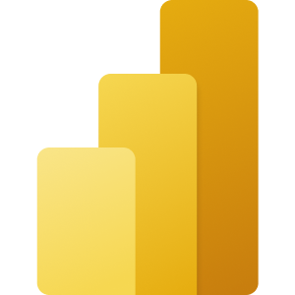
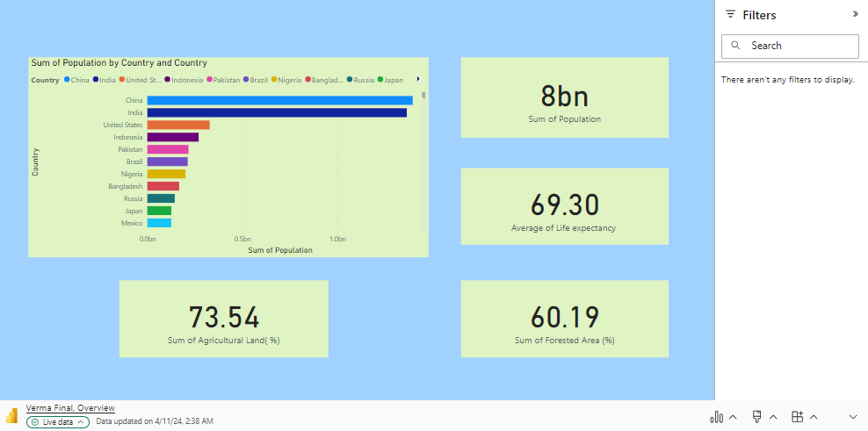
Microsoft Power BI

Slide 25
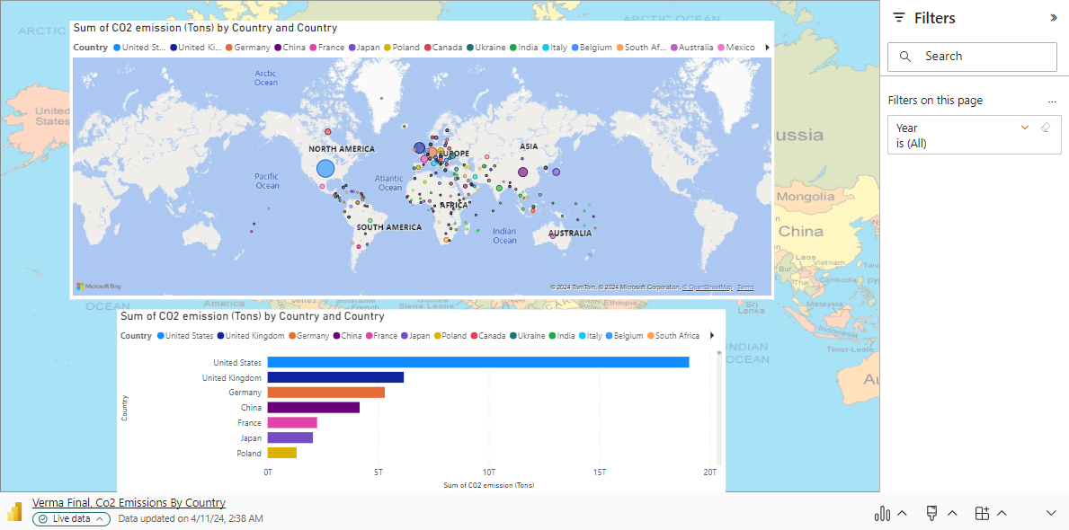
Microsoft Power BI

Slide 26
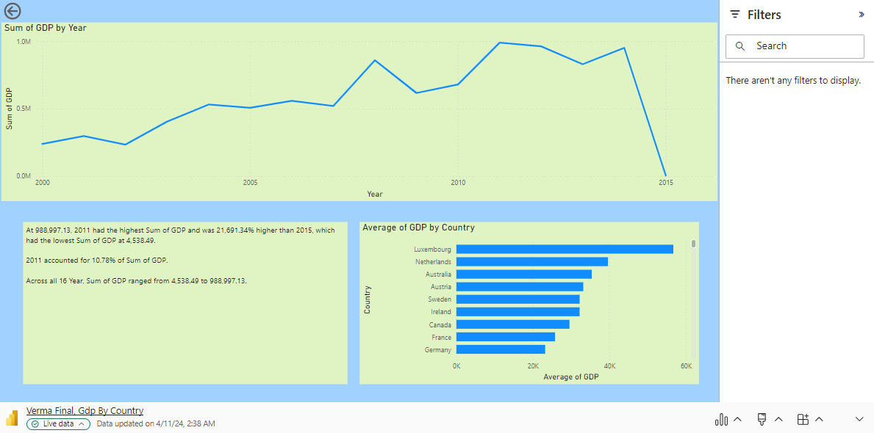
Microsoft Power BI

Slide 27
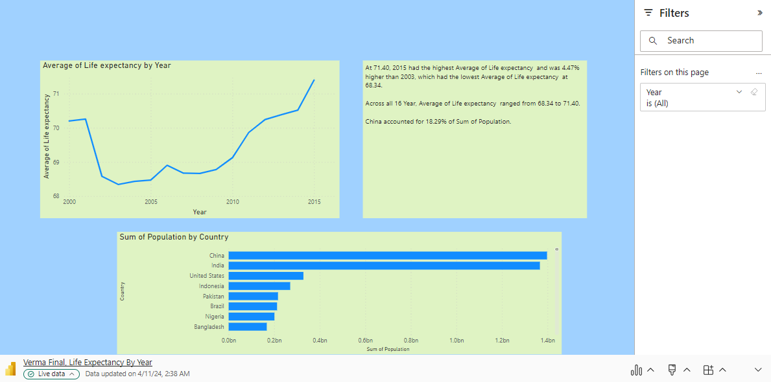
Microsoft Power BI

Slide 28
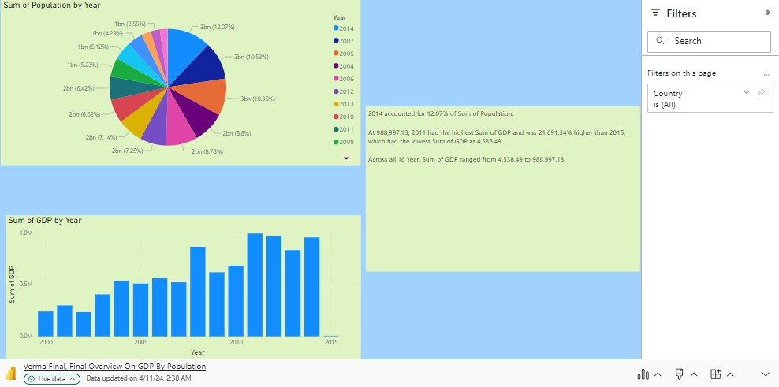
Microsoft Power BI

Slide 29
Work Management: Implementation Status Report
Work Completed:
Data Collection:
Datasets retrieved from Kaggle.
Data sources identified and downloaded.
Initial exploration of datasets completed.
Visualization Development:
Initial visualizations created using D3.js for uncleaned dataset.
Visualizations refined and enhanced using Python libraries (Matplotlib, Seaborn) for cleaned dataset.
Dynamic dashboards and reports created using Microsoft Power BI.
Report Generation:
Detailed reports summarizing analysis findings, insights, and conclusions drawn from visualizations and data analysis process.
Reports formatted and finalized for presentation.

Slide 30
Responsibilities and Contributions:
Jyothirmai Vallakati (11697705): 25%
Data Collection
Visualization Development (Python)
Manohar Varma Buddharaju (11724300): 25%
Data Collection
Visualization Development (D3.js)
Keerthi Yanala (11629948): 25%
Visualization Development (Python)
Report Generation(powerbi)
Pranay Rajana (11667766): 25%
Data Collection
Report Generation(powerbi)

Slide 31
References/Bibliography
Kaggle: https://www.kaggle.com - Source of datasets used in the analysis.
D3.js Documentation: https://d3js.org - Documentation for D3.js library.
Python Documentation: https://www.python.org/doc - Official documentation for the Python programming language.
Pandas Documentation: https://pandas.pydata.org/docs - Documentation for Pandas library.
NumPy Documentation: https://numpy.org/doc - Documentation for NumPy library.
Matplotlib Documentation: https://matplotlib.org/stable/contents.html - Documentation for Matplotlib library.
Seaborn Documentation: https://seaborn.pydata.org - Documentation for Seaborn library.
Microsoft Power BI Documentation: https://docs.microsoft.com/en-us/power-bi/ - Documentation for Microsoft Power BI.

Slide 32
Thank You

