Slide 1
INDEX
INTRODUCTION TO PROJECT
REASON BEHIND CHOOSING THIS PROJECT
ALGORITHM
FLOWCHART
SOURCE CODE
OUTPUT AND RESULTS
APPLICATION
CONCLUSION
REFRENCE

Slide 2
INTRODUCTION
PROJECT TITLE:- MEAN VARIANCE AND STANDARD DEVIATION CALCULATOR
AIM:- WRITE A C PROGRAM TO POPERATION ON MEAN, VARIANCE ERFORM OPERATION ON DATA SET, INCLUDE MENU DRIVEN

Slide 3
WHAT IS MEAN VARIANCE AND STANDARD DEVIATION?
MEAN:- Mean is average of a given set of data.
VARIANCE:- Variance is the sum of squares of differences between all numbers and means.
STANDARD DEVIATION:- Standard Deviation is square root of variance. It is a measure of the extent to which data varies from the mean.

Slide 4
WHY THIS TOPIC IS CHOOSED?
Mean Variance and Standard Deviation are mainly used in statistics.
These methods makes easier for a user to define a complex data in proper mode.
It tells user about chances and Probability.
On a basic level, standard deviation and variance put scores into perspective. For example, knowing the mean and standard deviation on any particular exams allows students to access how well they did relative to other students in the course.

Slide 5
ALGORITHM:-
Step 1:- Start.
Step 2:- Declare global variable m is 150 and n is 5 using #define (where m is no of columns which is 150 and n is no of rows which is 5)
Step 3:- Declare global float type array arrm[m] and arrv[m] which stores mean and variance type data at different time interval for different neurons.
Step 4:- Declare float type 2D array data[5][150] and store all values in that array.
Step 5:- Declare integer type choice variable.
Step 6:- Create do While loop till value 1.
Step 7:- Read choice from user inside while loop.

Slide 6
CONTD…
Step 8:- if choice==1 then call mean() function and pass data array in mean() function.
1. Declare integer type local variables i and j .
2. Declare float type local variables sum_mean .
3. Print Mean Matrix denotes Mean at each time step.
4. Create for loop with i variable started from 0 to less than m.
5. Assign sum_mean is equal to 0.
6. Again Create for loop inside previous loop with j variable started from 0 to less than n.
7. Inside these j variable loop assign sum of data[j][i] and sum_mean to sum_mean
8. Increament j by 1 and again iterate j loop.

Slide 7
CONTD…
9. When j loop get terminated then store sum_mean divide by n store into arrm[i] array and print arrm[i] .
10. Increment i by 1 and again iterate i and j loop.
11. When i loop get terminated then go into next line.
12. And return toward main() function and break the statement and Repeat Step 6.
Step 9:- if choice==2 then call variance() function and pass data array in variance() function.
1. Declare integer type local variables i and j .
2. Declare float type local variables sum_var .
3. Print Variance Matrix denotes variance at each time step.
4. Create for loop with i variable started from 0 to less than m.

Slide 8
CONTD…
5. Assign sum_var is equal to 0.
6. Again Create for loop inside previous loop with j variable started from 0 to less than n.
7. Inside these j variable loop assign sum of pow((data[j][i]-arrm[i]),2) and sum_var to sum_var
8. Increament j by 1 and again iterate j loop.
9. When j loop get terminated then store sum_var divide by (n-1) store into arrv[i] array and print arrm[i].
10. Increment i by 1 and again iterate i and j loop.
11. When i loop get terminated then go into next line.
12. And return toward main() function and break the statement and Repeat Step 6.

Slide 9
CONTD…
Step 10:- if choice==3 then call STD() function and pass data array in STD() function.
1. Declare integer type local variables i.
2. Declare float type local array array_std[m] .
3. Print Standard Deviation Matrix denotes standard deviation at each timestep.
4. Create for loop with i variable started from 0 to less than m.
5. Assign sqrt(arrv[i]) to arr_std[i].
6. Increment i by 1 and again iterate i loop.
7. Return toward main() function and break the statement and Repeat Step 6.
Step 11:- if choice==4 then return value 1 to while loop and while loop get terminated.
Step 12:- Return 0.
Step 13:- END.

Slide 10
FLOWCHART:-

Slide 11
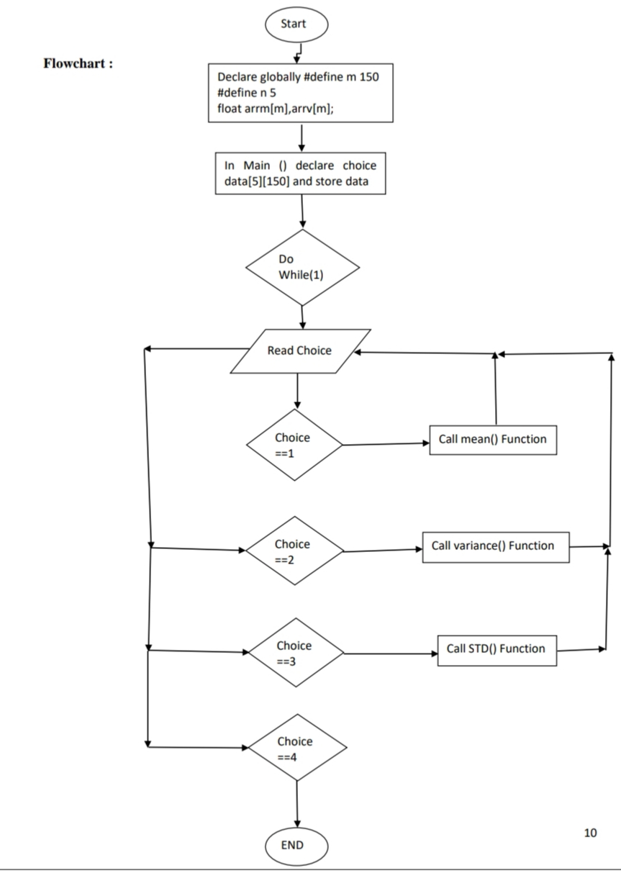

Slide 12
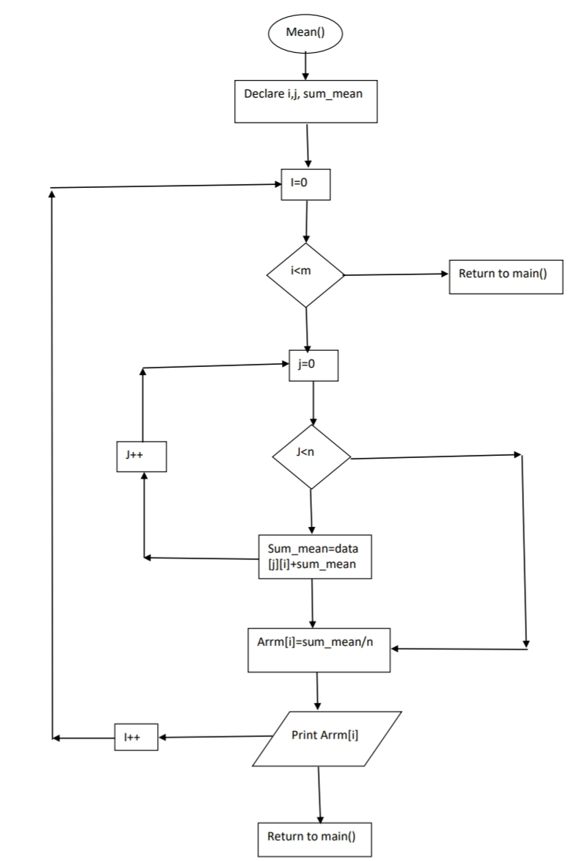

Slide 13
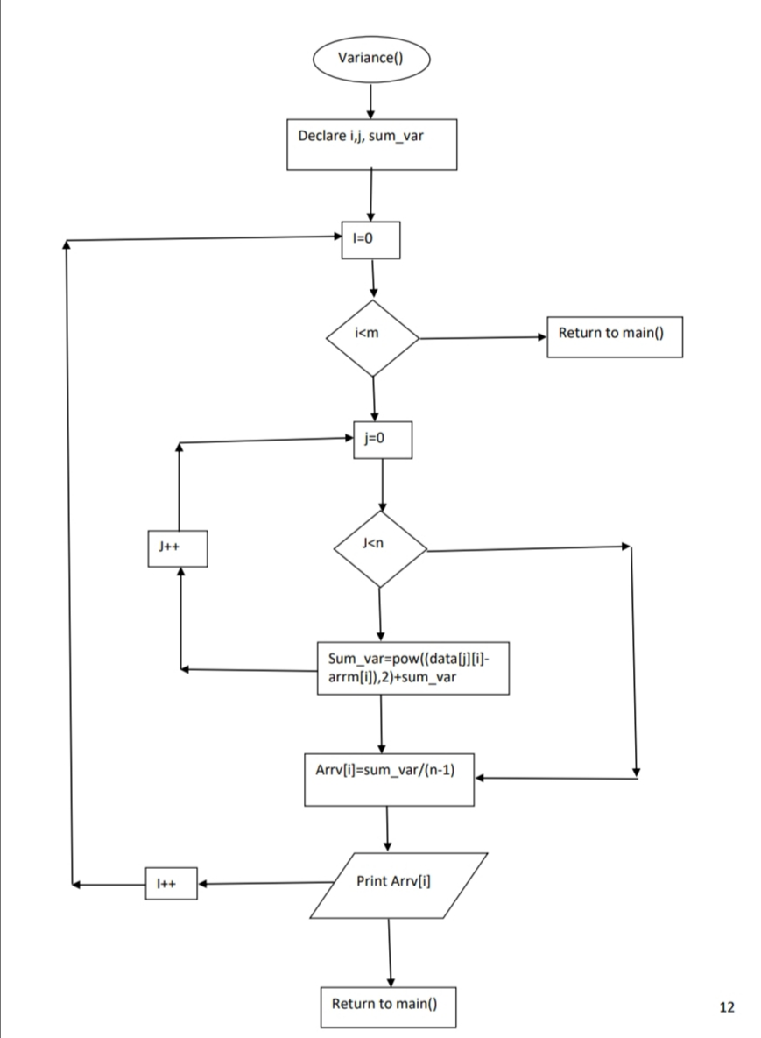

Slide 14
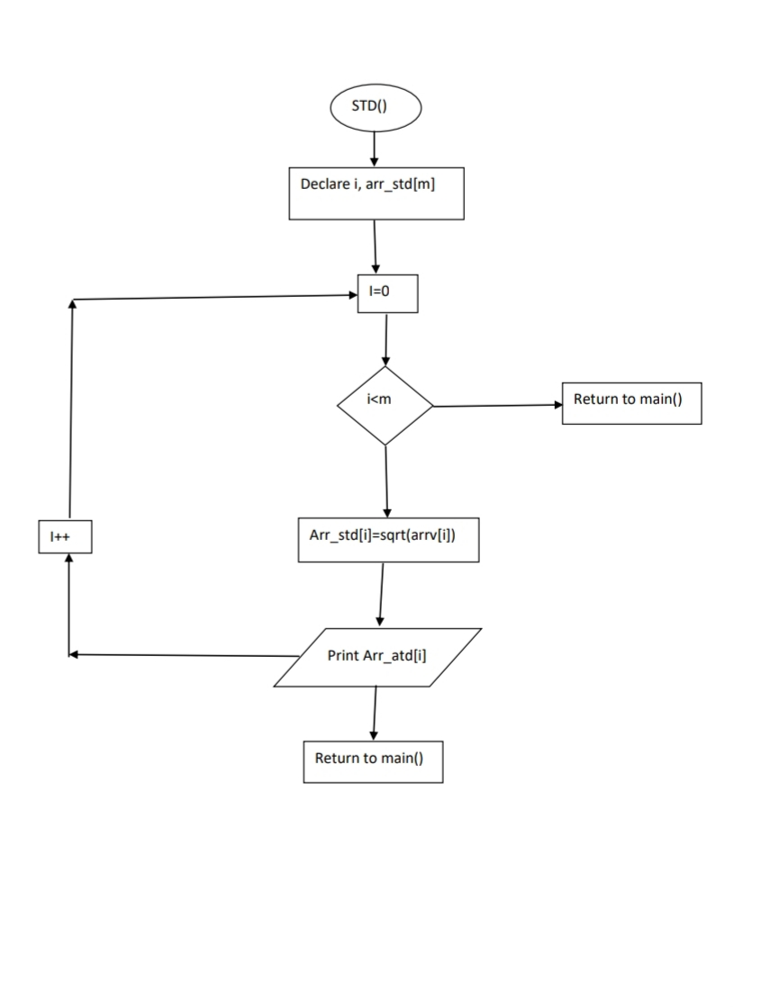

Slide 15
SOURCE CODE:-
#include <stdio.h>
#include <math.h>
#define m 150
#define n 5float arrm[m],arrv[m];
void mean(float data[5][150])
{ int i,j;
float sum_mean;
printf("---------------------------------------------------------------------------------------------------------------------\n");
printf("***Mean Matrix denotes Mean at each time step***\n");
for(i=0;i<m;i++)
{ sum_mean=0;
for(j=0;j<n;j++)
{ sum_mean=data[j][i]+sum_mean;
}
arrm[i]=sum_mean/n;
printf("%f ",arrm[i]);
}

Slide 16
CONTD…
printf("\n");
printf("--------------------------------------------------------------------------------------------------------------------\n");}
void variance(float data[5][150])
{ int i,j;
float sum_var;
printf("--------------------------------------------------------------------------------------------------------------------\n");
printf("*****Variance Matrix denotes variance at each time step****\n");
for(i=0;i<m;i++)
{
sum_var=0;
for(j=0;j<n;j++)
{
sum_var=pow((data[j][i]-arrm[i]),2) + sum_var;
}
arrv[i]=sum_var/(n-1);
printf("%f ",arrv[i]);
}

Slide 17
CONTD…
printf("\n");
printf("-------------------------------------------------------------------------------------------------------------------\n");
}
void STD(float data[5][150])
{ int i,j;
float arr_std[m];
printf("------------------------------------------------------------------------------------------------------------------- \n");
printf("****Standard Deviation Matrix denotes standard deviation at each timestep*****\n");
for(i=0;i<m;i++)
{
arr_std[i]=sqrt(arrv[i]);
printf("%f ",arr_std[i]); } printf("-------------------------------------------------------------------------------------------------------------------\n");
}
int main()
{
// declare array and store all data
int choice;

Slide 18
CONTD…
float data[5][150]=
{
{-0.06,-0.05760673,-0.05644655,-0.05607283,-0.05551852,-0.05535924 ,-0.05502568,-0.05450414,-0.05242005,-0.05260019,-0.05281973,-0.0511416 ,-0.04961093,-0.04932232,-0.04909275,-0.04787739,-0.04809972,-0.04725665 ,-0.04779453,-0.04770675,-0.04568373,-0.04625991,-0.04548438,-0.04350374 ,-0.04306824,-0.04215146,-0.04322013,-0.04294348,-0.04360004,-0.04324338 ,-0.04384253,-0.04218712,-0.04221541,-0.04222301,-0.04076474,-0.04002928 ,-0.03952227,-0.03878069,-0.03957821,-0.03827995,-0.0382924,-0.03711287 ,-0.03619914,-0.03485415,-0.03617629,-0.03717025,-0.03664258,-0.03638992 ,-0.0372637,-0.03737814,-0.03721815,-0.03781337,-0.03736952,-0.03810783 ,-0.03856217,-0.03976682,-0.03933154,-0.03777989,-0.03671307,-0.03602329 ,-0.03609036,-0.03553849,-0.03474713,-0.03466346,-0.03473292,-0.03618757 ,-0.03492095,-0.0339098,-0.03323606,-0.03210412,-0.03307337,-0.03414961 ,-0.0338426,-0.03538036,-0.03597579,-0.03541095,-0.03400475,-0.03308633 ,-0.03447454,-0.03561958,-0.03535422,-0.03632464,-0.03474444,-0.03592876 ,-0.03483871,-0.03633475,-0.03512996,-0.03389135,-0.03410231,-0.03378534 ,-0.03237951,-0.03282505,-0.03309537,-0.03400732,-0.03273506,-0.03354395,-0.03229303,-0.03269405,-0.03384831,-0.03400141,-0.03475775,-0.03340957 ,-0.03411543,-0.03522653,-0.03591164,-0.03474854,-0.03348474,-0.03279571 ,-0.0316805,-0.0333088,-0.0347989 ,-0.03358864,

Slide 19
CONTD…
-0.03304441,-0.03262367 ,-0.03258068,-0.03201964,-0.03108497,-0.03094692,-0.03129528,-0.03210311 ,-0.03184802,-0.03198408,-0.03253213,-0.03376327,-0.03303152,-0.03172461 ,-0.03256497,-0.03198003,-0.03304984,-0.03270715,-0.03373155,-0.03517146 ,-0.03555482,-0.03701486,-0.03814014,-0.03645419,-0.03507783,-0.03410975 ,-0.03500432,-0.03623673,-0.03481071,-0.03401755,-0.03459124,-0.03330745 ,-0.03276231,-0.03423123,-0.03428505,-0.03464289,-0.03447265,-0.0337914} ,{-0.06,-0.06016476,-0.05983919,-0.05808855,-0.05629988,-0.055792 ,-0.05552755,-0.05346487,-0.05381526,-0.05208975,-0.05057301,-0.04995349 ,-0.05058969,-0.04928076,-0.04949659,-0.04741245,-0.04661074,-0.04501571 ,-0.04500504,-0.04540446,-0.04484822,-0.04285308,-0.04129946,-0.04222392 ,-0.04186574,-0.04120995,-0.04205912,-0.04202438,-0.04136451,-0.04116716 ,-0.0416653 ,-0.04253884,-0.04067744,-0.04190439,-0.04295846,-0.04179482 ,-0.04072139,-0.03890731,-0.03839171,-0.0392723 ,-0.04031909,-0.03897363 ,-0.03826126,-0.03873266,-0.03980945,-0.04014113,-0.03844577,-0.03731851 ,-0.03801231,-0.03807253,-0.03903273,-0.04009765,-0.04054826,-0.04128169 ,-0.04140628,-0.03975367,-0.03925183,-0.03986801,-0.03892371,-0.03808456 ,-0.03897996,-0.03813873,-0.03751406,-0.03748591,-0.03675896,-0.03692465 ,-0.03771121,-0.03827994,-0.03824114,-0.03769806,-0.03643255,-0.03541594 ,-0.03427159,-0.03411795,-0.03401651,-0.03466178,-0.03552268,-0.03558238 ,-0.0345509 ,-0.03567252,-0.03556368,-0.03524283,-0.0341839 ,-0.03465702 ,-0.03479893,-0.03544067,-0.03538152,-0.03650175,-0.03735821,-0.03701806 ,-0.03576938,-0.03468262,-0.03602179,-0.03655186,-0.03577749,

Slide 20
CONTD…
,-0.03453033 ,-0.03359434,-0.03314045,-0.03306026,-0.03280818,-0.03221242,-0.03358949 ,-0.03402137,-0.03425326,-0.03387578,-0.03488559,-0.03419806,-0.0354739 ,-0.03442773,-0.03361239,-0.03455533,-0.03305175,-0.03401528,-0.03292779 ,-0.03425336,-0.03557972,-0.0349621 ,-0.0361908 ,-0.03544498,-0.0366523 ,-0.03685639,-0.03689019,-0.03550959,-0.03552753,-0.03657946,-0.03797815 ,-0.03892336,-0.03843226,-0.03971867,-0.03917444,-0.03826877,-0.03872834 ,-0.03899882,-0.0391488 ,-0.03890509,-0.03907247,-0.03875731,-0.03891336 ,-0.03961886,-0.03961804,-0.04091401,-0.04096786,-0.04112035,-0.03970858 ,-0.03919649,-0.04029522,-0.03997028,-0.04001108,-0.04113147,-0.04011706} ,{-0.06 ,-0.05728241,-0.0554272 ,-0.05501319,-0.05487028,-0.05462455 ,-0.05487839,-0.05508984,-0.05552473,-0.05482242,-0.0535184 ,-0.0537252 ,-0.0530815 ,-0.05312463,-0.05228605,-0.05034747,-0.04900013,-0.04785187 ,-0.04602081,-0.0440153 ,-0.04213172,-0.04308431,-0.04389734,-0.04399557 ,-0.04261588,-0.04247794,-0.0418394 ,-0.04170685,-0.04216717,-0.0417937 ,-0.04001239,-0.04115461,-0.03960515,-0.03862984,-0.03872298,-0.03883016 ,-0.0398154 ,-0.03855332,-0.0386176 ,-0.03845822,-0.03934622,-0.03834043 ,-0.03845797,-0.03733355,-0.03799075,-0.0386968 ,-0.03776769,-0.03888417 ,-0.03902892,-0.04033681,-0.03911381,-0.03779633,-0.03678119,-0.03762948 ,-0.03679659,-0.0371913 ,-0.03561299,-0.03517145,-0.03422624,-0.03531966 ,-0.03520986,-0.03504401,-0.03495453,-0.03614376,-0.03736656,-0.03718272 ,-0.03759206,-0.0377751 ,-0.03907222,-0.03832925,-0.03810227,-0.0370952 ,-0.03655301,-0.03548115,-0.03563904,-0.03528016,-0.03593384,-0.03454143

Slide 21
CONTD…
,-0.03332179,-0.0330555 ,-0.03357524,-0.03398186,-0.03513092,-0.03550805 ,-0.03498319,-0.03472433,-0.03545747,-0.03654444,-0.03713559,-0.03850811 ,-0.03794451,-0.0381361 ,-0.03947346,-0.0378902 ,-0.03870434,-0.03966223 ,-0.04021973,-0.04138957,-0.04255816,-0.04328733,-0.04246717,-0.04094387 ,-0.03956307,-0.0402341 ,-0.03910624,-0.03992769,-0.03834651,-0.03807401 ,-0.03662628,-0.03724543,-0.03611641,-0.03738639,-0.03829092,-0.03941112 ,-0.03959608,-0.04070438,-0.03910002,-0.03953142,-0.03995333,-0.03988214 ,-0.03975789,-0.03946724,-0.03921901,-0.03778118,-0.03780947,-0.03839889 ,-0.03850913,-0.03888519,-0.03900478,-0.03799308,-0.03700046,-0.03818745 ,-0.03750237,-0.03820019,-0.03701052,-0.03739684,-0.03833091,-0.03769796 ,-0.03754675,-0.03631992,-0.0357907 ,-0.0362875 ,-0.03542036,-0.03599283}, {-0.06 ,-0.05728241,-0.0554272 ,-0.05501319,-0.05487028,-0.05462455 ,-0.05487839,-0.05508984,-0.05552473,-0.05482242,-0.0535184 ,-0.0537252 ,-0.0530815 ,-0.05312463,-0.05228605,-0.05034747,-0.04900013,-0.04785187 ,-0.04602081,-0.0440153 ,-0.04213172,-0.04308431,-0.04389734,-0.04399557 ,-0.04261588,-0.04247794,-0.0418394 ,-0.04170685,-0.04216717,-0.0417937 ,-0.04001239,-0.04115461,-0.03960515,-0.03862984,-0.03872298,-0.03883016 ,-0.0398154 ,-0.03855332,-0.0386176 ,-0.03845822,-0.03934622,-0.03834043 ,-0.03845797,-0.03733355,-0.03799075,-0.0386968 ,-0.03776769,-0.03888417 ,-0.03902892,-0.04033681,-0.03911381,-0.03779633,-0.03678119,-0.03762948 ,-0.03679659,-0.0371913 ,-0.03561299,-0.03517145,-0.03422624,-0.03531966 ,-0.03520986,-0.03504401,-0.03495453,-0.03614376,-0.03736656,-0.03718272 ,-0.03759206,-0.0377751 ,-0.03907222,-0.03832925,-0.03810227,-0.0370952 ,-0.03655301,-0.03548115,-0.03563904,-0.03528016,-0.03593384,-0.03454143 ,-0.03422254,-0.0345813 ,-0.03483159,-0.03427661,-0.03300687,-0.03282979

Slide 22
CONTD…
,-0.03332179,-0.0330555 ,-0.03357524,-0.03398186,-0.03513092,-0.03550805 ,-0.03498319,-0.03472433,-0.03545747,-0.03654444,-0.03713559,-0.03850811 ,-0.03794451,-0.0381361 ,-0.03947346,-0.0378902 ,-0.03870434,-0.03966223 ,-0.04021973,-0.04138957,-0.04255816,-0.04328733,-0.04246717,-0.04094387 ,-0.03956307,-0.0402341 ,-0.03910624,-0.03992769,-0.03834651,-0.03807401 ,-0.03662628,-0.03724543,-0.03611641,-0.03738639,-0.03829092,-0.03941112 ,-0.03959608,-0.04070438,-0.03910002,-0.03953142,-0.03995333,-0.03988214 ,-0.03975789,-0.03946724,-0.03921901,-0.03778118,-0.03780947,-0.03839889 ,-0.03850913,-0.03888519,-0.03900478,-0.03799308,-0.03700046,-0.03818745 ,-0.03750237,-0.03820019,-0.03701052,-0.03739684,-0.03833091,-0.03769796 ,-0.03754675,-0.03631992,-0.0357907 ,-0.0362875 ,-0.03542036,-0.03599283}
};
printf("***Dataset of 5 Neurons at 150 timesteps use for analysation***\n");
do
{
printf("Enter Choice\n1.Mean of given dataset\n2.Variance of given dataset\n3.Standard Deviation of given dataset\n4.EXIT\n");
scanf("%d",&choice);
switch(choice)
{
case 1:
mean(data);
break;

Slide 23
CONTD…
case 2:
variance(data);
break;
case 3:
STD(data);
break;
case 4:
return(1);
break;
}
}
while(1);
// your code goes here
return 0;
}

Slide 24
APPLICATION:-
This Calculator makes very easy to measure mean variance and standard deviation of any data set given for study purpose.
This calculator can be used in IT industry also to take attention of various statistical activities.
This calculator can be used in Research activities.
This calci makes easir for any organization or institute to take study different types of surveys.

Slide 25
REFRENCE:-
Refrences:-
http://neuromatch.io/
https://github.com/NeuromatchAcademy/course-content
https://colab.research.google.com/github/NeuromatchAcademy/course-content/blob/master/tutorials/W0D1_PythonWorkshop1/student/W0D1_Tutorial1.ipynb

Slide 26
Thank you

