Slide 1

Agile Methods
Agile methods:
Scrum
Extreme Programming
Adaptive Software Development (ASD)
Dynamic System Development Method (DSDM)
Department of Computer Engineering, VIIT , Pune-48

Slide 2
Scrum - an agile process
SCRUM is an agile, lightweight process for managing and controlling software and product development in rapidly changing environments.
Iterative, incremental process
Team-based approach
developing systems/ products with rapidly changing requirements
Controls the confusion of conflicting interest and needs
Improve communication and maximize cooperation
Protecting the team from disturbances
A way to maximize productivity
Department of Computer Engineering, VIIT , Pune-48

Slide 3
Scrum
 Scrum—distinguishing features
 Development work is partitioned into “packets”


Testing and documentation are on-going as the product is constructed
Work units occurs in “sprints” and is derived from a “backlog” of existing
changing prioritized requirements
 Changes are not introduced in sprints (short term but stable) but in backlog.
 Meetings are very short (15 minutes daily) and sometimes conducted without chairs ( what did you do since last meeting? What obstacles are you encountering? What do you plan to accomplish by next meeting?)
 “demos” are delivered to the customer with the time-box allocated. May not contain all functionalities. So customers can evaluate and give feedbacks.
Department of Computer Engineering, VIIT , Pune-48

Slide 4
Characteristics
Self-organizing teams.
Product progresses in a series of month-long “sprints”.
Requirements are captured as items in a list of “product backlog”
No specific engineering practices prescribed.
Uses generative rules to create an agile environment for delivering projects.
One of the “agile processes”.
Department of Computer Engineering, VIIT , Pune-48

Slide 5
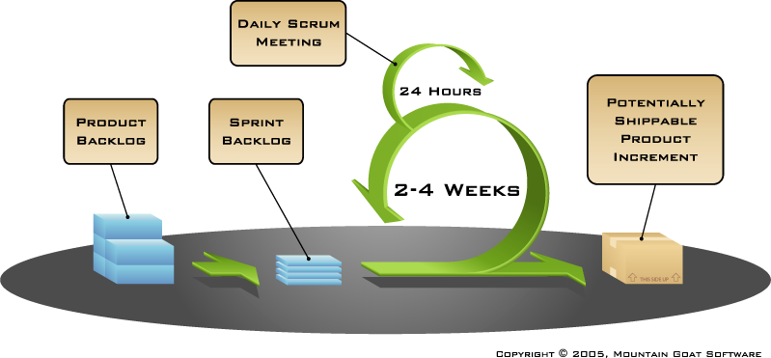
Functionality of Scrum
Department of Computer Engineering, VIIT , Pune-48

Slide 6
Project Management Emphasis based on a Standard 30-day Sprint
Scrum: a definite project management emphasis.
Scrum Master: A Scrum project is managed by a Scrum Master, who can be considered as much a consultant or coach as a manager.
Sprint. Scrum has a fundamental 30-day development cycle called a Sprint, preceded by
pre-Sprint activities and post-Sprint activities.
Daily Scrum: A short (less than 30 minutes) daily Scrum Meeting allows the team to monitor status and communicate problems.
Department of Computer Engineering, VIIT , Pune-48

Slide 7
Product Backlog for Planning
Project planning is based on a Product Backlog, which contains
functions and
technology enhancements
intended for the project.
Two meetings are held –
one to decide the features for the next Sprint and
the other to plan out the work.

Slide 8
Scrum - Queues
Product Backlog ➔ Sprint Backlog ➔ Sprint ➔ Working increment of the Software
Scrum uses lightweight queue-based management and work-breakdown mechanisms.
Product Backlog queue: a low-tech customer-managed queue of demand requests for products.
Sprint: At launch time, a Sprint (30-day time-boxed iteration) does just-in-time planning
Sprint Backlog: queue for Sprint work-mgmt.
Department of Computer Engineering, VIIT , Pune-48

Slide 9
Scrum - Management
Daily Scrum: Very notable and very visible
Is a daily standup,
except that it is the team that is participating and sharing coordination information not a central project manager.
Scrum Master
holds daily scrum and
acts more as a facilitator and runs interference for the core team when blocks or issues arise. (Kennaley, SDLC 3.0, p. 31)
Department of Computer Engineering, VIIT , Pune-48

Slide 10
Components of Scrum
Scrum Roles
The Process
Scrum Artifacts
Department of Computer Engineering, VIIT , Pune-48

Slide 11
Core Roles – Scrum Master
Scrum is facilitated by a Scrum Master –
Accountable for removing impediments for team to deliver sprint goal / deliverables.
Scrum Master is not the team leader, but acts as a buffer between the team and any distracting influences.
Scrum Master ensures process is used as intended.
Scrum Master is the enforcer of rules.
Scrum Master’s role: protect the Team and keep it focused on the tasks at hand.
Department of Computer Engineering, VIIT , Pune-48

Slide 12
The Scrum Master
Represents management to the project
Responsible for enacting Scrum values and practices
Removes impediments
Ensure that the team is fully functional and productive
Enable close cooperation across all roles and functions
Shield the team from external interferences
Department of Computer Engineering, VIIT , Pune-48

Slide 13
Core Roles – Development Team
The Development Team is responsible for delivering potentially shippable product increments at end of each Sprint.
Cross-functional
QA, Programmers, UI Designers, etc.
Team = 3–9 people with cross-functional skills.
Team does actual work
(analyze, design, develop, test, technical communication, document, etc.).
Team is self-organizing, even though they may interface with project management organizations (PMOs).
Membership can change only between sprints
Department of Computer Engineering, VIIT , Pune-48

Slide 14
Core Roles – Product Owner
The Product Owner represents stakeholders and is the voice of the customer.
Product Owner is accountable for ensuring that the team delivers value to the business.
Product Owner
writes customer-centric items (typically user stories),
prioritizes them, and
adds them to the product backlog.
Note:
Scrum teams should have one Product Owner.
May also be a member of the development team
Not recommend this person be Scrum Master.
Department of Computer Engineering, VIIT , Pune-48

Slide 15
Product Owner
Define the features of the product
Decide on release date and content
Be responsible for the profitability of the product (ROI)
Prioritize features according to market value
Adjust features and priority every iteration, as needed
Accept or reject work results.
Knows what needs to be build and in what sequence this should be done
Typically a product manager
Department of Computer Engineering, VIIT , Pune-48

Slide 16
The Process
Sprint Planning Meeting
Sprint
Daily Scrum
Sprint Review Meeting
Department of Computer Engineering, VIIT , Pune-48

Slide 17
Sprint Planning Meeting
A collaborative meeting in the beginning of each Sprint between the Product Owner, the Scrum Master and the Team.
Takes 8 hours and consists of 2 parts (“before lunch and after lunch”)
Department of Computer Engineering, VIIT , Pune-48

Slide 18
Sprint Planning Meeting
Product Owner
Scrum Team
Customers
Management
Product Backlog
Sprint Planning
Meeting
Team Capabilities
Sprint Goal
Business Conditions
Technology
Sprint Backlog
Current Product
Department of Computer Engineering, VIIT , Pune-48

Slide 19
Parts of Sprint Planning Meeting
1st Part:
Creating Product Backlog
Determining the Sprint Goal.
Participants: Product Owner, Scrum Master, Scrum Team
2nd Part:
Participants: Scrum Master, Scrum Team
Creating Sprint Backlog
Department of Computer Engineering, VIIT , Pune-48

Slide 20
Pre-Project/Kickoff Meeting
A special form of Sprint Planning Meeting.
Meeting before the begin of the Project.
Department of Computer Engineering, VIIT , Pune-48

Slide 21
Sprint
A month-long iteration, during which is incremented a product functionality
NO outside influence can interference with the Scrum team during the Sprint
Each Sprint begins with the Daily Scrum Meeting
Department of Computer Engineering, VIIT , Pune-48

Slide 22
Sprints
Scrum projects make progress in a series of “sprints”
Analogous to XP iterations.
Target duration is one month
+/- a week or two
But, a constant duration leads to a better rhythm
Product is designed, coded, and tested during the sprint.
Department of Computer Engineering, VIIT , Pune-48

Slide 23
Sprint: basic unit of development in Scrum.
Sprint duration: one week to one month;
“Time Boxed" effort of a constant length.
Each sprint:
Preceded by a planning meeting,
where the tasks for sprint are identified and an
estimated commitment for the sprint goal made, and followed by a review or retrospective meeting, where the progress is reviewed and lessons for the next sprint are identified.
Department of Computer Engineering, VIIT , Pune-48

Slide 24
During Sprint, team creates finished portions of a product. (an increment)
Features going into a Sprint come from the product backlog: a prioritized list of requirements.
Which backlog items go into sprint (sprint goals) determined during Sprint Planning Mtg.
Sprint Goal
sets up minimum success criterion for the Sprint and
keeps the team focused on the broader picture rather than narrowly on the task at hand.
Department of Computer Engineering, VIIT , Pune-48

Slide 25
The team then determines how many selected items can be completed during the next sprint.
These then go into the Sprint Backlog.
Sprint Backlog is property of the development team, During a sprint, no one is allowed to edit the sprint backlog except for development team.
Development: time-boxed; Sprint must end on time;
Requirements not completed for any reason?
are omitted and returned to Product Backlog.
When Sprint is done, team demonstrates software.
Department of Computer Engineering, VIIT , Pune-48

Slide 26
Daily Scrum
Is a short (15 minutes long) meeting, which is held every day before the Team starts working
Participants: Scrum Master (which is the chairman), Scrum Team
Every Team member should answer on 3 questions
Department of Computer Engineering, VIIT , Pune-48

Slide 27
Daily Scrum
Is NOT a problem solving session
Is NOT a way to collect information about WHO is behind the schedule
Is a meeting in which team members make commitments to each other and to the Scrum Master
Is a good way for a Scrum Master to track the progress of the Team
Department of Computer Engineering, VIIT , Pune-48

Slide 28
Questions
What did you do since the last Scrum?
What are you doing until the next Scrum?
What is stopping you getting on with the work?
Department of Computer Engineering, VIIT , Pune-48

Slide 29
Sprint Review Meeting
Is held at the end of each Sprint
Business functionality which was created during the Sprint is demonstrated to the Product Owner
Informal, should not distract Team members of doing their work
Department of Computer Engineering, VIIT , Pune-48

Slide 30
Sprint Retrospective Meeting
Scrum Team only
Feedback meeting
Three questions
Start
Stop
Continue
Don’t skip for the first 5-6 sprints!!!
Department of Computer Engineering, VIIT , Pune-48

Slide 31
Scrum Artifacts
Product Backlog
Sprint Backlog
Burn down Charts
Department of Computer Engineering, VIIT , Pune-48

Slide 32
Product Backlog
Requirements for a system, expressed as a prioritized list of Backlog Items
Is managed and owned by a Product Owner
Spreadsheet (typically)
Usually is created during the Sprint Planning Meeting
Can be changed and re-prioritized before each Planning Meeting
Department of Computer Engineering, VIIT , Pune-48

Slide 33
Product Backlog
A list of all desired work on the project
Usually a combination of
story-based work (“let user search and replace”)
task-based work (“improve exception handling”)
List is prioritized by the Product Owner
Typically a Product Manager, Marketing, Internal Customer, etc.
Department of Computer Engineering, VIIT , Pune-48

Slide 34
Product Backlog
Requirements for a system, expressed as a prioritized list of Backlog Items
Is managed and owned by a Product Owner
Spreadsheet (typically)
Usually is created during the Sprint Planning Meeting
Can be changed and re-prioritized before each PM
Department of Computer Engineering, VIIT , Pune-48

Slide 35
Artifact: Product Backlog
Product backlog is an ordered list of "requirements" that is maintained for a product
Contains Product Backlog Items ordered by the Product Owner based on
considerations like risk,
business value,
dependencies,
date needed, etc.
Features added to backlog commonly written in story format
The product backlog is the “What” that will be built, sorted in the relative order it should be built in.
Product Owner is ultimately responsible for ordering the stories on the backlog for the Development Team.
Department of Computer Engineering, VIIT , Pune-48

Slide 36
Artifact: Product Backlog
The product backlog contains rough estimates of both business value and development effort, these values are often stated in story points using a rounded Fibonacci sequence.
Those estimates help the Product Owner to gauge the timeline and may influence ordering of backlog items.
Example, if the “add spellcheck” and “add table support” features have the same business value, the one with the smallest development effort will probably have higher priority, because the Return on Investment is higher.
Department of Computer Engineering, VIIT , Pune-48

Slide 37
Artifacts – The Product Backlog 2
Product Owner: responsible for the product backlog and the business value of each item listed.
Development Team: responsible for the estimated effort to complete each backlog item.
Team contributes by estimating Items and User-Stories, either in “Story-points” or in “estimated hours.”
Department of Computer Engineering, VIIT , Pune-48

Slide 38
Sprint Backlog
A subset of Product Backlog Items, which define the work for a Sprint
Is created ONLY by Team members
Each Item has it’s own status
Should be updated every day
Department of Computer Engineering, VIIT , Pune-48

Slide 39
Sprint Backlog
No more then 300 tasks in the list
If a task requires more than 16 hours, it should be broken down
Team can add or subtract items from the list. Product Owner is not allowed to do it.
Is a good warning monitor
Department of Computer Engineering, VIIT , Pune-48

Slide 40
From Sprint Goal to Sprint Backlog
Scrum team takes the Sprint Goal and decides what tasks are necessary
Team self-organizes around how they’ll meet the Sprint Goal
Manager doesn’t assign tasks to individuals
Managers don’t make decisions for the team
Sprint Backlog is created
Department of Computer Engineering, VIIT , Pune-48

Slide 41
Sprint Backlog during the Sprint
Changes
Team adds new tasks whenever they need to in order to meet the Sprint Goal
Team can remove unnecessary tasks
But: Sprint Backlog can only be updated by the team
Estimates are updated whenever there’s new information
Department of Computer Engineering, VIIT , Pune-48

Slide 42
Sprint Backlog
A subset of Product Backlog Items, which define the work for a Sprint
Is created ONLY by Team members
Each Item has it’s own status
Should be updated every day
Department of Computer Engineering, VIIT , Pune-48

Slide 43
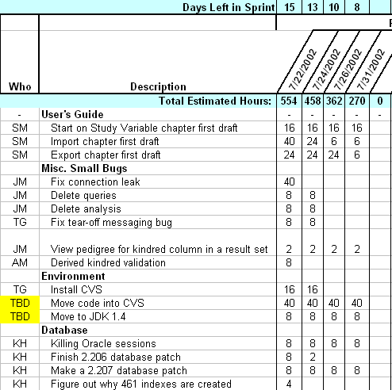
Sample Sprint Backlog
Department of Computer Engineering, VIIT , Pune-48

Slide 44
Artifacts: Sprint Backlog
Sprint Backlog: list of work the Development Team must address during the next sprint.
List derived by selecting stories/features from the top of the product backlog until the Development Team feels it has enough work to fill the sprint.
Thinking: This is done by the Development Team asking "Can we also do this?" and adding stories/features to the sprint backlog.
History: Development Team should note velocity of previous Sprints (total story points completed from each of the last sprints stories) when selecting stories/features for the new sprint.
Use number as guide for "effort" they can complete.
Department of Computer Engineering, VIIT , Pune-48

Slide 45
Artifacts: Sprint Backlog
Stories/features: broken down into tasks by Development Team- should normally be between four and sixteen hours of work.
With this level of detail the Development Team understands exactly what to do, and potentially, anyone can pick a task from the list.
Tasks on sprint backlog are never assigned; tasks are signed up for. by team members during daily scrum, according to priority and member skills.
Sprint backlog is property of Team, and all included estimates are provided by the Development Team.
Department of Computer Engineering, VIIT , Pune-48

Slide 46
Artifacts - Increment
The “increment” is sum of all Product Backlog Items completed during a sprint and all previous sprints.
At end of a sprint, Increment must be done according to Scrum Team's definition of done.
The increment must be in usable condition regardless of whether the Product Owner decides to actually release it.
Department of Computer Engineering, VIIT , Pune-48

Slide 47
Burn down Charts
Are used to represent “work done”.
Are wonderful Information Radiators
3 Types:
Sprint Burn down Chart (progress of the Sprint)
Release Burn down Chart (progress of release)
Product Burn down chart (progress of the Product)
Department of Computer Engineering, VIIT , Pune-48

Slide 48
Artifacts: Burn Down
The sprint burn down chart is a publicly displayed chart showing remaining work in the sprint backlog.
Updated every day; gives a simple view of the sprint progress.
Other types of burn down:
Release burn down chart: shows amount of work left to complete the target commitment for a Product Release
This normally spans multiple iterations
Alternative Release burn down chart: basically does the same, but clearly shows scope changes to Release Content, by resetting the baseline.

Slide 49
Sprint Burn down Chart
Depicts the total Sprint Backlog hours remaining per day
Shows the estimated amount of time to release
Ideally should burn down to zero to the end of the Sprint.
Department of Computer Engineering, VIIT , Pune-48

Slide 50
Release Burn down Chart
Will the release be done on right time?
X-axis: sprints
Y-axis: amount of hours remaining
The estimated work remaining can also burn up
Department of Computer Engineering, VIIT , Pune-48

Slide 51
Alternative Release Burn down Chart
Consists of bars (one for each sprint)
Values on the Y-axis: positive AND negative
Is more informative then a simple chart
Department of Computer Engineering, VIIT , Pune-48

Slide 52
Product Burn down Chart
Is a “big picture” view of project’s progress (all the releases)
Department of Computer Engineering, VIIT , Pune-48

Slide 53
Scaling Scrum
A typical Scrum team is 6-10 people
Jeff Sutherland - up to over 800 people
"Scrum of Scrums" or what called "Meta-Scrum“
Frequency of meetings is based on the degree of coupling between packets
Department of Computer Engineering, VIIT , Pune-48

Slide 54
Sprint Burndown Chart
Department of Computer Engineering, VIIT , Pune-48

Slide 55
XP@Scrum
Scrum is an effective project management wrapper for eXtreme Programming development practices, which enables agile projects to become scalable and developed by distributed teams of developers.
Department of Computer Engineering, VIIT , Pune-48

Slide 56
Pros/Cons
Advantages
Completely developed and tested features in short iterations
Simplicity of the process
Clearly defined rules
Increasing productivity
Self-organizing
each team member carries a lot of responsibility
Improved communication
Combination with Extreme Programming
Drawbacks
“Undisciplined hacking” (no written documentation)
Violation of responsibility
Current mainly carried by the inventors
Department of Computer Engineering, VIIT , Pune-48

Slide 57
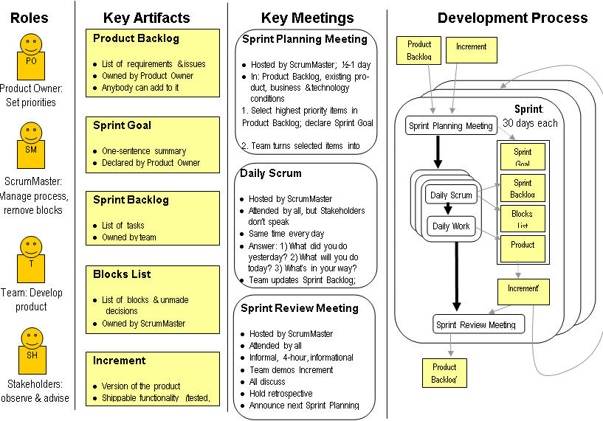
Department of Computer Engineering, VIIT , Pune-48

Slide 58
References
https://www.unf.edu › ~broggio › cen6016 › classnotes › 6a.Agile Software.
www.uml.org.cn › softwareprocess
https://www.unf.edu › ~broggio › cen6016 › classnotes › Lecture 12 - Agi...
Department of Computer Engineering, VIIT , Pune-48

Slide 59
References
[1]. Abrahamsson P, Salo O and Ronkainen J. Agile software development methods (Review and analysis).
[2]. Scott W Ambler. Agile model driven development.
[3]. Cohen D, Lindvall M, Costa P. Agile software development.
[4]. http://en.wikipedia.org/wiki/Agile_Modeling.
[5]. http://en.wikipedia.org/wiki/Extreme_Programming.
[6]. http://en.wikipedia.org/wiki/Agile_Unified_process.
[7]. http://en.wikipedia.org/wiki/Scrum_28development29.
Department of Computer Engineering, VIIT , Pune-48

Slide 60
CS435: Introduction to Software Engineering
Dr. M. Zhu
Chapter 3
 Agile Development
Slide Set to accompany
Software Engineering: A Practitioner’s Approach, 7/e
by Roger S. Pressman
Slides copyright © 1996, 2001, 2005, 2009 by Roger S. Pressman
Department of Computer Engineering, VIIT , Pune-48

Slide 61
Thank You
Department of Computer Engineering, VIIT , Pune-48

Slide 62
More Terminology Used in Scrum:
Tasks: Added to story at beginning of a sprint and broken down into hours.
Each task should not exceed 12 hours, but it's common for teams to insist that a task take no more than a day to finish.
Definition of Done (DoD): The exit-criteria used to determine whether a product backlog item is complete.
In many cases the DoD requires that all regression tests should be successful.

Slide 63
More Terminology Used in Scrum:
Velocity: The total effort a team is capable of in a sprint. The number is derived by adding all the story points from the last sprint's stories/features.
This is a guideline for the team and assists them in understanding how many stories they can do in a sprint.
Impediment: Anything that prevents a team member from performing work as efficiently as possible.

Slide 64
Conclusions
The professional goal of every software engineer, and every development team, is to deliver the highest possible value to our employers and customers.
And yet, our projects fail, or fail to deliver value, at a dismaying rate.
Though well intentioned, the upward spiral of process inflation is culpable for at least some of this failure.
The principles and values of agile software development were formed as a way
to help teams break the cycle of process inflation, and
to focus on simple techniques for reaching their goals.
At the time of this writing there were many agile processes to choose from. These include
SCRUM,
Crystal,
Feature Driven Development (FDD),
Adaptive Software Development (ADP), and most significantly,
Extreme Programming (XP).
Others…

Slide 65
Information Radiator
"Two characteristics are key to a good information radiator. The first is that the information changes over time. This makes it worth a person's while to look at the display... The other characteristic is that it takes very little energy to view the display."
Department of Computer Engineering, VIIT , Pune-48

