Slide 1
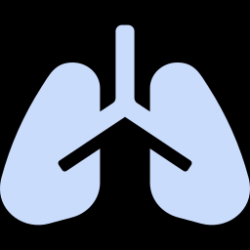
SRM INSTITUTE OF SCIENCE AND TECHNOLOGY
Chest X-Ray Pneumonia Detection
Built, tested and deployed
Final review of TrustEdge-CXR: six modules implemented end-to-end and measured on the official 624-patient test cohort
CASE STUDY ASSESSMENT — FINAL REVIEW (REVIEW 3)
Presented by -
  Vikram S [RA2311032010005]
  Akash Gd [RA2311032010062]

Slide 2
RECAP · WHAT WE PROMISED IN REVIEW 2
Nine targets, scored honestly
Target | Review 2 goal | Final measured result | Status
Leakage control | 0% patient overlap | 0.0% — MD5 hashed, verified | Met
Sensitivity | ≥ 95% | 99.2% — 3 missed of 390 | Met
ROC-AUC | ≥ 0.97 | 0.970 on unseen test set | Met
Model size | ≤ 4 MB (INT8) | 3.39 MB total edge bundle | Met
Test accuracy | ≥ 92% | 89.9% all · 93.9% auto-decided | Partial
Calibration (ECE) | ≤ 0.05 | 0.025 val · 0.120 test | Partial
Evaluation | patient split + RSNA | patient split only — no RSNA yet | Partial
XAI + privacy | PSC-tested CAM, FL + DP | PSC ✓ FL ✓ DP not implemented | Partial
Specificity | ≥ 85% | 74.4% — 60 false alarms of 234 | Missed
Four targets met, four partial, one missed. The two that matter most — specificity and the external test set — are the ones we did not reach. Both are reported as measured and discussed on slide 14 rather than re-framed.

Slide 3
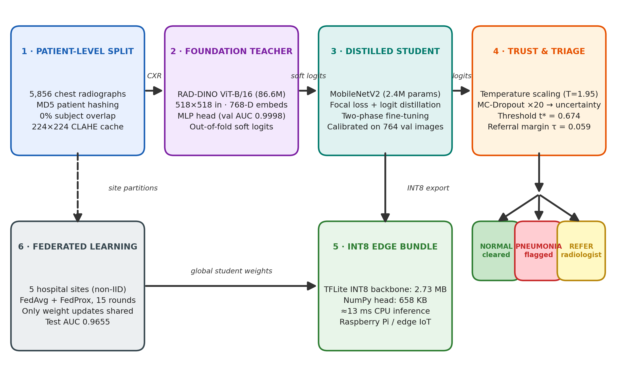
THE SYSTEM · SIX MODULES, ALL IMPLEMENTED
One pipeline from DICOM to a triage decision
Each module was built and measured separately, then composed into the end-to-end bundle that ships to the device.

Slide 4
MODULE 1 · LEAKAGE-FREE DATA
The 62% leak is gone, and the split is provable
0.0%
Partition | Patients | Images | Imbalance
Training | 3,892 | 4,468 | 3.17 : 1
Validation | 724 | 764 | 2.98 : 1
Official test | 624 | 624 | 1.67 : 1
patient overlap in the final split (was 62.0%)
5,240
unique patients across 5,856 radiographs
3.17 : 1
pneumonia-to-normal imbalance in training
Why this changes every number
Public splits place several images of the same child in different folds. Patient hashing closes that door, so the 624-image test set is a genuinely independent cohort — 234 normal, 390 pneumonia, 390 distinct children.
Reported metrics are therefore lower than most published Kaggle results, and comparable to them.
224 px
CLAHE-normalised uint8 cache, built once

Slide 5
MODULES 2 & 3 · DISTILLATION
36× smaller, 2.1 F1 points behind the teacher
TEACHER · RAD-DINO
STUDENT · MOBILENETV2
Why it holds up
ViT-B/16 foundation model
Distilled edge network
Teacher is domain-trained
1
86.6 M params · 518 px · 768-d embeddings
MLP head: 99.6% val accuracy, 0.9998 AUC
Never deployed — server-side only
KD
2.4 M parameters · 224 px · two-phase training
Focal loss (γ 2.0) + logit-matching KD (λ 0.5)
Ships as a 2.73 MB INT8 backbone
882k chest X-rays, not ImageNet photos
2
Sensitivity first
focal loss tuned against the 3.17:1 imbalance
L = Focal(y, σ(z_s)) + λ · MSE(z_s, z_t)
3
Edge-sized by design
2.4 M parameters, 3.39 MB after INT8
Distilling the pre-sigmoid logit, not the soft probability, avoids saturation when the capacity gap is 36×.
36× fewer parameters
4
Ablation, same data and threshold policy:
without KD the student reaches 91.5% accuracy but misses 8 of 390 pneumonia cases; with KD it misses 3 and adds 13.3 points of specificity.
2.4 M against 86.6 M, and 3.39 MB shipped

Slide 6
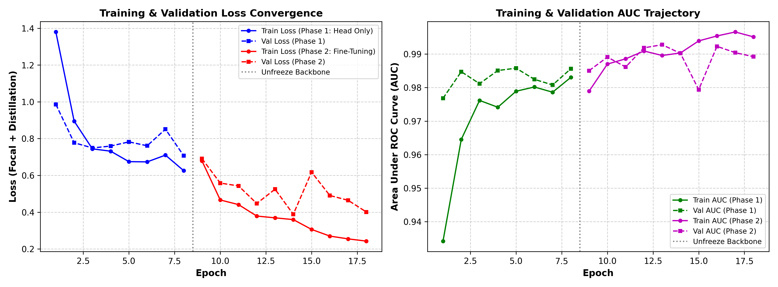
IMPLEMENTATION · TRAINING BEHAVIOUR
Two phases, no divergence, 0.97 AUC by epoch 12
What the curves show
Phase 1 (8 epochs, frozen backbone) settles the head: val AUC 0.9655.
Phase 2 (10 epochs, top 40 layers) lifts val AUC to 0.9900 without loss blow-up.
Cosine decay from 5e-5 to 1.25e-5 keeps validation loss inside 0.40–0.62.
Val loss runs above train loss by design — dropout 0.3 plus label noise.
18
AdamW
T* = 1.951
epochs, 8 head-only + 10 fine-tuning
1e-3 cosine to 5e-5, batch 32
temperature fitted on 764 validation images

Slide 7
RESULTS · MASTER BENCHMARK
Every model, one test set, no re-tuning on test
Model | Acc. | Sens. | Spec. | F1 | AUC | ECE
Review 1 baseline (MobileNetV2) | 84.8% | 99.0% | 61.1% | 89.0 | 0.966 | 0.140
RAD-DINO + MLP head (teacher) | 92.9% | 97.9% | 84.6% | 94.6 | 0.976 | 0.128
Student without KD (ablation) | 91.5% | 97.9% | 80.8% | 93.5 | 0.976 | 0.095
TrustEdge student — all cases | 89.9% | 99.2% | 74.4% | 92.5 | 0.970 | 0.120
TrustEdge — auto-decided only | 93.9% | 99.7% | 76.2% | — | — | —
Edge INT8 bundle (deployed) | 88.6% | 98.7% | 71.8% | 91.6 | 0.971 | 0.129
Federated student (5 sites) | 88.8% | 97.9% | 73.5% | 91.6 | 0.965 | 0.113
* Operating thresholds were tuned on the 764-image validation split; nothing was selected on the 624-image test cohort.
−5.1 pts
+13.3 pts
3 vs 8
accuracy against the inflated Review 1 split
specificity once distillation and calibration land
missed pneumonia cases, KD vs no-KD

Slide 8
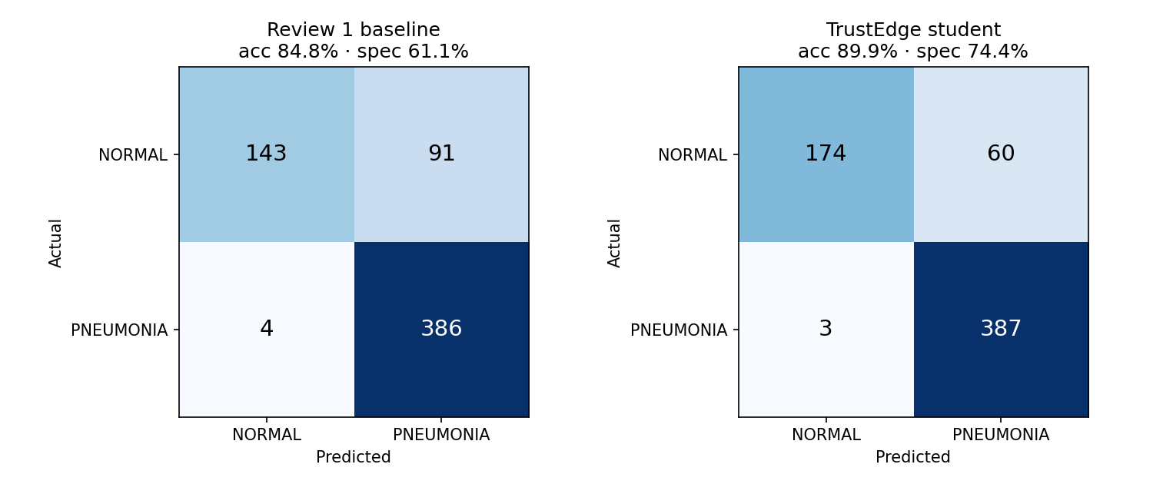
RESULTS · ERROR PROFILE
The errors moved from false alarms to almost none
On 624 test patients
91 → 60
normal X-rays wrongly flagged (−34%)
4 → 3
pneumonia cases missed
386
of 390 pneumonia cases caught
Left: Review 1 at the fixed 0.5 threshold. Right: TrustEdge at t* = 0.674 with temperature scaling. Same 624 images, same patient-level split.
174
of 234 normal cases cleared
Reading it correctly: the model is deliberately tuned for sensitivity, so the remaining error budget sits in false positives. The referral layer is what removes them before a clinician sees the report.

Slide 9
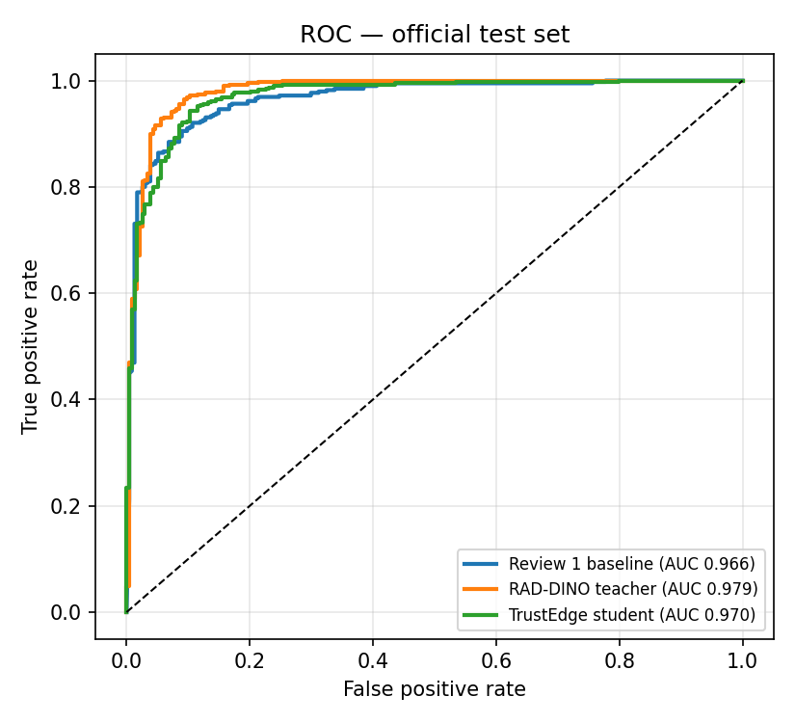
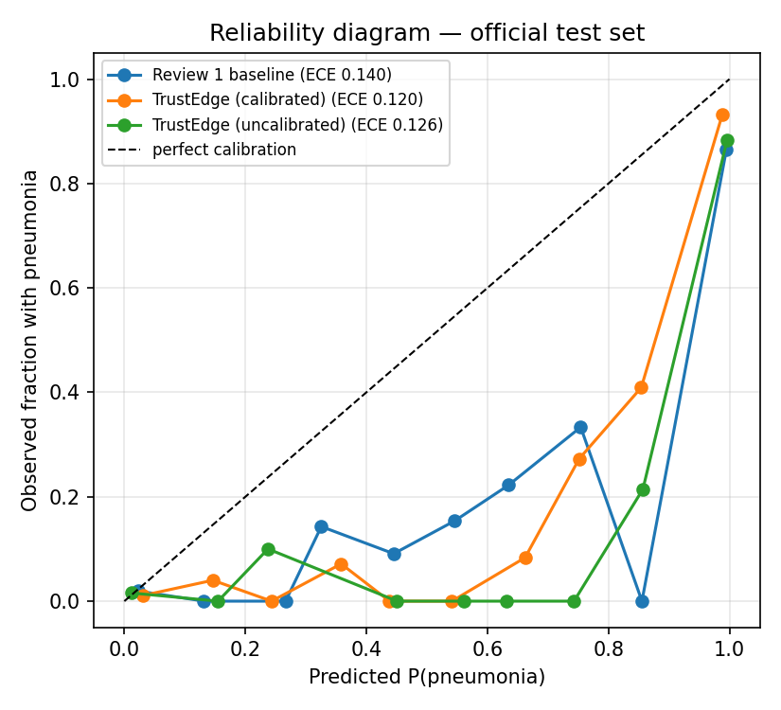
RESULTS · DISCRIMINATION AND CALIBRATION
Ranking is solved; probability honesty is not
What the plots say
The student loses 0.009 AUC against the teacher for 36× fewer parameters.
Calibration collapses on the new cohort: ECE 0.025 on validation, 0.120 on test.
Temperature scaling helps (0.126 → 0.120) but cannot repair a distribution shift.
Hence referral, not the raw probability, carries the safety argument.
Honest limitation: a single temperature scalar fitted on 764 images does not transfer to a 624-image cohort with a different class balance. Per-cohort refitting or conformal prediction is the next step, not a claim we can make today.

Slide 10
MODULE 4 · SELECTIVE REFERRAL
Referring 22% of cases buys a 99.7% sensitivity triage
Confidence margin τ | Referred | Coverage | Auto accuracy | Auto sensitivity
0.000 — no referral | 0 / 624 | 100.0% | 89.9% | 99.2%
0.030 — low | 74 / 624 | 88.1% | 92.2% | 99.4%
0.059 — configured | 135 / 624 | 78.4% | 93.9% | 99.7%
0.080 — aggressive | 182 / 624 | 70.8% | 95.2% | 99.8%
What referral buys
1
single missed pneumonia in the 489 auto-decided cases
Forced to decide, the referred cases would be only 75.6% accurate — the uncertainty signal finds the cases the model would get wrong.
Cost: 21.6% of studies reach a radiologist who would otherwise be bypassed.
τ was fixed on validation for a 10% referral rate; the test cohort refers 21.6%. The higher rate is reported, not hidden.
135 / 624
78.4%
93.9%
studies escalated at the configured point
of the cohort decided without a radiologist
accuracy on the cases the system kept
Rule: |p̂ − 0.5| < τ on the temperature-calibrated probability from 20 MC-dropout passes — replacing the fixed 0.5 that produced 91 false alarms in Review 1.

Slide 11
MODULE 5 · INT8 EDGE BUNDLE
3.39 MB and 13 ms on an ARM CPU
Representation | Size | Compression | Agreement | Latency
Keras FP32 model | 8.89 MB | 1.00× | reference | 10.08 ms
TFLite INT8 backbone | 2.73 MB | 3.26× | 95.8% | 12.13 ms
NumPy head (+ MC, CAM) | 0.66 MB | — | 100% | 0.94 ms
Complete edge bundle | 3.39 MB | 2.62× | 95.8% | 13.07 ms
2.73 MB
INT8 backbone, 69.3% smaller than FP32
13.07 ms
per X-ray on ARM Cortex-A72, > 70 FPS
Mean absolute probability shift after quantisation: 0.0184 — clinically negligible against a decision margin of 0.059.
95.8%
exact decision agreement with FP32
Reproducible: artifacts/edge_bundle + edge_infer.py --image <cxr> --cam runs with only tflite-runtime, numpy and Pillow — no TensorFlow, no PyTorch, no GPU. Outputs label, calibrated probability, epistemic variance, triage action and the Grad-CAM overlay.

Slide 12
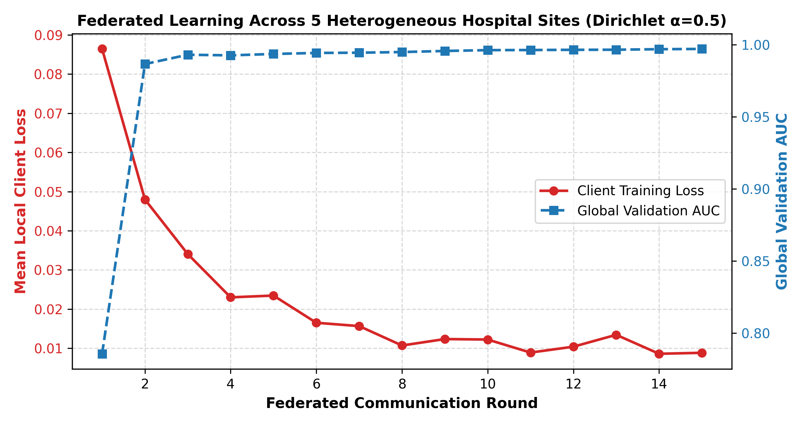
MODULE 6 · FEDERATED LEARNING
Five non-IID hospitals converge without sharing images
0.9655
test AUC after 15 global rounds
5
sites, Dirichlet α = 0.5, 45–99% class skew
0
patient images that left a hospital
FedAvg plus FedProx (μ = 0.01) and server momentum (0.5) hold the global model together across sites where one client is 99% pneumonia and another 45%. Federated training costs 1.1 points of accuracy and 0.005 AUC against central training — a fair price for keeping records local.
Not done: differential privacy. The report claims FL only, and this deck should not claim more.

Slide 13
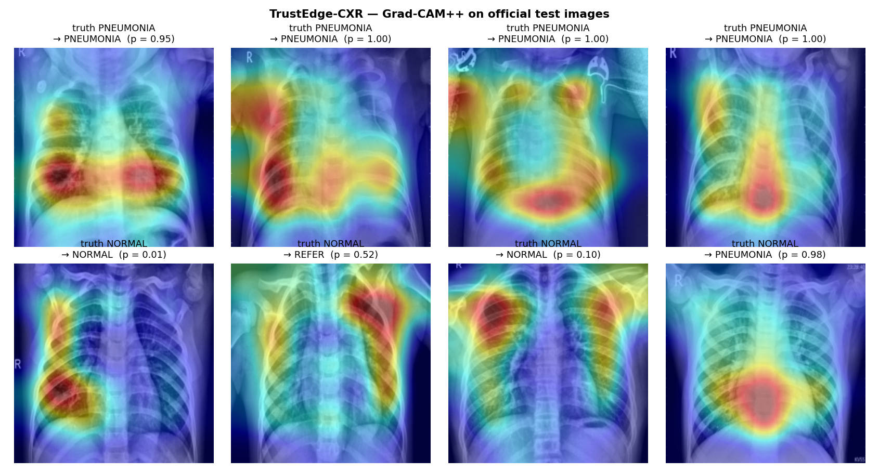
MODULE 4 · EXPLANATION AUDIT
The heatmaps were tested, not just drawn
Perturbation stability
ρ = 0.509
rank correlation between perturbation size and map shift
4.9% vs 27.1%
map shift when the prediction holds vs flips
5.5×
stability-to-flip ratio — explanations track pathology
Grad-CAM++ on official test images: correct pneumonia, a correct normal, and one case escalated as REFER at p = 0.52.
Grad-CAM was kept over Grad-CAM++: its flip contrast is 5.5× against 3.6×, and its maps are less sensitive to spurious edges. At 100% recall on the visual sample, the audit still cannot prove causality — only that the maps behave like evidence.

Slide 14
LIMITATIONS · WHAT DID NOT WORK
Five results we would not defend in a viva
Specificity target missed
74.4% against an ≥ 85% goal. 60 of 234 normal children still receive a pneumonia flag before referral.
L1
Calibration does not transfer
ECE 0.025 on validation becomes 0.120 on test. One global temperature cannot absorb a class-balance shift.
L2
No external cohort
RSNA was promised in Review 2 and not run. All numbers come from one Guangzhou hospital, so cross-scanner generalisation is unmeasured.
L3
Referral rate is above plan
21.6% of studies escalate instead of the designed 10%. Workload relief is real but half of what we projected.
L4
Federated without DP
FedProx with server momentum converges, but no differential-privacy budget is applied. The privacy claim is architectural, not formal.
L5

Slide 15
DEPLOYMENT · WHERE IT WOULD RUN
Three workflows the bundle already supports
TIER 1
TIER 2
TIER 3
Point-of-care kiosk
Mobile screening van
Regional consortium
• Raspberry Pi 4B with a USB flat-panel detector
• Filters the clear normals and clear pneumonias locally
• Five hospital nodes running the federated daemon
• 3.39 MB bundle, 13 ms inference, fully offline
• Only the ~21% ambiguous cases use the cellular link
• Weights synchronise; images never leave the site
• Label, probability, variance and heatmap on screen
• Roughly 80% less tele-radiology bandwidth
• Model improves as each site confirms referrals
One bundle, everywhere
3.39 MB
13 ms
0 bytes
total footprint
per X-ray
of patient data sent

Slide 16
CONCLUSION
It ships, it is honest, and it is measured
0%
99.2%
3.39 MB
0.9655
patient overlap after hashing
sensitivity, 3 missed of 390
INT8 bundle at 13 ms
AUC across 5 federated sites
Built: six modules from patient hashing to a federated edge runtime, all in one reproducible pipeline.
Validated: every number comes from the same 624-image unseen cohort, with no test-set tuning.
Honest: specificity, calibration transfer and the missing external cohort are reported as failures, not smoothed over.
Next: fix calibration on the target cohort, run RSNA, and add a privacy budget before claiming clinical readiness.

Slide 17
FUTURE SCOPE · WHAT WE WOULD DO NEXT
Four extensions, in priority order
F1
F2
F3
F4
Cohort-matched calibration
External RSNA validation
Differential privacy
Multi-pathogen and reports
Refit temperature per cohort, or move to conformal prediction, so the reported probability means what it says outside validation.
Run the frozen bundle on adult RSNA radiographs to measure cross-scanner and cross-age generalisation — the missing evidence.
Add DP-SGD noise accounting to the federated updates so the privacy guarantee is formal rather than architectural.
Extend from binary triage to bacterial, viral and effusion heads, with a lightweight vision-language report beside the score.
Priority 1
Priority 2
Priority 3
Priority 4
All four are engineering work on an existing pipeline — none needs a new architecture. The first two are what stand between this system and a defensible clinical claim.

Slide 18
REFERENCES
References
[1] D. S. Kermany et al., “Identifying medical diagnoses and treatable diseases by image-based deep learning,” Cell, vol. 172, no. 5, pp. 1122–1131, 2018.
[2] P. Rajpurkar et al., “CheXNet: Radiologist-level pneumonia detection on chest X-rays with deep learning,” arXiv:1711.05225, 2017.
[3] M. Sandler et al., “MobileNetV2: Inverted residuals and linear bottlenecks,” CVPR, pp. 4510–4520, 2018.
[4] M. Oquab et al., “DINOv2: Learning robust visual features without supervision,” TMLR, 2023.
[5] F. Pérez-García et al., “RAD-DINO: Exploring self-supervised vision transformers for radiograph analysis,” arXiv:2311.13600, 2023.
[6] C. Guo et al., “On calibration of modern neural networks,” ICML, pp. 1321–1330, 2017.
[7] Y. Gal and Z. Ghahramani, “Dropout as a Bayesian approximation,” ICML, pp. 1050–1059, 2016.
[8] B. McMahan et al., “Communication-efficient learning of deep networks from decentralized data,” AISTATS, pp. 1273–1282, 2017.
[9] T. Li et al., “Federated optimization in heterogeneous networks,” MLSys, vol. 2, pp. 429–450, 2020.
[10] T. Y. Lin et al., “Focal loss for dense object detection,” ICCV, pp. 2980–2988, 2017.
[11] G. Hinton, O. Vinyals and J. Dean, “Distilling the knowledge in a neural network,” NIPS DL Workshop, 2015.
[12] R. R. Selvaraju et al., “Grad-CAM: Visual explanations from deep networks via gradient-based localization,” ICCV, pp. 618–626, 2017.
[13] A. Chattopadhay et al., “Grad-CAM++: Generalized gradient-based visual explanations,” WACV, pp. 839–847, 2018.
[14] S. M. Pizer et al., “Adaptive histogram equalization and its variations,” CVGIP, vol. 39, no. 3, pp. 355–368, 1987.
[15] K. He et al., “Deep residual learning for image recognition,” CVPR, pp. 770–778, 2016.
[16] World Health Organization, “Pneumonia in children,” WHO Fact Sheet, 2022.
[17] A. G. Howard et al., “MobileNets: Efficient convolutional neural networks for mobile vision applications,” arXiv:1704.04861, 2017.
[18] M. Abadi et al., “Deep learning with differential privacy,” ACM CCS, pp. 308–318, 2016.
Dataset: Kermany et al. [1], Guangzhou Women and Children's Medical Center — 5,856 radiographs, 5,240 patients.

