Slide 1
Digital Twin Health Activity Tracker
Maintenance Process Model
Model: Iterative Enhancement Model
Date
29 April 2026
Team
Project Development Team
Software Maintenance Engineering | Iterative Enhancement Model

Slide 2
Maintenance Process Model Selection
Project: Digital Twin Health Activity Tracker
✔ Selected Model: Iterative Enhancement Model
Why Iterative Enhancement?
Other Models Considered
▸ Continuous Evolution
✗ Quick Fix Model
Digital twin health-score algorithm needs periodic recalibration as more user activity data is gathered.
Rejected — reactive only, no structured phased improvement cycle.
▸ User-Driven Feedback
✗ Boehm Model
Health metrics (steps, sleep, calories, workouts) require iterative UX improvements each cycle.
Partially adopted — used for maintenance type classification only.
▸ Safe Schema Growth
SQLite schema evolves as new activity types are added; iterative cycles enable safe migrations.
✗ Osborne Model
Rejected — suited for legacy COBOL-era systems, not a modern Node.js stack.
▸ API Enhancement
REST endpoints need backward-compatible extensions without breaking existing clients.
✗ Reuse-Oriented Model
▸ Ongoing Calibration
Not applicable — system is built from scratch, limited reuse scope.
Health thresholds and rating logic must be tuned periodically against real-world data.

Slide 3
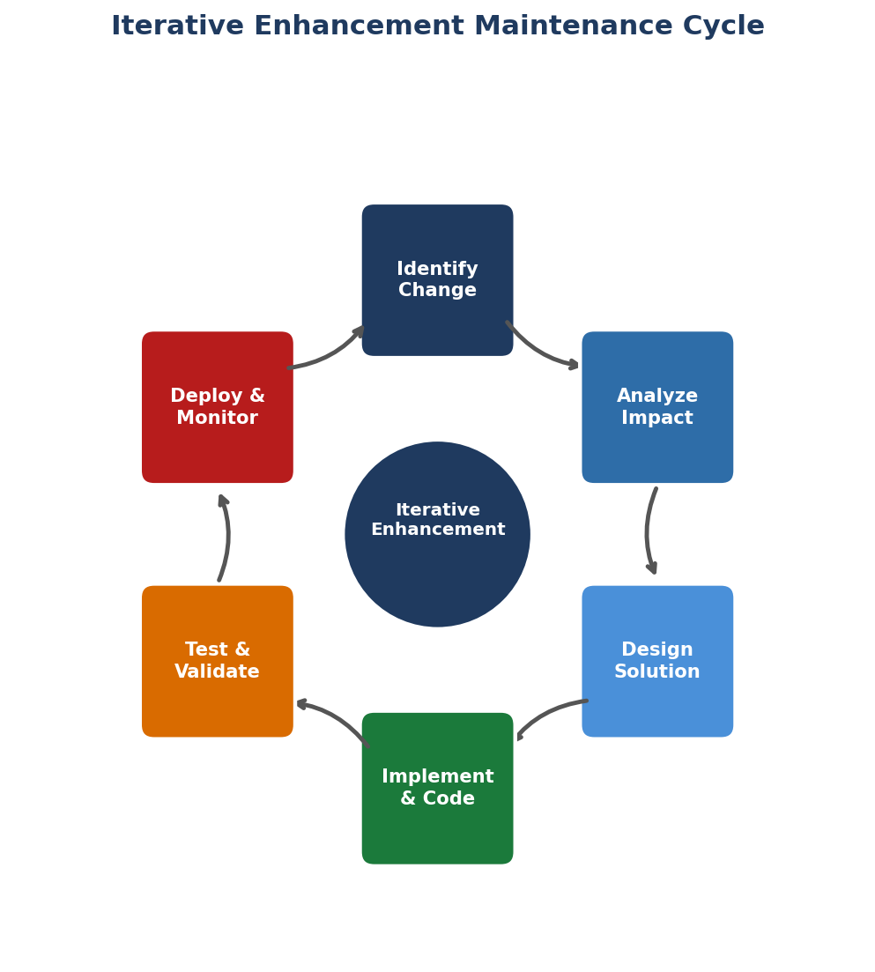
Iterative Enhancement Process Flow
Six-step maintenance cycle applied to the Digital Twin system
1. Identify Change
Bug reports, user feedback, or tech-debt items raise a maintenance need.
2. Analyze Impact
Assess affected modules (routes, models, DB schema, tests).
3. Design Solution
Draft code changes; update API contracts or DB migration scripts.
4. Implement & Code
Apply changes in feature branch; follow coding standards.
5. Test & Validate
Run api.test.js (Node runner) + Playwright UI suite; check coverage.
6. Deploy & Monitor
Merge to main, restart server, monitor /api/health & logs.

Slide 4
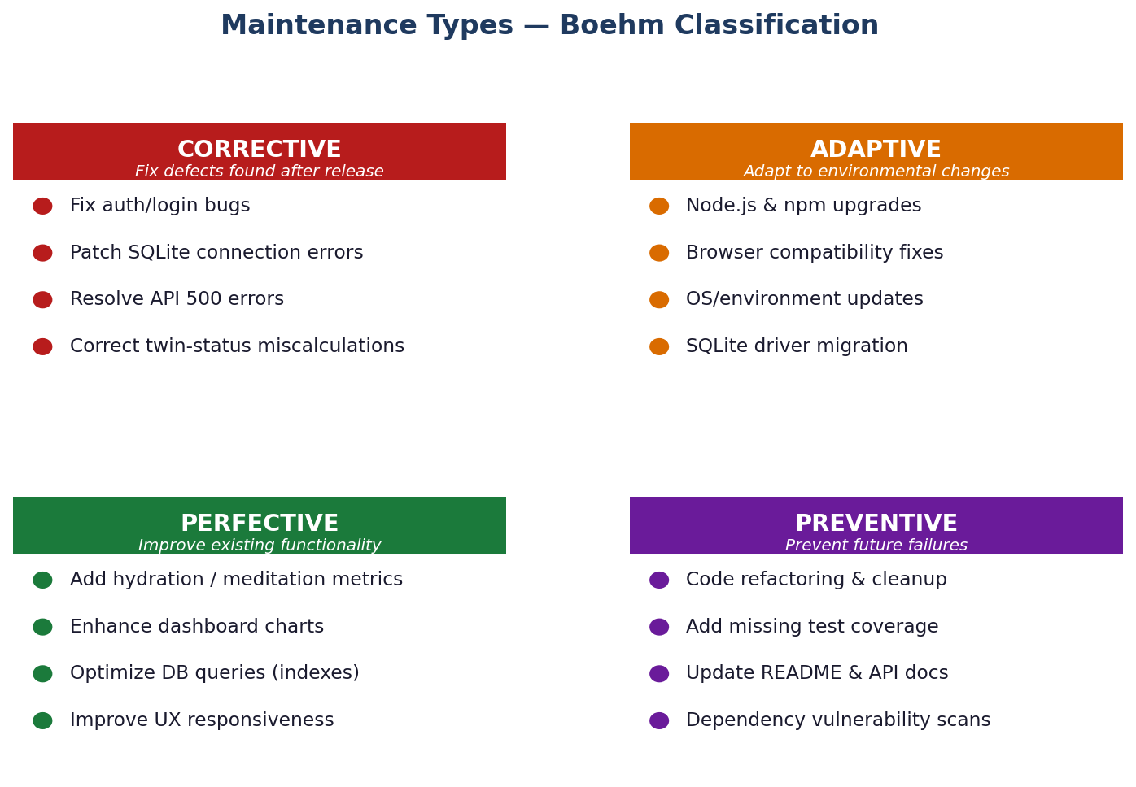
Maintenance Types — Boehm Classification
Every change request is categorised before work begins

Slide 5
Project-Specific Maintenance Activities
Mapped to Boehm categories for the Digital Twin Health Tracker
Type
Activity
Module(s) Affected
Priority
CORRECTIVE
Fix twin-status rating bug (0-total shows 'good')
src/routes/twin.js
High
CORRECTIVE
Resolve auth missing-password 400 response
src/routes/users.js
High
ADAPTIVE
Upgrade better-sqlite3 after Node.js v22 release
package.json, database.js
Medium
ADAPTIVE
Ensure Playwright tests pass on latest Chromium
tests-ui/ specs
Medium
PERFECTIVE
Add weekly trend chart to dashboard
public/js/charts.js
Medium
PERFECTIVE
Add hydration activity type + seeding data
models/Activity.js, seed.js
Low
PREVENTIVE
Increase API test coverage to 80%+
tests/api.test.js
Medium
PREVENTIVE
Refactor middleware to reduce code duplication
src/middleware/
Low

Slide 6
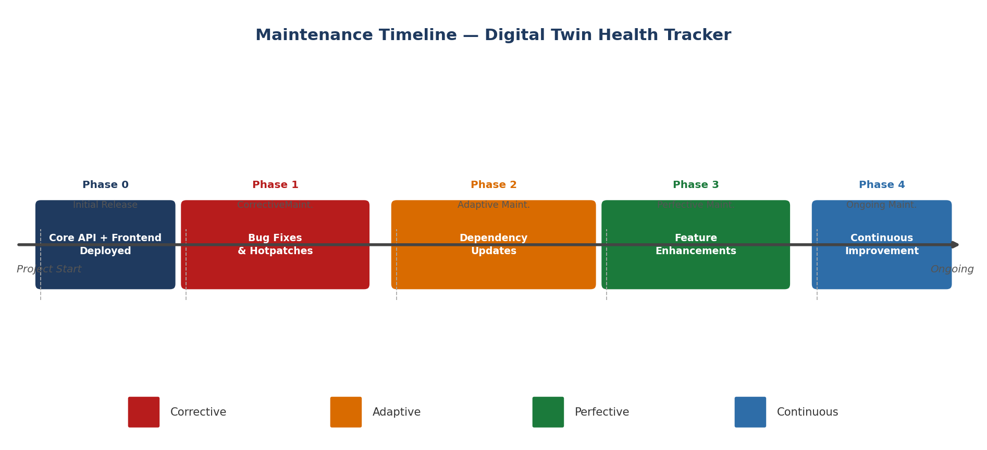
Maintenance Timeline & Release Phases
Planned phases following initial deployment

Slide 7
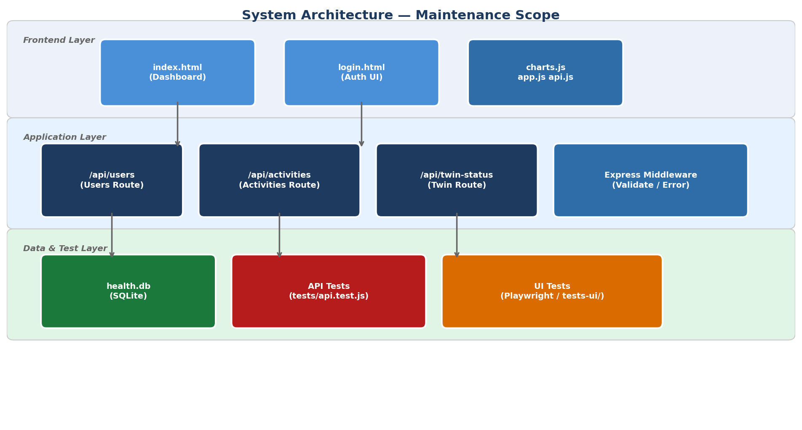
System Architecture — Maintenance Scope
Components requiring active maintenance attention

Slide 8
Maintenance Tools & Procedures
Standard toolchain used across all maintenance phases
Version Control
[Git]
Bug Tracking
[GitHub Issues]
Feature branches, PR reviews, tags per release. Rollback via git revert.
Issues labelled corrective/adaptive/perfective/preventive before sprint.
API Testing
[Node Test Runner]
UI Testing
[Playwright]
tests/api.test.js — run npm test. Target: >80% route coverage.
tests-ui/ specs (auth, dashboard, activities). Run npm run test:ui.
Monitoring
[/api/health + Logs]
Documentation
[README + JSDoc]
Health endpoint polled every 60s. Error middleware logs to stdout.
Setup guide, API reference, and inline comments kept up-to-date.

Slide 9
Conclusion
Summary of the Maintenance Process Model for Digital Twin Health Activity Tracker
The Digital Twin Health Activity Tracker adopts the Iterative Enhancement Model as its core maintenance strategy. This model best fits the project's need for continuous improvement, regular algorithm recalibration, and user-driven feature evolution while keeping the system stable and tested throughout its lifecycle.
Corrective
Adaptive
All reported defects logged as GitHub Issues and triaged before each sprint.
Dependencies pinned via package-lock.json; updated every minor sprint.
Perfective
Preventive
Feature roadmap driven by health-domain insights and user feedback.
80%+ test coverage target + code reviews enforced on every pull request.
Maintenance Process Model | Digital Twin Health Activity Tracker | 29 April 2026

