Slide 1
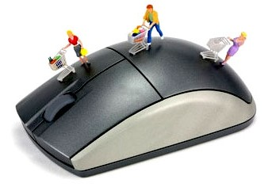
Database Presentation
Vikrant Dabas | Ajinkya Mohapatra | Yuvaraj | Rudhra Balankari
Team Lead, Database Design and Implementation | Front End Design, Documentation of Project | Database Design | Front End Design
800936479 | 800963333 | 800903707 | 800962658

Slide 2
Agenda
Objective
Overview of the project
Query Optimization(Use of Explain)
Stored Procedures
Triggers
Usage of Indexes
Transaction
Future Improvements
Thank You!
An interesting Question?

Slide 3
Objective
To set up an online store and maintain the details of the donation items which come from alumni and current students
A simple easy-to-understand interface for the customers
User friendly for computer illegitimate
Easy to maintain by the admin

Slide 4
Overview
To design a database which is capable of maintaining the details of the donations which come from alumni, current students, faculty and staff and friends of Phi Beta Lambda or Catawba College, items (available in the closet),customer, the person who checks in the item and people who follow the clothing closet.
Implemented two different UIs, one for the Admin and Members and the other open to the public for viewing which have been achieved by mapping the UIs to different URLs and keeping the admin URL secure.

Slide 5
Overview(Continued)
The UI open to the public:
Shows items for sale – by categories – anyone can browse, anyone can buy but when they click to buy, they will be prompted to register and receive newsletter; if they don’t register, they will be directly taken to purchasing screen and we won’t keep track of who bought the item
Has a webpage to register as new user, login [can register and will contain options for Forgot Password]
Has a web page through which user can view and edit his/her profile and also view his/her last purchases and/or donations
The UI accessible only to the admin and members [will be achieved by User Authorizations made by admin] will have functionality to:
Edit the database schema
Register people that are members and check in the clothes, also register people that donate
Enter items for sale, update items when a sale is made and email is received from the processing system on the Catawba server, delete items (archive)
Mark items sold and update selling price from sales recorded from Instagram[manual] or from web

Slide 6
Overview(Continued)
The below business functionalities have been implemented in project:
A donation receipt is associated with only one donator and one admin who received it.
A donation receipt has one to many items on it and shows the total.
An item is on only one donation receipt.
An item can be in one category (belts, shoes, men’s jacket, etc.)
An item is bought only by one person. A person can buy zero to many items.
On the 1st day of every month, items over 15 days old are reduced by 50%, unless the item is flagged as the one which doesn’t get a reduction.
A donator receives an id and password once he donates an item with which he can view the items donated by him and the corresponding Tax Document
Newsletters will only be sent to subscribed users.
Donation receipt should be mailed to persons donating items
The receipt for every purchase is saved.

Slide 7
STORE PROCEDURES
Get a list of top donators according to the total cost of the items donated every month(Bronze Coupon)/ 6-months(Silver Coupon)/ year(Gold Coupon).
Get all items which are on reduced price, ordered by price in increasing order and send a list of top 20 items to the user in newsletter.
Procedure called on monthly basis to find the profit earned by the clothing store for donation taking into consideration the reduction.
Procedure called to find the items donated in a month based on a category of interest to the customer /previous purchases of the customer. -- columns needs to be added unable to fetch the user who bought something
Procedure called to get the users who have added items to the cart and the items have been added for more than 2 days. - column needs to be added
Procedure to determine the top performer of a month - done

Slide 8
TRIGGERS | EVENTS
Update total price for each cart when Item is added or deleted.
Remove the items from the cart if it is in a cart for more than two days
Reduce the price of the items marked for reduction at the beginning of every month

Slide 9
SARGABLE - Search ARGument ABLE ?
A condition (or predicate) in a query is said to be sargable if the DBMS engine can take advantage of an index to speed up the execution of the query.
The typical situation that will make a SQL query non-sargable is to include in the WHERE clause a function operating on a column value.
The WHERE clause is not the only clause where sargability can matter; it can also have an effect on ORDER BY, GROUP BY and HAVING clauses.
The SELECT clause, on the other hand, can contain non-sargable expressions without adversely affecting the performance.

Slide 10
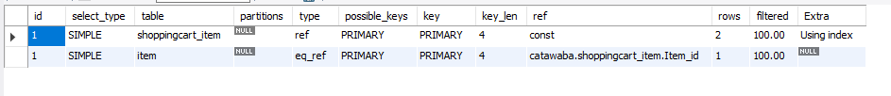
Query Optimization(Use of Explain)
EXPLAIN SELECT * FROM shoppingcart_item WHERE Cart_id=1;
EXPLAIN EXTENDED SELECT item.brand, item.Selling_Price,item.Item_id
FROM item INNER JOIN shoppingcart_item ON item.Item_id=shoppingcart_item.Item_id
WHERE shoppingcart_item.Cart_id = 1;

Slide 11

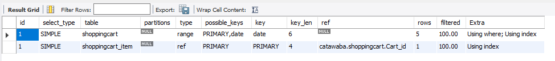
INDEXES USAGE
EXPLAIN SELECT shoppingcart_item.Item_id FROM shoppingcart_item, shoppingcart
WHERE shoppingcart_item.Cart_id = shoppingcart.Cart_id
AND shoppingcart.added_time < DATE_SUB(now(), INTERVAL 2 DAY);
ALTER TABLE shoppingcart ADD INDEX date (added_time);

Slide 12
INDEXE USAGE
EXPLAIN SELECT Item_id, Color, Brand, Size, Description, Value FROM item
WHERE Reduction = 1 AND Sold_Indicator = 0
ORDER BY Value ASC LIMIT 20;
ALTER TABLE item ADD INDEX proc2 (Reduction, Sold_Indicator, Value);

Slide 13
TRANSACTION EXAMPLE
START TRANSACTION;
SELECT * FROM item;
SELECT * FROM shoppingcart_item;
UPDATE item SET Sold_Indicator=1 WHERE Item_id IN (SELECT Item_id from shoppingcart_item WHERE Cart_id=1);
DELETE FROM shoppingcart_item WHERE Item_id IN (SELECT c.Item_id FROM (SELECT shoppingcart_item.Item_id from shoppingcart_item WHERE shoppingcart_item.Cart_id = 1) AS c);
SELECT * FROM item;
SELECT * FROM shoppingcart_item;
ROLLBACK;

Slide 14
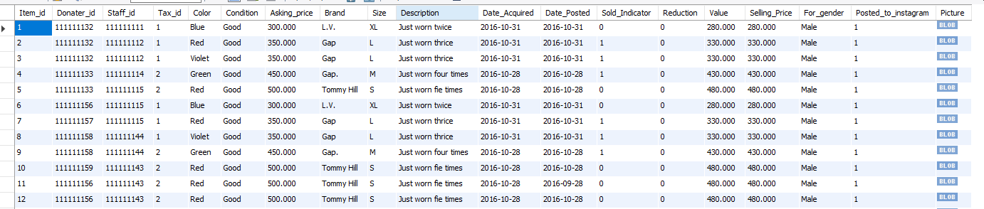
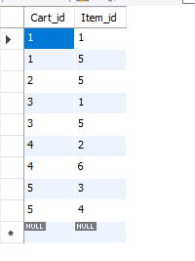

Slide 15
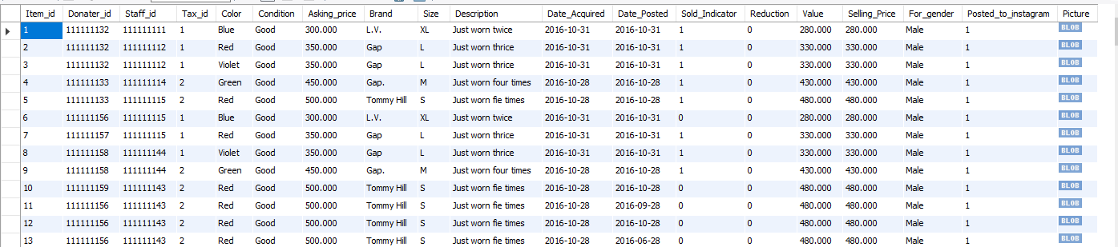
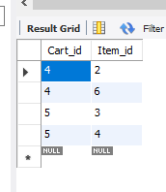

Slide 16
Future Improvements
The following improvements can be achieved
Using a NO-SQL approach[Tackle impedance mismatch problem]
Making the system highly robust and secure
Making the database capable of handling heavy loads
Mobile Application
Provide a robust searching mechanism and live updates

Slide 17
THANKS!

Slide 18
