Slide 1

Face Mask Detector
MAKING THIS WORLD A SAFER PLACE
Version 1.0
August 01 2020

Slide 2
Abstract
Face mask detection is emerging as a new problem statement because of Covid-19
So are team will be working on different datasets to train our face mask detection application in a very efficient way.
Our application will be able to detect face masks with an accuracy of more than 90%.
It can be used in surveillance cameras in many public places to detect face masks.
There are only a few research studies about face mask detection based on image analysis. Therefore, we bring a high-accuracy and efficient face mask detector. This is a one-stage detector, which consists of a feature pyramid network to fuse high-level semantic information with multiple feature maps, and a novel context attention module to focus on detecting face masks. We will also use cross-class object removal algorithm to reject predictions with low confidences and the high intersection of union. We will be using OpenCV and Keras / TenserFlow for detecting faces and face mask by using CNN algorithm.

Slide 3
Introduction
As we all know Coronavirus disease 2019 has affected the world seriously. One major protection method for people is to wear face masks in public areas. Furthermore, many public service providers require customers to use the service only if they wear masks correctly. Therefore, we are proposing this project which will detect the face mask with a high-accuracy and efficiency using ML algorithms. This will help general public all around the world to keep themselves safe and help them to take care of their health. Making this world a much safer place.
Many countries have been affected adversely due lack of proper implementations of the Covid-19 lockdown and unlock rules.
There are rules that one should always wear protective gears such face masks, hand gloves, etc., but people often don’t abide with rules which is the main reason behind the spread of coronavirus disease.
It becomes difficult for law keepers to keep an on each and every individual in public areas, but it is far easier and faster for computers to do so within fraction of second.

Slide 4
PROBLEMS STATEMENT
To train object detection models capable of identifying the location of masked faces in an image
To detect the location of unmasked faces in the image.
It should be robust to noise and provide as little room as possible to accommodate false positives for masks due to the potentially dire consequences that they would lead to.
Ideally, it should be fast enough to work well for real-world applications.

Slide 5
Literature Survey
S.no. | Title | Author | Algorithm/Methodology | Dataset | Result | Finding Achievement | Drawback
1. | Face Mask Detector with OpenCV,Keras/TensorFlow,and Deep Learning | Adrian Rosebrock (2020) | Computer Vision approach involving: OpenCV Algo Keras | PyImageSearch | With mask=99% Without mask=99% | This approach used helped in achieving a high accuracy rate. | Limited data for training detector software.
2. | Face Mask Detector using Deep Learning(YOLOv3) | Alexandra Lorenzo | Machine Learning | Kaggle | With mask=95% | Use of YOLO makes it a lot faster to detect. | With faster detection comes low accuracy.
3. | Detecting Masked Faces in the Wild with LLE-CNNs | Shiming Ge et al (2020) | locally linear embedding (LLE) , Machine Learning , | Masked Faces(MAFA), Magnetotelluric (MT). | 76.4% with MAFA, 60.8% with MT | The ‘real wild’ scenarios are much more challenging than expected for con- training faces captured at unexpected resolution, illumination and occlusion | MAFA is very challenging for existing face detectors

Slide 6
S.no. | Title | Author | Algorithm/Methodology | Dataset | Result | Finding Achievement | Drawback
4. | RETINAFACEMASK: A FACE MASK DETECTOR | Mingjie Jiang at el(2020) | Feature Pyramid Network(FPN), Single Shot MultiBox Detector (SSD), | Wider Face, MAsked FAces (MAFA) | RetinaFaceMask+MobileNet; Face=95.6% | face and mask detection precision respectively, and 11.0% and 5.9% | __
5. | Face Detection and Segmentation Based on Improved Mask R-CNN | Kaihan Lin, Huimin Zhao (2020) | R-CNN, Fast R-CNN, Faster R-CNN | COCO challenges, Cityscapes dataset, FDDB, ChokePoint | G-Mask method achieved 95.97% average precision (AP) | G-Mask method achieves promising performance. | The extracted face features have background noise.
6. | Identifying Facemask-wearing Condition Using Image SuperResolution with Classification Network to Prevent COVID-19 | BOSHENG QIN, DONGXIAO LI(2020) | SRCNet, CNN | Medical Masks Dataset in the Kaggle | Mask : 98.57% Net : 97.26% | SRCNet achieved 98.70% accuracy | These findings are achieved bby using contained test data cannot be said same for live data.

Slide 7
S.no. | Title | Author | Algorithm/Methodology | Dataset | Result | Finding Achievement | Drawback
7. | Face Mask Detector using Deep Learning (PyTorch) and ^{Computer} ^{Vision (OpenCV)} | Ramachandran K (2020) | CNN, MobileNetV2, PyTorch | PyImageSearch | Net while using test data: avg 96.3% Net while using livestream: avg 60% | Easy to maintain and build the environment. | Accuracy using real time live data is not up to the mark.
8. | Masked Face Detection Via a Novel Framework | Qiting Ye (2020) | NMS and MTCNN | Baidu, Bing and Sougou | Avg precisionn : 76.8% | AP reaches up to 76.8% over the testing set of the dataset, the second-best model, MT, only reaches an AP of 60.8%. | Findings were made using only images. Not enough data to reproduce or cross check the results

Slide 8
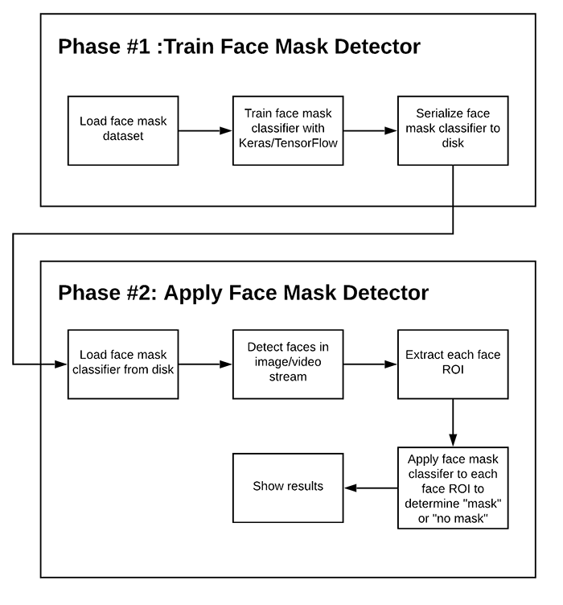
Roadmap of project

Slide 9
Phase #3: Testing
Input Through Webcam
Mask
No mask
YES(Green)/Accuracy percentage(%)
NO(Red)/Accuracy percentage(%)

Slide 10
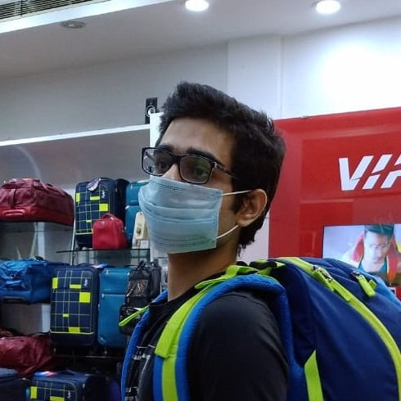
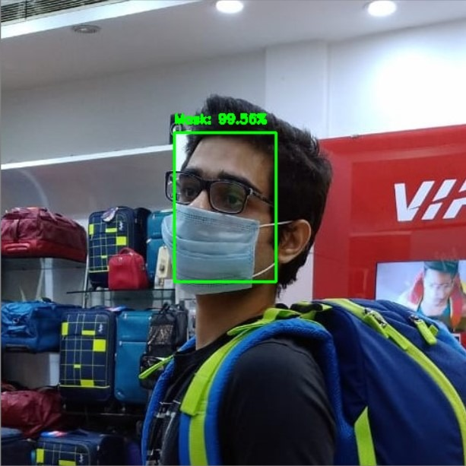
RESULTS
DETECTED WITH ABOVE 99% ACCURACY

Slide 11
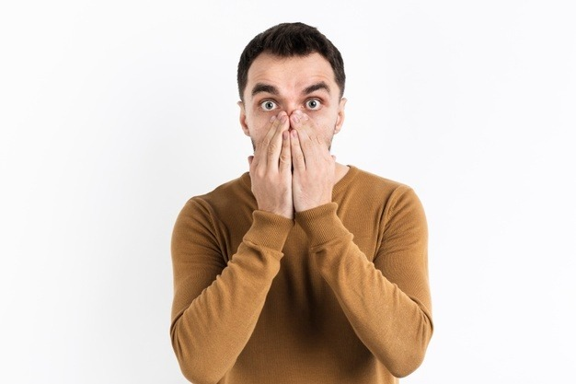
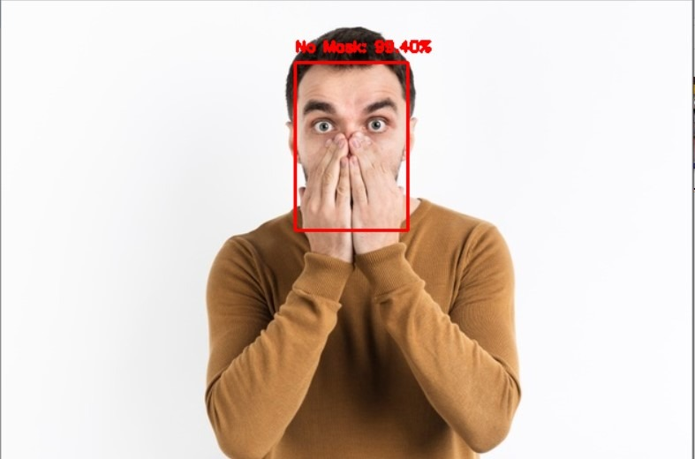
DETETED WITH ABOVE 95% ACCURACY

Slide 12
RESULTS
As we processed the raw images into the face mask detector system it responded its best accuracy.
Finally with the help of Face mask detector system we come to the conclusion that the system is performing its best to provide more precise accuracy. With the help of this system any of us can detect that the person is wearing a mask or not in this pandemic which will help us to stay safe from the coronavirus spread.

Slide 13
Thank you!!

