Slide 1
Project Aurora
Scaling the platform to 10M daily active users
Vikrant Singh, Engineering Leadership · Q1 FY26

Slide 2
SECTION
Where we are

Slide 3
Executive summary
▪ Revenue run-rate up 42% YoY, driven by enterprise adoption
▪ Platform reliability reached 99.95% availability this quarter
▪ Two strategic risks need a decision today: capacity and talent
▪ Ask: approve $4.2M investment to unblock the FY26 roadmap
Aurora · Confidential - Leadership Review
3
Notes:
Open with the headline numbers. Pause after the ask so leadership can react.
Keep this slide under 90 seconds.

Slide 4
The numbers that matter
Metric | FY25 | FY26 Target | Status
Daily active users | 3.1M | 10M | On track
p95 latency | 280ms | 150ms | At risk
Gross margin | 61% | 68% | On track
NPS | 42 | 55 | Ahead
Aurora · Confidential - Leadership Review
4

Slide 5
What's driving growth
▪ Enterprise self-serve onboarding
▪ Usage-based pricing rollout
▪ 14 new integrations shipped
▪ Partner-led motion in EMEA
▪ Mobile DAU up 3.4x
▪ Activation rate 31% → 47%
▪ Churn down to 1.8% monthly
▪ Expansion revenue now 38% of net-new
Aurora · Confidential - Leadership Review
5

Slide 6
SECTION
What we need to decide

Slide 7
Strategic bet: invest in capacity now
▪ Option A - Incremental sharding. Lower risk, caps out at ~7M DAU.
▪ Option B - Re-platform to a cell-based architecture. Higher upfront cost, scales past 25M DAU.
▪ Recommendation: Option B, phased over three quarters.
Aurora · Confidential - Leadership Review
7

Slide 8
“
The best architecture is the one that lets a small team move fast for years without rewrites.
- Aurora Engineering Tenets
Aurora · Confidential - Leadership Review
8

Slide 9
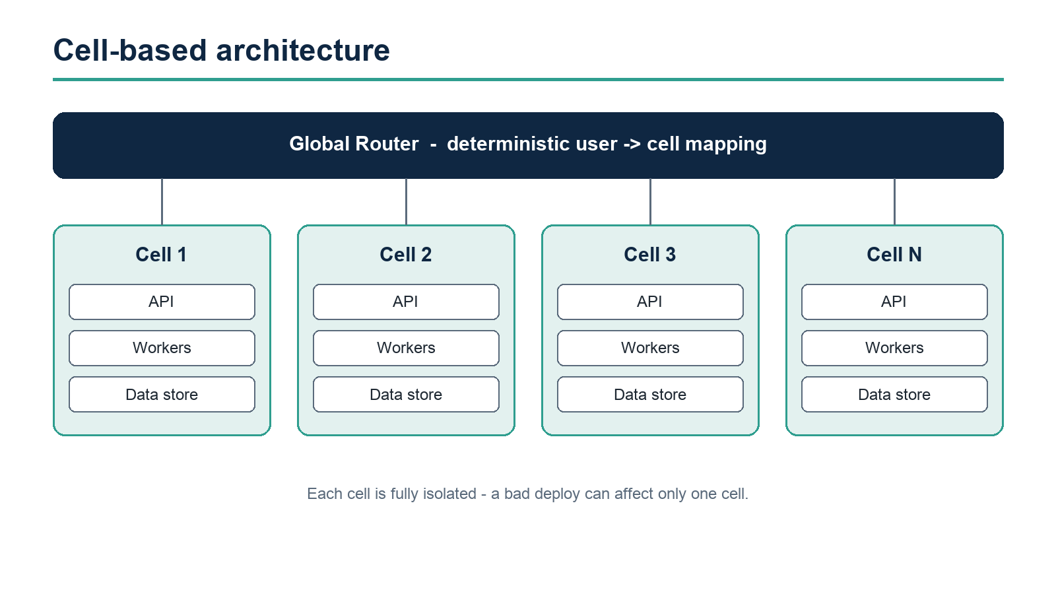
Architecture at a glance
Aurora · Confidential - Leadership Review
9

Slide 10
How the rollout works
▪ Each cell is fully isolated: its own data, queues, and capacity
▪ A bad deploy can only ever affect one cell
▪ Cells are added without downtime - capacity becomes a config change
def route_request(user_id: str) -> Cell:
"""Deterministically map a user to a cell for blast-radius isolation."""
cell_id = stable_hash(user_id) % len(active_cells())
return active_cells()[cell_id]
Aurora · Confidential - Leadership Review
10

Slide 11
The ask
▪ Approve $4.2M for the FY26 platform investment
▪ Backfill 6 senior engineers across two squads
▪ Green-light Option B with a phased, quarter-by-quarter rollout
▪ Decision needed by end of week to hold the timeline
Aurora · Confidential - Leadership Review
11

Slide 12
Thank you
Questions, challenges, and decisions - let's discuss

