Slide 1
Computerized Cognitive Retraining Program for Home Training of Children with Disabilities
CSE7101- Capstone Project
Review-1
Batch Number: PSCS_19
Roll Number | Student Name
Under the Supervision of,
Dr./Mr./Ms./Prof. John Bennet J
Professor / Associate Professor / Assistant Professor
School of Computer Science and Engineering
Presidency University
20221CAI0085 | Manoj Kumar KR
20221CAI0074 | Gnaneshwar DY
20221CAI0063 | Vikranth Reddy
Name of the Program:
Name of the HoD: Refer- Annexure-1
Name of the Program Project Coordinator: Refer- Annexure-1
Name of the School Project Coordinators: Dr. Sampath A K , Dr. Geetha A

Slide 2
Problem Statement Number:
Organization:
Category (Hardware / Software / Both) : Software
Problem Description:
Many children with cognitive disabilities struggle with attention, memory, executive
function, and problem-solving, which profoundly impacts their development, learning, and daily functioning. Traditional in-person therapy poses challenges in accessibility, scheduling, and cost. There’s an urgent need for a flexible, accessible, home-based solution to enable effective and sustained cognitive retraining

Slide 3
Content
Problem Statement
Objectives
Background and Related work for title Selection
Analysis of Problem Statement
Innovation or Novel Contributions
Git-hub Link
Timeline of the Project
References

Slide 4
Problem Statement
Children with cognitive disabilities face substantial barriers to traditional therapy.
A home-based, computerized cognitive retraining program aims to address these gaps through interactive, personalized, and adaptive digital modules that support progress at each child’s unique pace, involving caregivers for better outcomes

Slide 5
Objectives
Develop an interactive, adaptive software platform for cognitive retraining for children with disabilities.
Enhance cognitive skills: attention, memory, executive function, and problem-solving.
Enable home-based therapy to bridge accessibility, scheduling, and cost barriers.
Provide caregiver-friendly tools for tracking, feedback, and customization

Slide 6
Background and Related work for title Selection
Cognitive retraining enhances skills through targeted activities.
Computerized programs have shown efficacy in improving memory, attention, problem-solving, with added engagement, feedback, and flexibility
Related works emphasize the importance of tailored interventions and caregiver involvement for effective therapy

Slide 7
Analysis of Problem Statement
Children need individualized, flexible, and accessible interventions. A computerized retraining platform can personalize exercises, dynamically adapt difficulty, and offer engaging gamified tasks—addressing both cognitive and motivational needs

Slide 8
Innovation or Novel Contributions
Personalized training: Adaptive difficulty and learning paths for each child.
Caregiver integration: Tools and dashboards for involvement and progress monitoring.
Multisensory engagement: Visual, auditory, tactile experiences.
Home accessibility: No need for frequent clinic visits.
Gamification and feedback loops that keep children motivated and engaged

Slide 9
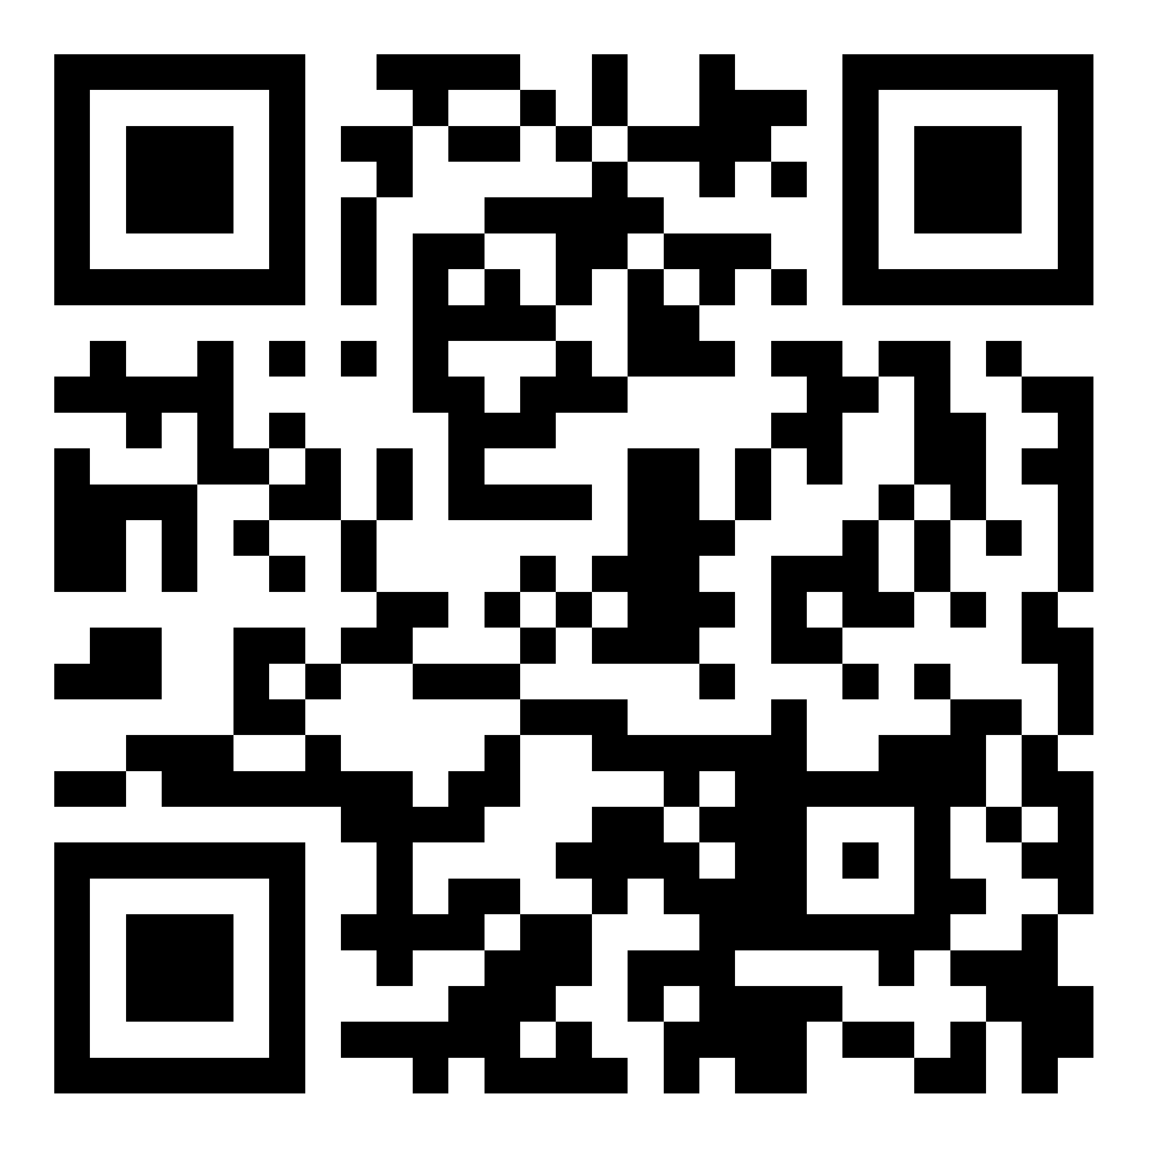
Github Link
https://github.com/Vikranth004/capstone-project

Slide 10
Technology Stack Components
Frontend: ReactJS/Angular (for UI)
Backend: Node.js/Python (for adaptive logic, progress storage)
Database: MongoDB/Firebase (user progress, activity data)
Platforms: Tablet, Laptop, PC (browser-based or standalone app)
APIs: For analytics, feedback loop, real-time adaptive changes

Slide 11
Software and Hardware Requirements
Basic: Modern PC/tablet with internet access
Software: Web browser, OS supporting modern web standards (Windows/Linux/MacOS/Android/iOS)
Storage for data persistence

Slide 12
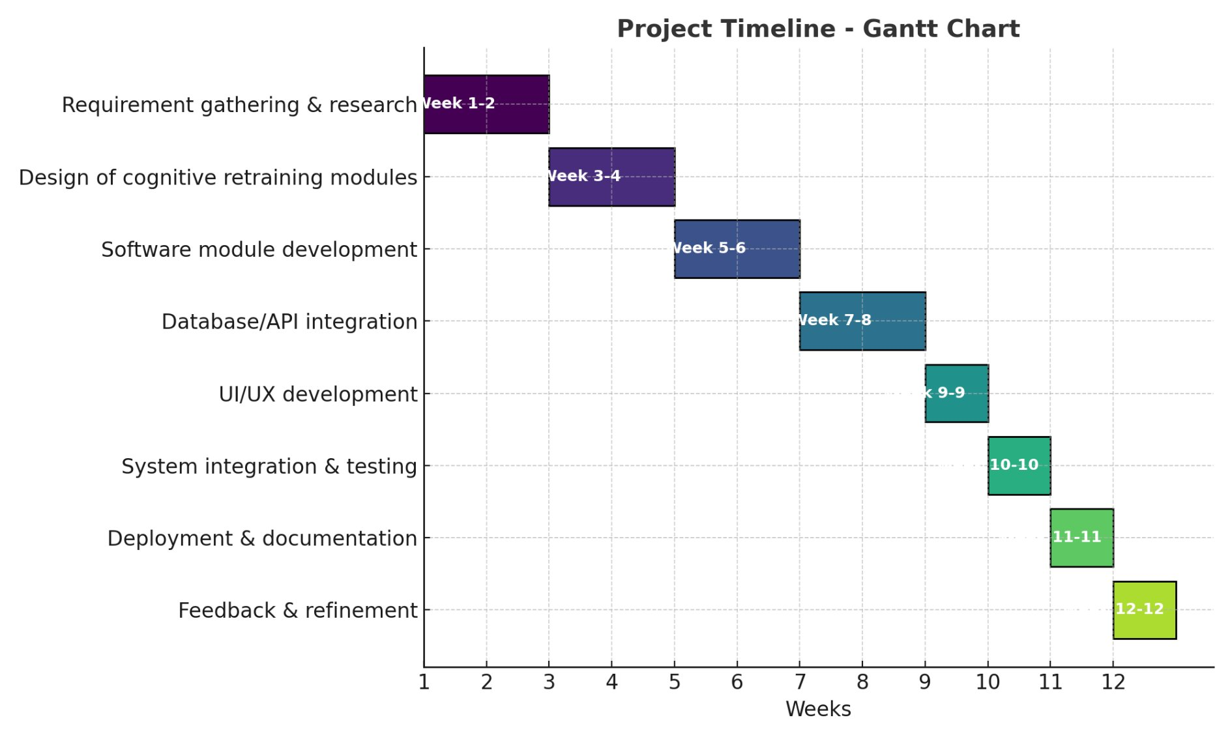
Timeline of the Project (Gantt Chart)

Slide 13
References (IEEE Paper format)
S. Aral & L.F. Stambaugh, “The effectiveness of computerized cognitive training in children with disabilities: A meta-analysis,” J. Cognitive Education and Psychology, vol. 18, no. 3, pp. 231-245, 2019.
K.E. Smith & S. Greenberg, “Computerized interventions for improving executive functions in children with ADHD,” J. Attention Disorders, vol. 25, no. 9, pp. 1228-1241, 2021.

Slide 14


