Slide 1




Binomial Distribution: Understanding Probability in Action
Probability plays a critical role in our everyday lives. In this presentation, we'll explore the fascinating world of the binomial distribution, a fundamental concept in probability theory. Get ready to dive deep into the realm of probabilities!
by Adi Sai Vikranth

Slide 2
Definition of Binomial Distribution
Success or Failure
Fixed Number of Trials
The binomial distribution models a series of independent events, each with two possible outcomes: success or failure.
The distribution is based on a fixed number of trials, which can be represented as flips of a coin or draws from a deck of cards.
Constant Probability
Independent Events
The probability of success remains constant for each trial, while the probability of failure is simply the complement of the success probability.
Each trial is independent, meaning that the outcome of one trial does not affect the outcomes of other trials.

Slide 3
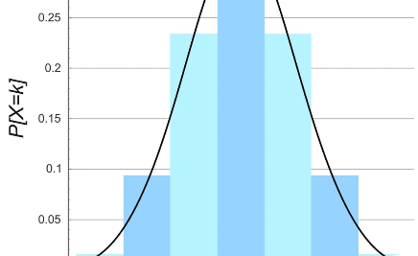
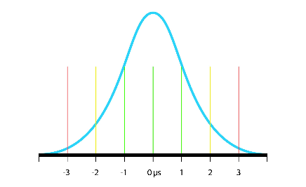
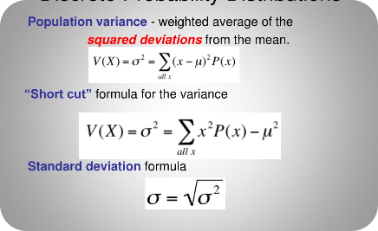
Properties of Binomial Distribution
Discrete Probability Distribution
Asymptotic Normal Distribution
The binomial distribution is a discrete probability distribution as it deals with a fixed number of discrete outcomes.
In large samples, the binomial distribution approximates a bell-shaped curve, known as the normal distribution.
Variance and Mean
The variance of a binomial distribution is equal to n times the product of the success probability and failure probability, while the mean is equal to n times the success probability.

Slide 4

Calculating Binomial Probabilities
1
Probability Mass Function
The probability of obtaining exactly k successes in n trials follows the binomial probability mass function formula: P(X=k) = (n choose k) * p^k * (1-p)^(n-k), where p is the success probability.
2
Cumulative Distribution Function
The cumulative distribution function calculates the probability of obtaining up to k successes: P(X≤k) = Σ (n choose i) * p^i * (1-p)^(n-i), where i ranges from 0 to k.
3
Using Technology
Computational tools like spreadsheets or statistical software greatly simplify the calculation of binomial probabilities for larger values of n.

Slide 5

Examples of Binomial Distribution
1
Flipping Coins
2
Card Games
3
Roulette Bets
Tossing a fair coin multiple times and counting the number of heads obtained.
The probability of drawing a specific card from a shuffled deck of cards after several draws.
Placing bets on black or red in roulette and calculating the probability of winning over multiple spins.

Slide 6

Conclusion
The binomial distribution provides a powerful tool for understanding and predicting the probabilities of success and failure in various real-world scenarios. Its applications span diverse fields and continue to shape our understanding of chance and uncertainty. Embrace the power of binomial distribution and unleash the potential of probability!

