Slide 1
Architecture
Event
App. 1
...
App. n
Reaction
Repository
Register
Register
Call External Function
Application
EDA
API
Publisher API
Caller Unit
Fetch Parameters
Config.xml
Event Type
Repository
Event
Repository
Invoke
(DB/xml)
Check
Check
trigger
(Thread per request arch.)
Listener

Slide 2
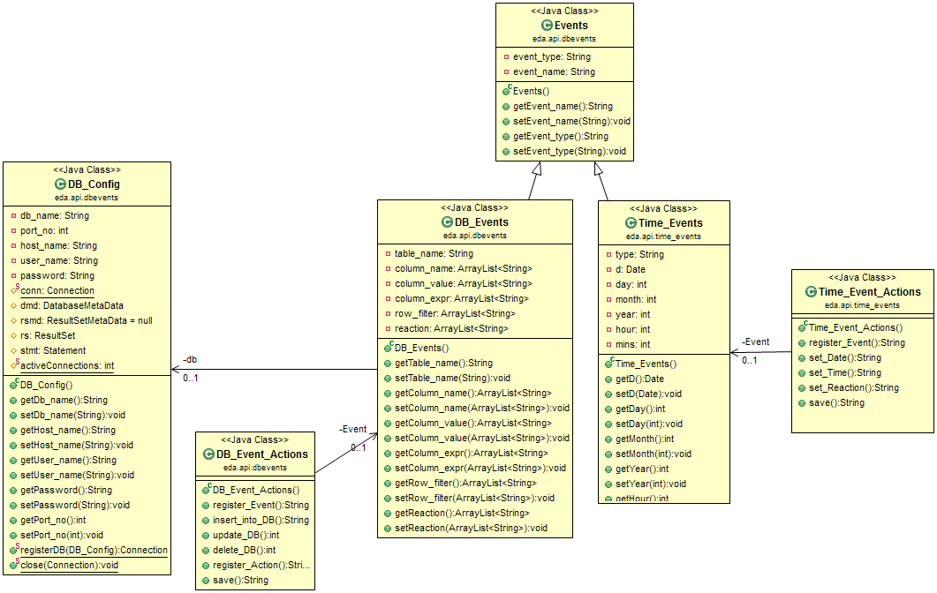
API Module.
Class Diag.:

Slide 3
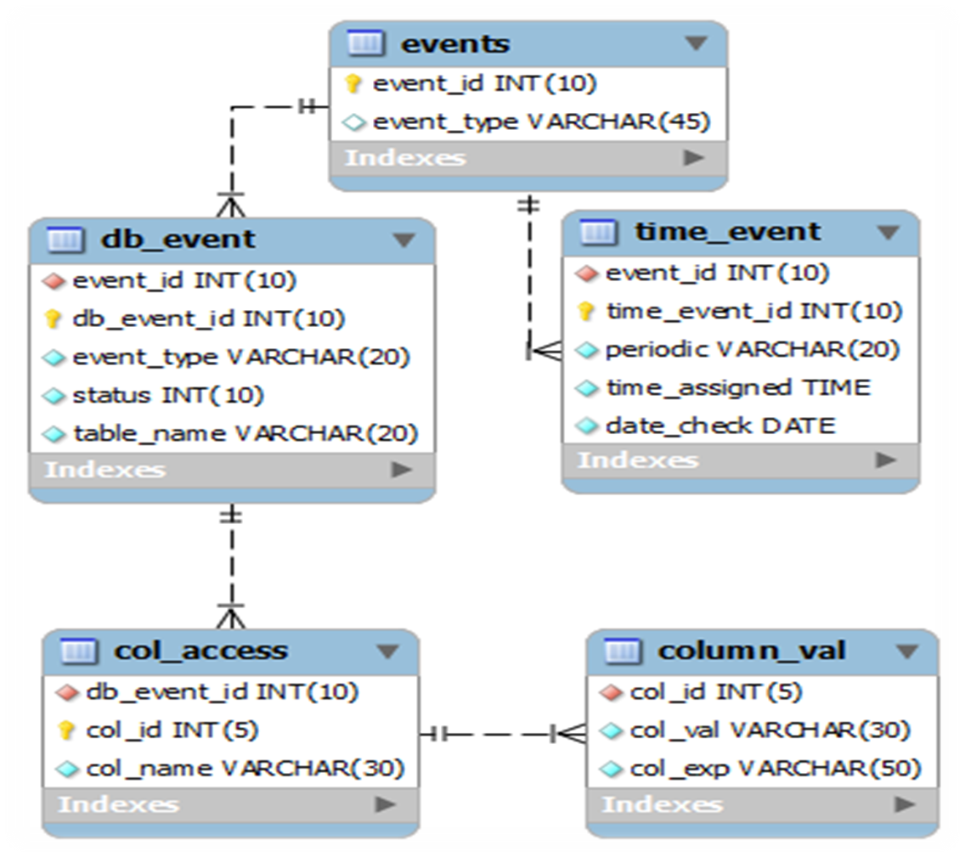
Event Type Repo. DB Schema

Slide 4
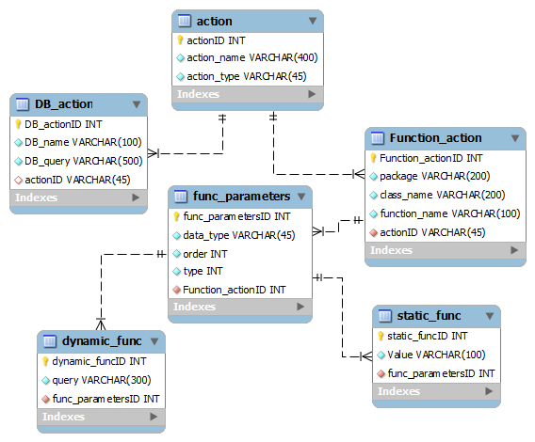

Slide 5
Events in App (Admission Proc.)
Registration
  Auto Mail
  Auto Registration Close – (Time based)
Fees
  Paid / Pending
  Set Eligible for Test
Add GATE / GRE Score
  Apply of waiver
  Cutoff
    Mail, Status change(selected or rejected)
Entrance Test
  Center Allocation
  Result
    Interview Call

