Slide 1
Movie recommendations using neo4j
Vikrham R A(17PD39)
Aakaash Babu P(17PD01)

Slide 2
Objective:
Design a movie recommendation system using neo4j database.
Dataset:
Movielens dataset containing the following:
Users data (contains users along with the given ratings).
Movies data (contains details about the movies).
Genres data (collection of genres are available here).
The above datasets are represented as nodes of the graph database.

Slide 3
The above nodes can be visualised as a graph by defining relationship between them.
Relationships:
Users_movies relation.
Movies_genres relation.
Users_genres relation.
Movies_similarity (using cosine similarity).

Slide 4
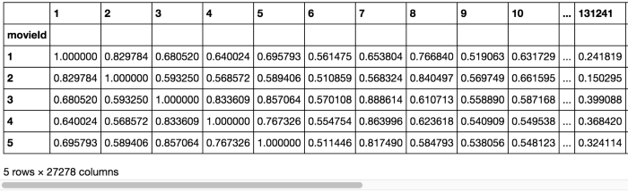
Customize data for defining relationship:
We create 3 dfs (mov_tag_df, mov_genres_df, mov_rating_df) and calculate 3 cosine similarities for each of them.
The aggregation of all 3 cos_similarities is calculated as movies_similarity = (mov_tag_df*0.5+mov_genres_df*0.25+mov_rating_df*0.25). The calculated cos_similarity is shown.

Slide 5
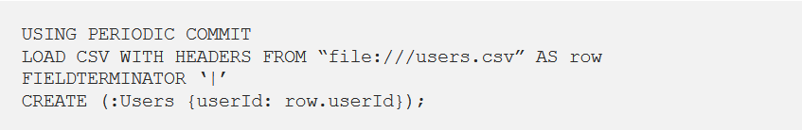
The nodes’ data and relationships’ data are exported as .csv files and loaded onto the neo4j database.
Importing nodes’ data to neo4j:
Executing the above cypher in neo4j, the nodes will be loaded to define relationships.

Slide 6
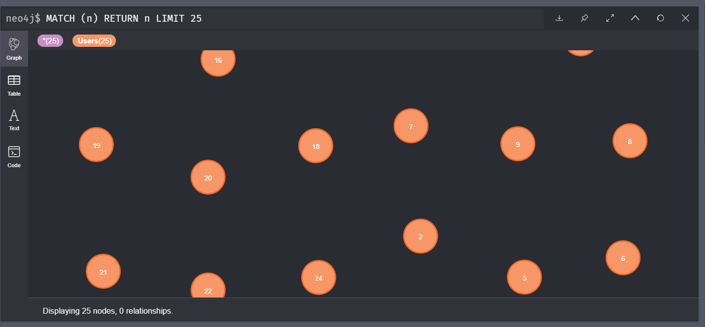

Slide 7
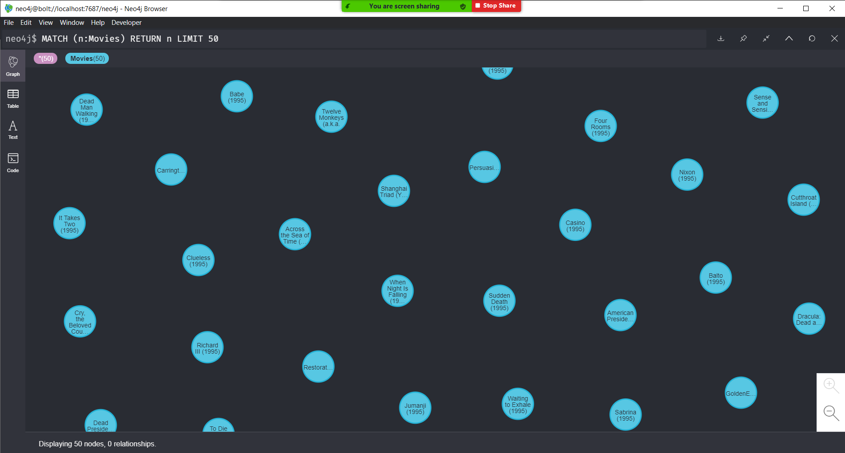
Executing the same cypher queries for creating the remaining nodes, we obtain the following.

Slide 8
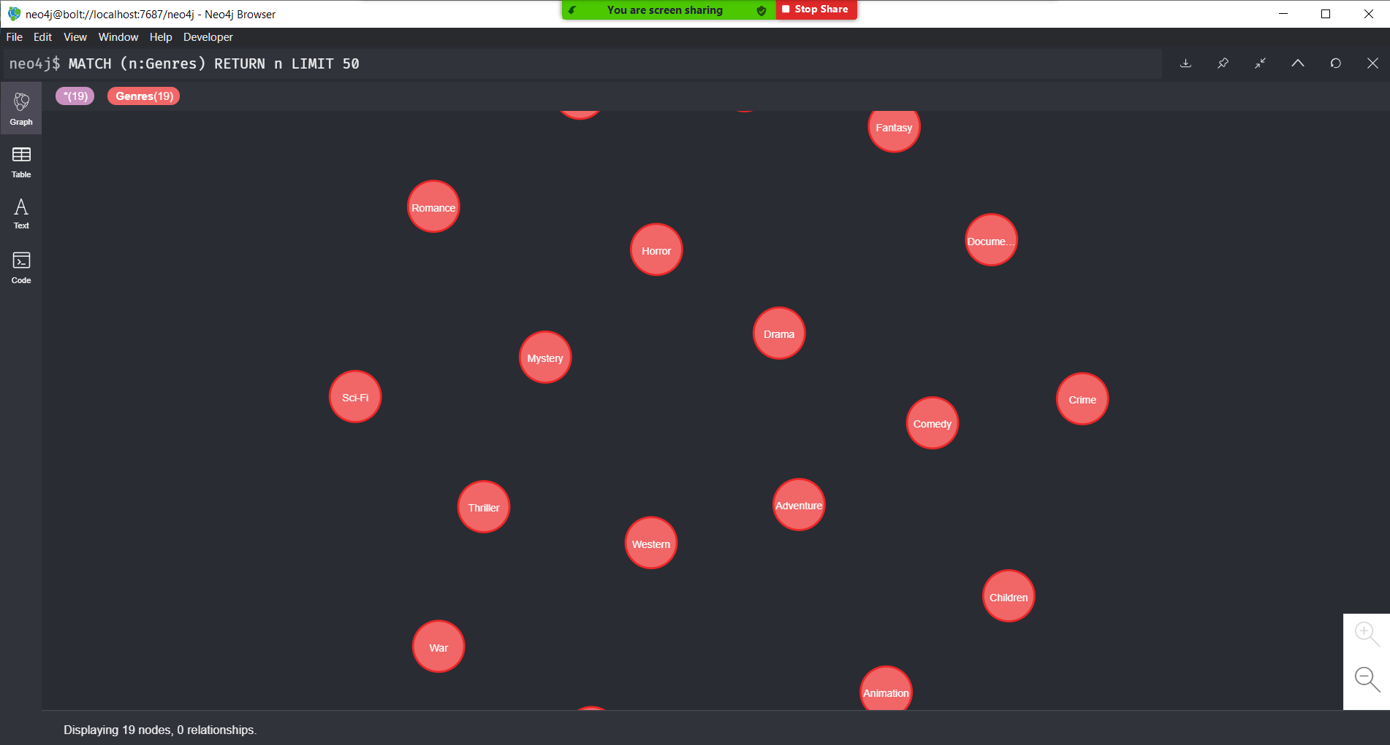

Slide 9
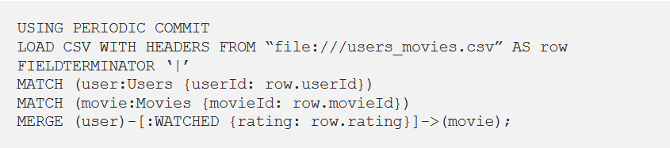
Importing relationships’ data to neo4j:
Executing the above cypher in neo4j, the relationship will be built between users’ nodes and movies’ nodes.

Slide 10
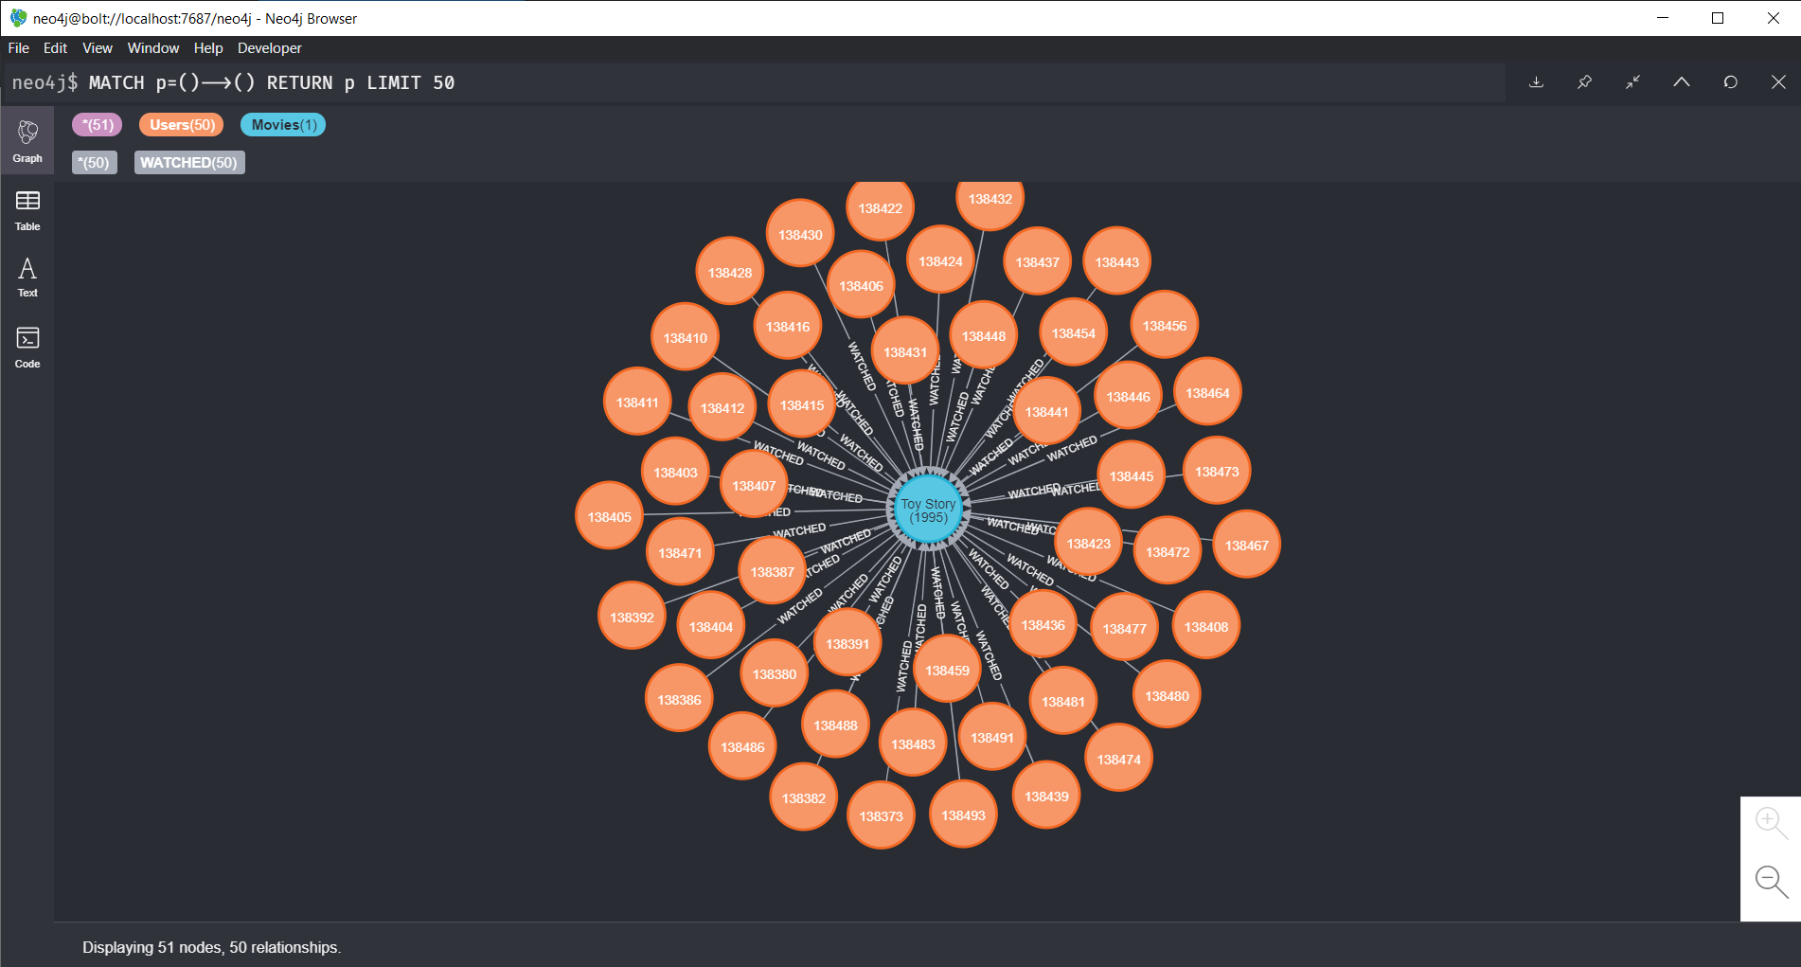

Slide 11
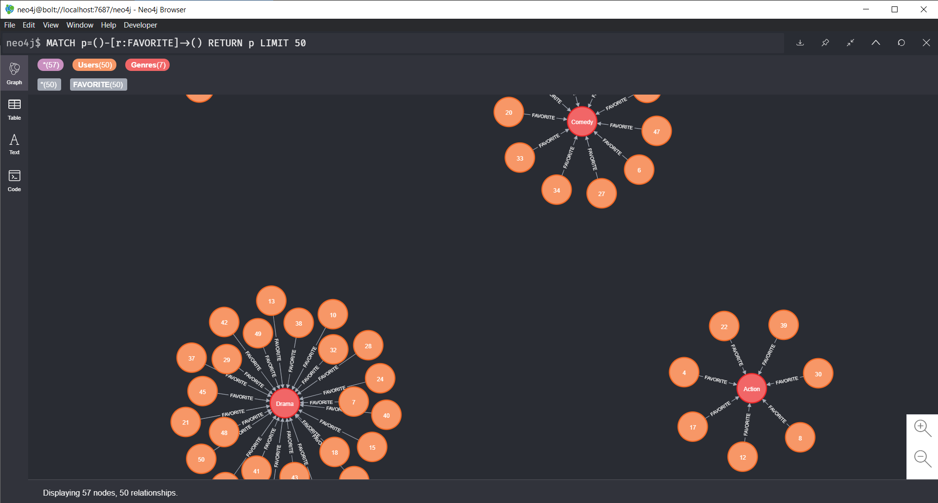
Similarly, for other relationships (users_genres, movies_genres and movies similarity)

Slide 12
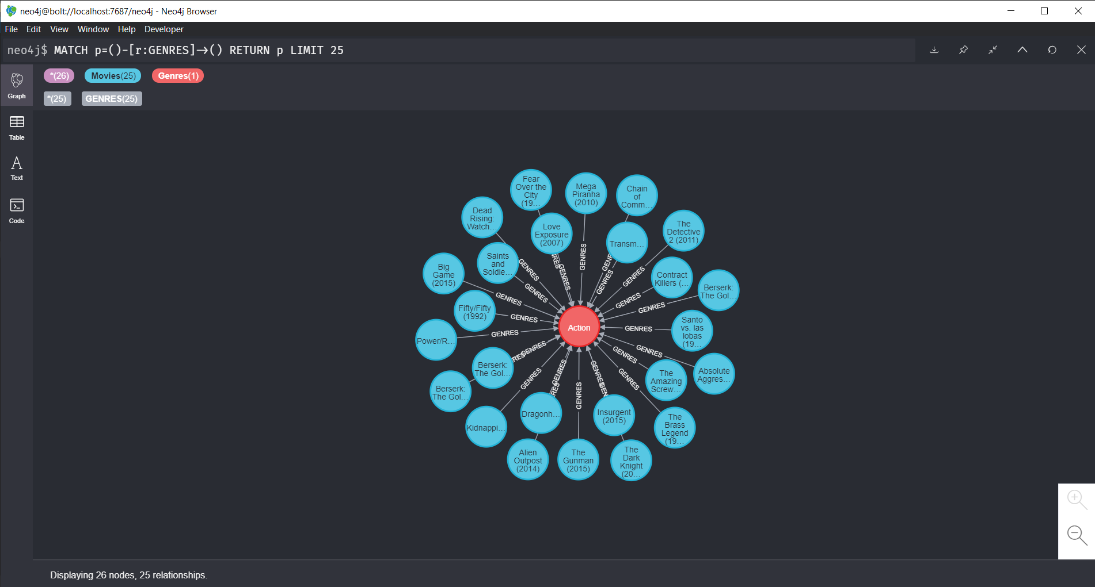

Slide 13
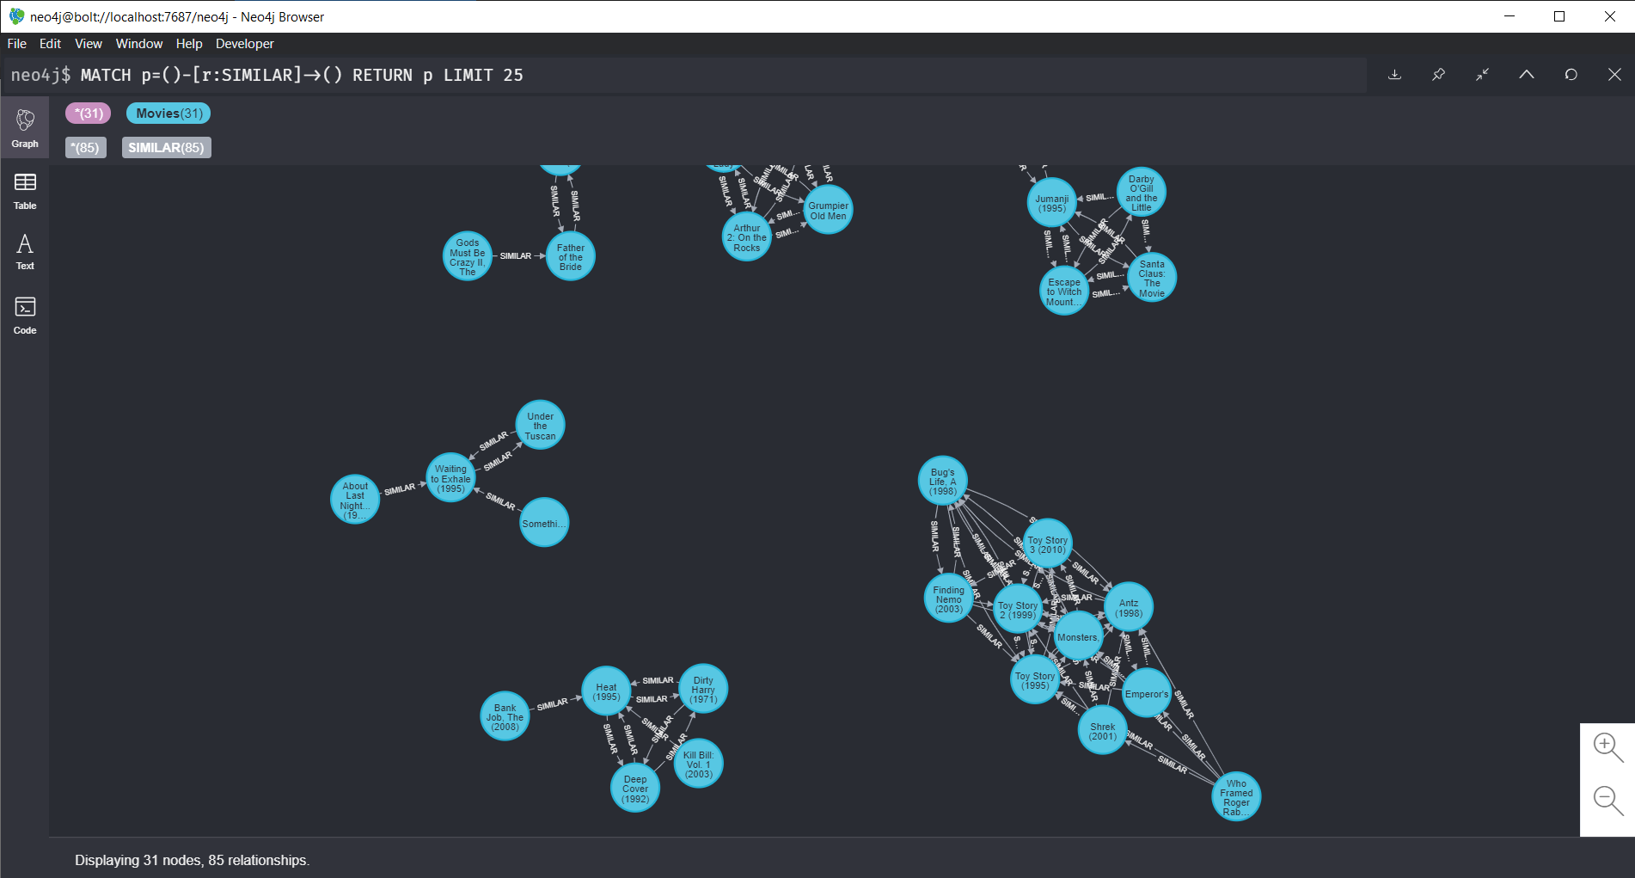

Slide 14
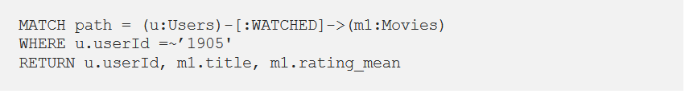
Query for recommendation:
Let’s review a user and check movies which are watched by him.
The above cypher query shows movies watched by a user. The output is as follows.

Slide 15
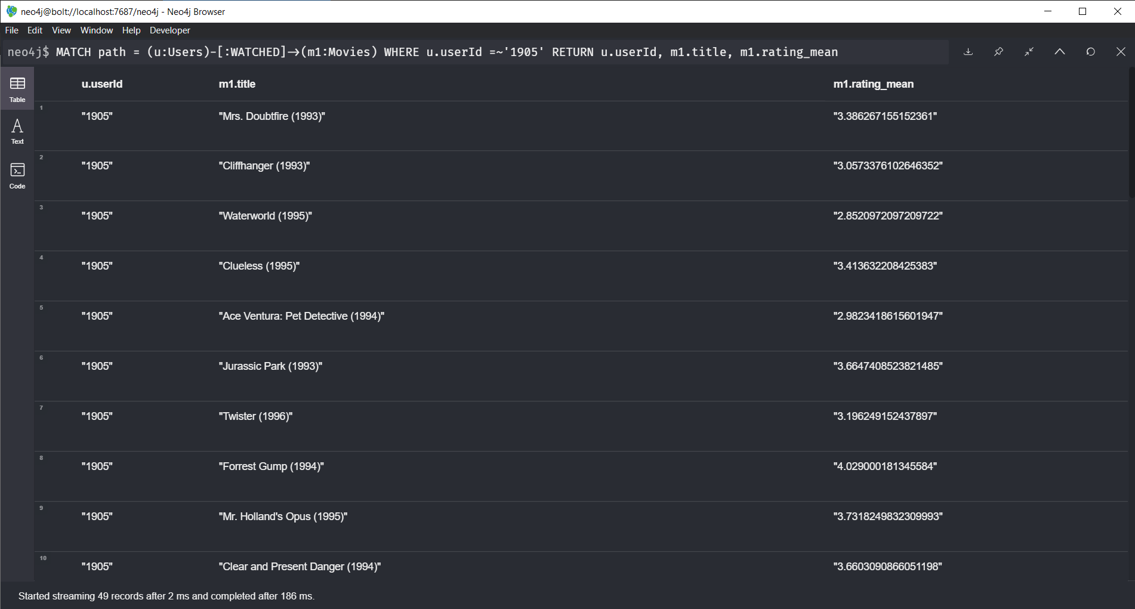

Slide 16
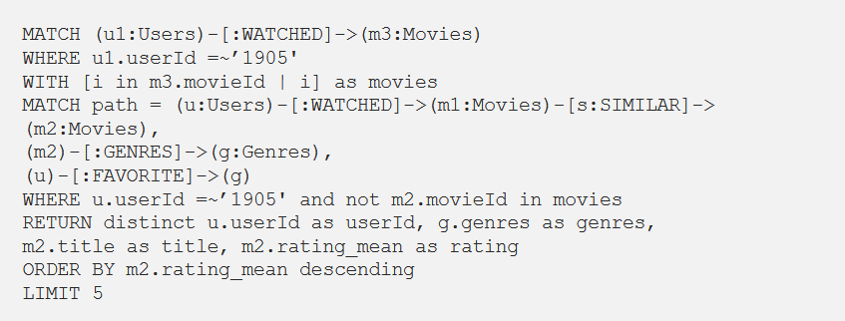
Filter movies which are already watched then sort them based on ratings and get 5 of them.

Slide 17
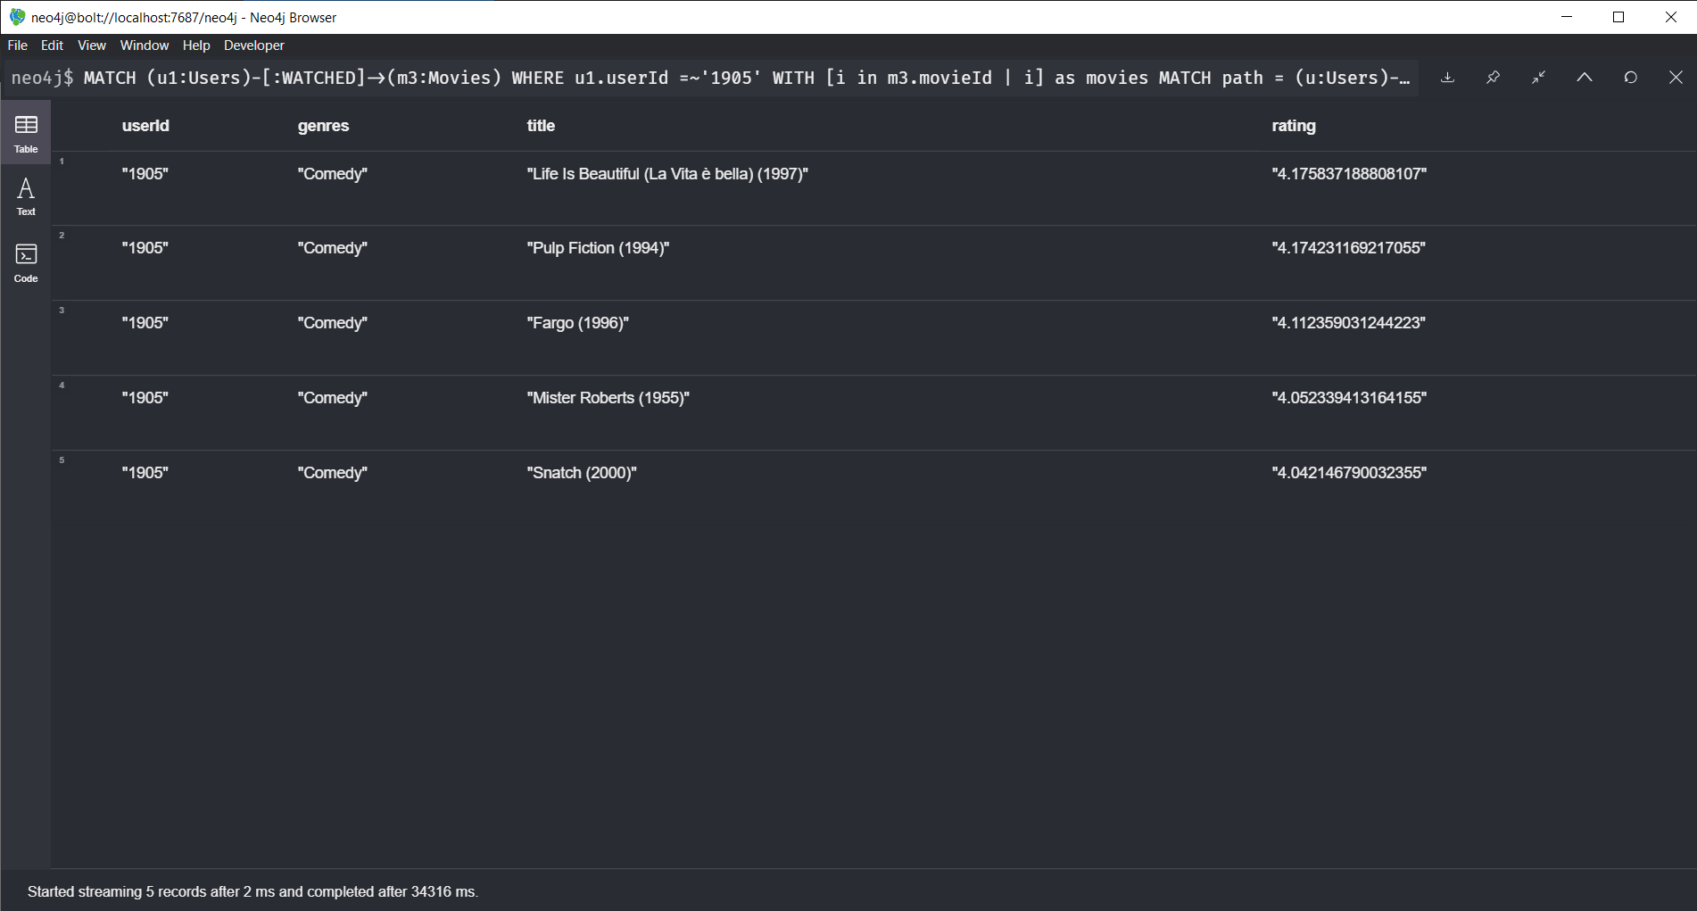

Slide 18
Thank you!
GitHub link: https://github.com/VikrhamRA/Movie-Recommendation

