Slide 1


Financial Modeling for Sun Pharma
This financial modeling exercise will forecast Sun Pharma's future financial performance and determine its valuation. We'll analyze the company's income statement, balance sheet, and cash flow to provide insights and recommendations.
VM
by Vikshita Mali

Slide 2

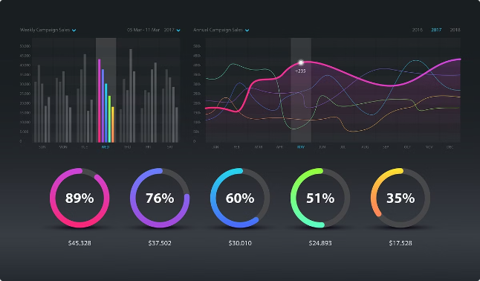
Data Gathering and Assumptions
1
Historical Financials
2
Industry Data
Collect 5 years of audited financial statements to establish baselines and trends.
Research market size, growth rates, and competitive landscape to inform projections.
3
Macroeconomic Factors
4
Management Guidance
Consider GDP, inflation, and other economic indicators that could impact the business.
Incorporate the company's internal goals and strategic initiatives.

Slide 3
Forecasting the Income Statement
Revenue Drivers
Cost Structures
Profitability Metrics
Project sales growth based on market trends, product pipeline, and competitive positioning.
Forecast cost of goods sold, R&D, and operating expenses based on historical data and future plans.
Calculate gross margin, EBITDA, and net income to assess financial performance over the forecast period.

Slide 4

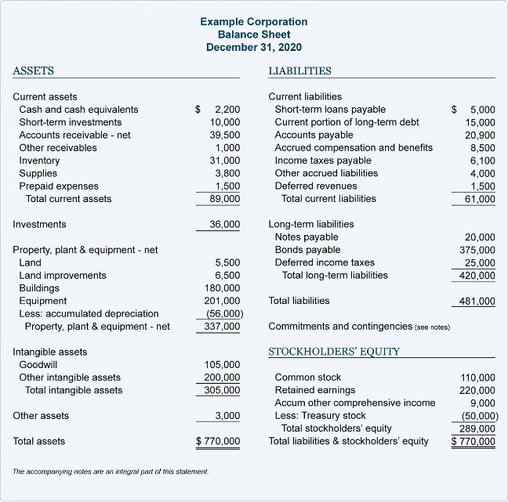
Forecasting the Balance Sheet
1
Assets
Project cash, receivables, inventory, and fixed assets based on revenue growth and operational needs.
2
Liabilities
Forecast payables, debt, and other obligations to maintain a healthy capital structure.
3
Equity
Account for changes in retained earnings, stock issuances, and other equity components.

Slide 5

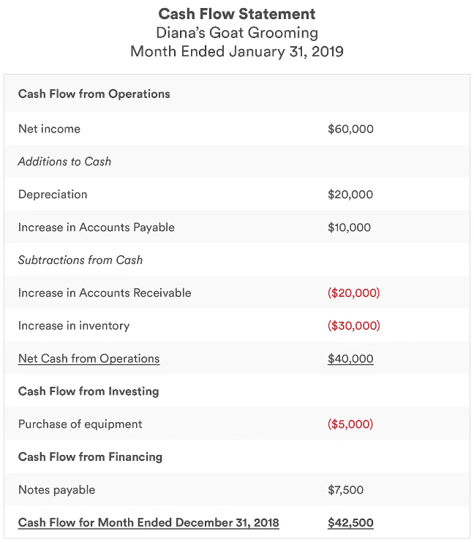



Forecasting the Cash Flow Statement
Operating Cash Flow
Estimate cash generated from normal business operations.
Investing Cash Flow
Project cash used for capital expenditures and other investments.
Financing Cash Flow
Forecast cash from debt, equity financing, and dividend payments.

Slide 6

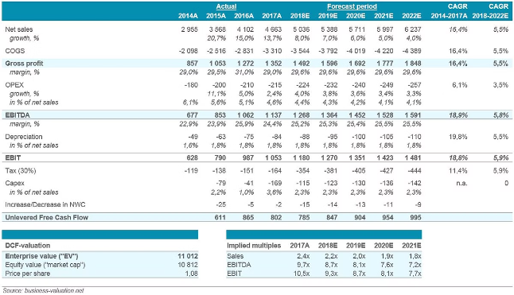
Discounted Cash Flow (DCF) Valuation
Free Cash Flows
Discount Rate
Calculate the company's future free cash flows based on the financial projections.
Determine the appropriate weighted average cost of capital (WACC) to discount the cash flows.
Terminal Value
Equity Valuation
Estimate the company's value beyond the explicit forecast period using a perpetuity growth model.
Derive the intrinsic value of Sun Pharma's equity by discounting the cash flows to the present.

Slide 7
Comparable Company Analysis
Peer Group
Valuation Multiples
Implied Valuation
Identify a set of publicly traded companies that are similar to Sun Pharma in terms of size, business model, and financial characteristics.
Calculate relevant multiples such as P/E, EV/EBITDA, and P/B for the peer group and Sun Pharma.
Derive an estimated valuation for Sun Pharma based on the average or median multiples of the peer group.

Slide 8

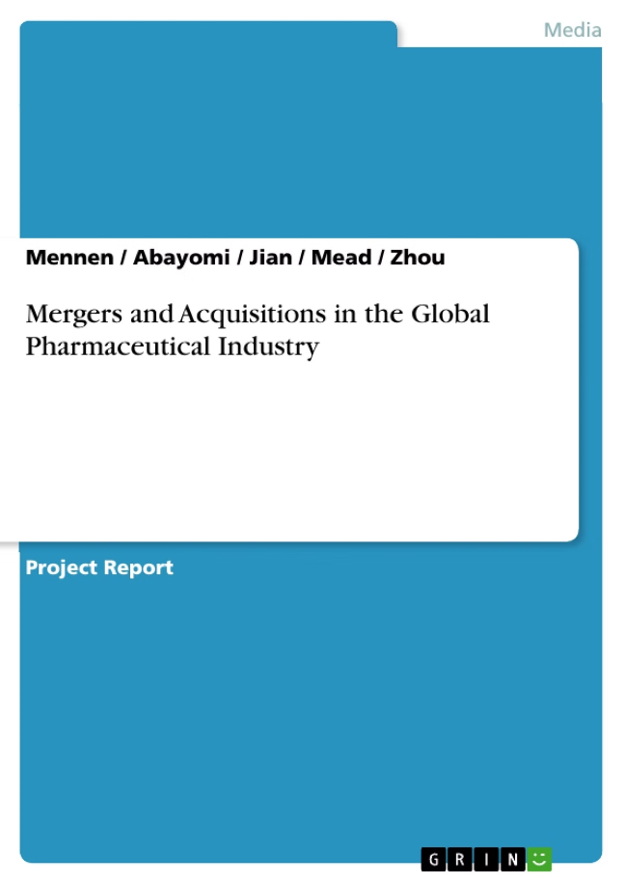




Precedent Transactions Analysis
Transaction Multiples
Deal Rationale
Examine the valuation multiples of recent M&A deals in the pharmaceutical industry.
Understand the strategic and financial motivations behind comparable transactions.
Synergies
Implied Valuation
Assess the potential for operational and financial synergies that could benefit Sun Pharma.
Derive an estimated value for Sun Pharma based on the observed transaction multiples.

Slide 9

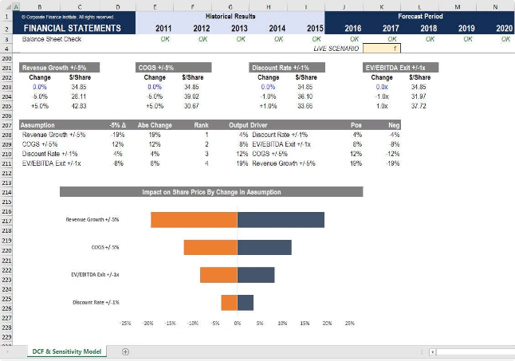
Sensitivity and Scenario Analysis
Assumption
Base Case
Upside
Downside
Revenue Growth Rate
8%
10%
6%
Gross Margin
65%
68%
62%
Discount Rate (WACC)
10%
9%
11%
Evaluate how changes in key assumptions impact the company's valuation and financial projections. This analysis will provide a range of potential outcomes and inform investment decisions.

Slide 10


Conclusion and Recommendations
1
Key Findings
2
Valuation Range
Summarize the most important insights from the financial modeling exercise.
Present the estimated intrinsic value of Sun Pharma's equity based on the various valuation approaches.
3
Strategic Recommendations
4
Investment Thesis
Conclude with a well-reasoned investment recommendation supported by the financial analysis.
Provide actionable recommendations to management on growth strategies, capital allocation, and other strategic initiatives.

