Slide 1
Developer Salaries:
A multivariate analysis and a predictive model
A portfolio project by Viktor Soltész

Slide 2
Abstract
Project Overview:
This project analyzes software developer salaries using thousands of survey responses collected over multiple years (2018-2024).
Data Sources:
The analysis builds on 11 publicly available surveys from 3 distinct sources,
covering a wide range of data points on developer salaries.
Project phases:
Preparation: Data cleaning, transformation, and quality assessment.
Analysis: Trend discovery and multivariate ANOVA.
Prediction: Regression modeling for personalized salary estimates.
Outcomes:
Provides a deep insight into the software development field.
Examined and evaluated the key variables influencing salaries, assessing their variability and significance.
Determined if all surveys consistently reflect the same underlying salary trends.
Developed a model to predict a personalized expected salary.

Slide 3
Developer Salaries:
Engineering review
A multivariate analysis and a predictive model

Slide 4
Project Scope
Objectives:
Project phases:
Data sources:
Seniority
Job title
Industry
Analyze software developer salaries using thousands of survey responses from 11 datasets (2018–2024).
Company size
Languages spoken
Country
City of residence
Year
Understand industry trends and salary drivers.
Quantify the impact of key factors using multivariate analysis.
Predict personalized salaries based on unique parameters.
Salary
Kaggle.com - Yearly survey (85k responses)
AI-Jobs.net - Their public record (14k datapoints)
Germany IT-Survey - Yearly survey (6k responses)
01 Data Preparation
01
02 Data Analysis
03 Salary Prediction

Slide 5
Developer Salaries:
Engineering report
Phase 01
Data Preparation

Slide 6
Phase 01: Data Sources and Preparation
Data Sources:
Kaggle: Large-scale, diverse responses from a global data and tech community.
AI-Jobs.net: Focused on data professionals; smaller, cleaner dataset from a recruitment platform.
Germany IT Survey: Region-specific survey targeting German tech professionals, providing valuable local insights.
Key Challenges in Data Preparation:
Inconsistent Formats: Addressed varying question structures, units of measurement, and terminologies.
Missing Data: Applied strategies for imputation, removal, and derivation of missing values.
Outliers: Detected and handled using modified Z-scores, signed Z-scores, and 1.5 IQR rules.
Data Cleaning and Transformation:
Standardized column names and data types across surveys.
Normalized salary values for inflation and GDP-per-capita.
Transformed salary values using log-normal distribution for improved analysis.

Slide 7
Phase 01: Structure
Scripts folder
Testing
Notebook
Testing folder
Analyze software developer salaries using thousands of survey responses from 11 datasets (2018–2024).
reusable cleaning functions
reusable testing functions
Diverse test-cases to ensure validity of the cleaning functions
Kaggle
AI-Jobs
DE-IT survey
Salary cleaning
data replication
2018 survey
String cleaning
report simulation
2019 survey
One dataset ranging from 2020-2024
2019 survey
2020 survey
2020 survey
2021 survey
2021 survey
As these functions clean, counters keep track of what modification was done.
2022 survey
2022 survey
2023 survey
Data cleaning
Data Quality Metrics
Cleaning report
Probing the length of dataframes continuously.
Union
Data filtering statistics
Contextual filtering
Deriving new variables
Outlier detection
Prepared data
Phase 02
Phase 03

Slide 8
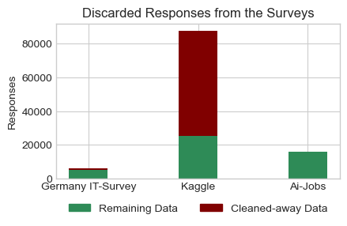
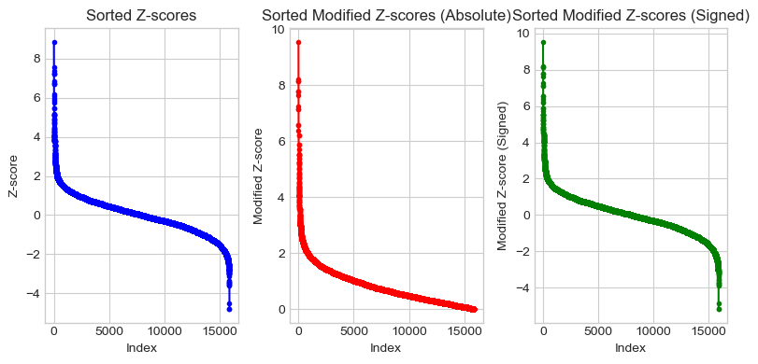
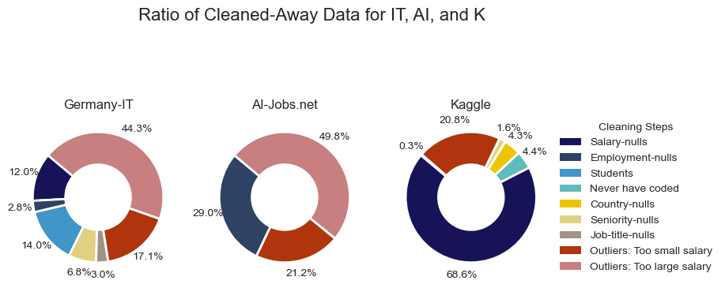
Outliers
Data Quality Metrics
To detect outliers, besides Z-score, the literature often advises the use of modified Z-score, which is basically its nonparametric counterpart, operating with medians instead of means.
Furthermore, a signed-modified-Z-score is also calculated, as the modified-Z-score loses the sign-dependence (will not distinguish between outliers that are too-low or too-high).
For threshold [3; 3] interval was used.
Overall discarded comparison:
Detailed reason for discarded data:

Slide 9
Developer Salaries:
Engineering review
Phase 02
Data Analysis

Slide 10
Phase 02: Structure
1. Profile of respondents
4. Determining distribution function
QQ-plot
Kolmogorov-Smirnov test
2. Strength of Association
Chi-squared
Cramér’s V
5. Sensitivity analysis
2. Exploratory Data Analysis
Yearly trends
Yearly Trends between Data-Professionals
Geographic trends
Barplot: Job categories
Managers vs. Developers
Effect of experience
München vs. Berlin
Language at work
6. Pre-ANOVA assumption check:
Independence
Normality
Homogeneity of variances
7. multivariate ANOVA
8. Post-ANOVA assumption check:
Normality of residuals
Homoscedasticity
3. Variable Selection
Factorial cell population
VIF
9. Interpretation:
Effect size calculation
Post-hoc power calculation

Slide 11
Phase 02: Exploratory Data Analysis (EDA)
Key Trends Identified:
Salary Distributions:
Highly skewed distributions observed; log-normal fits the data well.
Significant differences between surveys in salary values, likely due to varying respondent profiles.
Yearly Trends:
Salaries show slight upward trends (2018–2024) but normalize after adjusting for inflation.
Adjustments reveal stable salary patterns over time.
Geographic Variability:
Normalizing salaries by GDP-per-capita reduces disparities across countries.
Focus narrowed to advanced Western nations for a more homogeneous comparison.
Insights:
Survey differences likely stem from differing respondent profiles rather than underlying salary trends.
Factors like seniority and job category exhibit the most notable influence on salary variability.

Slide 12
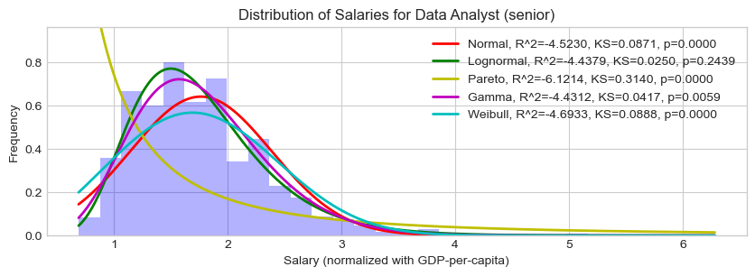
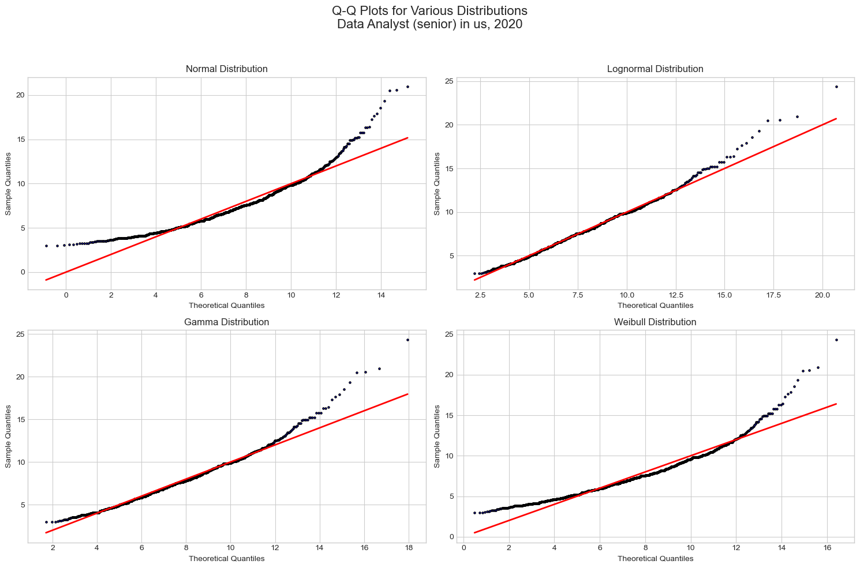
Phase 02: Distribution function
After multiple exploratory approaches (QQ-plot, visual function fitting), lognormal distribution fits the observations best on a factorial-cell level.
Lognormality of salary is backed up by literature [1].
Exploratory Tests:
Distribution checks for factorial cells (Normal, Lognormal, Gamma, Weibull).
Non-normality in ~40% of cells, necessitating cautious interpretation of results.
[1]: McDonald and Jensen (1979): An Analysis of the Distribution of Income

Slide 13
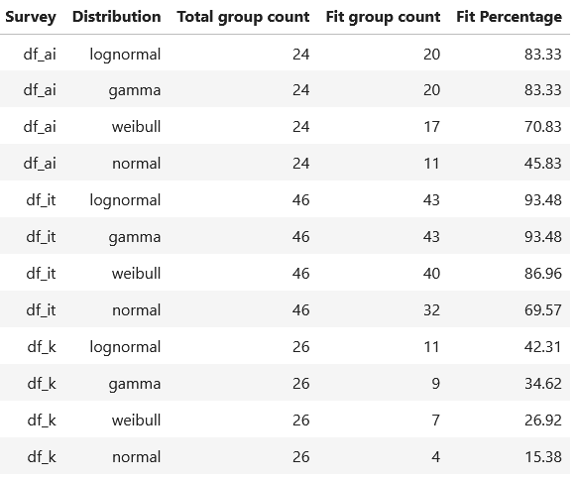
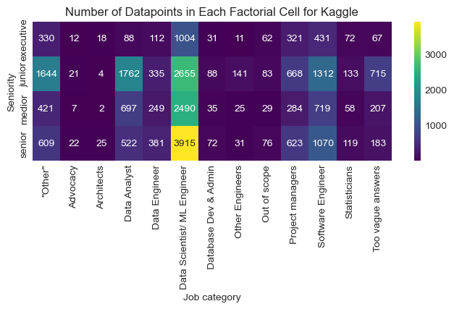
Phase 02: Factorial cells
For a more definite approach, Kolmogorov-Smirnov test was used on each the Factorial Cells (groups).
Log-transforming the salaries is reasonable.
Multiple statistical tests were conducted on factorial cell-level. So handling the observations in their group, and comparing group-by-group.
Eligibility for such comparison was drawn at 20 observations.
[1]: McDonald and Jensen (1979): An Analysis of the Distribution of Income

Slide 14
Phase 02: Statistical Analysis
Objective: Assess salary determinants through multivariate ANOVA, validate dataset consistency, and test assumptions for robust statistical inference.
Methodology:
ANOVA Design:
Multi-way ANOVA with factors: survey, job category, seniority, country, and year.
Type III Sum-of-Squares to account for unbalanced data.
Partial Eta-squared to measure effect sizes for each variable.
Validation of Assumptions:
Normality:
Tested residuals with Lilliefors and visual methods (histogram, QQ-plot).
Log-transformed salary data for better normality.
Homoscedasticity:
Assessed residual variance using Brown-Forsythe test and visual scatterplots.
Independence:
Assumed based on survey design but acknowledged potential overlaps due to repeated annual surveys.

Slide 15
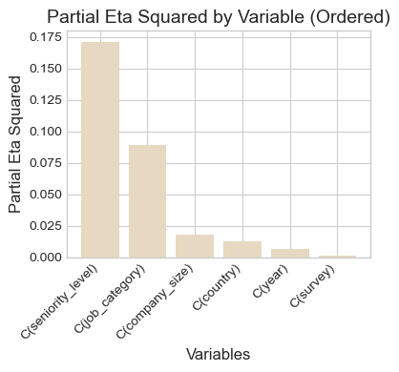
Phase 02: Statistical Analysis
3. Key Results:
Significant Factors:
Seniority Level: Explains ~17% of salary variance (largest effect).
Job Category: Explains ~9.6% of variance.
Country (GDP-normalized): Significant but low practical impact (<2%).
Minimal Impact:
Survey Source and Year show negligible effect sizes (<1%).
4. Insights:
Salary variability is largely driven by seniority and job category, with limited influence from other variables.
Despite meeting statistical assumptions partially, results align with expected salary trends, affirming model validity.

Slide 16
Developer Salaries:
Engineering review
Phase 03
Salary Prediction

Slide 17
Phase 03: Structure
Objective: Develop and validate regression models to predict software developer salaries, ensuring alignment with real-world benchmarks and personalizability.
1. Baseline (core) Multiregression
1.6. Refitting without influential points,
Checking residuals: Normality,
Checking residuals: Homoscedasticity.
1.1. Initial model fitting
1.2. Checking Residuals: Normality
Visual approach: Histogram, QQ-plot
MC simulation of Shapiro-Wilk test
1.7. Validation across factorial cells:
Observations
Prediction
Glassdoor
1.3. Checking residuals: Homoscedasticity
Visual approach: Residuals vs. Fitted values
MC simulation of Breusch-Pagan test
2. Extended (exploratory) Multiregression:
1.4. Influential point identification:
Cook’s Distance
Leverage
Repeating steps 1.1 - 1.6.
2.7. personalized salary prediction
1.5. Comparing VIF values
With influential points
Without influential points
3. Extracting the model coefficients
This gives the comparison of variables, properly controlled by other variables

Slide 18
Phase 03: Predictive Modeling
Modeling Approach:
Baseline Model:
Core predictors: job category, seniority level, and country (GDP-normalized).
Ensured alignment with external benchmarks (Glassdoor salary data).
Extended Model:
Included additional predictors: industry, company size, years in Germany, languages spoken, city.
Designed for enhanced personalization, particularly for Germany-specific predictions.
Validation Steps:
Diagnostic checks for residuals:
Normality: Histogram, QQ-plot, iterative Shapiro-Wilk simulations.
Homoscedasticity: Scatterplots, iterative Breusch-Pagan simulations.
Addressed influential points using Cook’s Distance and Leverage thresholds.
Improvement Techniques:
Log-transformed salary as target to handle skewness.
Excluded factorial cells with insufficient observations (<20).
No extrapolation: Predictions only made for in-scope categories.

Slide 19
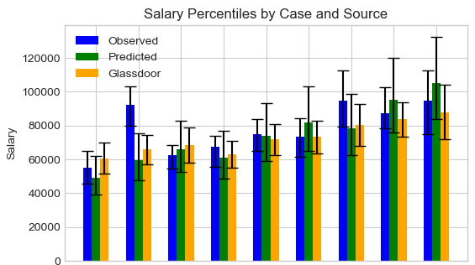
Phase 03: Predictive Modeling
Key Results:
Baseline Model:
Adjusted R² = 0.35.
Sufficiently predicts salaries, aligning closely with Glassdoor benchmarks.
Extended Model:
Adjusted R² = 0.52.
Improved explanatory power but with diminishing returns from additional variables.
Insights:
Baseline model is robust and interpretable, suitable for general salary predictions.
Extended model offers more personalization but requires careful handling of additional variables to avoid overfitting.
Comparing in key scenarios:
Observed data
Model prediction
Glassdoor data
cases:
1 2 3 4 5 6 7 8 9
1. Data Analyst
2. Junior Data Engineer
3. Data Scientist
specified to Germany
4. Data Analyst
5. Medior Data Engineer
6. Data Scientist
7. Data Analyst
8. Senior Data Engineer
9. Data Scientist

Slide 20
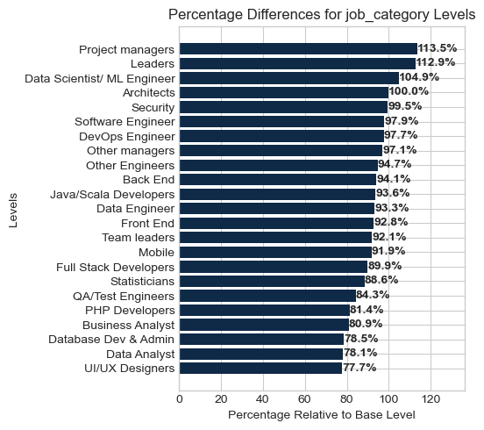
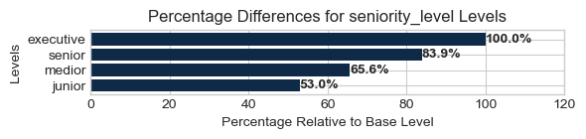
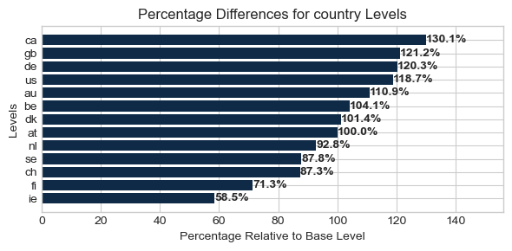
Phase 03: Predictive Modeling
The coefficients of the model:
In a multiregression model, the coefficients are controlled by the presence of other variables.
Assuming validity of the assumptions of multiregression model, these coefficients give the true effect of the variables.
1. Data Analyst
2. Junior Data Engineer
3. Data Scientist
specified to Germany
4. Data Analyst
5. Medior Data Engineer
6. Data Scientist
7. Data Analyst
8. Senior Data Engineer
9. Data Scientist

Slide 21
Developer Salaries:
Engineering review
In closing

Slide 22
In closing: Methodological challenges
Survey Inconsistencies:
Challenge: Different question formats, units of measurement, and missing data across surveys.
Solution: Standardized and uniformized variables (e.g., inflation-adjusted salaries, GDP-normalized values).
Outlier Detection:
Challenge: Detecting unrealistic salary values due to survey design issues.
Solution: Combined manual inspection with statistical techniques (modified Z-scores, strict iterative cutoffs).
Assumption Violations:
Challenge: Residuals and factorial cells partially violated normality and homoscedasticity.
Solution: Log-transformed salaries for better normality. Monte-carlo Brown-Forsythe for homoscedasticity
Multicollinearity in Predictive Models:
Challenge: High Variance Inflation Factor (VIF) for certain predictors, especially with interaction terms.
Solution: Excluded problematic interaction terms and monitored VIF during model tuning.
Sparse Data in Factorial Cells:
Challenge: Many factorial cells had insufficient observations for reliable analysis.
Solution: Filtered cells with <20 observations and focused on robust predictors with adequate data coverage.
Balancing Complexity and Interpretability:
Challenge: Adding more variables improved model fit but risked overfitting and reduced clarity.
Solution: Built a baseline model for simplicity and an extended model for personalization.

Slide 23
In closing: Improvement potentials
Enhanced Modeling Techniques:
Explore Bayesian Hierarchical Models to better handle nested structures (e.g., countries within regions).
Implement Aligned Rank Transform (ART) for nonparametric factorial ANOVA, addressing partial assumption violations.
Dimensionality Reduction:
Use Multiple Correspondence Analysis (MCA) for categorical variables to reduce dimensionality
Introduce regional categories for countries, grouping them into meaningful clusters (e.g., Western Europe, Eastern Europe).
Interaction Effects:
Include interaction terms carefully, mitigating multicollinearity with targeted tuning or penalization methods.
Class Imbalance Handling:
Address imbalanced categorical levels using weighted models, oversampling, or stratified validation.
Validation and Stability:
Implement cross-validation for model evaluation.
Use bootstrap resampling to assess estimate stability and derive robust standard errors.
Data Expansion:
Add new surveys or datasets to increase data coverage.

Slide 24
Thank you!
Github: https://github.com/Viktor-Soltesz/salary_analysis
email: solteesz.viktor@gmail.com
linkedin: https://www.linkedin.com/in/viktor-soltesz/

Slide 25
Appendix

Slide 26
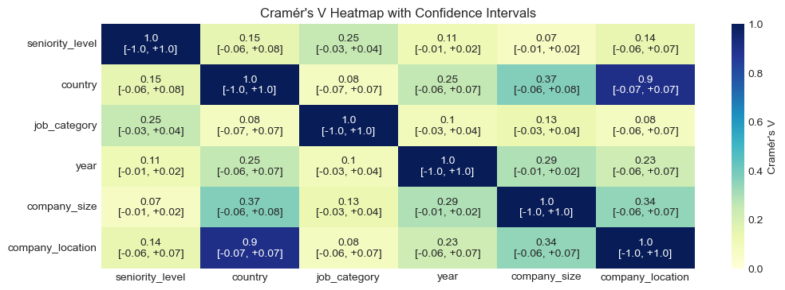
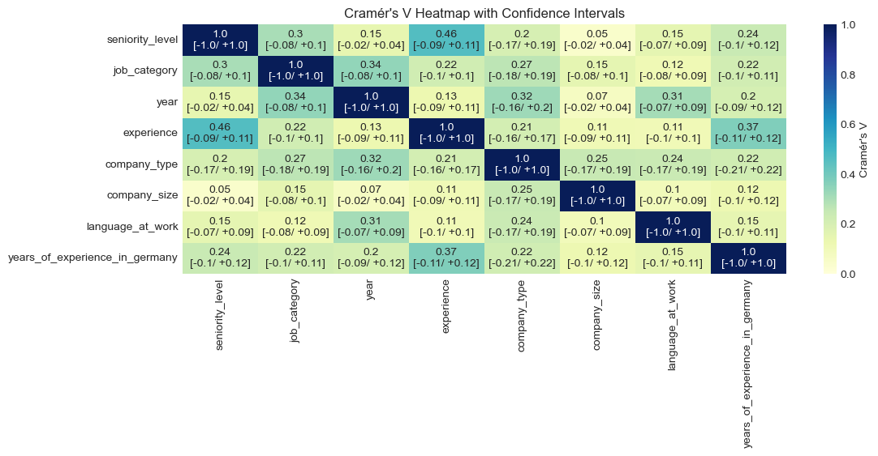
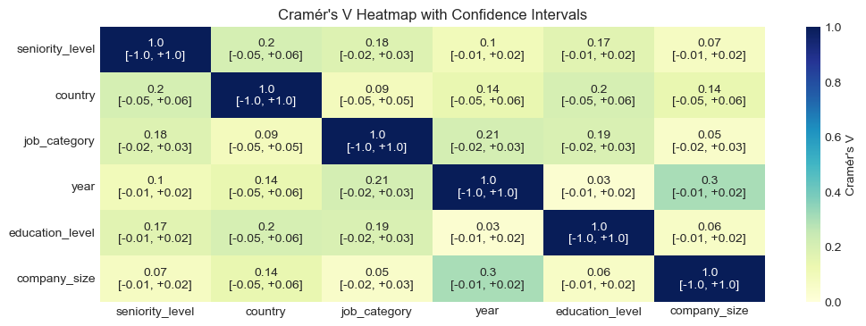
Phase 02: Strength of association
Cramér’s V
AI-Jobs.net
DE-IT
Kaggle

Slide 27
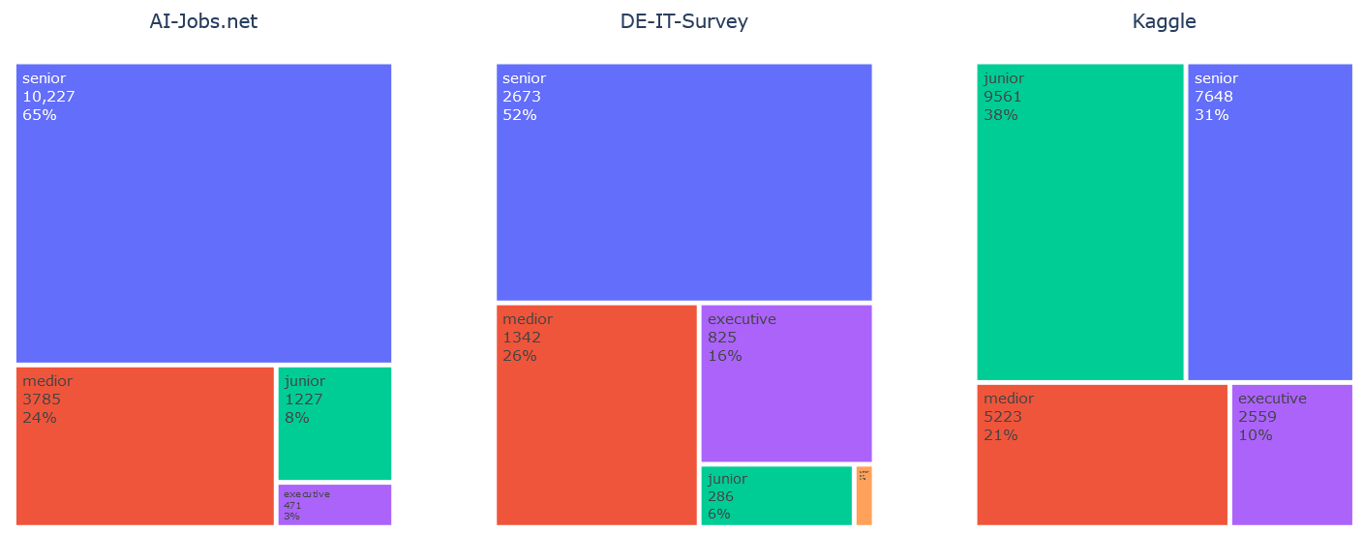
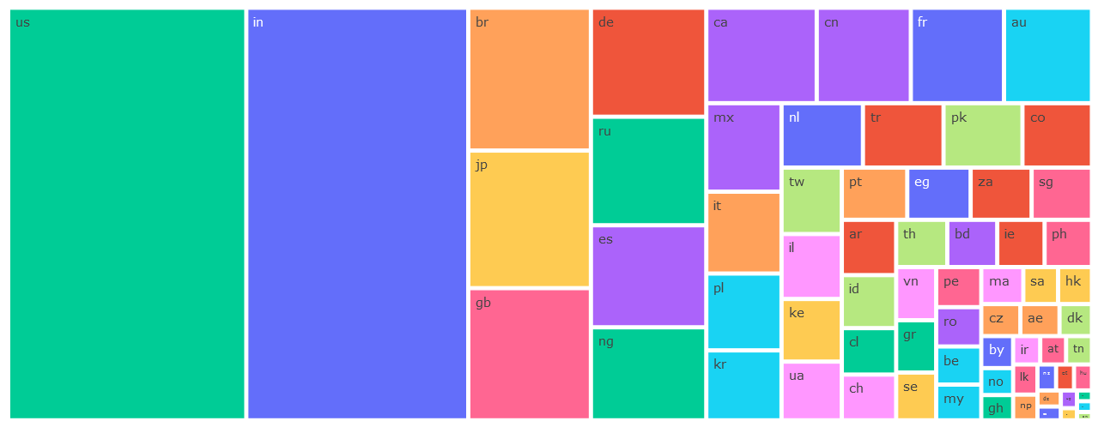
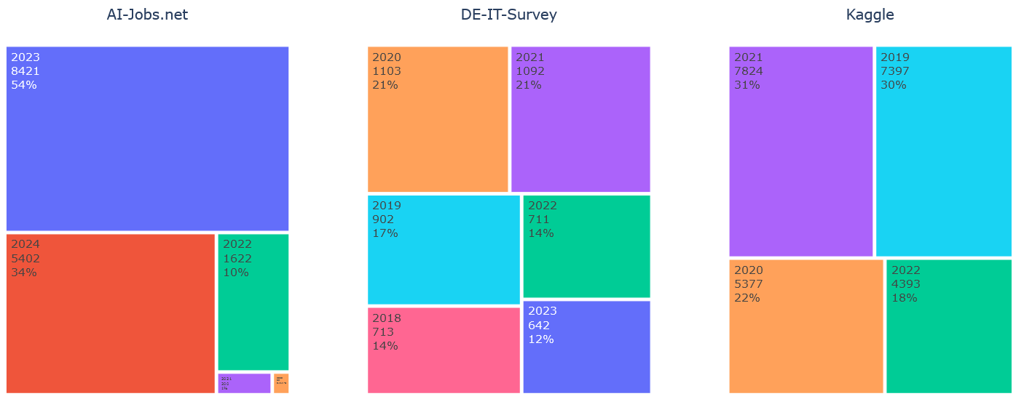
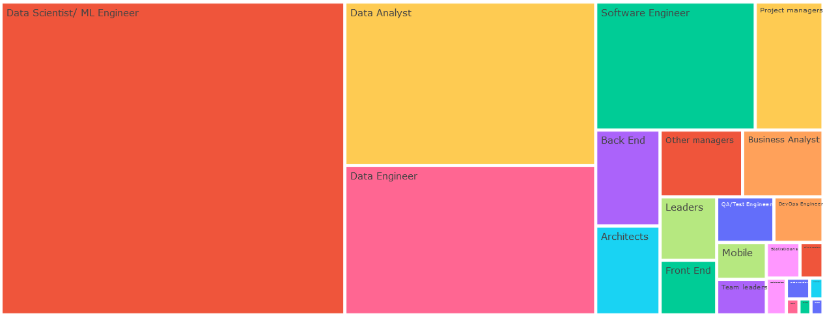
Phase 02: Profile of the respondants
Distribution of seniority levels:
Distribution of countries:
Distribution of years:
Distribution of job categories:

Slide 28
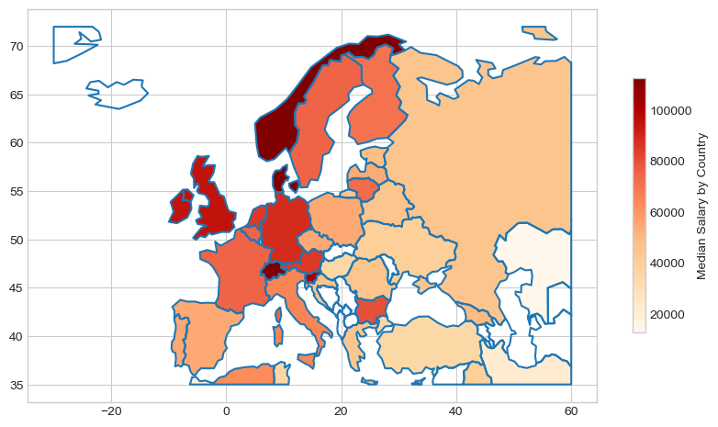
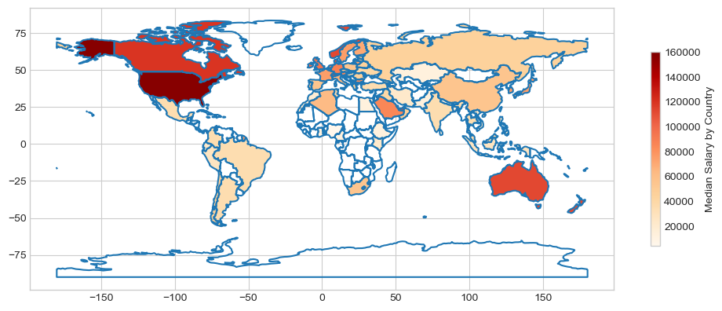
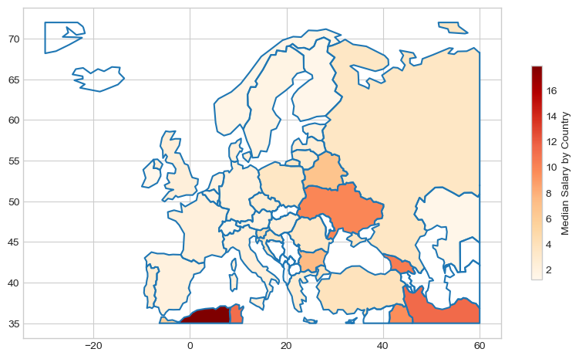
Phase 02: Geographic plot
normalization by GDP-PPP

Slide 29
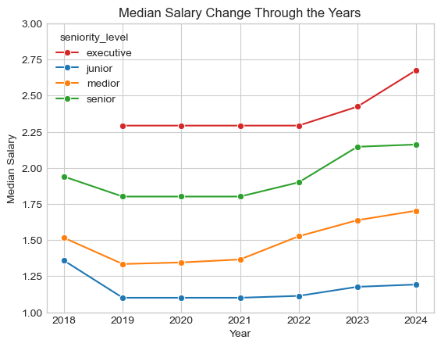
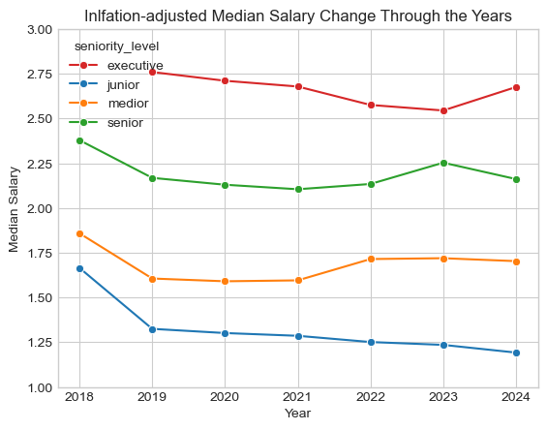
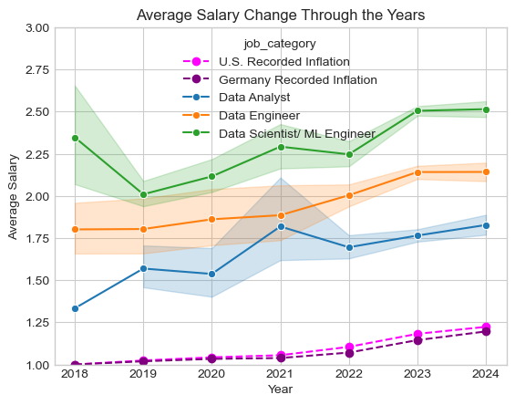
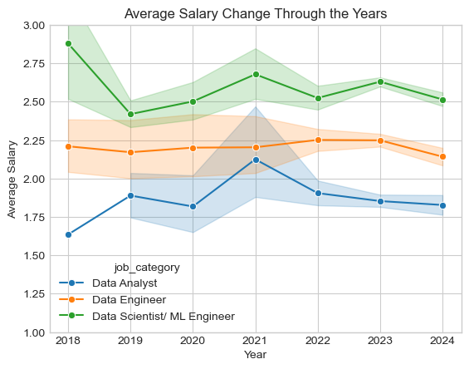
Phase 02: Yearly change
Change from the perspective of Seniority
[median]
normalization
by inflation
Change from the perspective of Data-Professionals
[mean]

Slide 30
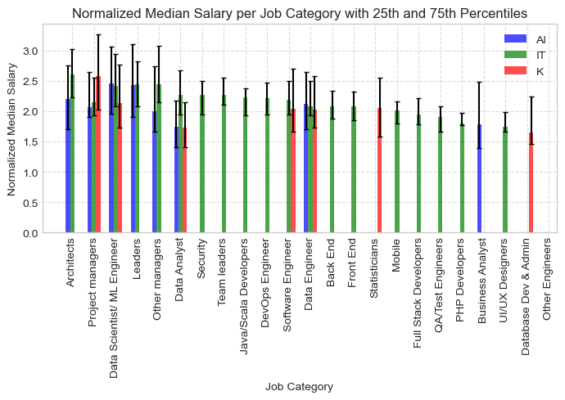
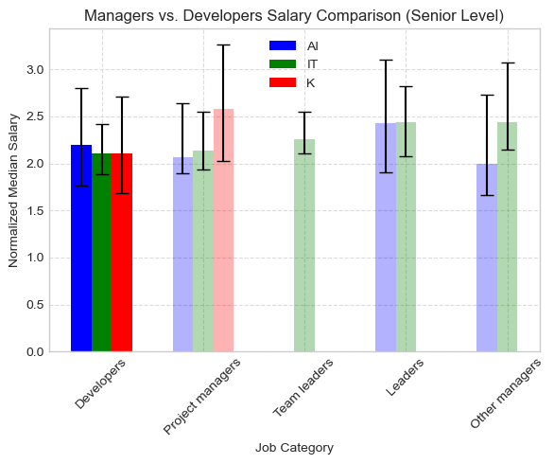
Phase 02: Job category

Slide 31
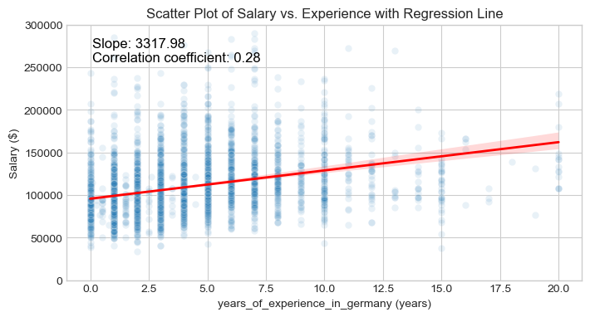
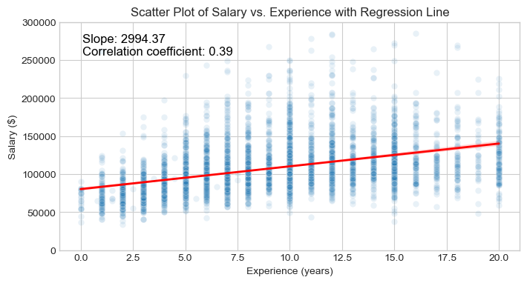
Phase 02: Experience

Slide 32
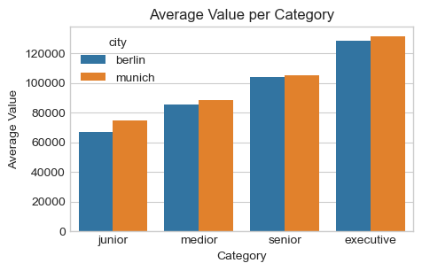
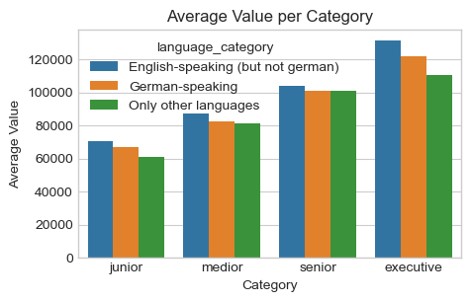
Phase 02: City and Language

Slide 33
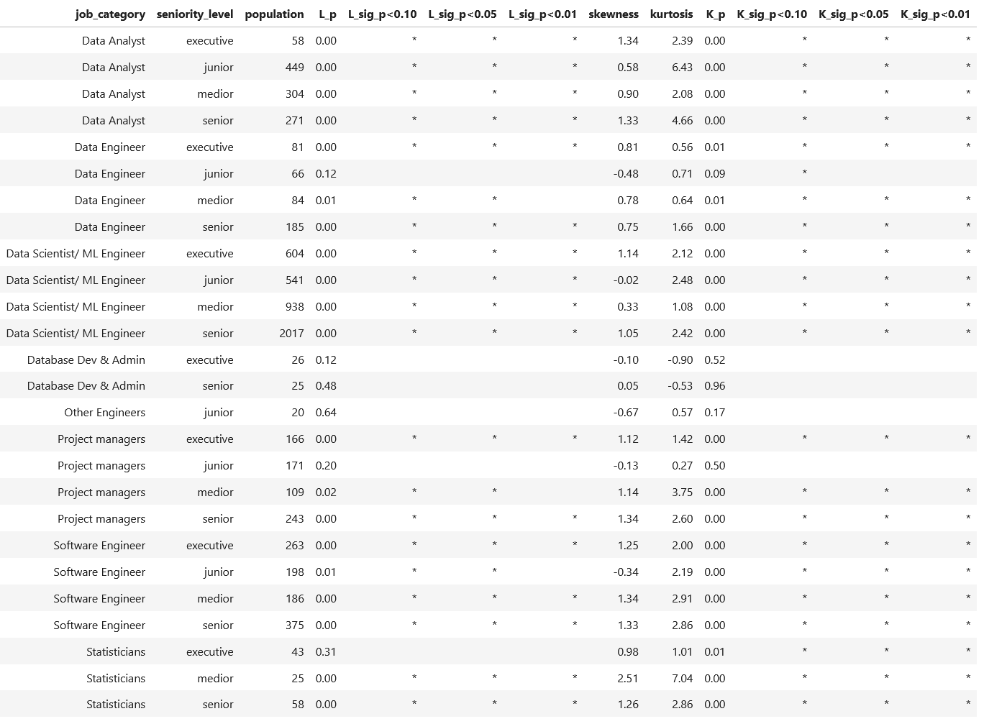
Phase 02: ANOVA assumptions
Normality Assumption on factorial-cell level:
Lilliefors test
Skewness
Kurtosis
D'Agostino's K-squared test

Slide 34
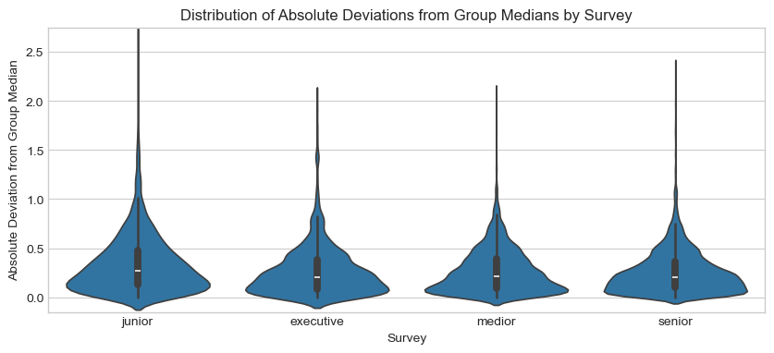
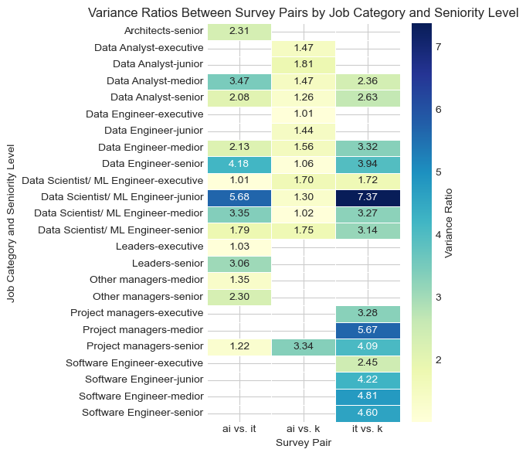
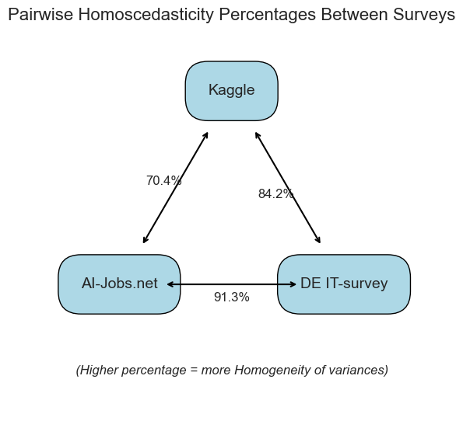
Phase 02: ANOVA assumptions
Homogeneity of variance

Slide 35
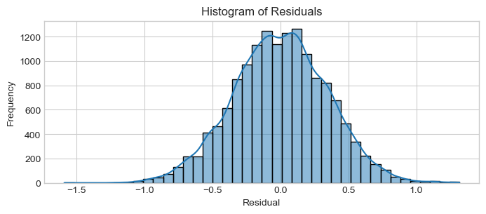
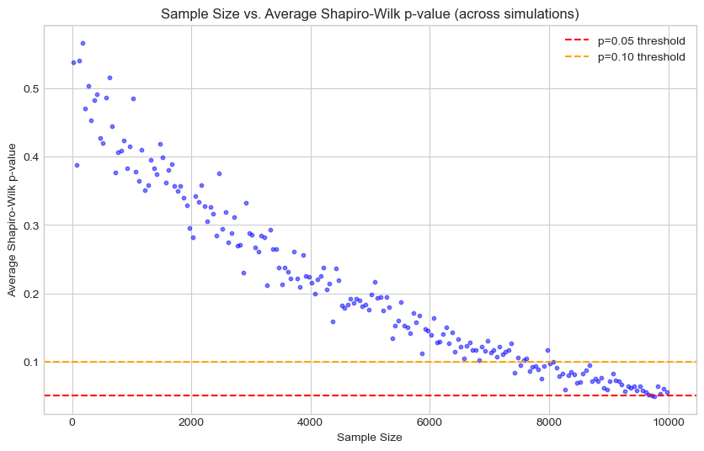
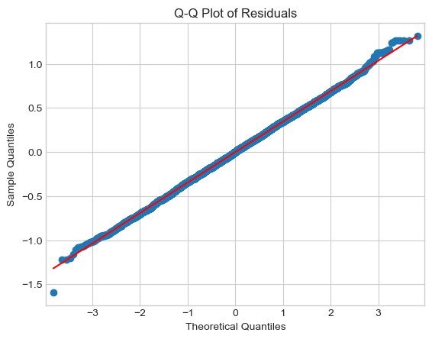
Phase 02: ANOVA assumptions
Normality of residuals:
Visual inspection of residuals:
Sample-size dependent monte-carlo simulation of Shapiro-Wilk normality test:

Slide 36
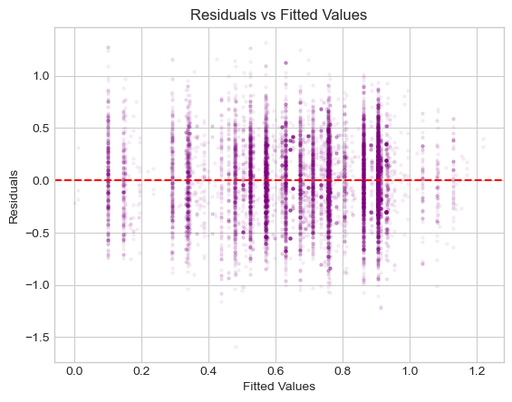
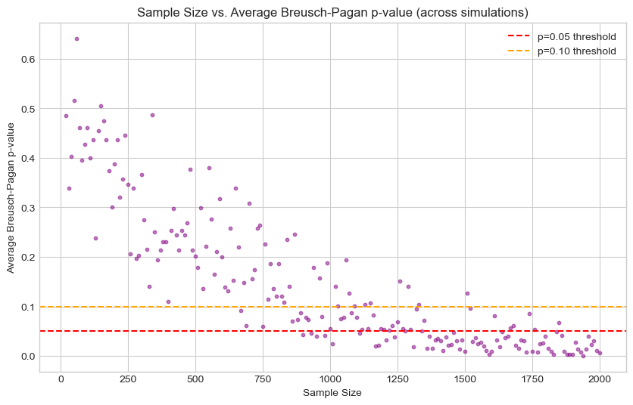
Phase 02: ANOVA assumptions
Homoscedasticity:
Sample-size dependent monte-carlo simulation of Breusch-Pagan homoscedasticity test.
Visual inspection of residuals:

Slide 37
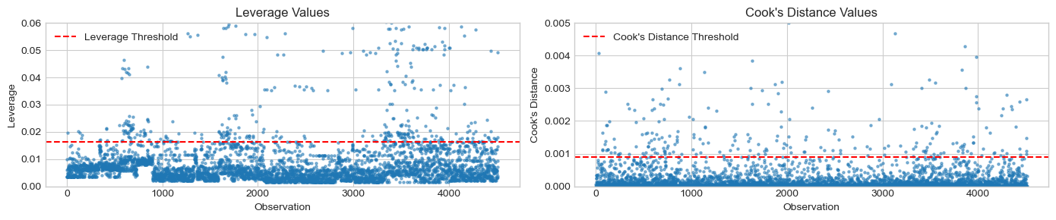
Phase 03: Multiregression
Influential points:

Slide 38
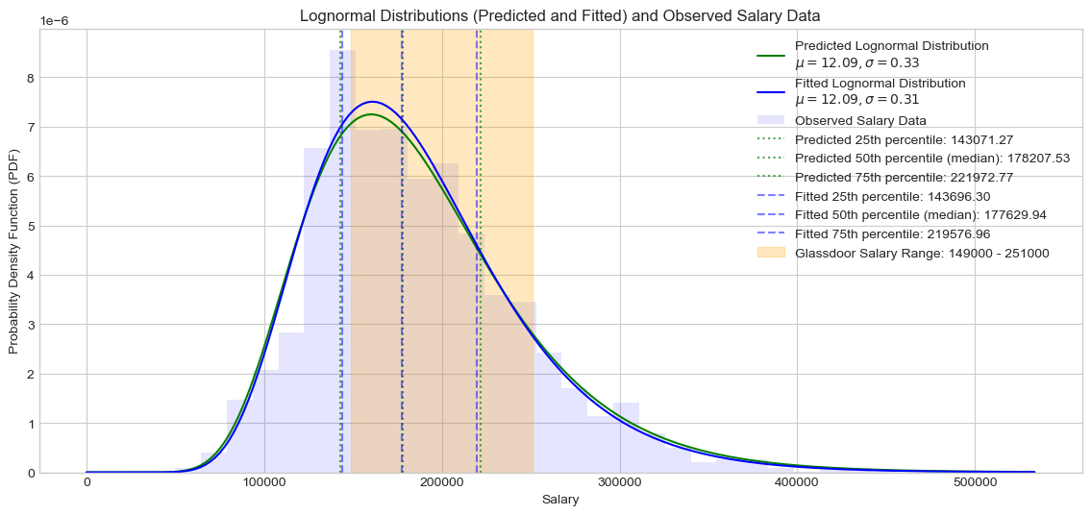
Phase 03: Multiregression
Results:
cases:
1 2 3 4 5 6 7 8 9
1. Data Analyst
2. Junior Data Engineer
3. Data Scientist
4. Data Analyst
5. Medior Data Engineer
6. Data Scientist
7. Data Analyst
8. Senior Data Engineer
9. Data Scientist

Slide 39
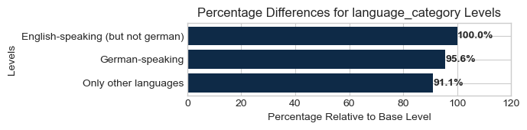
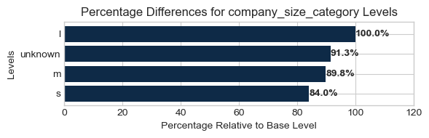
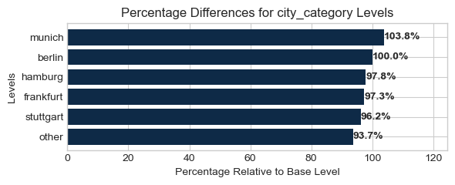
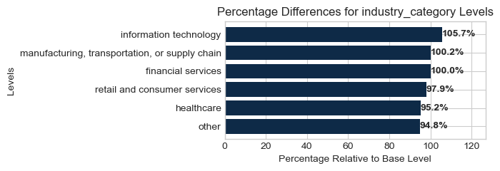
Phase 03: Multiregression
Normalized coefficients:

Slide 40
Backup

Slide 41
Phase 02: Strength of association
Questrial (14):
Nunito (12)
0.9 spacing: with 0 before, 4 after
Variable selection
VIF
Training-testing split
Pre-regression assumption
Multiregression model fitting
Model diagnostics
Outliers
Performance metrics
Validating with Glassdoor data
Extrapolation

