Slide 1
Developer Salaries:
A multivariate analysis and a predictive model
A portfolio project by Viktor Soltész

Slide 2
Abstract
Project Overview:
This project analyzes software developer salaries using thousands of survey responses collected over multiple years (2018-2024).
Data Sources:
The analysis builds on 11 publicly available surveys from 3 distinct sources,
covering a wide range of data points on developer salaries.
Project phases:
Preparation: Data cleaning, transformation, and quality assessment.
Analysis: Trend discovery and multivariate ANOVA.
Prediction: Regression modeling for personalized salary estimates.
Outcomes:
Provides a deep insight into the software development field.
Examined and evaluated the key variables influencing salaries, assessing their variability and significance.
Determined if all surveys consistently reflect the same underlying salary trends.
Developed a model to predict a personalized expected salary.

Slide 3
Developer Salaries:
Management report
A multivariate analysis and a predictive model

Slide 4
Project Scope
Objectives:
Project phases:
Data sources:
Seniority
Job title
Industry
Analyze software developer salaries using thousands of survey responses from 11 datasets (2018–2024).
Company size
Languages spoken
Country
City of residence
Year
Understand industry trends and salary drivers.
Quantify the impact of key factors using multivariate analysis.
Predict personalized salaries based on unique parameters.
Salary
Kaggle.com - Yearly survey (85k responses)
AI-Jobs.net - Their public record (14k datapoints)
Germany IT-Survey - Yearly survey (6k responses)
01 Data Preparation
01
02 Data Analysis
03 Salary Prediction

Slide 5
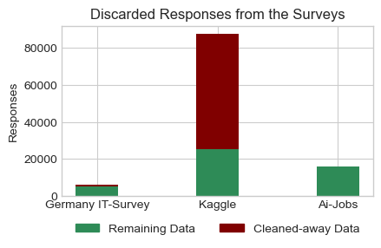
Phase 01: Preparation
Data Quality metrics:
Objective:
To standardize, clean, and prepare survey data from multiple sources (2018–2024) for robust analysis and salary prediction.
■ Germany IT Survey:
Good-quality responses.
Best fitting project scope.
■ Kaggle:
Large scale, lower consistency,
Methodological errors (correctable).
■ AI-Jobs.net:
Excellent quality,
Unknown methodology
Key Activities:
Data Consolidation
Integrated together the surveys.
Standardized common variables.
Data Cleaning
Addressed missing values, typos, and inconsistencies.
Removed irrelevant responses (e.g., freelancers, students, trainees).
Outlier Detection
Applied advanced statistical methods (Z-score, modified Z-score) to detect anomalies.
Variable Enhancements
Created new metrics:
Inflation-adjusted salaries.
Country economic normalization (e.g., GDP-PPP).
Data Quality Assessment
Evaluated and compared survey quality

Slide 6
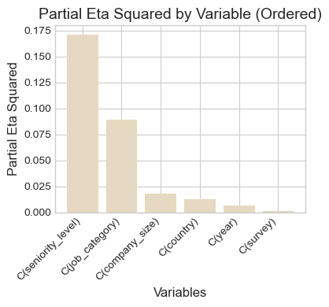
Phase 02: Data Analysis
Impact of variables:
Objective:
Effect size (Partial Eta-Squared) results by multivariate ANOVA with normalized variables.
To analyze salary determinants among software developers globally.
Assessing variable relationships (e.g., job category, seniority, country, survey year). Validating the consistency of three survey datasets.
Preparing the dataset for predictive modeling.
Key Insights:
Strength of Association:
Low-to-moderate correlations between key predictors
Salary Trends:
Inflation-adjusted yearly trends are minimal.
After GDP normalization, country differences decrease, but remain non-negligible.
Statistical Validity:
Assumptions met for a reliable multivariate analysis.
ANOVA Results:
Significant effects for seniority, job category, and country.
Survey and year effects are negligible.
Partial Eta squared quantifies how much relative explaining power a variable has regarding the predicted variable (salary)

Slide 7
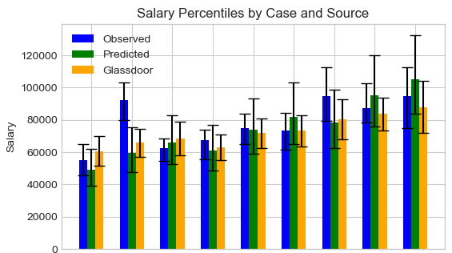
Phase 03: Prediction
Prediction results:
Objective:
Build and validate predictive models for software developer salaries, ensuring alignment with real-world benchmarks (Glassdoor) and creating a tool for personalized salary estimation.
Comparing in key scenarios:
Observed data
Model prediction
Glassdoor data
Results:
Validated Predictive Framework:
Developed a multiregression model based on key variables.
Validations confirmed alignment with Glassdoor, demonstrating credible real-world applicability.
Expanded to include additional parameters for richer personalization, improving Adjusted R² to 0.52.
Methodology Highlights:
Rigorous assumption checks (normality, homoscedasticity) and iterative diagnostics ensure model validity.
Removal of influential data points using leverage and Cook’s Distance to enhance robustness.
cases:
1 2 3 4 5 6 7 8 9
1. Data Analyst
2. Junior Data Engineer
3. Data Scientist
specified to Germany
4. Data Analyst
5. Medior Data Engineer
6. Data Scientist
7. Data Analyst
8. Senior Data Engineer
9. Data Scientist

Slide 8
Conclusion
Improvement potentials:
Goal Achieved:
Developed a validated, data-driven framework for predicting software developer salaries.
Interaction Effects: Experiment with refined interaction terms to capture complex relationships between variables.
Class Imbalances: Address imbalances in categorical data through stratified validation or reweighting.
Advanced Models: Explore Bayesian hierarchical models to handle nested data structures and sparse observations more effectively.
Key Outcomes:
Data Preparation: Standardized and cleaned survey data from multiple sources, addressing inconsistencies, creating derived metrics, and ensuring high data quality for analysis.
Comprehensive Analysis: Multivariate ANOVA identified key factors influencing salaries. Survey and year effects are negligible.
Validated Predictions: Multiregression models aligned with external benchmarks (Glassdoor), ensuring real-world applicability.
Personalization: Enhanced models with additional variables (e.g., industry, city, language) to deliver personalized salary estimates.
Impact: Insights provide actionable benchmarks for salary planning and strategic decision-making, highlighting a balance between predictive accuracy and interpretability.

Slide 9
Thank you!
Github: https://github.com/Viktor-Soltesz/salary_analysis
email: solteesz.viktor@gmail.com
linkedin: https://www.linkedin.com/in/viktor-soltesz/

