Slide 1

Bike rental application

Slide 2
Why Easy Bike
Rent a Bike easy with just one click on your phone.
Keep away from traffic problems and delay your workplace or meeting.
Long waiting at the traffic lights and lot of cars horns from all sides.
Navigate quickly and easily to your desired destination.
Service Easy Bike will allow you to go to work fast and simple, with no worries about the traffic.

Slide 3
We have a solution
Topic Public bicycles Summary EASY BIKE is a commercial public bicycle service.
The scheme is designed for one way trips or daily use.
To obtain access to the call a bike service, users must to send a message with special id number that has every bike) on special service number to start the rent service.

Slide 4
Why Us?
Because our system of renting is unique and offers the ability to quickly , easily and securely renting a bicycle.
It's Fast.
It is easy because the process of renting is just one clicks in our application
It is safe because all information concerning the payment is stored on another server.

Slide 5



Who its works
PICK
RIDE
DROP

Slide 6
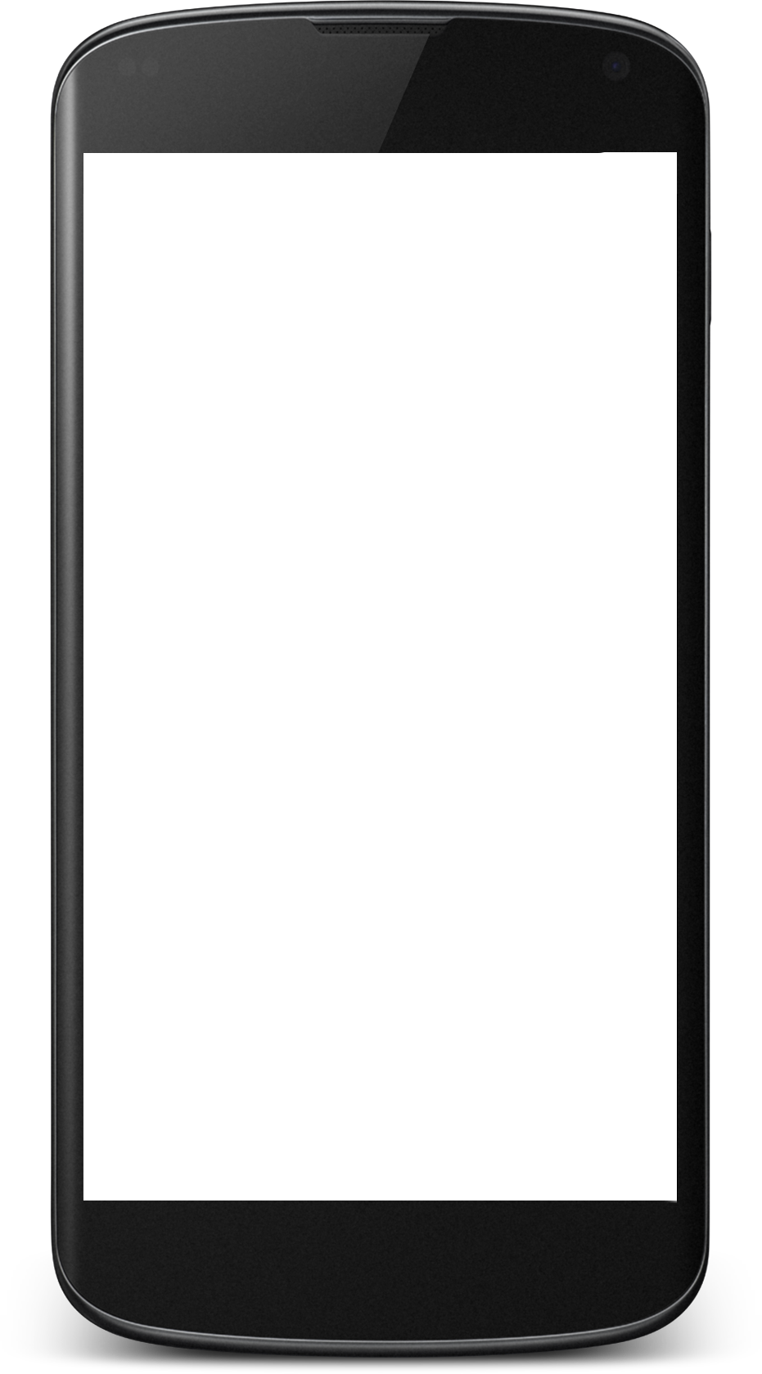
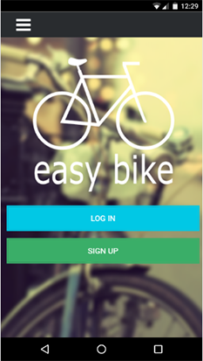
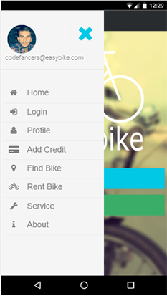
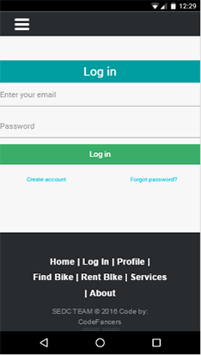
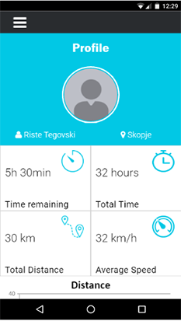
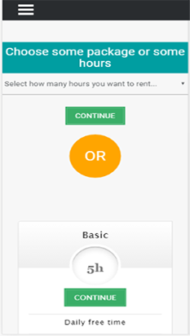
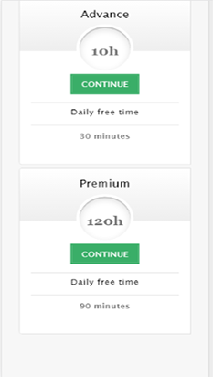
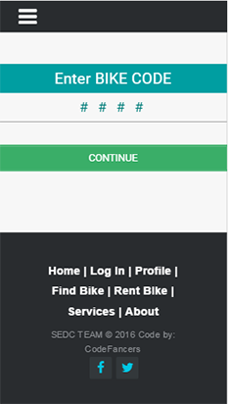
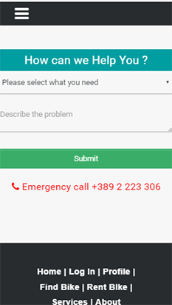

Slide 7
Thank you

