Slide 1
Team C
Louise Villander
Cameron Robertson
Viktor Drugge

Slide 3
Mean temperatures of every day of the year

Slide 4

Mean temperature for each day:

Slide 5
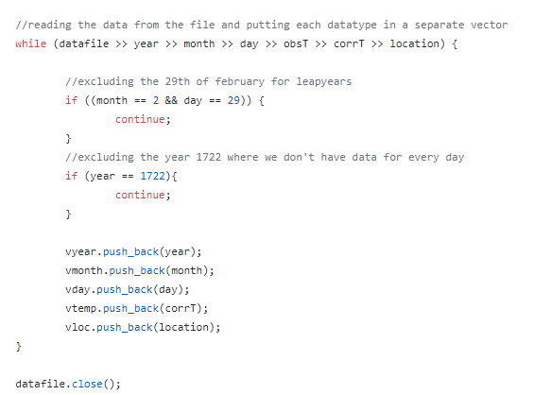

Slide 6
Reading file --> vectors
k: { 0, 1, …, 364, 365, …, 106214}
year: { 1723, 1723, ..., 1723, 1724, …, 2013}
month: { 01, 01, …, 12, 01, …, 12}
day: { 01, 02, …, 31, 01, …, 31}
Temperature at day k = T[k]

Slide 7
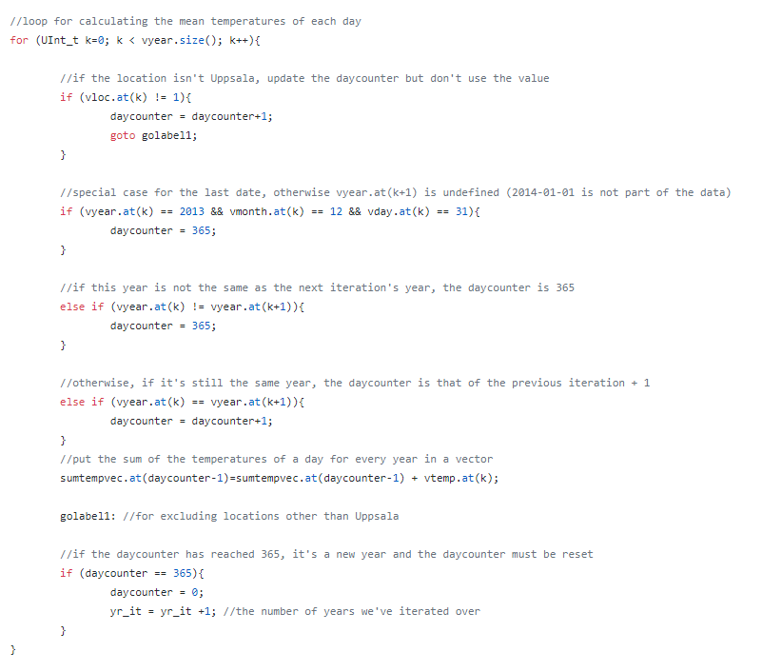

Slide 8
Loop: sum of temperatures
Sum of temperatures
= { T[0], T[1], …, T[364] } year 1
+ { T[365], T[366], …, T[729] } year 2
. . . . . .
+ { . . . . . . . . , T[106214] } year 291

Slide 9
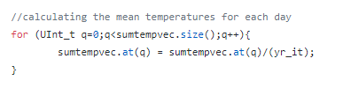
Calculating mean temperatures:
Mean temperature of each day =
{ SumT[day1], SumT[day2], …,SumT[day365]} / 291

Slide 10
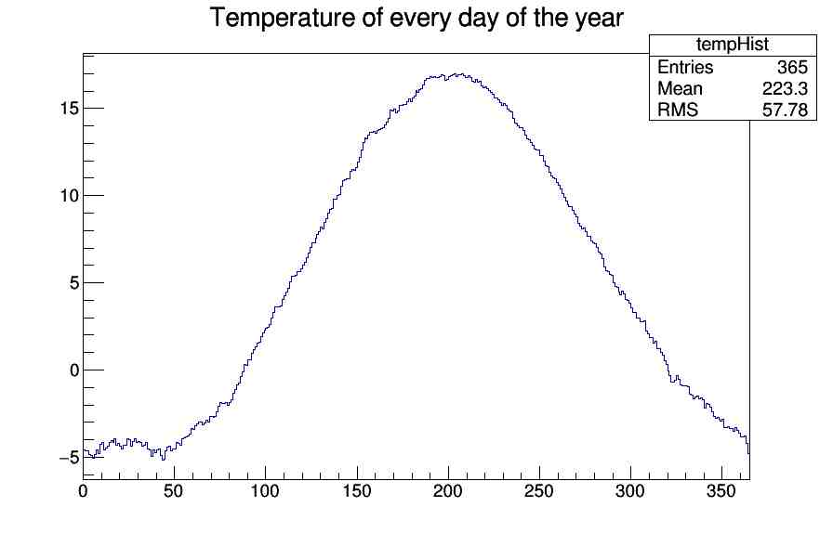

Slide 11

Standard deviation

Slide 12
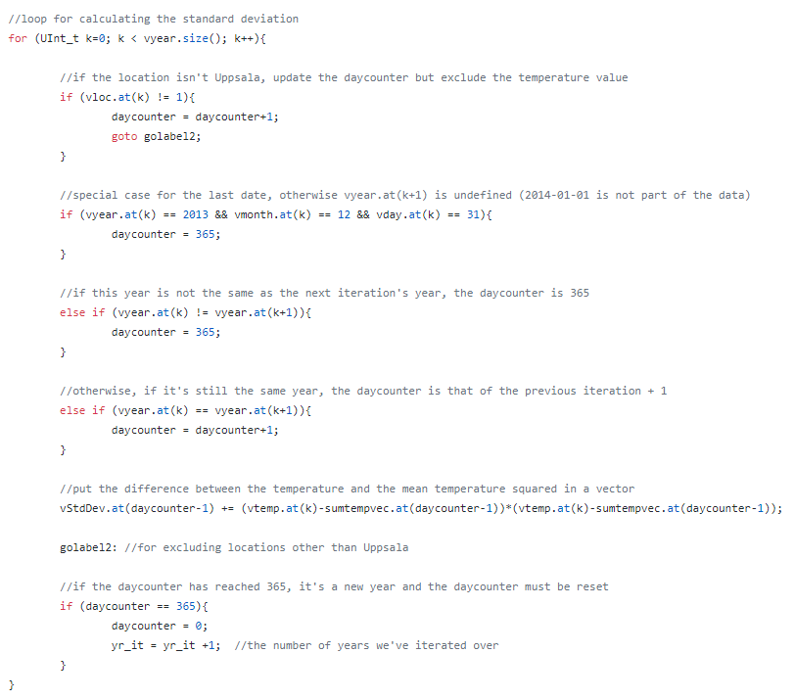

Slide 13


Standard deviation
After the loop we have

Slide 14
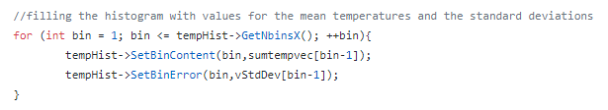
Filling the histogram

Slide 15
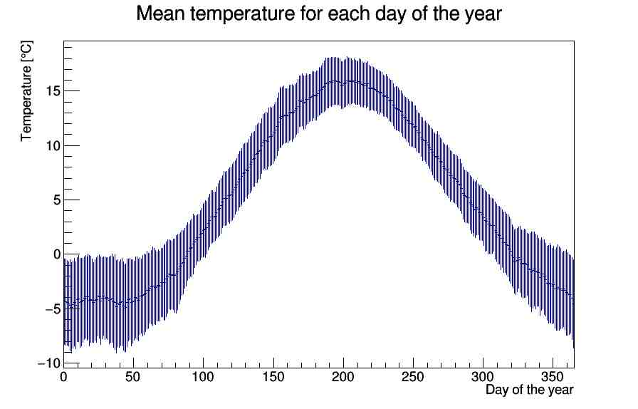

Slide 17
Spring Temperatures

Slide 18
Aims of this section
Plot urban corrected climate data from 1722-2013 in a histogram
Compare mean and standard deviation over two weeks
Determine whether this is a viable way to determine the beginning of Spring
Compare this data at different time periods
Possible improvements

Slide 19
Streaming the dataset
6 columns, all useful apart from the 4th
Program was written for this
Takes a month and day for arguments
Some similarities with previous section

Slide 20
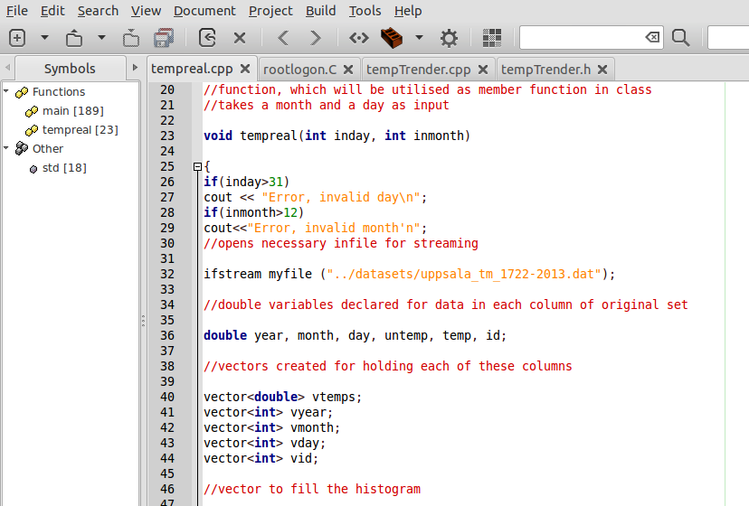
Code

Slide 21
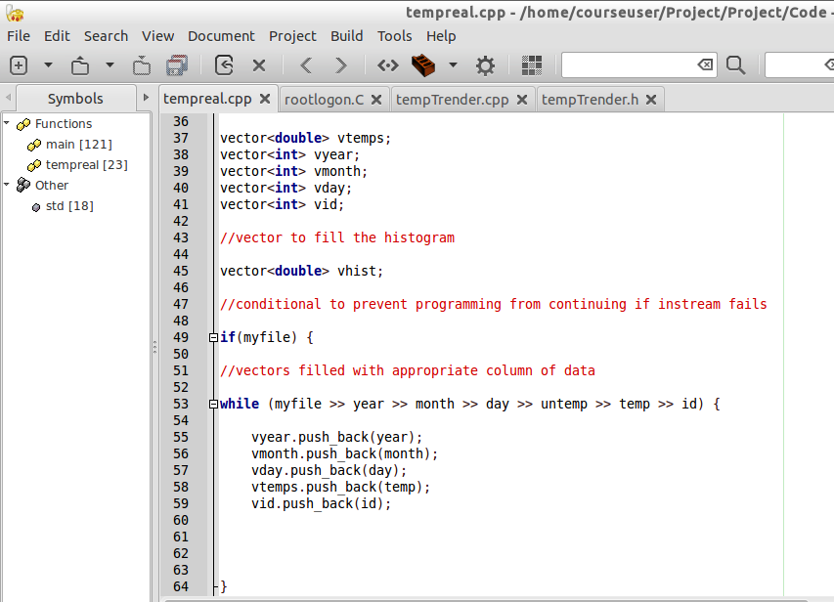

Slide 22
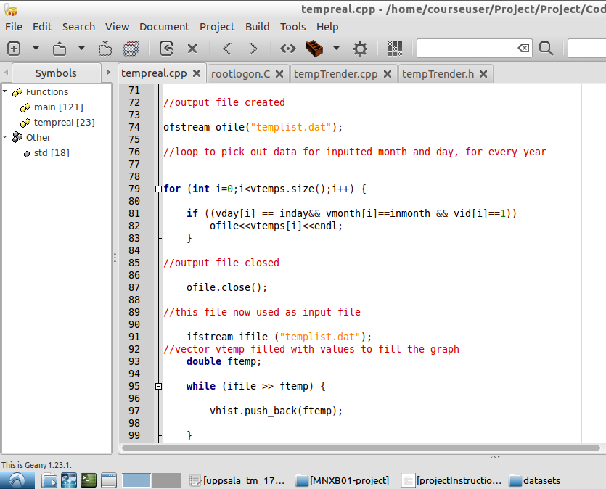

Slide 23
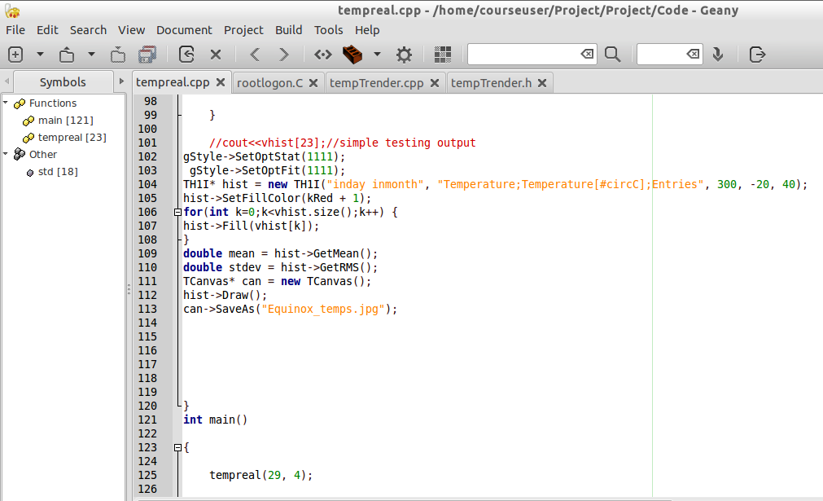

Slide 24
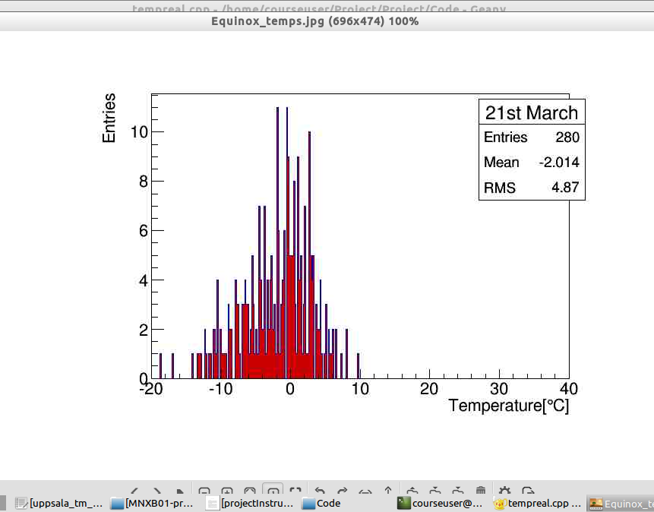

Slide 25
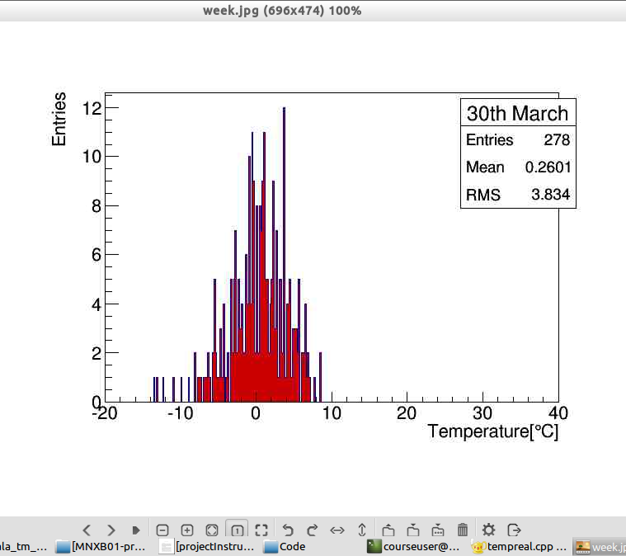

Slide 26
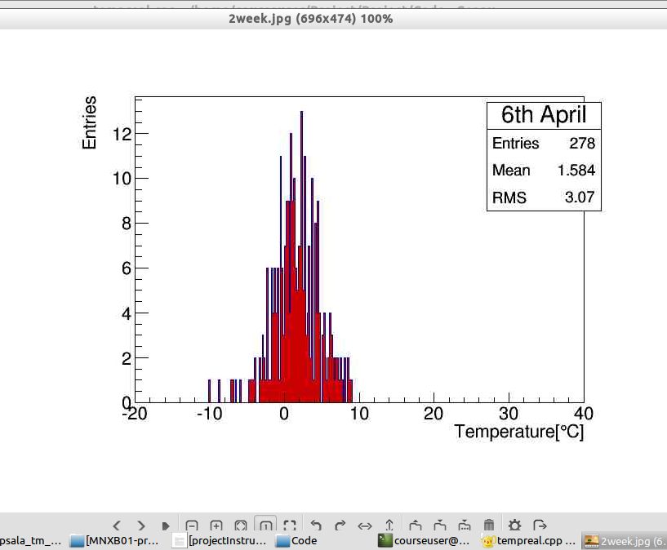

Slide 27
As expected, increase in temperature
Not especially helpful for seeing when Spring starts
High standard deviation in each case
Large data sample, not useful for predictions

Slide 28
Any changes with time?
Split the data into three roughly equal time periods (Hard to be precise because of non Uppsala data)
Compare each of these

Slide 29
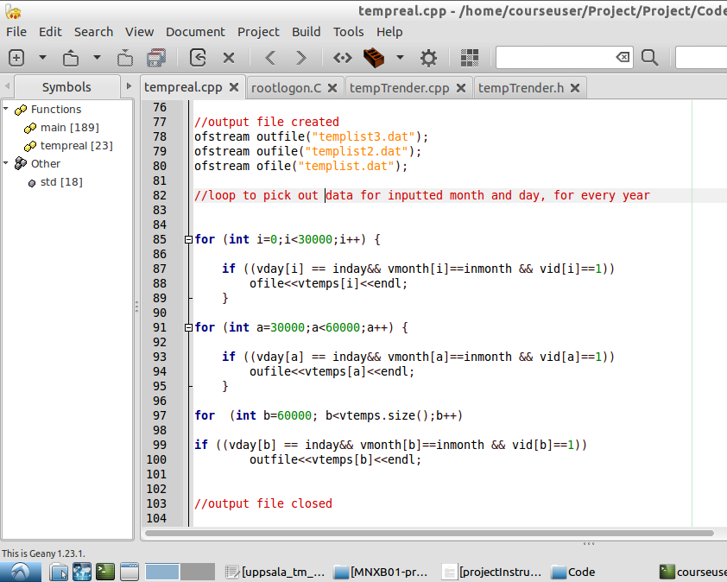

Slide 30
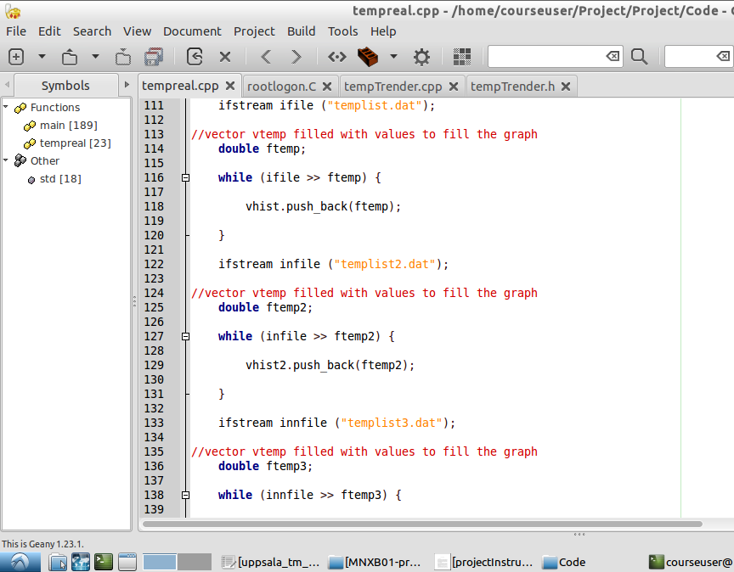

Slide 31
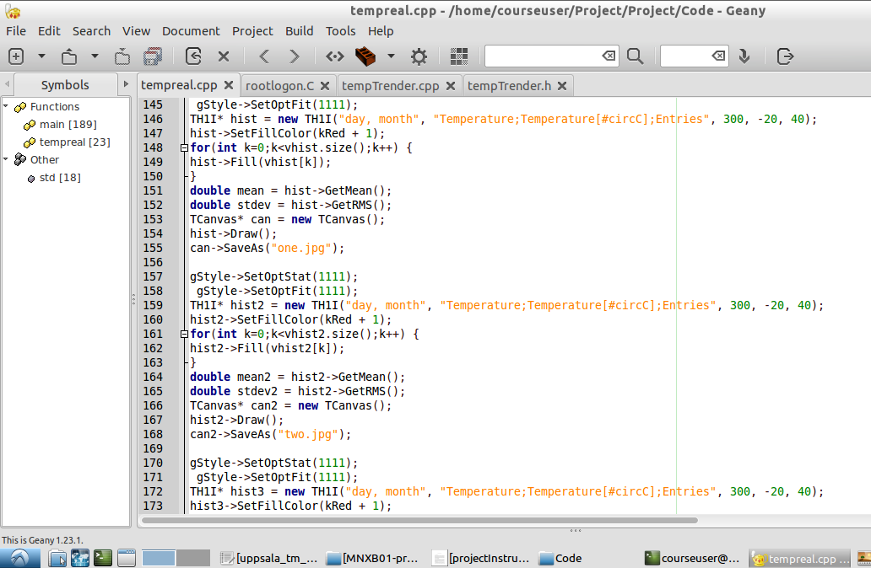

Slide 32
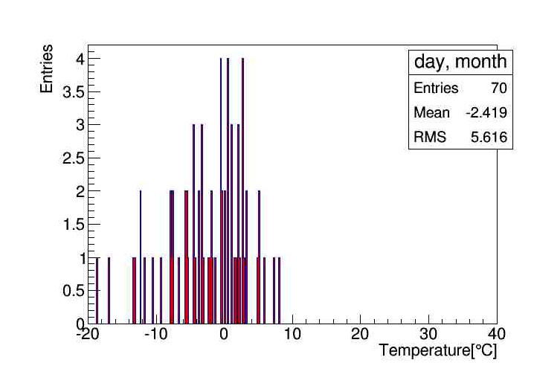
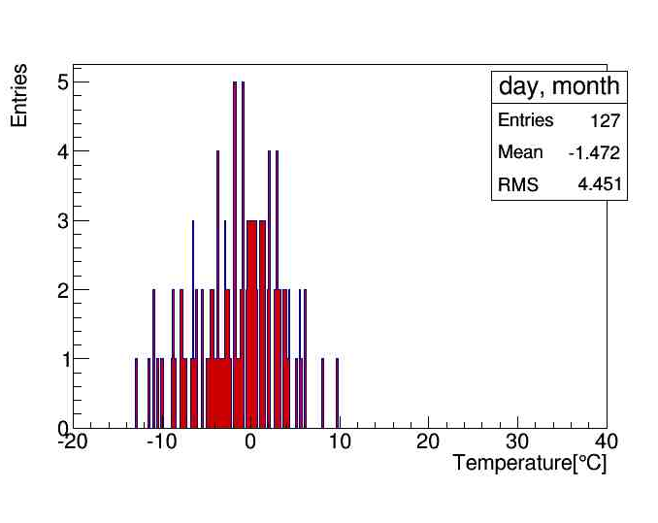
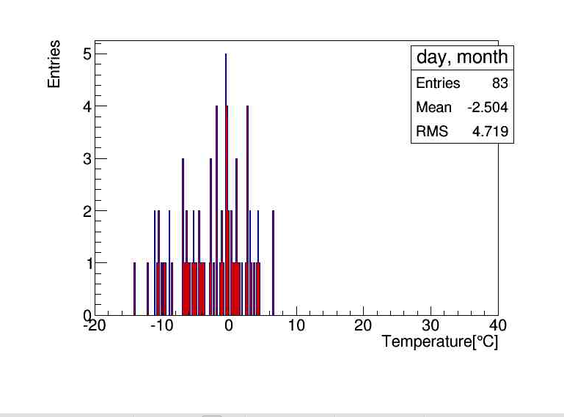

Slide 33
Not the same case for every date
Sometimes temperature decreases, hard to check every day!
Quite large difference at vernal equinox though
Graphs are uneven in all cases, so not a great comparison

Slide 34
Would have to type in each date to find the start of Spring using this method
Would take some time and not be that reliable
Another method is needed!

Slide 35

The start of spring
Different definitions of seasons and their time period
We use the meterological definition given on SMHI:s webpage

Slide 36
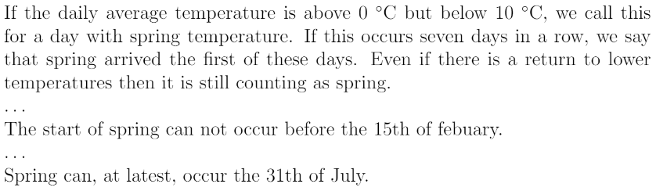
Meterological definition used

Slide 37
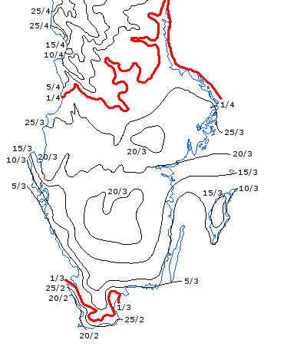
Map of spring arrival
Uppsala
Figure show the typical date of spring arrival (not only for 2013)
For Uppsala spring occur near the end of March
Source: https://www.smhi.se/vadret/vadret-i-sverige/arstidskarta/ank_var_2013.html

Slide 38
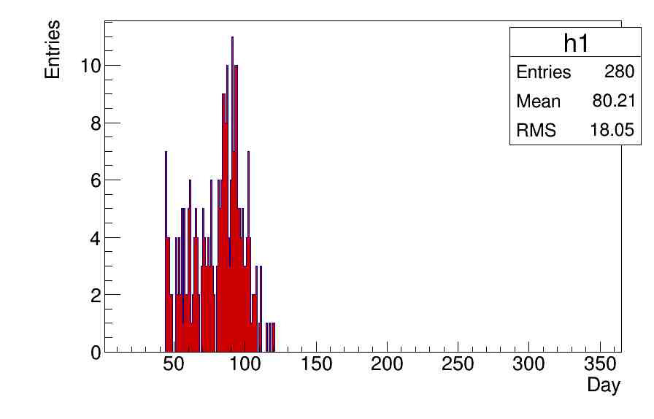
Histogram of spring dates
Days span from 1 to 365
Leap years are shifted by 1 day
Mean at day 80, represent 21th of March or 20th of March if leap year
Standard deviation roughly 2.5 weeks

Slide 39
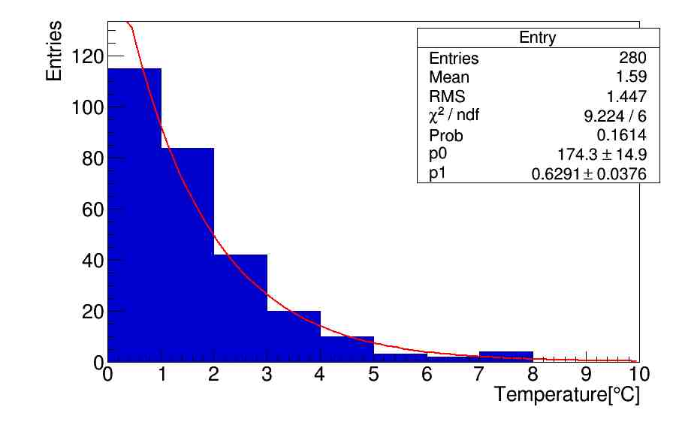

Temperature of determined dates
Gradual increase in temperature yield decaying shape
Fit using a exponential function
p0 represent α
p1 represent λ
$$f\left(x\right)=αe^{−λx}$$

Slide 40

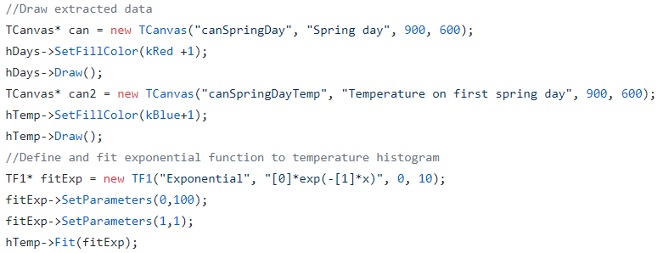
Code
Create two histograms
Read data (+check conditions)
Plot data

Slide 41
Thank you for listening
References: https://www.smhi.se
https://www.epochconverter.com/days/2017

