Slide 1
AUTOPARK
Tarasenko Dmitry
Lebedev Daniil
Graskov Viktor
Powered by:

Slide 2
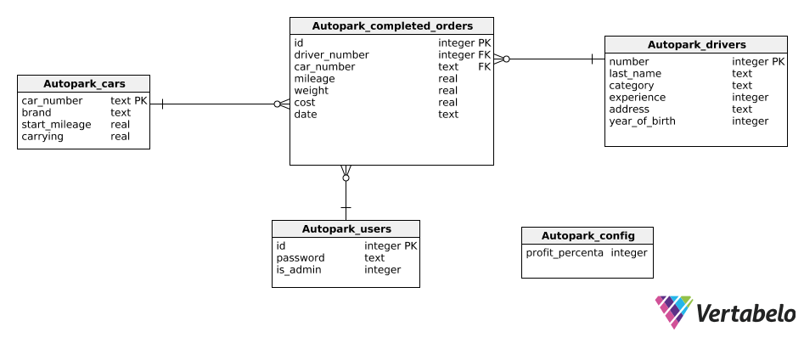
Database structure

Slide 3

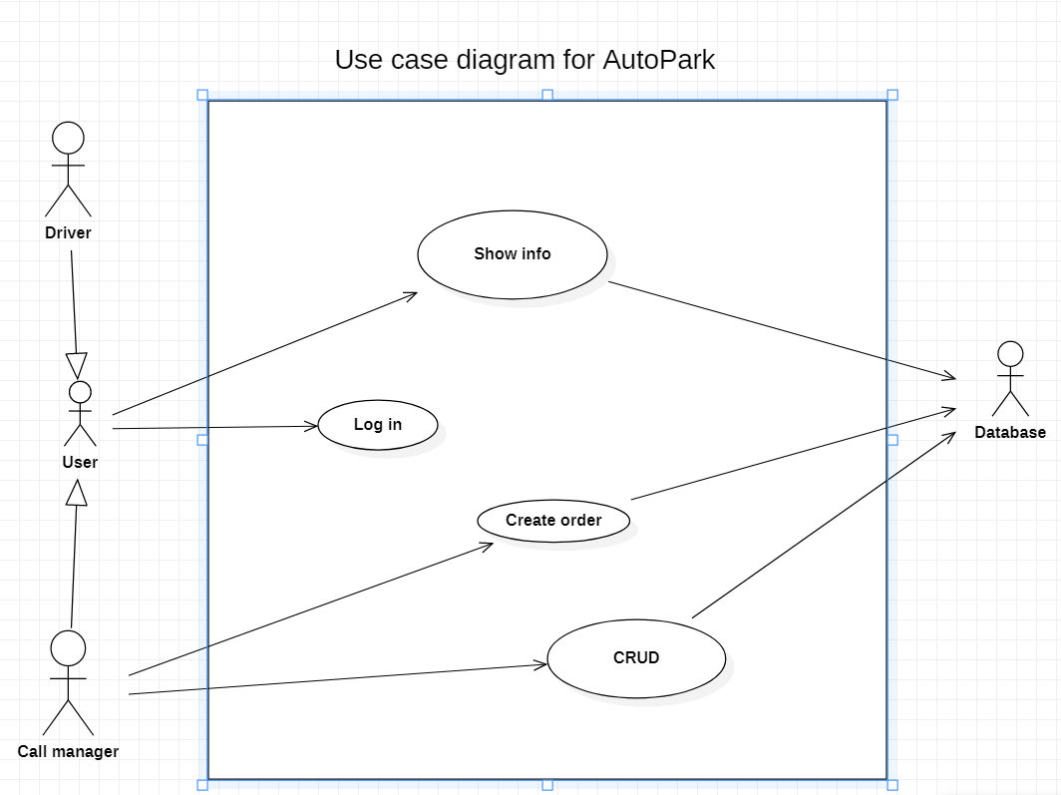
Use case project diagram:
StarUML

Slide 4

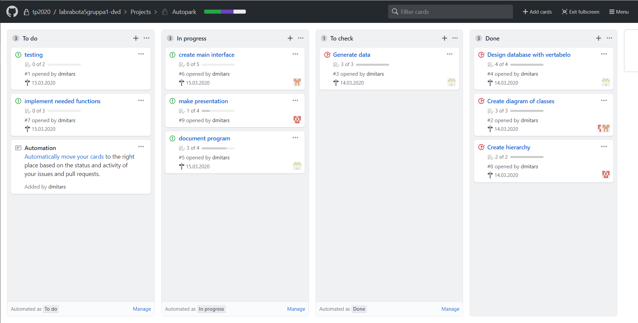
Work in team:

Slide 5

Application requirements:
Insertion of the information into database
Deletion information from database
Selection information from database:
Selection by driver his own orders (*)
With car: its mileage and total value of delivered weight (*)
By driver: total amount of trips, total value of delivered weight, sum of earned money (*)
By driver who made the least amount of trips: all information and sum of earned money
With car that has max mileage: all information (*)
(*) - can be executed by driver; driver can get his own information.

Slide 6
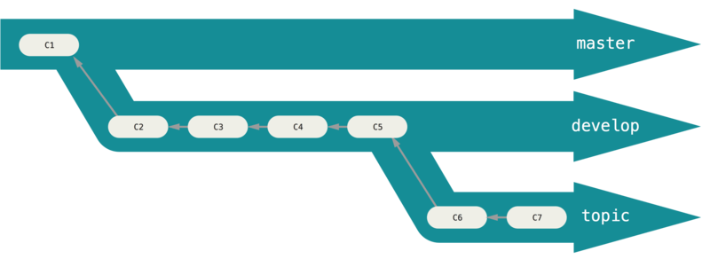
Simple git branching model:

Slide 7
Thank you for attention!!!

