Slide 1
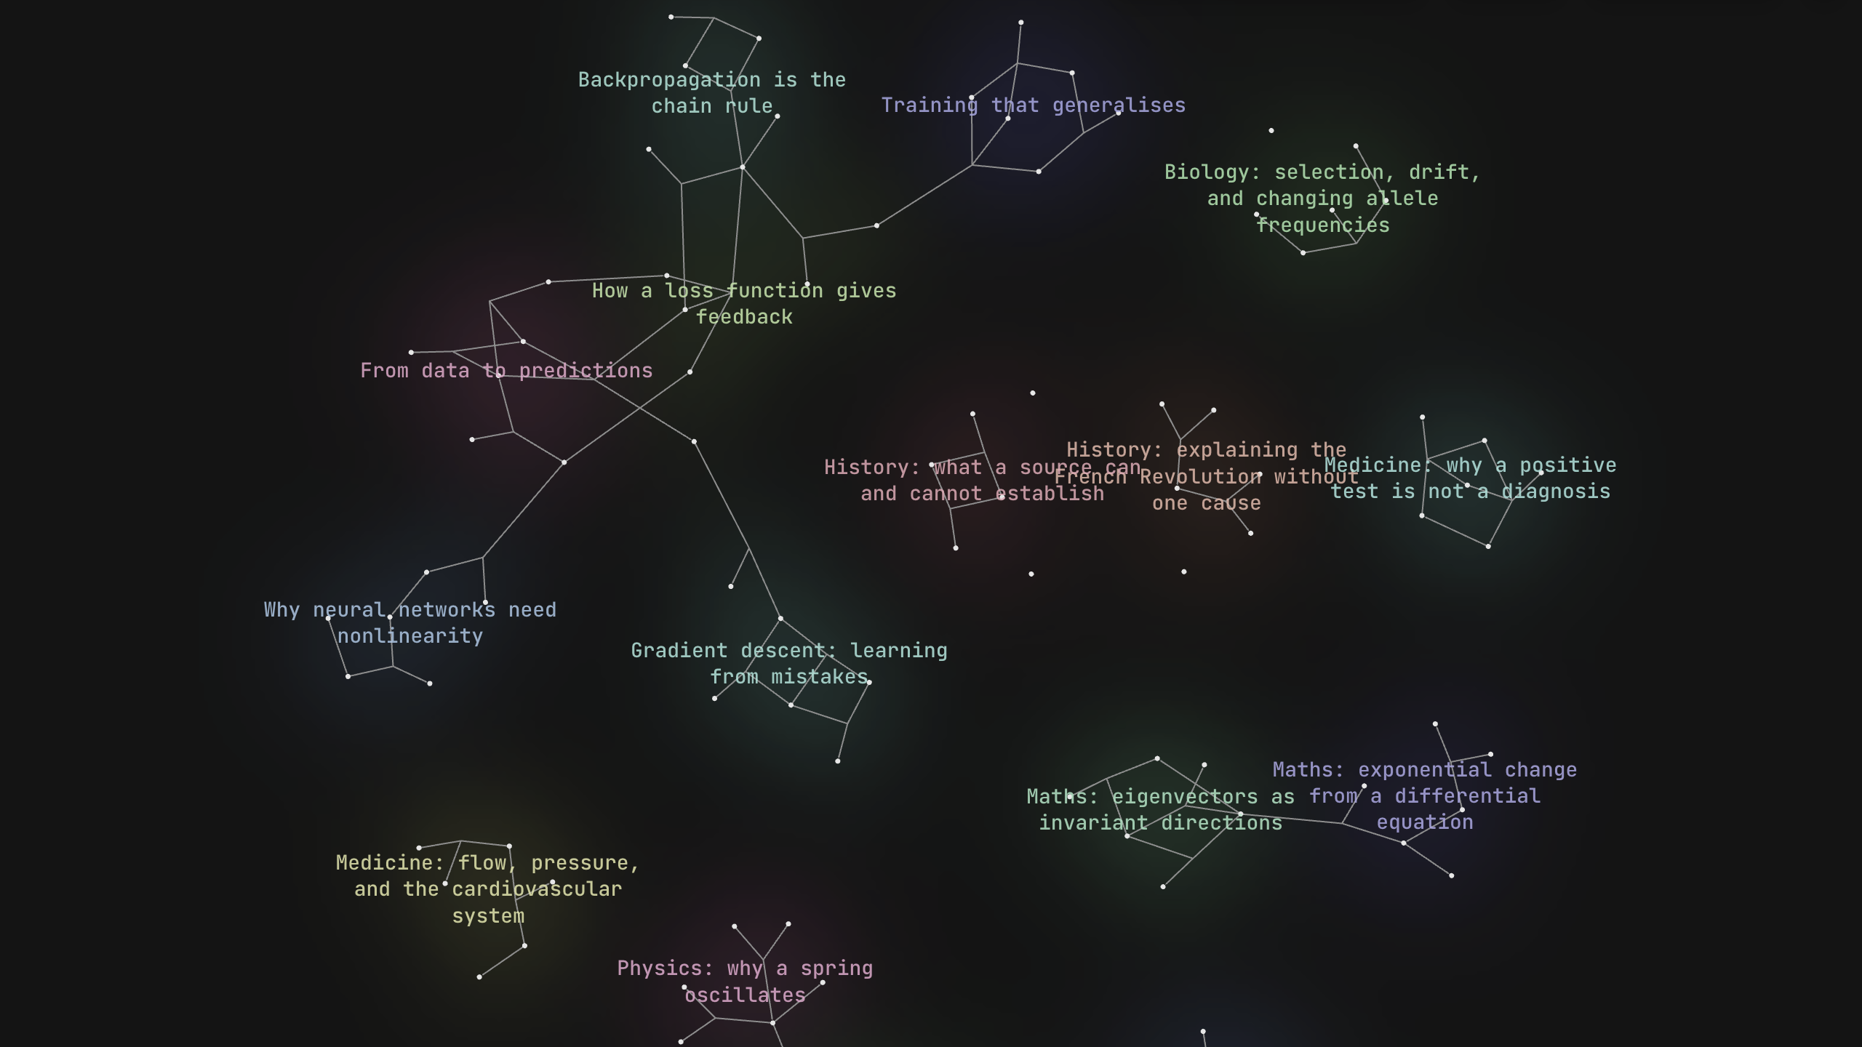
VT-Harness
An AI tutor that builds
from your understanding
A visible learning process.
A memory for the next session.
Actual app with synthetic demo history
Notes:
0–8 seconds
AI can explain a topic, but students still need to discover what they misunderstand. VT-Harness starts there.
Slide cue: introduce the project and the learning problem. Do not read graph labels or demo counts yet.
Evidence: README.md; demo/seed/manifest.json; screenshot: localhost:3006, graph overview.
All learner transcripts and learning records shown are synthetic demonstration data. Screenshots show the running app.

Slide 2
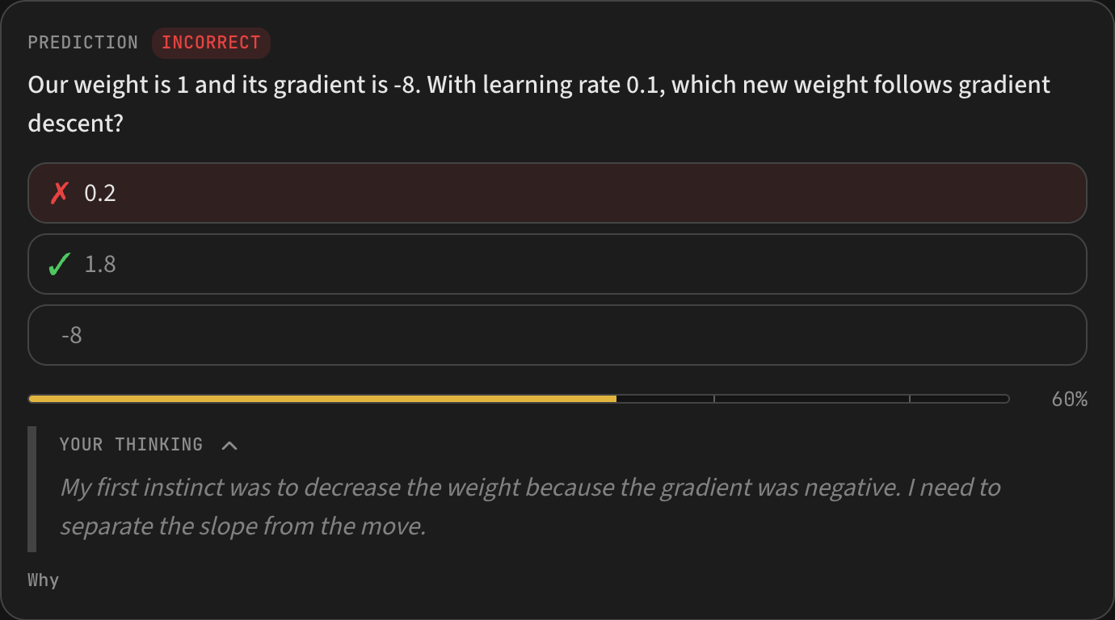
VT-HARNESS
02
Teaching that follows your reasoning
Probe the starting point
Build a lesson plan
Predict, explain, check
Reasoning exposes the mistake.
The repair: subtracting a negative gradient increases the weight
1 − 0.1 × (−8) = 1.8
Synthetic lesson example
Notes:
8–23 seconds
It probes your understanding and builds a lesson plan. You predict before the explanation, and your reasoning reveals the misconception. Here, the learner chooses the wrong gradient update, so the tutor repairs that specific mistake.
Slide cue: point to the wrong 0.2 answer, then the thinking field. The equation explains the corrected direction. The learner later answers a check correctly.
Evidence: README.md, How it works; demo/seed/chats/chat_demo_gradient-descent.json; screenshot: prediction card with expanded thinking.
All learner transcripts and learning records shown are synthetic demonstration data. Screenshots show the running app.

Slide 3
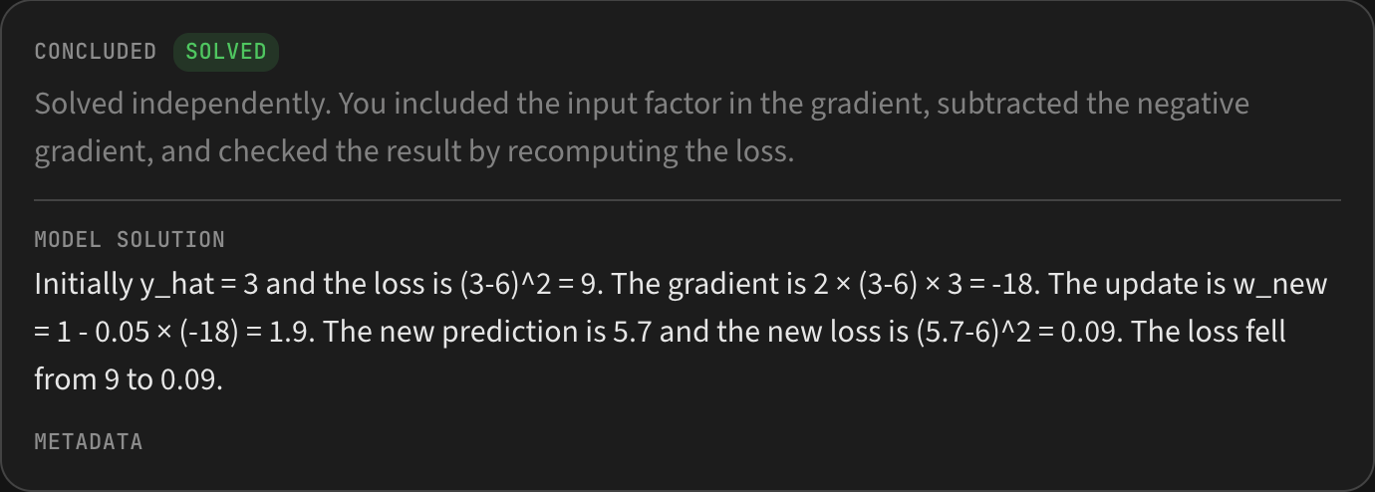
VT-HARNESS
03
Practice that tests transfer
A fresh problem
Visible reasoning
Adaptive hints
New weight: 1.9
Loss: 9 becomes 0.09
Synthetic practice example with a completed solution
Notes:
23–34 seconds
Then practice tests a fresh problem, with adaptive hints when needed. You can see the learner’s thinking and the checked solution.
Slide cue: point to YOUR THINKING, then SOLVED. This example needs no hints. The numbers describe one illustrative loss calculation, not a measured educational outcome.
Evidence: README.md, Practice; demo/seed/chats/chat_demo_practice-updates.json; screenshot: completed problem and solution. Hints are a supported capability, not used in this solved example.
All learner transcripts and learning records shown are synthetic demonstration data. Screenshots show the running app.

Slide 4
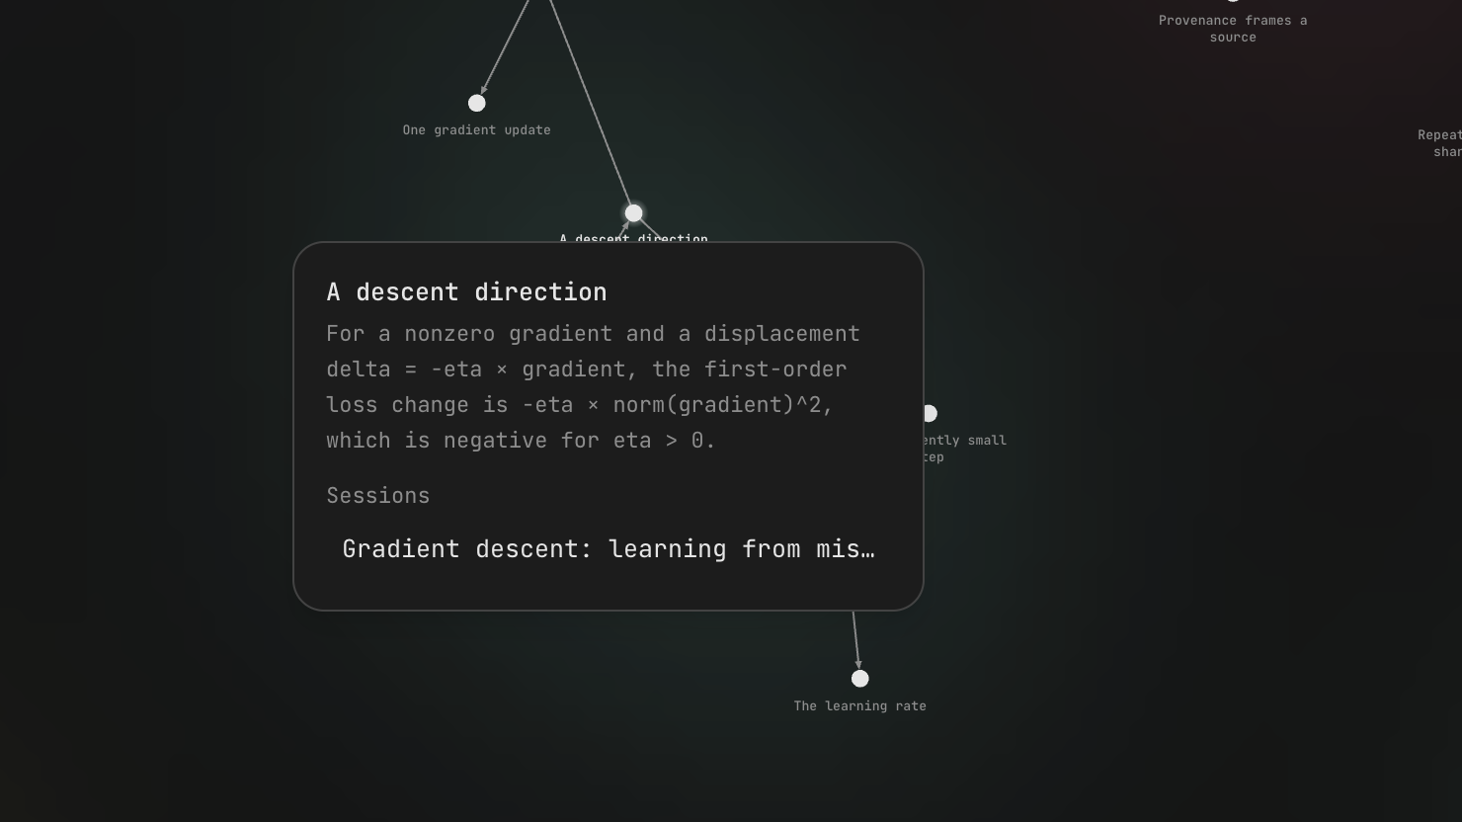
VT-HARNESS
04
A memory for the next session
96 concepts
53 reasoning chains
Claims and their premises,
linked to the source lesson
Maths, Physics, Biology, History, Medicine and neural networks
Notes:
34–46 seconds
Learning accumulates in a local graph of concepts and reasoning chains, linked to source lessons. The demo spans Maths, Physics, Biology, History and Medicine, alongside neural networks.
Slide cue: point to the selected concept and its session link. Demo totals are 23 sessions, including 16 lessons and 7 practice sessions. These are prepared synthetic examples. The graph stores propositions and reasoning relationships, not ability scores.
Evidence: src/core/graph.ts; demo/seed/manifest.json; screenshot: graph concept with source-session link; all counts describe synthetic demo data, not users or educational outcomes.
All learner transcripts and learning records shown are synthetic demonstration data. Screenshots show the running app.

Slide 5

VT-HARNESS
05
Your material, voice and models
Your material
Your explanations
PDFs, files, notes and supplied URLs
Visuals, image annotations and interactive demos
Your voice
Your models
Thinking fields and dictation
API keys, subscriptions, CLI or local endpoints
Local learning records. Open source.
github.com/ViktorIvan8787/GreatUniHack
Notes:
46–60 seconds
Bring files, PDFs or URLs, think aloud with dictation, and use visuals or interactive demos. Choose your own AI provider. VT-Harness carries that learning into the next session.
Slide cue: summarise the options and stop at 60 seconds. API and subscription availability depend on the selected provider. Optional dictation uses Deepgram. Desktop supports attaching local file paths and image annotations. Supplied-source URL reading is supported; web search was removed. Local records do not make external provider processing offline.
Evidence: README.md; docs/getting-started.md; docs/development.md; docs/claude-code.md; docs/custom-providers.md; screenshot: actual composer with attachments, dictation and model selection. File paths and annotations have desktop-specific capabilities. Models receive the context needed for a task. Local storage does not imply offline processing.
All learner transcripts and learning records shown are synthetic demonstration data. Screenshots show the running app.

Slide 6
APPENDIX
06
Capability reference
Learning
Probing questions, confidence and thinking fields. Dependency plans, predictions, explanations and checks.
Practice
Graph-based problem selection, adaptive hints, learner reasoning, verdicts and model solutions.
Memory
Persistent propositions and reasoning chains. Source-session links, graph search and note import.
Materials
Supplied web URLs and PDFs, local file access, images, visual generation, annotations and interactive demos.
Control
Dictation, provider and model choice, editable prompts, context and cost visibility, local records and open source.
External providers still process the context you send. Some file and image tools require desktop.
Notes:
Optional appendix. Do not present during the 60-second pitch.
Capabilities verified against README.md, docs/getting-started.md, docs/development.md, docs/architecture.md, docs/claude-code.md, docs/custom-providers.md, src/agent/tools.ts, src/agent/tools/jobs.ts, components/settings/agent-section.tsx and components/settings/settings-dialog.tsx.
Cost display estimates known API usage only. Subscriptions, CLI and custom endpoints can have unknown costs. Local data is not a claim that external requests are private or offline. The current Settings sections are Providers, Agent and Graph. Web search is absent. All sample learner outcomes are synthetic.

Slide 7
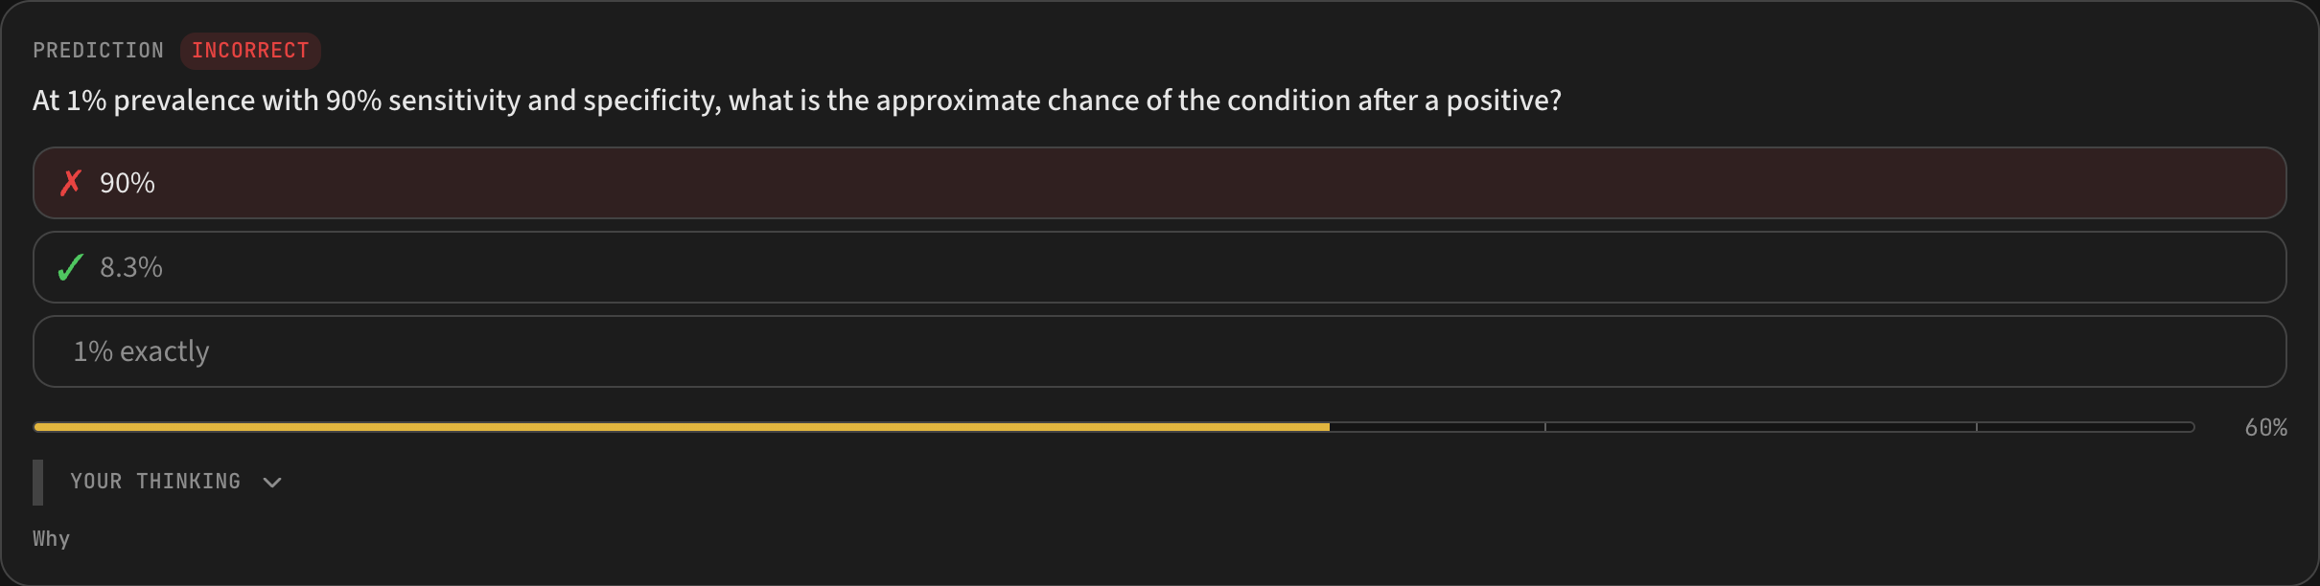
APPENDIX
07
University examples ready to explore
Maths
Eigenvectors and differential equations
Physics
Spring oscillations and energy
Biology
Gene regulation, selection and drift
History
The French Revolution and source criticism
Medicine
Two lessons and one practice
session per university discipline
Cardiovascular physiology and diagnostic probability
Synthetic teaching history. Medicine uses fictional exercises.
Notes:
Optional appendix. Each subject name links to a live local lesson and requires the demo server at localhost:3006. Full lesson and practice links are in demo/README.md and the companion guidance file.
Screenshot source: localhost:3006/chat/chat_demo_medicine-diagnostic-probability. This is a synthetic probability exercise for an invented screening test, not a clinical recommendation. Its underlying educational references are in the lesson.
Dataset source: demo/disciplines.ts and demo/seed/manifest.json. 10 new lessons and 5 new practice sessions complement the 8 original neural-network sessions.

