Slide 1
The student house project
From Viktor Skachkov, Alexander Petrov, Matija Mandarelo and Desislav Hristov

Slide 2


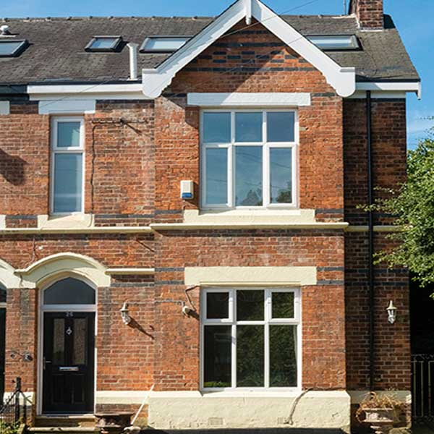

Problem statement
Create an app in order to improve the experience for both students and owners
Find multiple ways to tackle difficulties and problems
Finish the project in a limited time frame

Slide 3
Functionalities

Slide 4
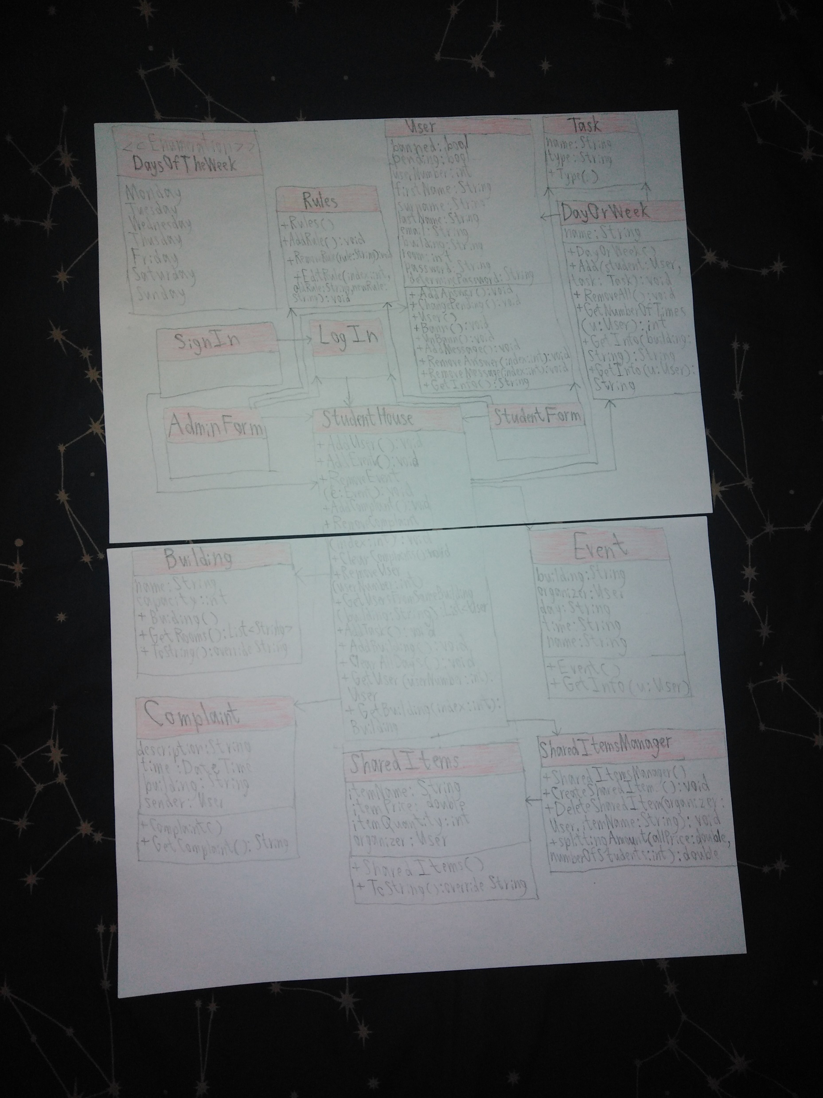
Class diagram

Slide 5
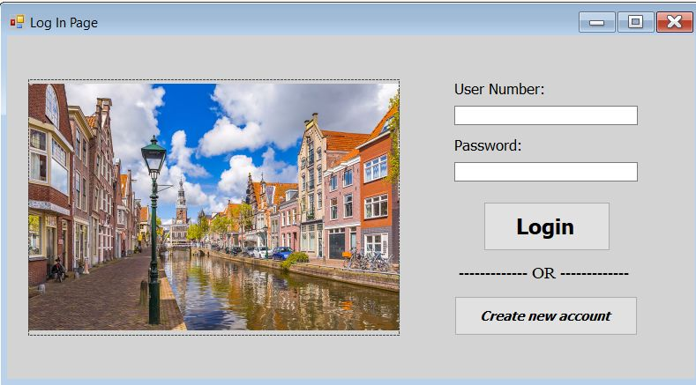
Components
The connection between the forms
The registration
The messages
The tasks
The events
The rules
The complaints
Shared items
Adding a new building

Slide 6
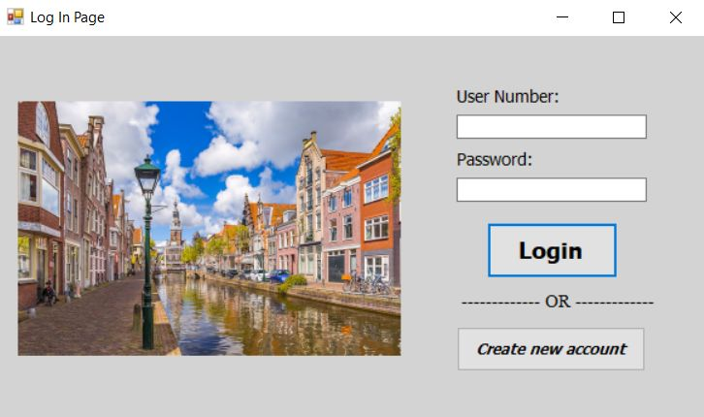
Connection between the forms

Slide 7
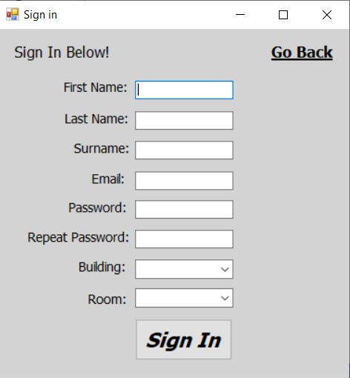
Registration

Slide 8
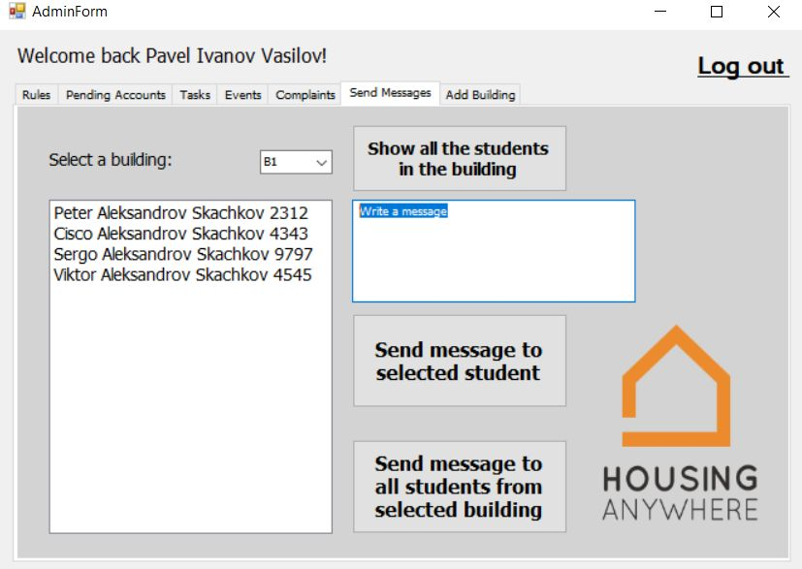
Messages

Slide 9
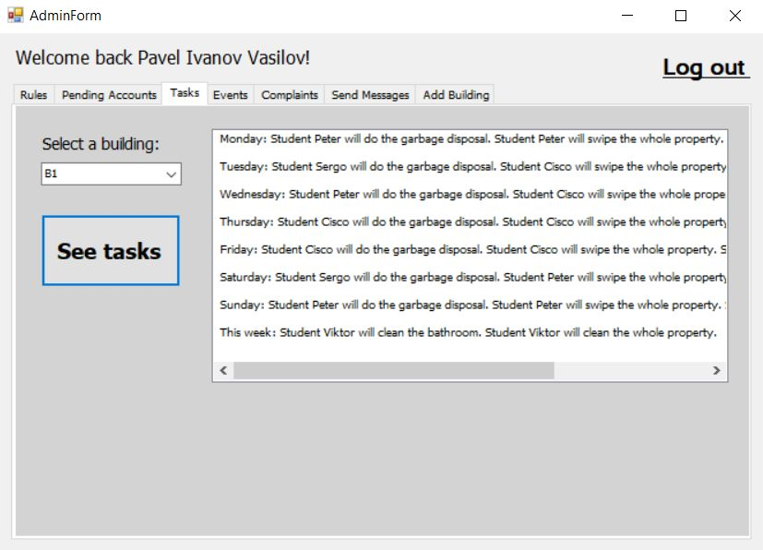
Tasks

Slide 10
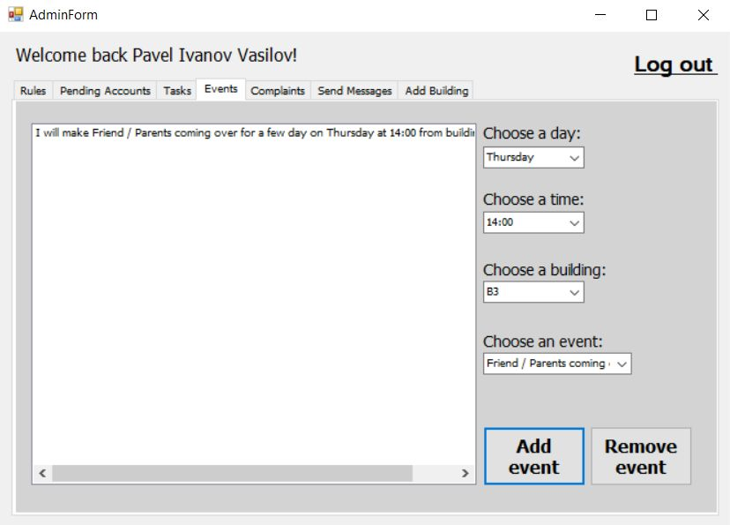
Events

Slide 11
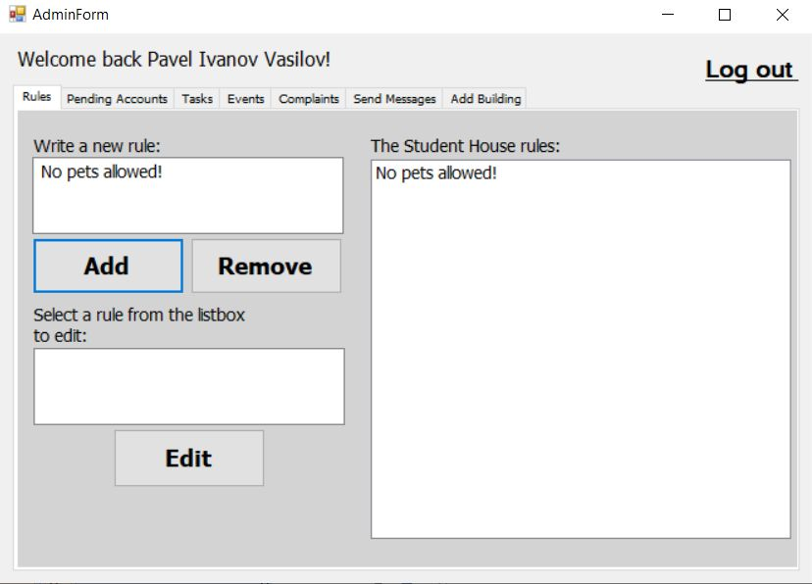
Rules

Slide 12
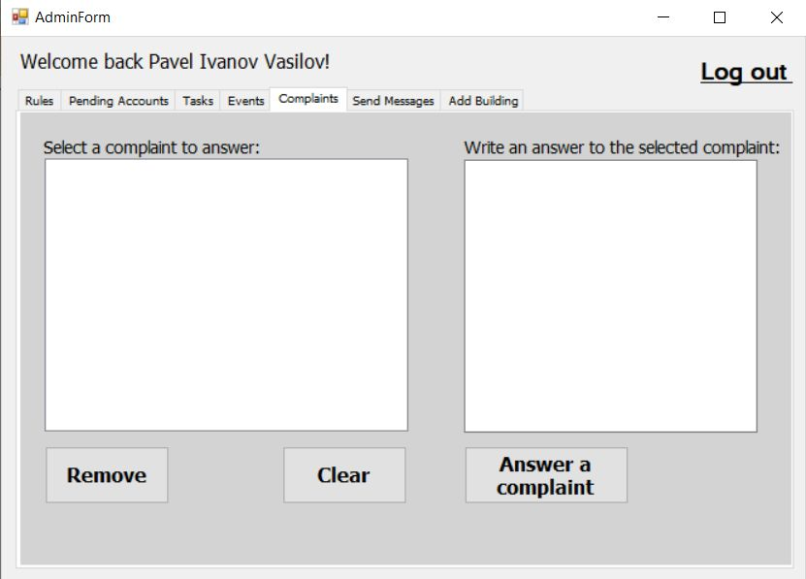
Complaints

Slide 13
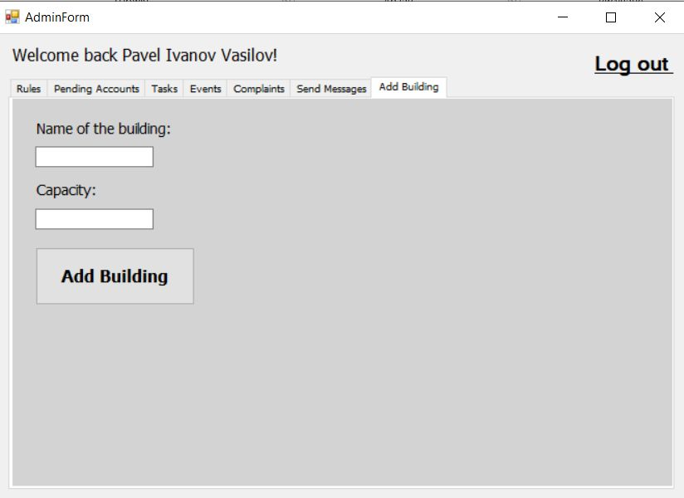
Adding a new building

Slide 14
Demonstration

Slide 15
Thank you for your attention. If you have any questions, please let us know!

