Slide 1
Coursera Capstone Project: Applied Data Science
Viktoriia Ilina March 5th, 2021

Slide 2
Outline of the presentation
Motivation
Data
Methodology
Findings
Discussion

Slide 3
Motivation
Prague is centuries of spires, centuries of magic and centuries of intrigue. The city’s labyrinth of cobbled lanes and hidden, winding courtyards is a treasure trove of delight any aimless wanderer would love to explore. Actually, according to Euromonitor‘s annual survey 2019 Prague is the sixth most visited city in Europe after London, Paris , Istanbul, Antalya and Rome. Given its relatively small size and populace compared to those giants, this is an impressive achievement. Art, culture and history play a large part in this popularity – as well as the excellent travel deals – but so too does its cuisine.
However, contemporary Czech cuisine is considered heavy and very filling, with meals centered on meats and starches. As a result some people may prefer other cuisines for health- related, religious, cultural or moral reasons. Besides, local residents may be looking to taste something new.
Thus, the present paper aims to give a simple recommendation: in which district of the city will you find a large number or even concentration of which types of restaurants? Where to eat Mediterranean food, where to find Vietnamese restaurants, where to get Sushi? The target audience is both foreign tourists and local residents.

Slide 4


Data
Required data has been gathered from two sources:
https://foursquare.com/ https://www.praha.eu/

Slide 5
Methodology
Used packages and libraries: Pandas, Numpy, Folium, Sklearn, Seaborn, Yellowbrick and so on.
Visualization: Folium maps
Method: an unsupervised machine learning algorithm, in particular K-means clustering algorithm
Determining the appropriate value of K: the ellbow method

Slide 6
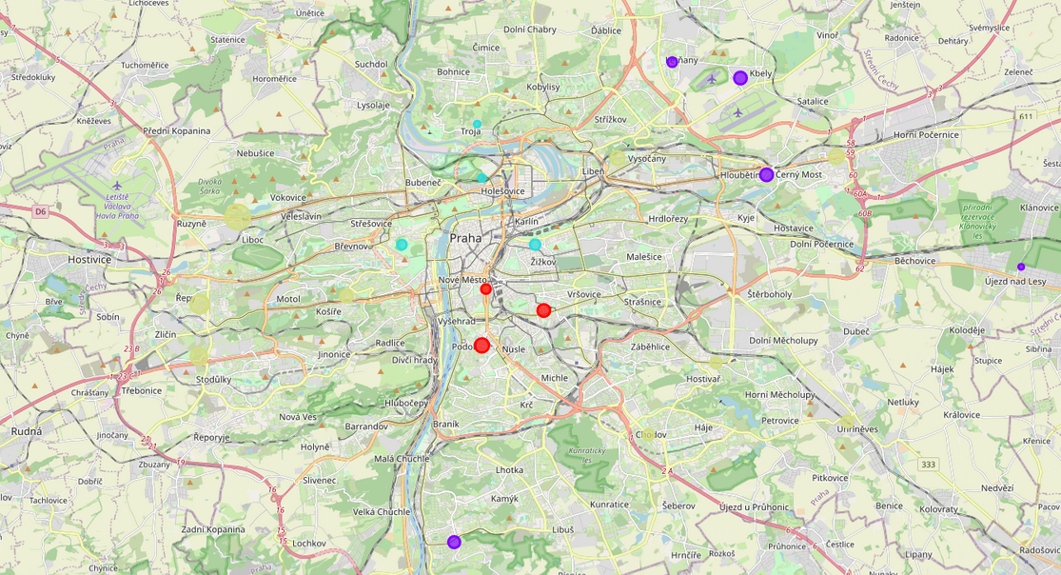
Findings
There are 335 restaurants come from 29 unique restaurant categories in Prague.
The most frequent type of restaurants in Prague is restaurant with fusion cuisine!
Prague 6 and Prague 17 have maximum number of restaurants (31 and 23 accordingly).
Prague 8 and Prague 21 have the least number of restaurants (8 and 7 respectively).
The Prague districts are divided into 4 clusters.

Slide 7
Discussion
Data is a nowadays’ key to finding solutions to various life situations – in regular life and unexpected occurrences as well. As for the dissected example, data made possible clustering the surrounding in Prague in terms of common food services across 22 districts of the city. The implications can come out useful, for instance, for travelers trying to pick the one district that fits their requirements or preferences the most.
However, since the scale of the current study does not imply gathering excessively vast and detailed data sets, so certain parameters got omitted and thus the analysis ignores various other factors, such as the location’s remoteness form transport stations, price ranges, and Michelin-starred restaurants, etc. The analysis then, targets at helping travelers get a quick outlook at the distributions of restaurants across 22 Prague’s districts, sorted by their categories.
Furthermore, this results also could potentially vary if we use some other clustering techniques like Expectation–Maximization Clustering using Gaussian Mixture Models or Density-Based Spatial Clustering of Applications with Noise.

Slide 8
Thank you for your attention!

