Slide 1
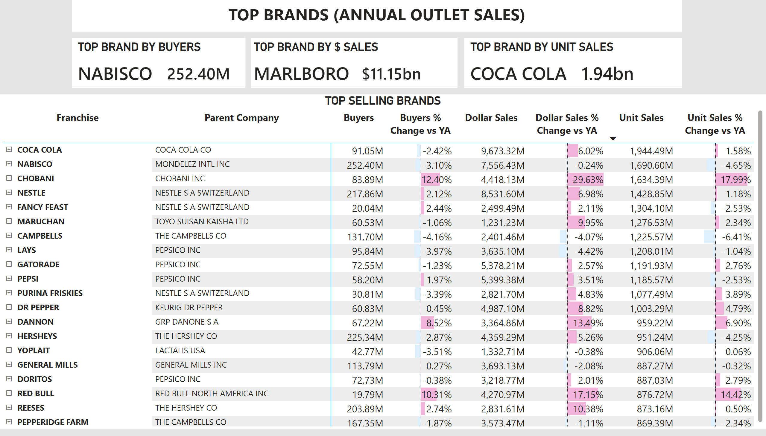
Overview
Notes:
TOP SELLING BRANDS
No alt text provided
TOP BRAND BY BUYERS
No alt text provided
TOP BRAND BY $ SALES
No alt text provided
TOP BRAND BY UNIT SALES
No alt text provided
textbox
No alt text provided

Slide 2
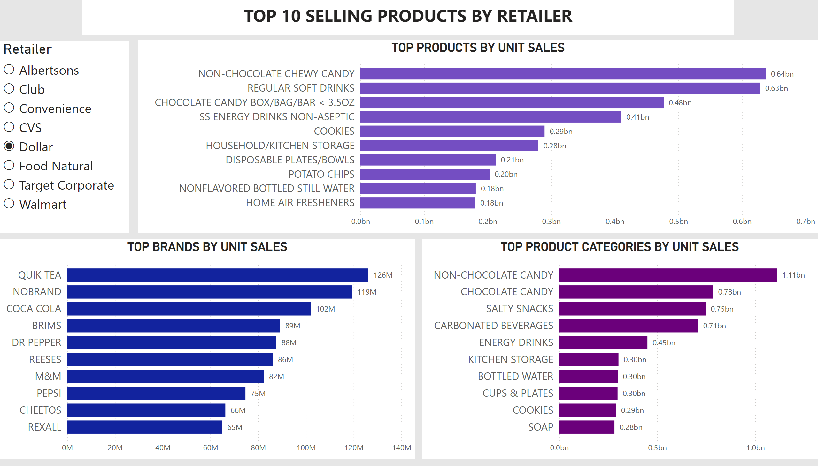
Top 10
Notes:
TOP BRANDS BY UNIT SALES
No alt text provided
listSlicer
No alt text provided
TOP PRODUCT CATEGORIES BY UNIT SALES
No alt text provided
TOP PRODUCTS BY UNIT SALES
No alt text provided
textbox
No alt text provided

Slide 3
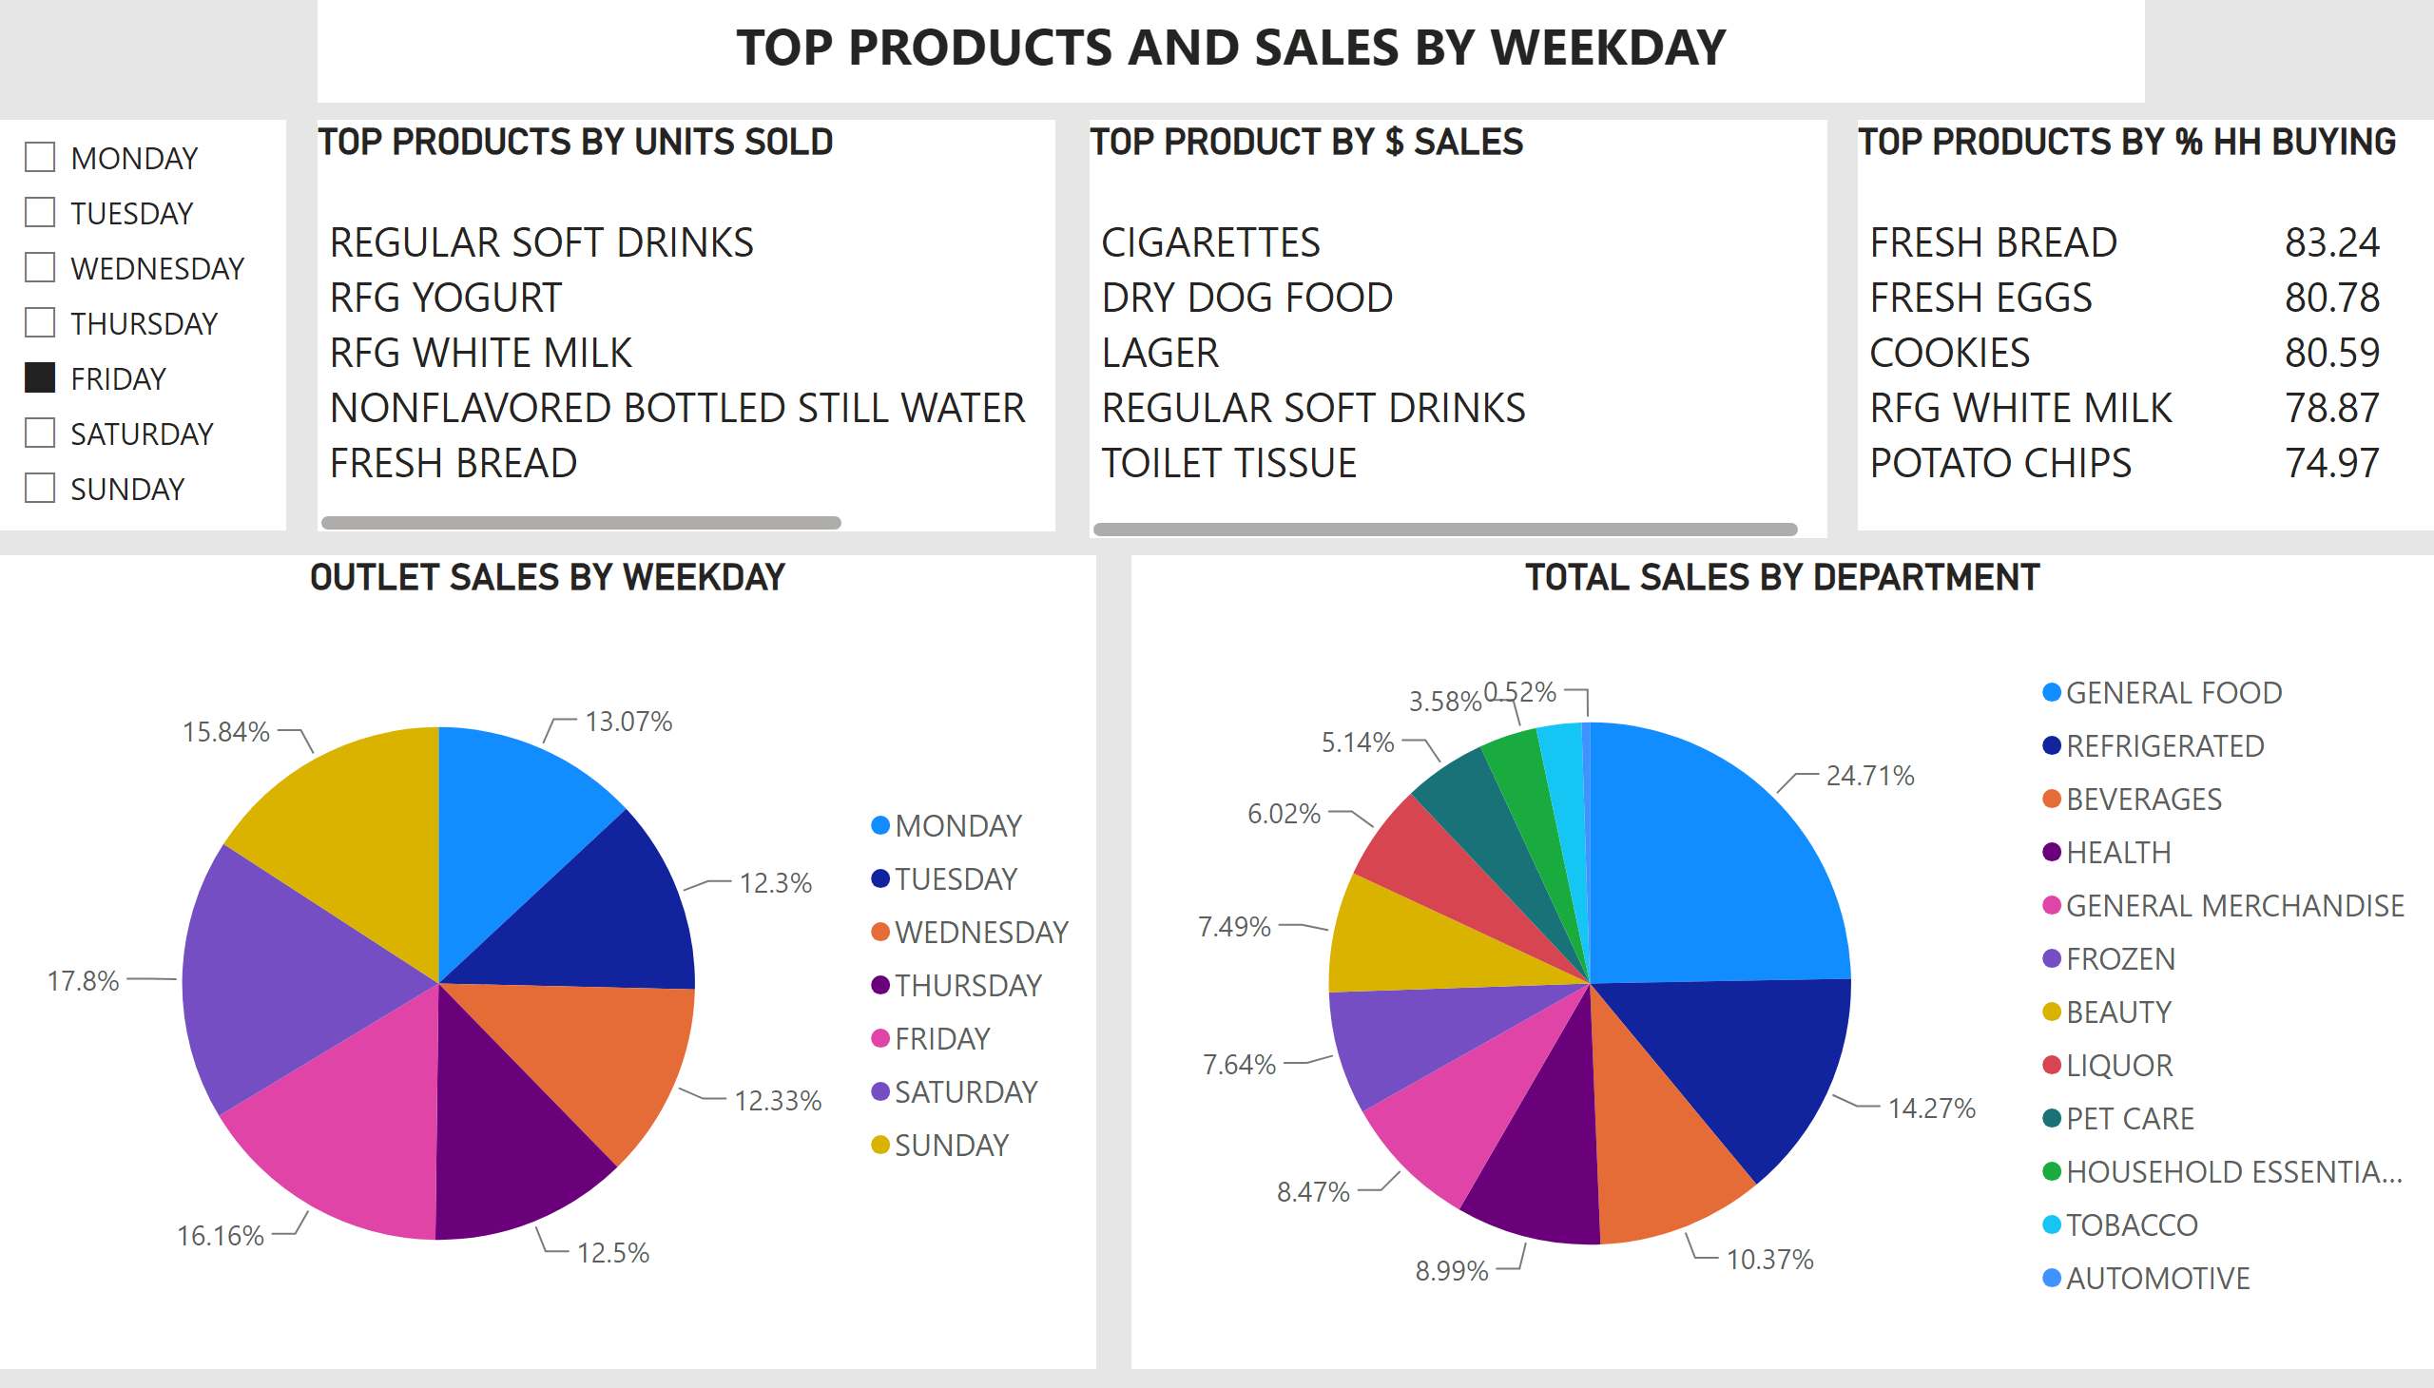
Products by Weekday
Notes:
OUTLET SALES BY WEEKDAY
No alt text provided
slicer
No alt text provided
TOP PRODUCTS BY UNITS SOLD
No alt text provided
TOP PRODUCT BY $ SALES
No alt text provided
TOTAL SALES BY DEPARTMENT
No alt text provided
TOP PRODUCTS BY % HH BUYING
No alt text provided
textbox
No alt text provided

Slide 4
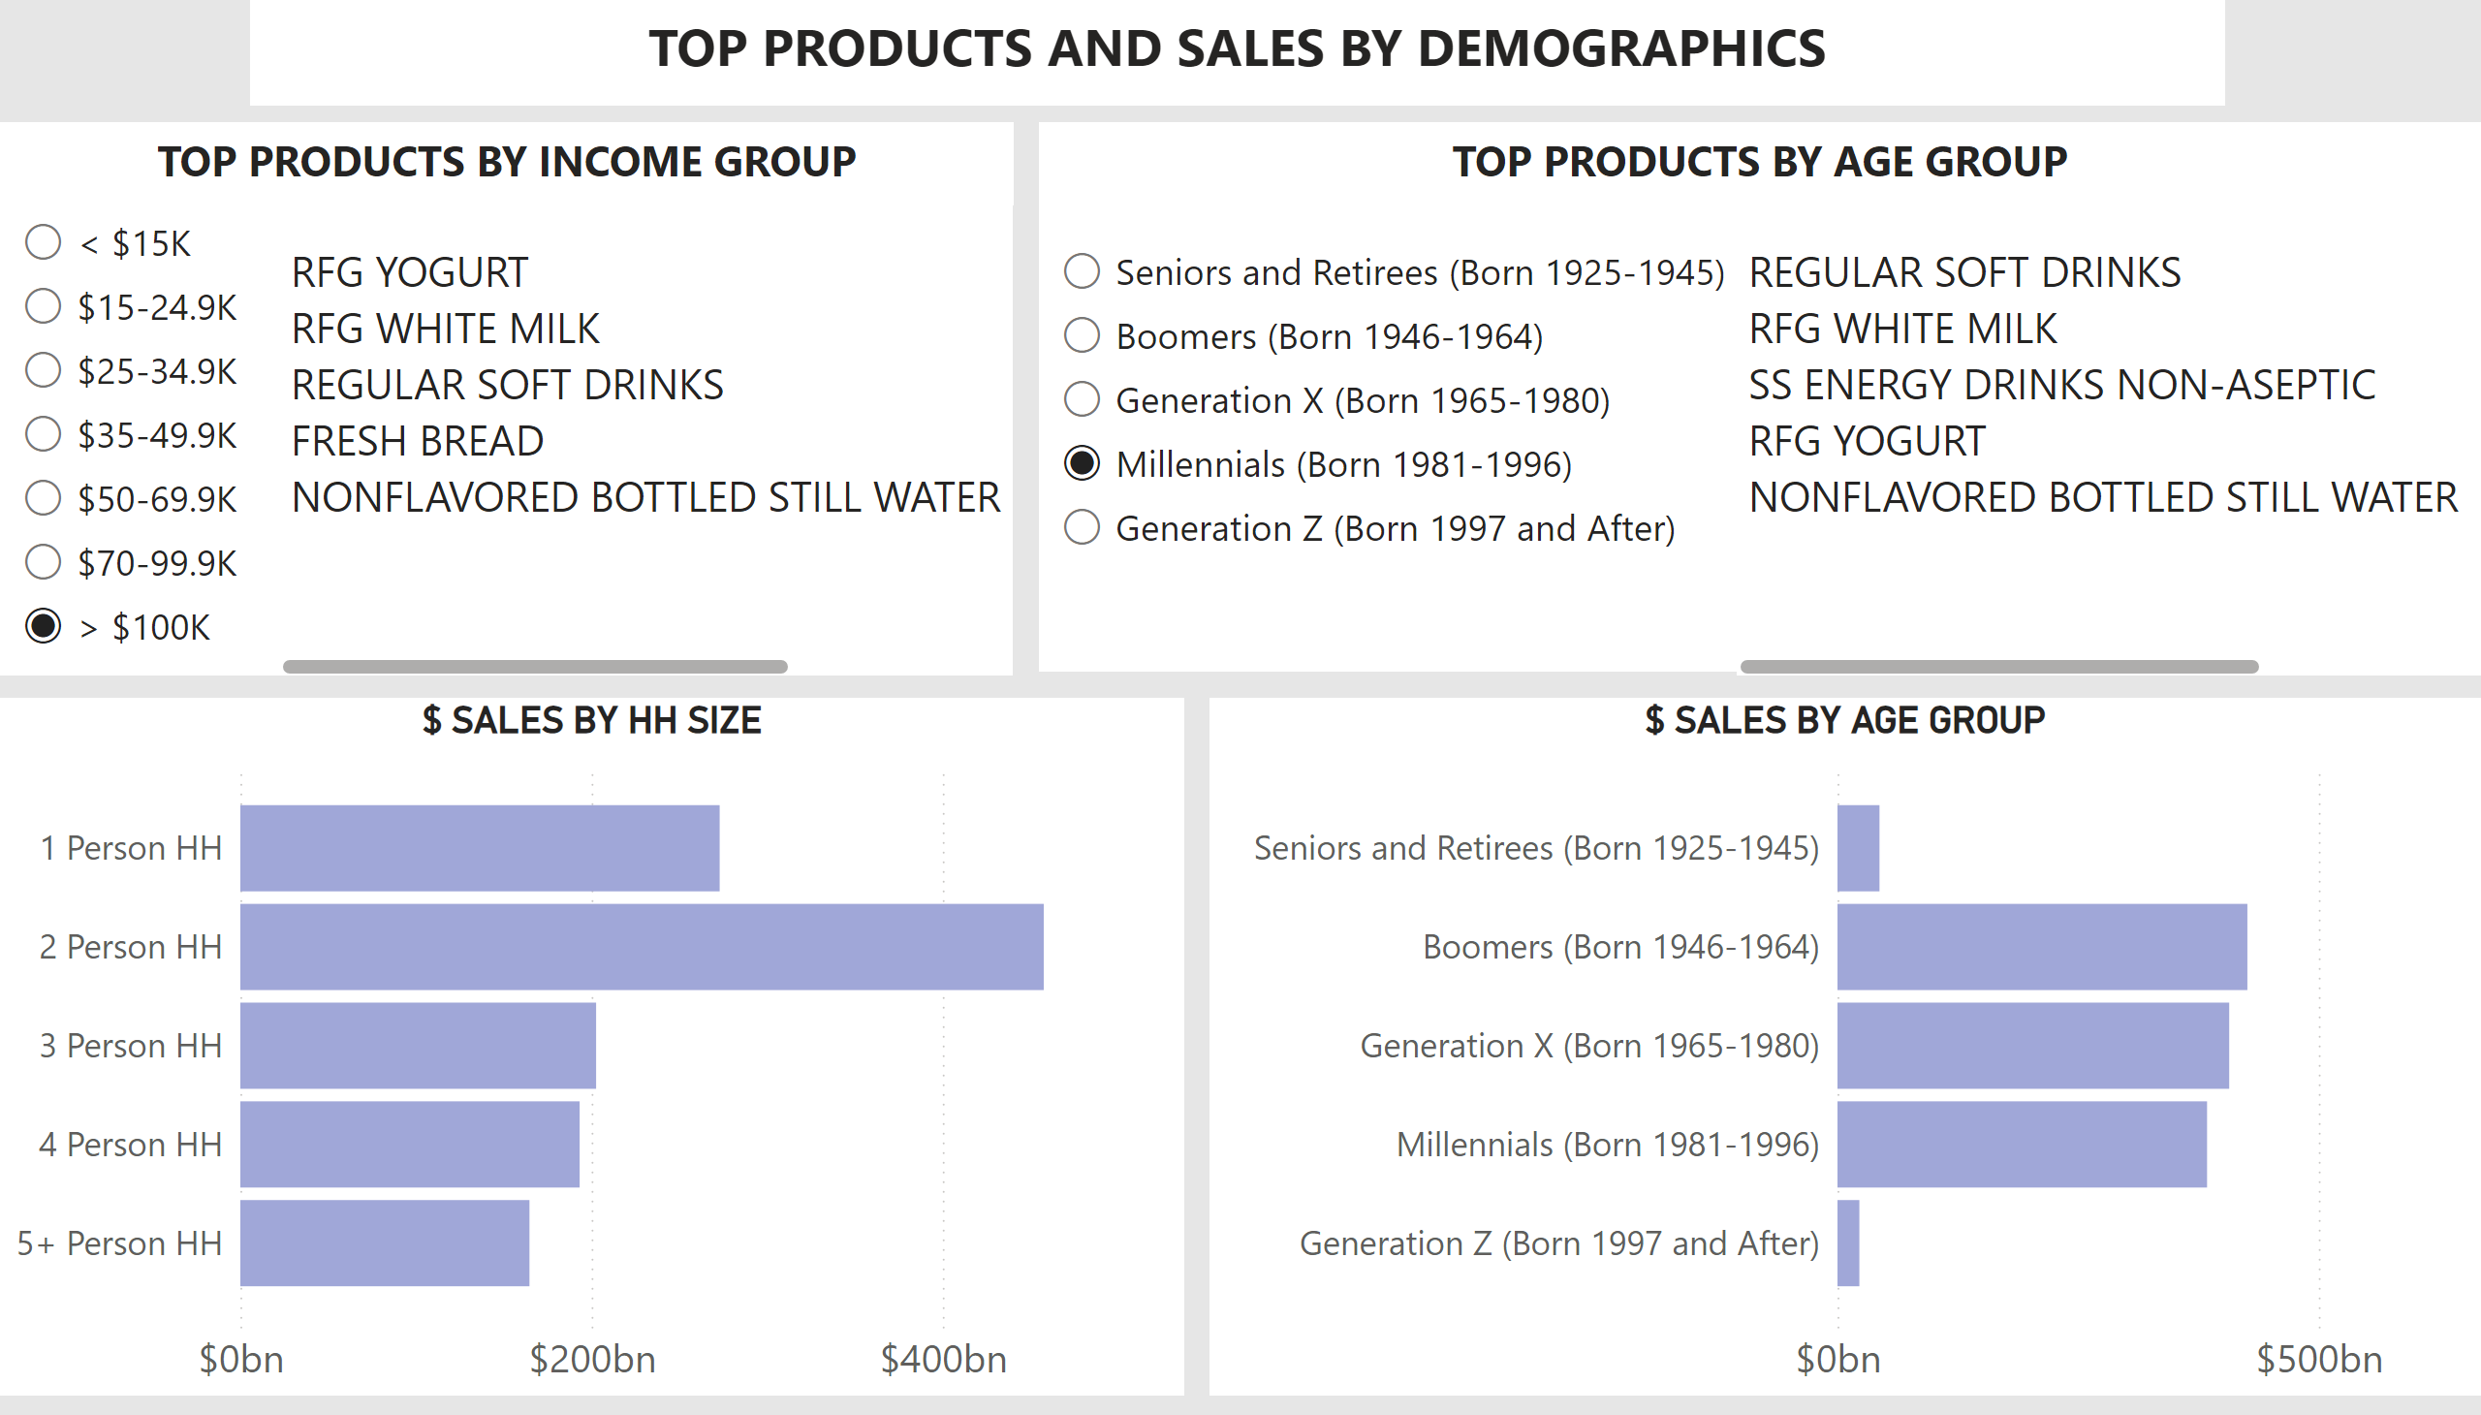
Demographics
Notes:
$ SALES BY AGE GROUP
No alt text provided
$ SALES BY HH SIZE
No alt text provided
tableEx
No alt text provided
slicer
No alt text provided
slicer
No alt text provided
tableEx
No alt text provided
textbox
No alt text provided
textbox
No alt text provided
textbox
No alt text provided

